Slide 1
Supply-side geographic variation in healthcare spending and utilization 1.) Finkelstein, Gentzkow, and Williams, 2016, Sources of Geographic Variation in Health Care: Evidence From Patient Migration 2.) Badinski, Finkelstein, Gentzkow, and Hull, 2023, Geographic Variation in Healthcare Utilization: the Role of Physicians
Liz Staton
Health Economics II
Notes:
From class website:
While there is substantial research documenting variation in healthcare spending and utilization, there is less consensus on the source of this variation. The first group of papers we’ll discuss today attempt to decompose variation in healthcare spending between demand and supply-side factors. We’ll focus on Finkelstein, Gentzkow, and Williams (2016) and Badinski et al. (2023) specifically. While these are relatively recent papers, the build on a much older literature studying variation in spending.

Slide 2
Overview
Overarching research question
What are the drivers of geographic variation in US health care utilization?
Empirical strategy
Both papers use migration of Medicare beneficiaries to separate demand and supply-side factors (Badinski et al., 2023 adds physician migration)
Notes:
Geographic Variation in Healthcare Utilization: The Role of Physicians (nber.org)
Sources of Geographic Variation in Health Care: Evidence From PatientMigration (repec.org)

Slide 3
Key findings
1. Finkelstein et al., 2016
There are sharp changes in utilization during the year of a move (larger for more discretionary utilization)
47% of the difference in log utilization between above- and below-median areas is due to patient characteristics, and the remainder is due to place-specific factors
Patient component of utilization is higher where patients are sicker and have higher SES
Place component of utilization is particularly high in areas with 1) larger share of for-profit hospitals, 2) larger share of doctors who report a preference for aggressive care, and 3) sicker patients
Notes:
The results appear inconsistent with patient effects arising primarily from habit formation or persistence of treatments started premove, and instead point toward heterogeneity in health status or preferences that are fixed over the horizon of our data
patient characteristics (health status or preferences),

Slide 4
Key findings
2.
Badinski et al., 2023
Physician practice intensity varies substantially across hospital referral regions (HRRs) & is the major supply-side factor driving differences in utilization
Overall role of sorting (systematic differences in the matching of patients to physicians with different practice intensities) is small (~6%)
Role of practice environment in patient demand comes from factors that determine the number of physician encounters, rather than the amount of utilization per encounter
Notes:
In this paper, we develop and estimate a model of annual patient health care utilization that separates variation due to physicians, non-physician supply factors, and patient demand. The physician component, which we refer to as physician practice intensity, includes differences in how physicians of a given specialty practice, as well as differences in the mix of physician specialties across areas. The non-physician supply component, which we refer to as practice environment, includes differences in hospital capacity, physical capital, hospital or health care facility ownership, the organization of health care markets, the degree of market competition, and organizational culture and norms (Lee and Mongan 2009). Recent empirical work has shown these practice environment factors to be important in affecting care delivery (e.g. Chan et al. 2022a; Duggan et al. 2022; Bloom et al. 2015; Otero and Munoz 2022; Doyle and Staiger 2022; Frakes et al. forthcoming; Eliason et al. 2020; Ho and Lee 2017, 2019; Craig et al. 2021).

Slide 5
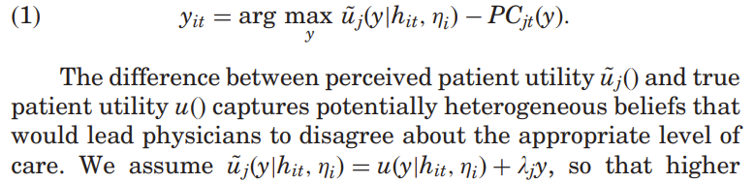

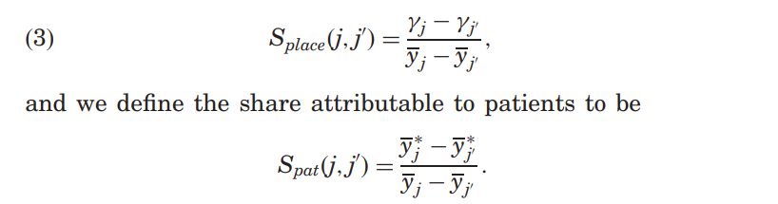

Theoretical Framework
1. Finkelstein et al., 2016
Physician chooses the level of care, y, to maximize the perceived utility of her patients’ utility minus their (net, private) costs of care provision
Decompose variation into supply side and demand side factors
Event study specification
maximized
Attributed to
Supply side
Patient side
Notes:
Assume: Patients differ in health status, preferences, and geographic area
Each patient living in area j in year t is matched to a representative physician who determines the patient’s care. We assume that a physician chooses y_it to maximize the perceived utility of her patients u_j (y) minus her (net, private) costs of care provision, PC_jt(y).
decompose
Then the difference in average log utilization between any two areas j and j 0 is the sum of the differences of the place and patient components:
Event study
For a mover i whose origin and destination areas are o ið Þ and d ið Þ, respectively, we denote by i the difference in average log utilization between the mover’s destination and origin
this is a partial equilibrium experiment in that it holds fixed supply-side characteristics such as stocks of physical and human capital

Slide 6
Set up of empirical analysis
1. Finkelstein et al., 2016
Event-study analysis of changes in log utilization around a move
Estimation model & decomposition
- replication with different measures of utilization
Evidence on the observable area-level correlates of our estimated place and patient effects
Notes:
We observe a sharp change in the year of a move, equal to about half of the difference in average log utilization between the origin and destination. There is little systematic trend premove, and no systematic adjustment postmove. The onimpact effect is similar for moves from low-to-high and highto-low utilization regions, and is roughly linear in the absolute value of the origin–destination difference in log utilization.
exploits migration to capture observed and unobserved patient characteristics composing demand-side factors from the explanatory power of patient observables.
Uses primary data source: 20% random sample of Medicare beneficiaries (‘‘patients’’) from 1998 through 2008

Slide 7
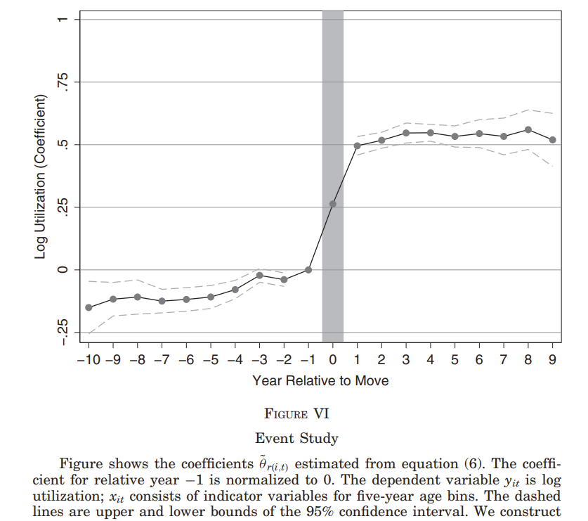
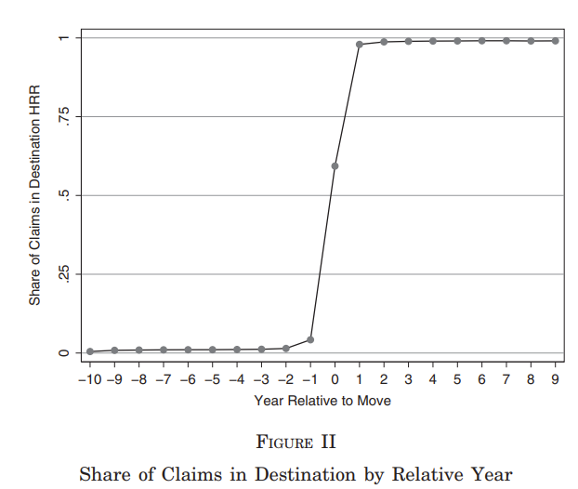
Key background and event study results
1. Finkelstein et al., 2016
Notes:
Table 1: movers and non movers look pretty similar
- Figure II shows the share of a mover’s claims located in their destination HRR, among those in either their origin or their destination HRR. moves from low- to high-utilization HRRs are as common as moves from high to low.
- Fig. VI: Under the assumptions of model, the plot should be flat in the years before and after the move. In practice, the plot shows no post-trend and a small but statistically significant pretrend. This trend could reflect systematic changes in log utilization of movers relative to nonmovers. Because our model restricts both HRR and patient effects to be time constant, it could also pick up HRR-specific trends that are the same for movers and nonmovers but happen to be correlated with movers delta

Slide 8
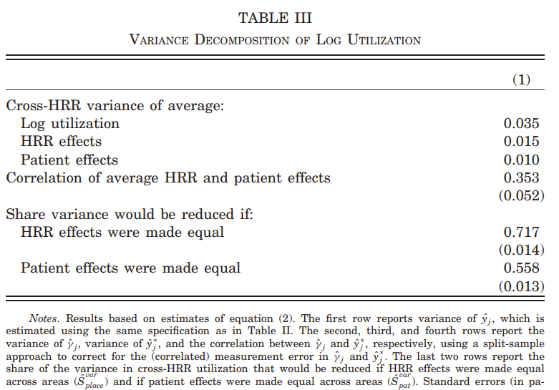
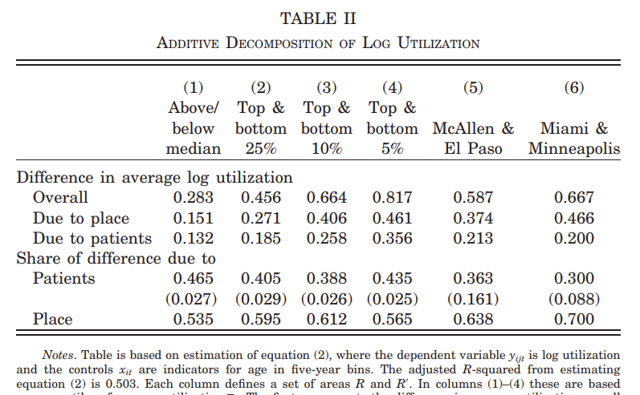
Main results
1. Finkelstein et al., 2016
Notes:
Table II
Column (1) decomposes the difference between above-median and below-median HRRs. We find that 47% of the difference in average log utilization is due to patients. This estimate is fairly precise; we can reject a role for patients of more than about 52% or less than about 41%.
Table III
Here we ask what share of the cross-HRR variance in log utilization would be eliminated in a counterfactual where average patient characteristics y j were equalized across HRRs.
We find that 56% of variance would be eliminated if patient effects were equalized. We find that 72% of variance would be eliminated if place effects were equalized.
Additional
Correlates of Patient and Place Effects:
The results show that HRRs with more hospital beds per capita, a higher share of cowboy cardiologists, and a lower share of nonprofit hospitals are all associated with statistically significantly higher place effects. HRRs with more female patients, less educated patients, and sicker patients by any measure are also associated with higher place effects. The post-Lasso multivariate regressions show that the shares of cowboy cardiologists and the number of nonprofit hospitals remain significant, as does patient health. The evidence is therefore consistent with past literature highlighting physician beliefs (Cutler et al. 2015) and endogenous responses to patient demand (Chandra and Staiger 2007) as key drivers

Slide 9
Results from more recent extension
2.
Badinski et al., 2023
Badinski et al. model health care utilization in 2 steps
Patients choose whether to seek care based on demand factors (e.g. health and preferences) as well as aspects of the practice environment
Patient choosing to seek care matches with a physician (encounter), depending on patient demand, practice environment, physician’s practice intensity
Both papers use 20% Medicare claims sample and focus on variation by HRR, but Badinski et al. look at 1998-2013. (Finkelstein et al. use 1998-2008)
Consistent with Finkelstein et al. 2016, patient mover analysis shows their average annual utilization changes, closing about half of the origin-destination gap
Extension to look at provider moves, shows average utilization per encounter changes with move, but closes about 40% of the origin-destination gap
Notes:
In this paper, we develop and estimate a model of annual patient health care utilization that separates variation due to physicians, non-physician supply factors, and patient demand. The physician component, which we refer to as physician practice intensity, includes differences in how physicians of a given specialty practice, as well as differences in the mix of physician specialties across areas. The non-physician supply component, which we refer to as practice environment, includes differences in hospital capacity, physical capital, hospital or health care facility ownership, the organization of health care markets, the degree of market competition, and organizational culture and norms (Lee and Mongan 2009)
Our baseline analysis sample contains 159 million encounters between 3 million patients and 1.7 million physicians.10 We characterize about 650,000 patients as movers and about 75,000 physicians as movers.
We model utilization in two steps. In the first step, patients choose whether to seek care based on their own demand factors (e.g. health and preferences) as well as aspects of the practice environment (e.g. wait times or travel times to nearby hospitals). If a patient does seek care, she matches with a physician in the second step. We refer to a patient-physician match as an encounter. The ensuing utilization in the encounter depends on patient demand, the practice environment, and the physician’s practice intensity, which is measured by a physician’s average effect on healthcare utilization per encounter. We allow for arbitrary matching between patients with different demand and physicians with different practice intensities.

Slide 10
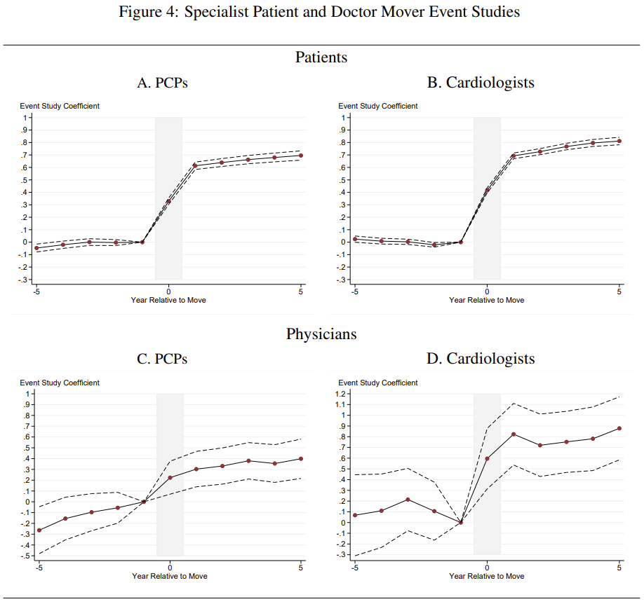


Event studies
2.
Badinski et al., 2023
Illustrative example figures from physician mover analysis:
Doctor, d
FE
Year t
Difference in LHS term between destination and origin HRR
Time-varying physician observables
Notes:
The main coefficients of interest θ D r are on the interactions between the relative year indicators and the difference in average log utilization per patient between a physician’s destination and origin; these capture how average annual physician log utilization per patient changes in the years preceding and following a physician’s move across HRRs, as a share of the average observed difference in this outcome between the destination and origin HRRs ∆ D d .

Slide 11
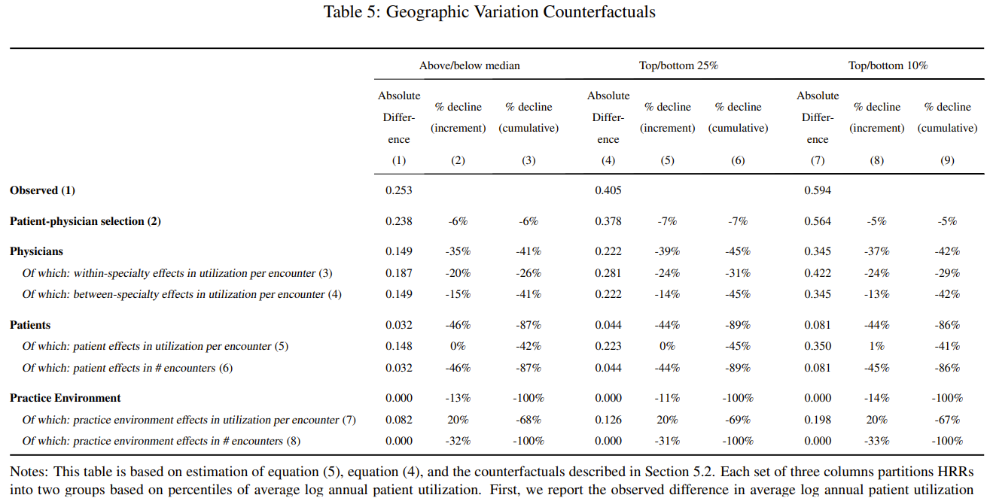
Components of geographic variation
2.
Badinski et al., 2023
Eliminate differences across HRRs in patient demand in two steps per category:
set the average physician component per HRR = within-specialty average physician component
equalize the across-specialty physician component across HRRs
Notes:
row 3 shows that eliminating differences across areas in within-specialty practice styles further decreases the above/below median difference by 20 percent of the original difference, to 0.187.
Row 4 shows that when we further eliminate differences across areas in the mix of physician specialties, difference decreases by another 15%
eliminate differences across HRRs in patient demand

Slide 12
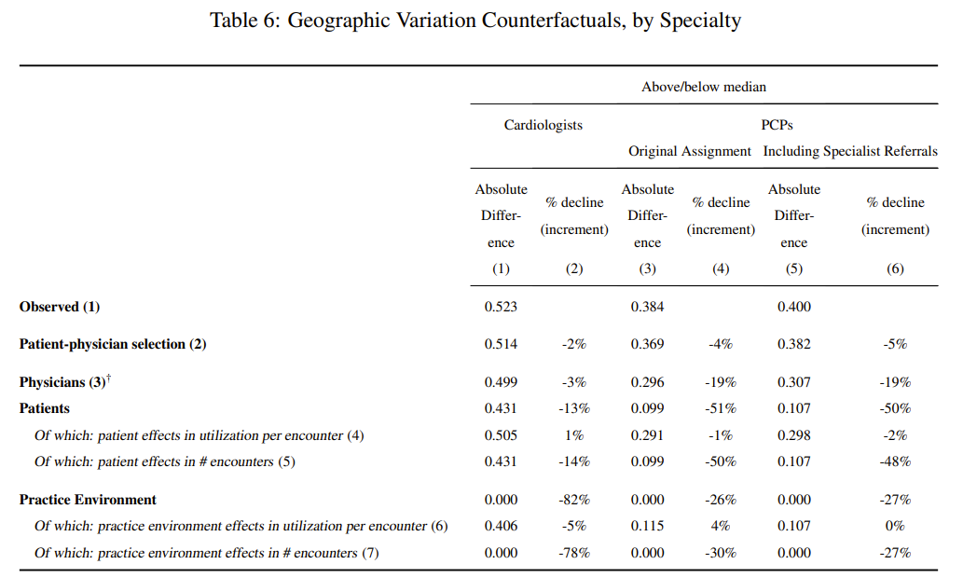
Geographic variation (2)
2.
Badinski et al., 2023
Consistent with event studies
Relative roles of different factors driving geographic variation in utilization are quite different for cardiologists compared to PCPs or the full sample of all physicians

Slide 13
Discussion questions
1
Why is variation in utilization important for researchers and/or policymakers? What about a decomposition of factors contributing to variation?
e.g.: Physician practice intensity drives supply side variation in health care utilization. What can be said about the policy implications of this?
Methodology discussion questions:
Finkelstein et al. note the R² of their estimation model. I’ve heard many people say we don’t (or shouldn’t) care about R², but it is more context dependent. Why is it relevant to mention in the context of the decomposition analysis?
Considering developments of Mullahy & Norton* and others, what do you think about the use of log transformed outcome?
2
* e.g., “Why Transform Y? A Critical Assessment of Dependent-Variable Transformations in Regression Models for Skewed and Sometimes-Zero Outcomes”
Notes:
1)
Understanding what drives geographic variation in utilization has important implications for policy. If high-utilization areas like McAllen and Miami are different mainly because their doctors’ incentives or beliefs lead them to order excessive treatments with low return, policies that change those incentives or beliefs could result in savings on the order of several percentage points of GDP (Congressional Budget Office 2008; Gawande 2009; Skinner 2011). On the other hand, if patients in high utilization areas are simply sicker or prefer more intensive care, such policies could be ineffective or counterproductive.
Adjusting for regional differences in age, sex, and race, health care spending for the average Medicare enrollee in Miami, FL, was $14,423 in 2010, but just $7,819 for the average enrollee in Minneapolis, MN.

