Slide 1
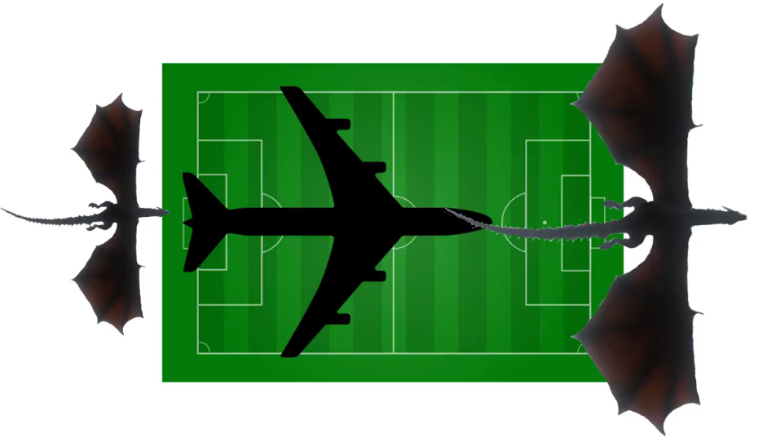
105 m
67m
63.5m
Boeing 747
59m
Balerion
Drogon

