Slide 1
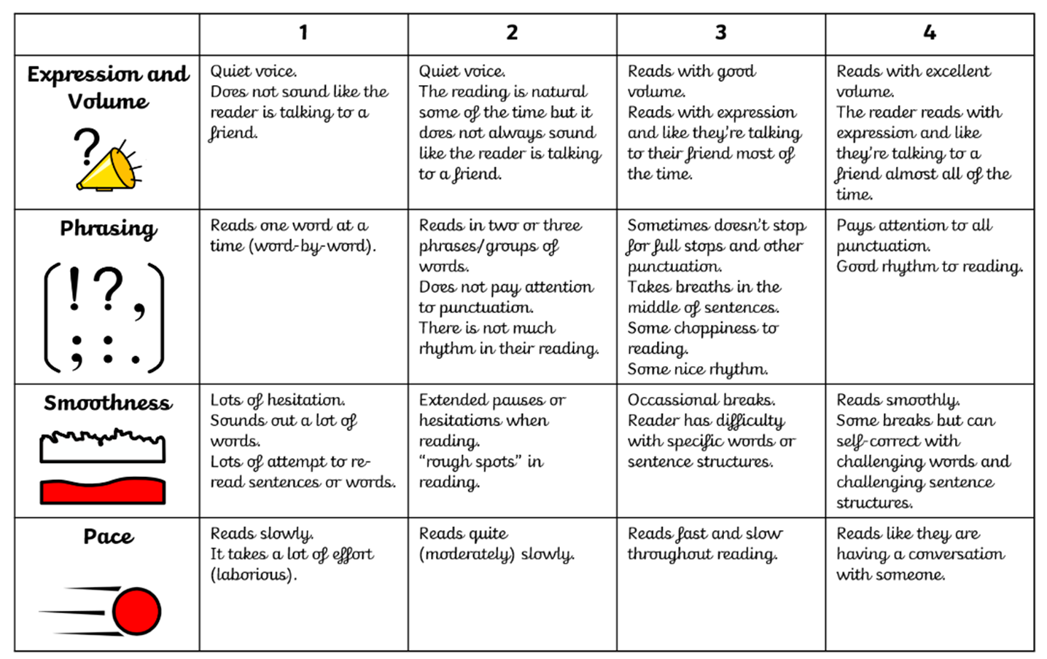

Slide 2


Being a Reader
Vocabulary
Tuesday

Slide 3
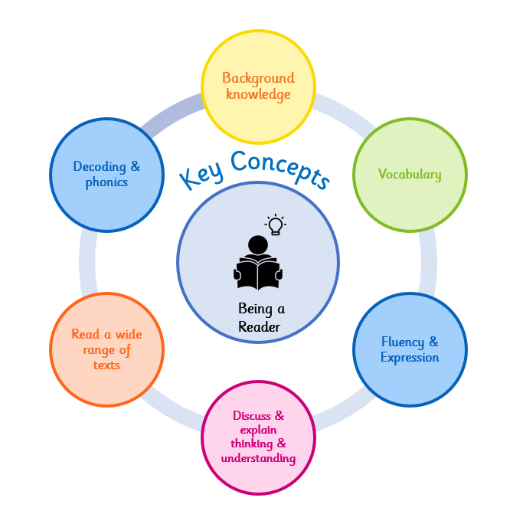
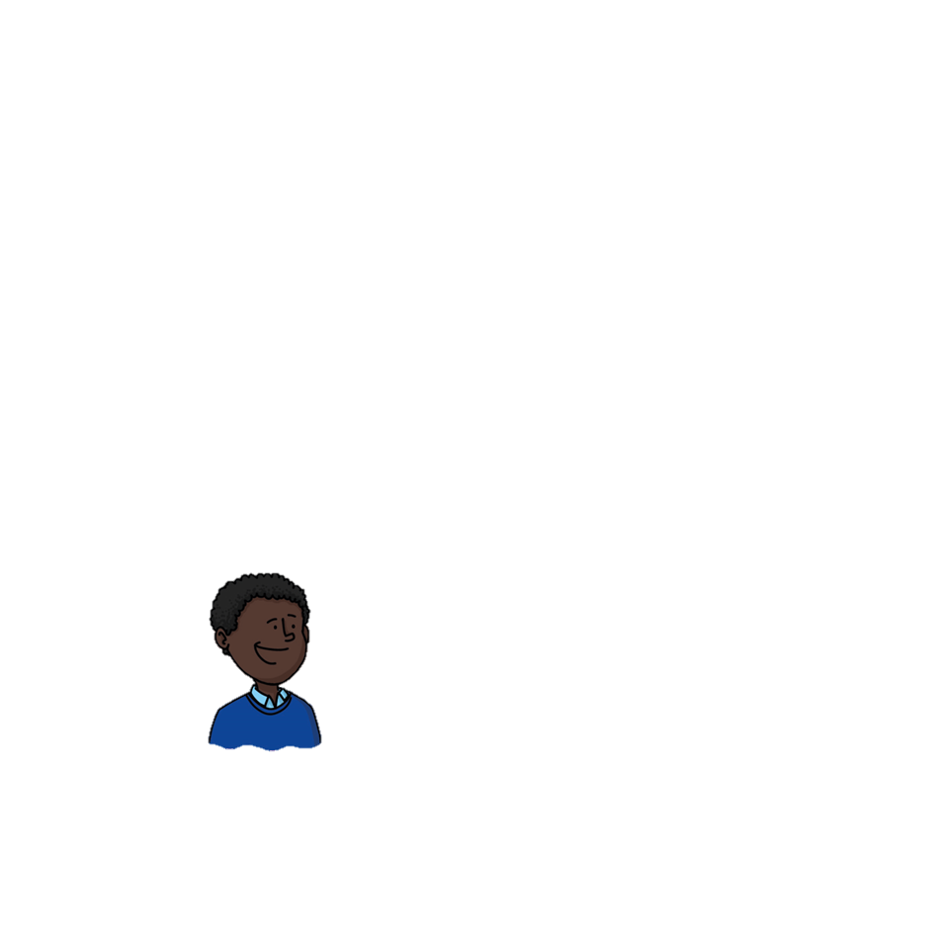
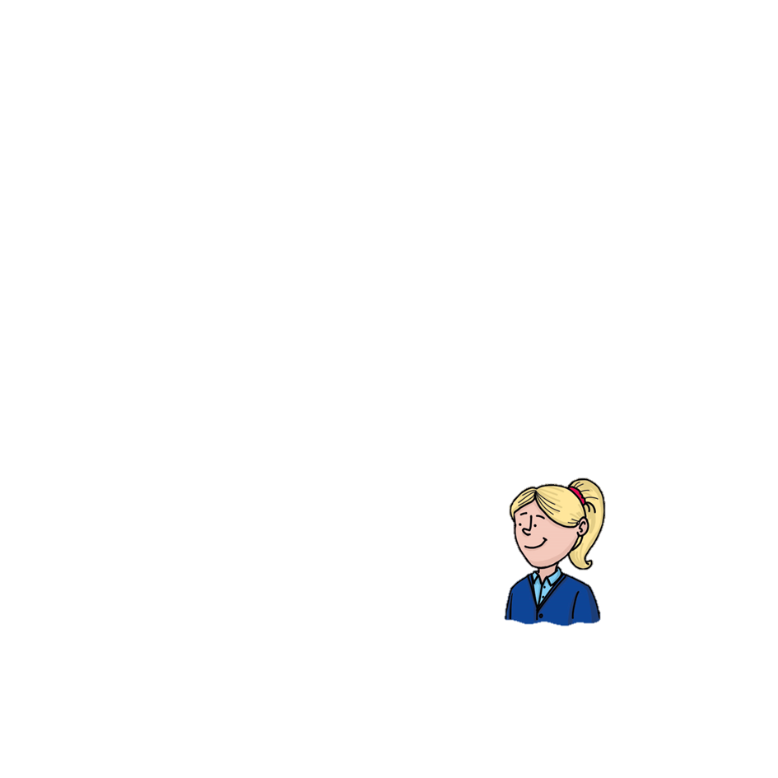
Why do we learn to read?
Reading makes me powerful because it helps me to understand the world around me.
At Wallscourt Farm Academy:
We love to read, learn to read and read to learn!
Notes:
Background knowledge – We use our background knowledge and experiences to help us with our reading
Vocabulary – we use new vocabulary when reading
Fluency & Expression – We read fluently and with expression to make our reading exciting
Discuss & explain thinking – We discuss and explain our thinking and understanding of our reading
Read a wide range of texts – We read a wide range of texts at WFA
Decoding and phonics – We use our phonics to help us decode and learn new words when we are reading

Slide 4

Vocabulary Focus
Vocabulary
Are there any words you feel confident to explain the meaning of (definition)? Are there any where you are less confident?
trembling | shaking slightly because of fear or excitement
overwhelmed | feeling as though something is too much to cope with
cautiously | carefully, trying to avoid danger or making a mistake
horizon | the line in the distance where the sky seems to meet the land
uncertain | not sure what is going to happen; unsure
?
?
?
?
?

Slide 5
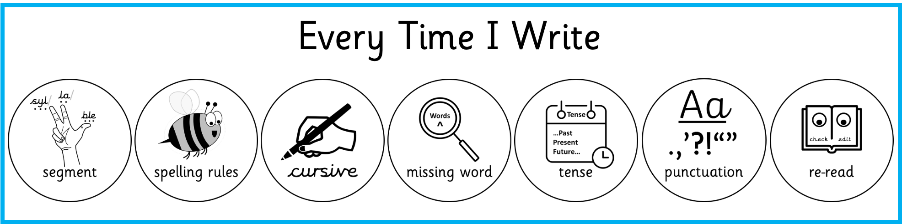
Vocabulary Focus
Vocabulary
Write it 5 times trembling | Use it in a sentence
Other linked words
trembling

Slide 6
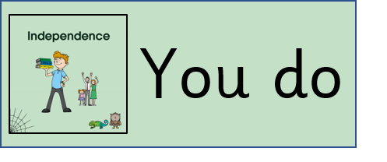
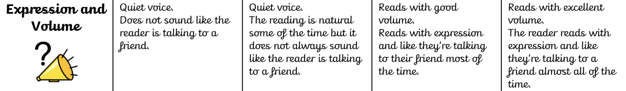
Paired reading. Read the text with a partner, taking turns sentence by sentence. Focus on reading smoothly and clearly, matching your pace to the punctuation.
Varjak had never left the tower before. For all of his short life, the ancient building had been his entire world — its cool stone corridors, its familiar smells, its safe, predictable rhythms. But now he stood at the great entrance, and the world beyond stretched out before him, vast and trembling in the early morning light. He felt overwhelmed. The sounds alone were enough to make his whiskers shake: the low rumble of distant engines, the clatter of pigeons overhead, the whisper of wind threading through the alleyways below. His paws pressed flat against the cold step as he cautiously peered outward, trying to make sense of what lay ahead. There was no map for this. No elder cat had told him what the city truly looked like from the ground, how enormous and uncertain it felt when you were standing inside it rather than gazing down from above. The horizon seemed impossibly far away, a smudge of grey and amber where the rooftops finally gave way to sky. Part of him wanted to turn back, to find his mother and curl up close. But somewhere deeper, in a place he had not known existed, something pulled him forward. He took one cautious breath. Then another. Then, trembling from his ears to the tip of his tail, Varjak Paw stepped out into the world.
Fluency & Expression
Show / Hide Extract
Notes:
OH ES & KW reading phonically decodable version with TP

Slide 7

Discuss & explain thinking & understanding
I am learning to find and extract information from within a text.
What am I learning?
retrieve
I am learning this because it will help me to develop a clear understanding of what I am reading.
Why am I learning this ?
How will I know when I get there?
I will show this by answering questions, making reference to the text.

Slide 8
Practice questions - Vocabulary
Scanning the text – I am trying to find the parts in the text where I will retrieve the answer to the question.
Varjak had never left the tower before. For all of his short life, the ancient building had been his entire world — its cool stone corridors, its familiar smells, its safe, predictable rhythms. But now he stood at the great entrance, and the world beyond stretched out before him, vast and trembling in the early morning light. He felt overwhelmed. The sounds alone were enough to make his whiskers shake: the low rumble of distant engines, the clatter of pigeons overhead, the whisper of wind threading through the alleyways below. His paws pressed flat against the cold step as he cautiously peered outward, trying to make sense of what lay ahead. There was no map for this. No elder cat had told him what the city truly looked like from the ground, how enormous and uncertain it felt when you were standing inside it rather than gazing down from above. The horizon seemed impossibly far away, a smudge of grey and amber where the rooftops finally gave way to sky. Part of him wanted to turn back, to find his mother and curl up close. But somewhere deeper, in a place he had not known existed, something pulled him forward. He took one cautious breath. Then another. Then, trembling from his ears to the tip of his tail, Varjak Paw stepped out into the world.
What sounds does Varjak hear when he looks outside?
He hears the low rumble of distant engines, the clatter of pigeons overhead and the whisper of wind threading through the alleyways below.
What does the word 'trembling' mean? Use the context of the text to help you.
Trembling means shaking slightly. The text tells us Varjak is frightened by the outside world and at the end he is shaking 'from his ears to the tip of his tail', which shows the word describes frightened shaking.
Checking my answers – does my answer match the question and use information from the text?
Show / Hide Extract

Slide 9
Being a Reader
Retrieval
Wednesday

Slide 10
Why do we learn to read?
Reading makes me powerful because it helps me to understand the world around me.
At Wallscourt Farm Academy:
We love to read, learn to read and read to learn!
Notes:
Background knowledge – We use our background knowledge and experiences to help us with our reading
Vocabulary – we use new vocabulary when reading
Fluency & Expression – We read fluently and with expression to make our reading exciting
Discuss & explain thinking – We discuss and explain our thinking and understanding of our reading
Read a wide range of texts – We read a wide range of texts at WFA
Decoding and phonics – We use our phonics to help us decode and learn new words when we are reading

Slide 11
Vocabulary Focus
Vocabulary
Are there any words you feel confident to explain the meaning of (definition)? Are there any where you are less confident?
relentless | never stopping or giving up; continuing with great force
instinct | a natural feeling that tells you what to do without thinking
desperate | feeling as though you need something so badly you will do anything
hesitated | paused for a moment because you were unsure what to do
alert | fully awake and paying close attention to everything around you
?
?
?
?
?

Slide 12
Vocabulary Focus
Vocabulary
Write it 5 times desperate | Use it in a sentence
Other linked words
desperate

Slide 13
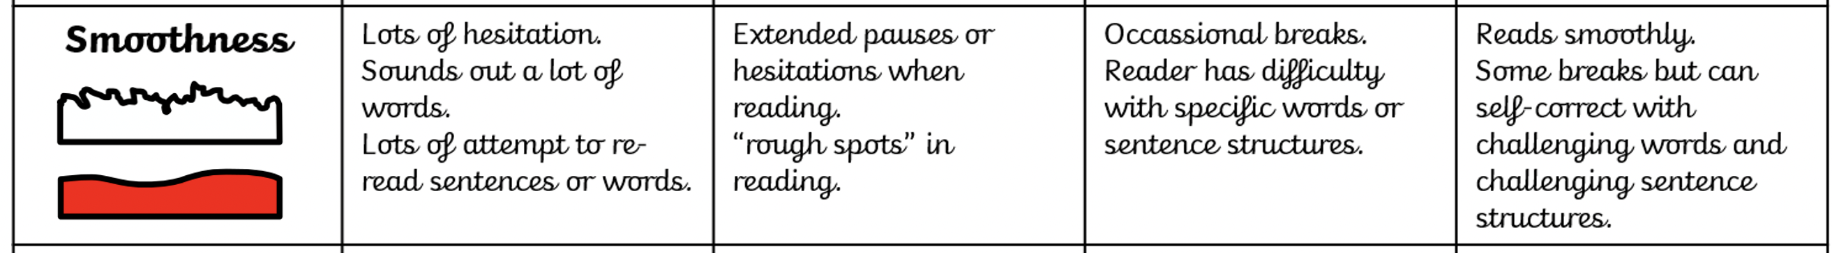
Independent Read
Decoding & phonics
Read the complete text – underline any words or phrases you don’t understand. Re-read full sentences for any parts you couldn’t read smoothly on the first attempt.
The alley was narrow and dark, and Varjak pressed himself against the damp wall, trying to make himself as small as possible. He had heard them before he saw them — two large dogs, moving with a relentless, heavy certainty, their paws thudding against the wet cobblestones. Every instinct Varjak had was screaming at him to run, but he forced himself to stay still. His mentor's words rang in his head: be the stillness at the centre of the storm. He was desperate. He had no food, no shelter and no idea where he was going. The dogs paused at the end of the alley, their heads swinging left and right as they sniffed the cold air. One of them was enormous, with a barrel chest and a low growl that Varjak felt more than heard. He hesitated, uncertain whether to stay hidden or bolt for the gap between the bins ahead. His heart hammered. He forced himself to breathe slowly, to stay alert, to notice every detail the way Jalal's teaching had shown him. The big dog took one step towards the alley. Then another. Varjak's claws bit into the ground. He was ready. But then, without warning, a car horn blared from the road and both dogs flinched and turned away, trotting off into the yellow evening light. Varjak let out a long, shaking breath. He was safe. For now.
Read by segmenting into phonemes and syllables
Make a sensible attempt, making sure you blend ALL the sounds as you read.
Use the context and parts of the word to make a sensible attempt at a definition.
Remember to re-read the entire sentence again.
Show / Hide Extract
Notes:
OH ES & KW reading phonically decodable version with TP

Slide 14
Vocabulary
I am learning to understand and take meaning from a text.
What am I learning?
I am learning this because it will help me to develop my understanding of vocabulary at a sentence and text level.
Why am I learning this ?
How will I know when I get there?
I will show this by answering questions which relate to the vocabulary used throughout the text.

Slide 15
Practice questions - Retrieval
The alley was narrow and dark, and Varjak pressed himself against the damp wall, trying to make himself as small as possible. He had heard them before he saw them — two large dogs, moving with a relentless, heavy certainty, their paws thudding against the wet cobblestones. Every instinct Varjak had was screaming at him to run, but he forced himself to stay still. His mentor's words rang in his head: be the stillness at the centre of the storm. He was desperate. He had no food, no shelter and no idea where he was going. The dogs paused at the end of the alley, their heads swinging left and right as they sniffed the cold air. One of them was enormous, with a barrel chest and a low growl that Varjak felt more than heard. He hesitated, uncertain whether to stay hidden or bolt for the gap between the bins ahead. His heart hammered. He forced himself to breathe slowly, to stay alert, to notice every detail the way Jalal's teaching had shown him. The big dog took one step towards the alley. Then another. Varjak's claws bit into the ground. He was ready. But then, without warning, a car horn blared from the road and both dogs flinched and turned away, trotting off into the yellow evening light. Varjak let out a long, shaking breath. He was safe. For now.
Give two reasons from the text why Varjak is feeling desperate.
Varjak is desperate because he has no food, no shelter and no idea where he is going.
What does Varjak do to try to stay calm when the dogs approach?
He forces himself to breathe slowly, stay alert and notice every detail around him, just as Jalal's teaching had shown him.
Show / Hide Extract

Slide 16
Being a Reader
Inference
Thursday

Slide 17
Why do we learn to read?
Reading makes me powerful because it helps me to understand the world around me.
At Wallscourt Farm Academy:
We love to read, learn to read and read to learn!
Notes:
Background knowledge – We use our background knowledge and experiences to help us with our reading
Vocabulary – we use new vocabulary when reading
Fluency & Expression – We read fluently and with expression to make our reading exciting
Discuss & explain thinking – We discuss and explain our thinking and understanding of our reading
Read a wide range of texts – We read a wide range of texts at WFA
Decoding and phonics – We use our phonics to help us decode and learn new words when we are reading

Slide 18
Vocabulary Focus
Vocabulary
Are there any words you feel confident to explain the meaning of (definition)? Are there any where you are less confident?
yearned | wanted something deeply and with great feeling, like an ache
solitary | alone, without anyone else around
flinched | made a small, sharp movement in reaction to pain or a sudden feeling
distant | far away, either in place or in feeling
resolve | a strong, firm decision that you will do something no matter what
?
?
?
?
?

Slide 19
Vocabulary Focus
Vocabulary
Write it 5 times yearned | Use it in a sentence
Other linked words
yearned

Slide 20
Independent Read
Decoding & phonics
Read the complete text – underline any words or phrases you don’t understand. Re-read full sentences for any parts you couldn’t read smoothly on the first attempt.
The city never truly slept. Even in the small hours, when most humans had retreated behind their lit windows, the streets below still hummed and clicked and breathed. Varjak crouched on a fire escape above it all, his tail wrapped around his paws, watching. He was completely alone. He had not eaten properly in two days, and the cold was beginning to bite at the edges of everything. He yearned for the tower with an ache that surprised him — not for the tower itself, exactly, but for the smell of it, the warmth of his brothers pressed close on either side, his mother's voice low and steady in the dark. He flinched at the memory, as though it had edges. Below him, a solitary figure crossed the empty road and disappeared into a doorway. Varjak watched until they were gone. Then he looked up. Above the yellow smear of city light, he could just make out a handful of stars — distant, cold, barely there. His grandfather had spoken of a sky full of stars. The world must have been a different place then, Varjak thought. But the thought did not break him. Instead, something hardened quietly in his chest. He had come too far to go back now. He did not know if he would succeed. He only knew that he would not stop. That resolve, small and solid and certain, was enough for tonight.
Read by segmenting into phonemes and syllables
Make a sensible attempt, making sure you blend ALL the sounds as you read.
Use the context and parts of the word to make a sensible attempt at a definition.
Remember to re-read the entire sentence again.
Show / Hide Extract
Notes:
OH ES & KW reading phonically decodable version with TP

Slide 21
Vocabulary
I am learning to understand and take meaning from a text.
What am I learning?
I am learning this because it will help me to develop my understanding of vocabulary at a sentence and text level.
Why am I learning this ?
How will I know when I get there?
I will show this by answering questions which relate to the vocabulary used throughout the text.

Slide 22
Practice questions - Inference
The city never truly slept. Even in the small hours, when most humans had retreated behind their lit windows, the streets below still hummed and clicked and breathed. Varjak crouched on a fire escape above it all, his tail wrapped around his paws, watching. He was completely alone. He had not eaten properly in two days, and the cold was beginning to bite at the edges of everything. He yearned for the tower with an ache that surprised him — not for the tower itself, exactly, but for the smell of it, the warmth of his brothers pressed close on either side, his mother's voice low and steady in the dark. He flinched at the memory, as though it had edges. Below him, a solitary figure crossed the empty road and disappeared into a doorway. Varjak watched until they were gone. Then he looked up. Above the yellow smear of city light, he could just make out a handful of stars — distant, cold, barely there. His grandfather had spoken of a sky full of stars. The world must have been a different place then, Varjak thought. But the thought did not break him. Instead, something hardened quietly in his chest. He had come too far to go back now. He did not know if he would succeed. He only knew that he would not stop. That resolve, small and solid and certain, was enough for tonight.
What three things does Varjak miss from the tower?
He misses the smell of the tower, the warmth of his brothers pressed close on either side and his mother's voice low and steady in the dark.
What does the word 'yearned' mean? How does the context help you work this out?
Yearned means wanting something deeply, like an ache. The text describes it as 'an ache that surprised him', and Varjak is clearly missing his family very much, which tells us the word means a deep, painful kind of longing.
Show / Hide Extract
Notes:
Background knowledge – We use our background knowledge and experiences to help us with our reading
Vocabulary – we use new vocabulary when reading
Fluency & Expression – We read fluently and with expression to make our reading exciting
Discuss & explain thinking – We discuss and explain our thinking and understanding of our reading
Read a wide range of texts – We read a wide range of texts at WFA
Decoding and phonics – We use our phonics to help us decode and learn new words when we are reading

