Slide 1


How does a writer make a reader feel characters’ emotions?
Write a powerful narrative and survival guide inspired by Varjak Paw.
To Entertain
Other Y4 learners
Monday AM

Slide 2
How does a writer make a reader feel characters’ emotions?
write speech using inverted commas, capital letters and correct end punctuation
I can punctuate dialogue accurately so that my writing is clear for the reader.
converting dialogue from the book into correctly punctuated direct speech.

Slide 3
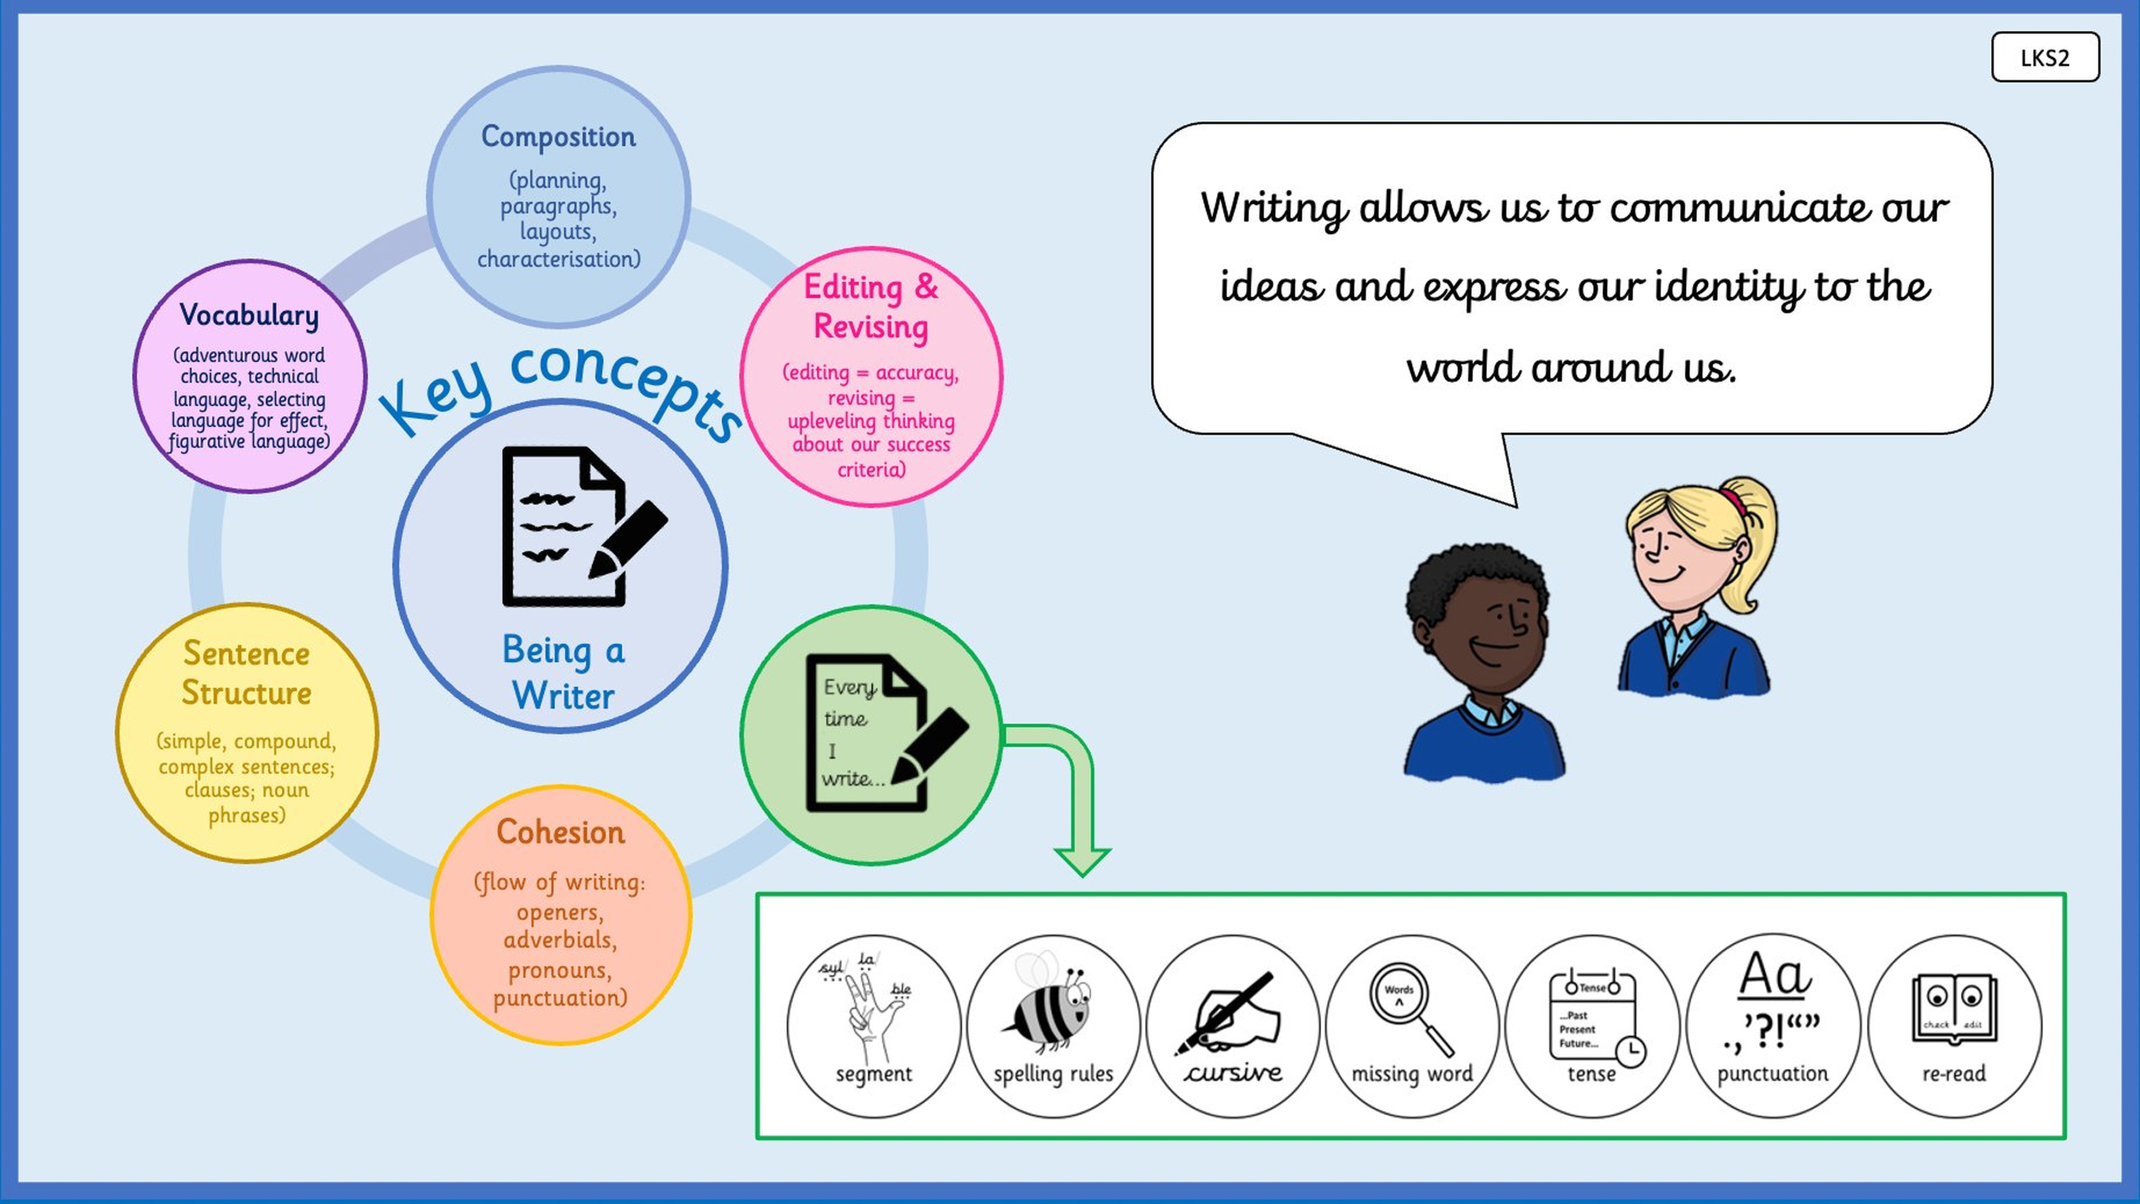

Slide 4
Grammar Warm-Up
What is the mistake? Can you spot the error in each sentence?
Sentence 1
Sentence 2
Sentence 3
"have you seen my hat?" asked the bear.
Spot the error!
"Have you seen my hat? asked the bear.
Spot the error!
"Have you seen my hat”? asked the bear.
Spot the error!

Slide 5
Let's remind ourselves...
Yesterday we read the whole story. Klassen doesn't use inverted commas in his book,
but when we write speech, we always need them.
Here is the Bear and Fox conversation from the story:
Have you seen my hat?
No. I have not seen any hats around here.
OK. Thank you anyway.
What needs to change before this counts as correctly written speech?

Slide 6
[ INSERT BOOK SPREAD: Bear and Fox ]
Display the double-page spread showing the Bear meeting the Fox.
This is the conversation: Have you seen my hat? / No. I have not seen any hats
around here. / OK. Thank you anyway.

Slide 7
Adding speech punctuation
Klassen's text (no inverted commas)
With speech punctuation
Have you seen my hat?
No. I have not seen any hats around here.
OK. Thank you anyway.
“Have you seen my hat?” asked the bear.
“No. I have not seen any hats around here,”
replied the fox.
“OK. Thank you anyway,” said the bear.
→

Slide 8
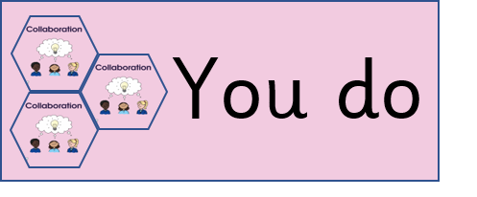
Speech Punctuation
Can you remember all the rules for writing speech punctuation?
Inverted commas / speech marks around what is said.
Capital letter at the beginning of the speech
Punctuation inside the speech marks (, ? ! or .)
A reporting clause or a way to make it clear who has spoken
Additional information for how it was said or what the character is doing
All other sentence punctuation rules.
What are the rules for speech punctuation?

Slide 9
Let's convert this together.
Now let's try this one together. Convert the Bear and Turtle conversation
into correctly punctuated direct speech. Use your checklist to help.
Have you seen my hat?
I haven't seen anything all day. I have been trying to climb this rock.
Would you like me to lift you on top of it?
Yes, please.
Think: who is speaking each time? What punctuation is needed?

Slide 10
[ INSERT BOOK SPREAD: Bear and Turtle ]
Display the double-page spread showing the Bear meeting the Turtle.
Conversation: Have you seen my hat? / I haven't seen anything all day.
I have been trying to climb this rock. / Would you like me to lift you?
Yes, please.

Slide 11
How did we do?
“Have you seen my hat?” asked the bear.
“I haven't seen anything all day. I have been trying to climb this rock,”
said the turtle.
“Would you like me to lift you on top of it?” asked the bear.
“Yes, please,” said the turtle.

Slide 12
Convert the Bear and Snake conversation into correctly punctuated direct speech.
Have you seen my hat?
I saw a hat once. It was blue and round.
My hat doesn't look like that. Thank you anyway.
Remember to:
• add inverted commas around what is said
• use a capital letter at the start of speech
• put punctuation inside the closing inverted comma
• add a reporting clause to show who is speaking
Peer check: swap with your partner and check using the speech punctuation checklist.

Slide 13
[ INSERT BOOK SPREAD: Bear and Snake ]
Display the double-page spread showing the Bear meeting the Snake.
Conversation: Have you seen my hat? / I saw a hat once. It was blue and round.
/ My hat doesn't look like that. Thank you anyway.

Slide 14
Now try on your own.
Have you seen my hat?
I saw a hat once. It was blue and round.
My hat doesn't look like that. Thank you anyway.
1. Convert this conversation into correctly
punctuated direct speech.
2. Check your work using the speech
punctuation checklist.
3. Swap with a partner and peer check.
Challenge: choose a different speech verb for each line — not just ‘said’.

Slide 15
Which speech punctuation rule did you find trickiest today?
How does using inverted commas help the reader?
Which piece of speech you wrote today are you most pleased with?

