Slide 1
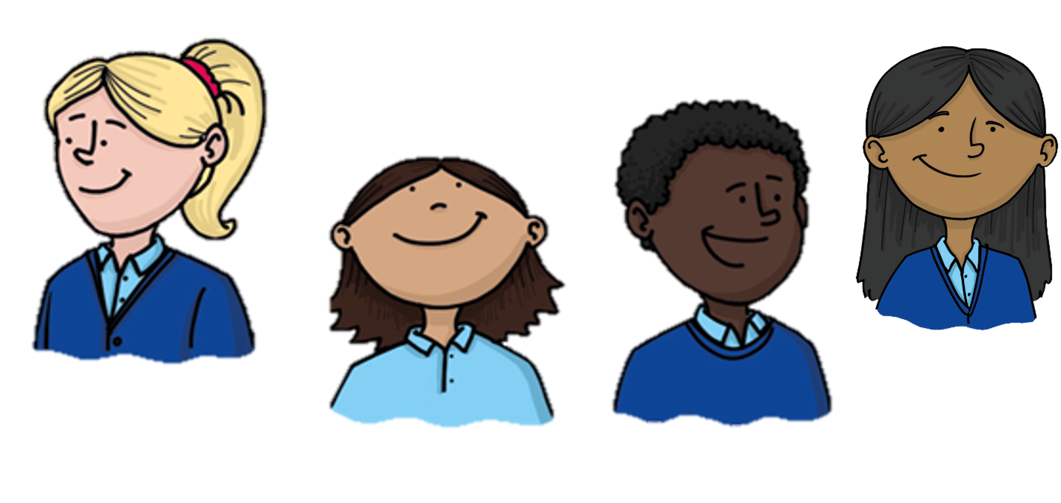





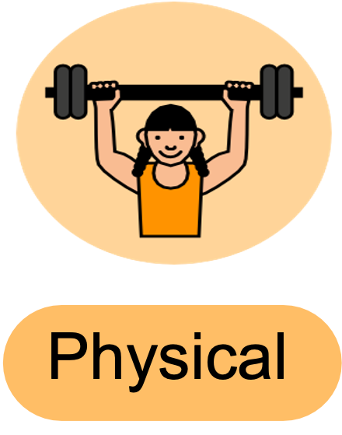
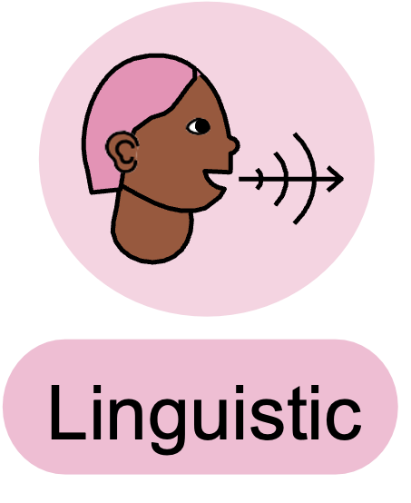
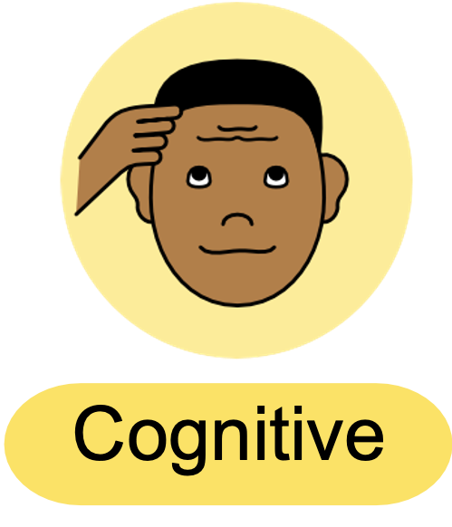

Learning Review
To give directions on a grid, I...
I found it tricky when...
I could check my directions were right by...
Notes:
WE DO — Learning Review
Stem 1: To give directions on a grid, I...
Stem 2: I found it tricky when...
Stem 3: I could check my directions were right by...
Stand to speak. Learning intelligence icons prompt discussion style.

