Slide 1


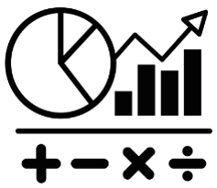
How can we describe exactly where something is?
Being a Mathematician
Notes:
KEY QUESTION — Coordinates
How can we describe exactly where something is?
Same slide used for all Coordinates lessons.

