Slide 1

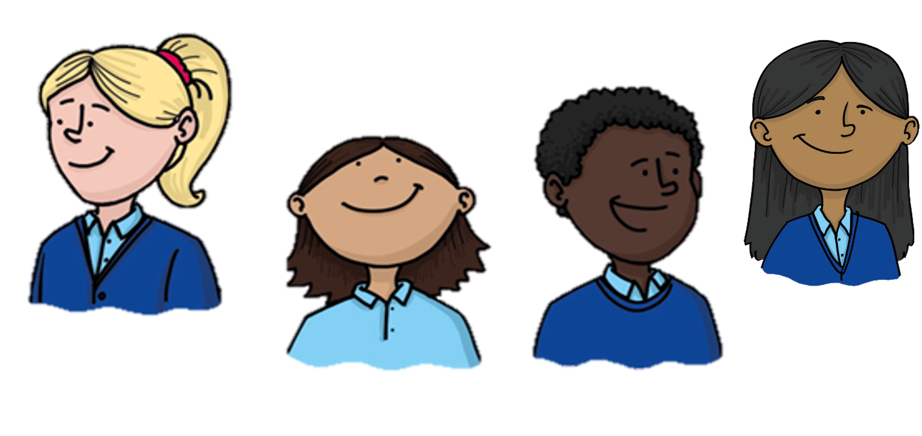

How can we describe exactly where something is?
Being a Mathematician
Notes:
KEY QUESTION — Coordinates
How can we describe exactly where something is?
Same slide used for all lessons in this topic block.

Slide 2
Being a Mathematician
Day 1
Notes:
DAY TITLE — Day 1 (Monday)
Topic: Coordinates
LI: Pupils give directions from one position to another on a grid.

Slide 3



What are we learning?
Why are we learning this?
How will I know when I get there?
We are learning to…
…give directions from one place to another on a grid.
This is because…
…being able to describe exactly where something is and how to get there is a skill we use in maps, plans and many other areas of maths.
I will show this by…
…writing clear directions using left, right, up and down with a number of steps, and checking them by tracing the route.
Notes:
I DO — Learning Objective
WALT: …give directions from one place to another on a grid.
TIOB: …being able to describe exactly where something is and how to get there is a skill we use in maps, plans and many other areas of maths.
IWSTB: …writing clear directions using left, right, up and down with a number of steps, and checking them by tracing the route.

Slide 4
Remember the details and the order
Click to Show
7
13
4
28
11
5
19
Go to the questions
Notes:
YOU DO — WM Number Sequence
Numbers: [7, 13, 4, 28, 11, 5, 19]
Click reveals numbers, cover reappears after 15s.

Slide 5
Now answer from memory!
Q1 What was the 1st number?
Q4 How many odd numbers were there?
Answer: 7
Answer: 4 (7, 13, 11, 19)
Q2 What was the 3rd number?
Q5 What was the largest number?
Answer: 4
Answer: 28
Q3 Sum of the first two numbers?
Answer: 20 (7 + 13)
Notes:
YOU DO — WM Q&A
All cards hidden at start. Reveal: Q1→A1→Q2→A2→Q3→A3→Q4→A4→Q5→A5

Slide 6
Rapid Maths – Day 1
Q1 Place Value
Q4 Geometry
What is the value of the digit 4 in 34,512?
How many sides does a hexagon have?
Q2 Fractions and Decimals
What is 1/2 as a decimal?
Q5 Measurement
How many centimetres are in 2 metres?
Q3 Multiplication / Division
What is 7 × 8?
Notes:
YOU DO — Rapid Maths Day 1
Q1 (Place Value): What is the value of the digit 4 in 34,512? → 4,000
Q2 (Fractions and Decimals): What is 1/2 as a decimal? → 0.5
Q3 (Multiplication / Division): What is 7 × 8? → 56
Q4 (Geometry): How many sides does a hexagon have? → 6
Q5 (Measurement): How many centimetres are in 2 metres? → 200 cm

Slide 7
Rapid Maths – Answers – Day 1
Q1 Place Value
Q4 Geometry
What is the value of the digit 4 in 34,512?
How many sides does a hexagon have?
4,000
6
Q2 Fractions and Decimals
What is 1/2 as a decimal?
0.5
Q5 Measurement
How many centimetres are in 2 metres?
200 cm
Q3 Multiplication / Division
What is 7 × 8?
56
Notes:
YOU DO — RM Answers Day 1
Q1: 4,000
Q2: 0.5
Q3: 56
Q4: 6
Q5: 200 cm

Slide 8
Precise Mathematical Vocabulary
grid
A pattern of lines making rows and columns of squares.
direction
The way you move on a grid — left, right, up or down.
steps
The number of squares you move in one direction.
route
The path you take from one place to another.
position
The exact place where something sits on a grid.
Notes:
WE DO — Vocabulary
Words: ['grid', 'direction', 'steps', 'route', 'position']
Word 1 visible at start; each definition and subsequent word revealed per click.

Slide 9
Giving directions on a grid
6
How do we get from A to B?
5
4
B
y
3
2
A
1
0
0
1
2
3
4
5
6
x
Notes:
I DO C1 — Narrate: 'From A, I move 3 right, then 2 up, and I arrive at B.'

Slide 10
Does the order of moves matter?
6
Try: 3 right then 2 down. Now try: 2 down then 3 right. Where do you end up?
5
A
4
y
3
B
2
1
0
0
1
2
3
4
5
6
x
Notes:
I DO C1 — Key question: does the order of moves change the destination?

Slide 11
Your turn — write the directions
6
From A, move ___ right/left and ___ up/down to reach B.
B
5
4
y
3
A
2
1
0
0
1
2
3
4
5
6
x
Notes:
WE DO C1 — Pupils tell the teacher what moves to make. Compare correct answers.

Slide 12
Trios — three-stop journeys
A: marks start and end
Swap roles each round — aim for 3 complete journeys each.
B: writes directions
Challenge: Can you find two different direction sequences that produce the same journey?
C: checks by tracing the route
Notes:
YOU DO (TRIOS)
Swap roles each round — aim for 3 complete journeys each.
Challenge: Can you find two different direction sequences that produce the same journey?

Slide 13
Independent — direction writing
Printed grid with 4 start/end pairs. Write directions for each. Mark the route taken.
Supported: Grids with only horizontal or vertical moves — not both combined. Use arrow cards instead of written directions initially.
Notes:
YOU DO (INDEPENDENT) — C1
Printed grid with 4 start/end pairs. Write directions for each. Mark the route taken.

Slide 14
Learning Paper 1
Notes:
YOU DO (INDEPENDENT)
Learning Paper 1
Leave blank — Innes adds screenshot.

Slide 15
Marking Station 1
Notes:
YOU DO (INDEPENDENT)
Marking Station 1
Leave blank — Innes adds screenshot.

Slide 16
Multi-step journeys — three positions
7
Journey: A → B → C. Write directions for each leg separately.
6
C
5
4
y
3
B
2
A
1
0
0
1
2
3
4
5
6
7
x
Notes:
I DO C2 — Model leg 1 (A→B): 2 right, 1 up. Leg 2 (B→C): 2 right, 3 up.

Slide 17
Spot the mistake
6
Instruction given: "From A at (3,3): move 4 squares right"
5
4 right from column 3 lands on column 7 — but the grid only goes to column 6. Always check the grid boundary before writing your directions.
4
A
y
3
✗
2
1
0
0
1
2
3
4
5
6
x
Notes:
I DO — Spot the Mistake (3-beat animated)
Beat 1 (load): Grid + instruction visible. Ask: 'What do you notice?'
Beat 2 (click 1): ✗ appears at landing position. Ask: 'Where does it end up?'
Beat 3 (click 2): Explanation revealed.
I DO C2 — Spot the Mistake
Concept: Move lands off the grid — direction count not checked against grid boundary
Beat 1 (load): Grid + instruction visible.
Beat 2 (click 1): X appears at error position.
Beat 3 (click 2): Explanation revealed.

Slide 18
Trios — create and swap
Shared roles from Cycle 1
Each trio creates a three-stop journey on a grid, writes the directions for each leg, and swaps with another trio to check.
Challenge: Can you find two different sets of directions for the same journey?
Notes:
YOU DO (TRIOS)
Each trio creates a three-stop journey on a grid, writes the directions for each leg, and swaps with another trio to check.
Challenge: Can you find two different sets of directions for the same journey?

Slide 19
Independent — three-stop journeys
Write directions for 3 three-stop journeys on a printed grid. Extension: describe the return journey for one of them.
Supported: Two three-stop journeys with one leg already written.
Notes:
YOU DO (INDEPENDENT) — C2
Write directions for 3 three-stop journeys on a printed grid. Extension: describe the return journey for one of them.

Slide 20
Learning Paper 2
Notes:
YOU DO (INDEPENDENT)
Learning Paper 2
Leave blank — Innes adds screenshot.

Slide 21
Marking Station 2
Notes:
YOU DO (INDEPENDENT)
Marking Station 2
Leave blank — Innes adds screenshot.

Slide 22
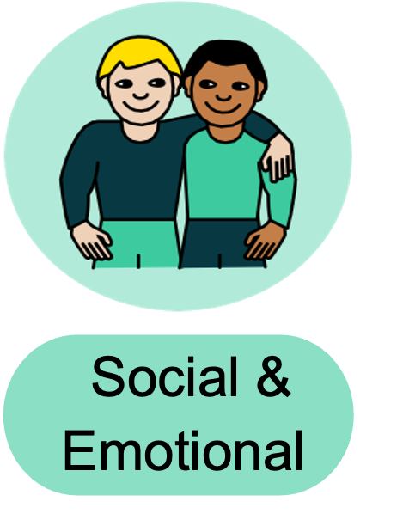
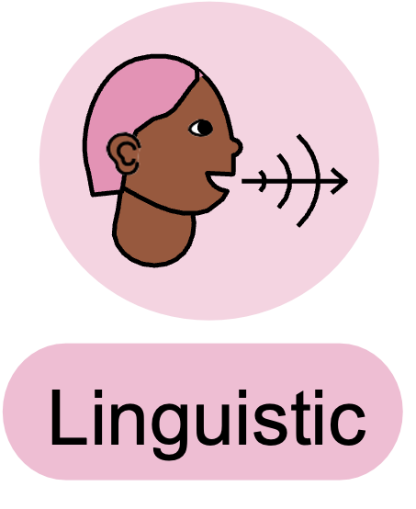




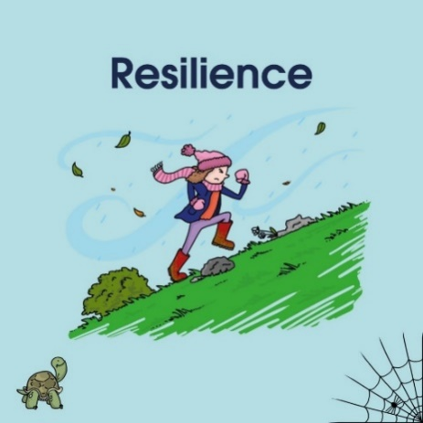
Learning Review
To give directions on a grid, I...
I found it tricky when...
I could check my directions were right by...
Notes:
WE DO — Learning Review
Stem 1: To give directions on a grid, I...
Stem 2: I found it tricky when...
Stem 3: I could check my directions were right by...
Stand to speak. Learning intelligence icons prompt discussion style.

