Slide 1
How do the geographies of England and Brazil compare?

Slide 3
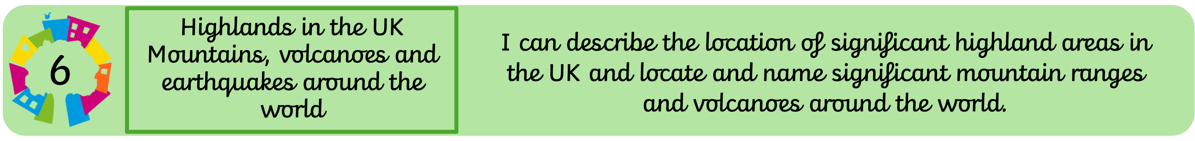

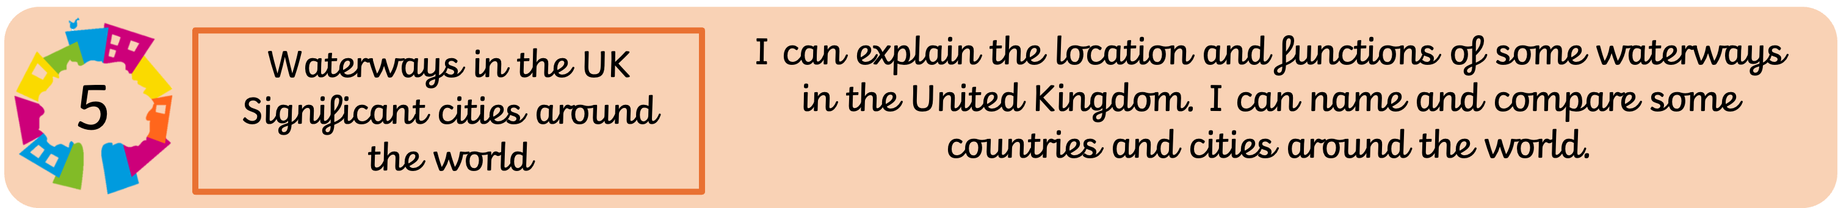


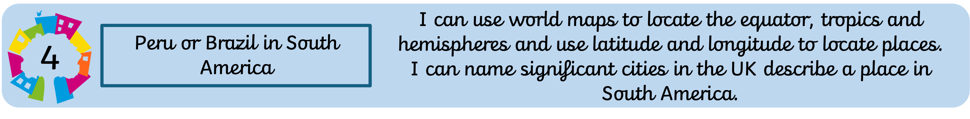
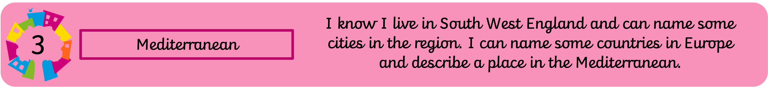


Place, space and scale
Places are areas that have been defined by a given name.
Space is about the importance of places and the way people organise where we live.
Scale is when we 'zoom-in and zoom-out' to explore local, regional and global patterns and connections.

Slide 4







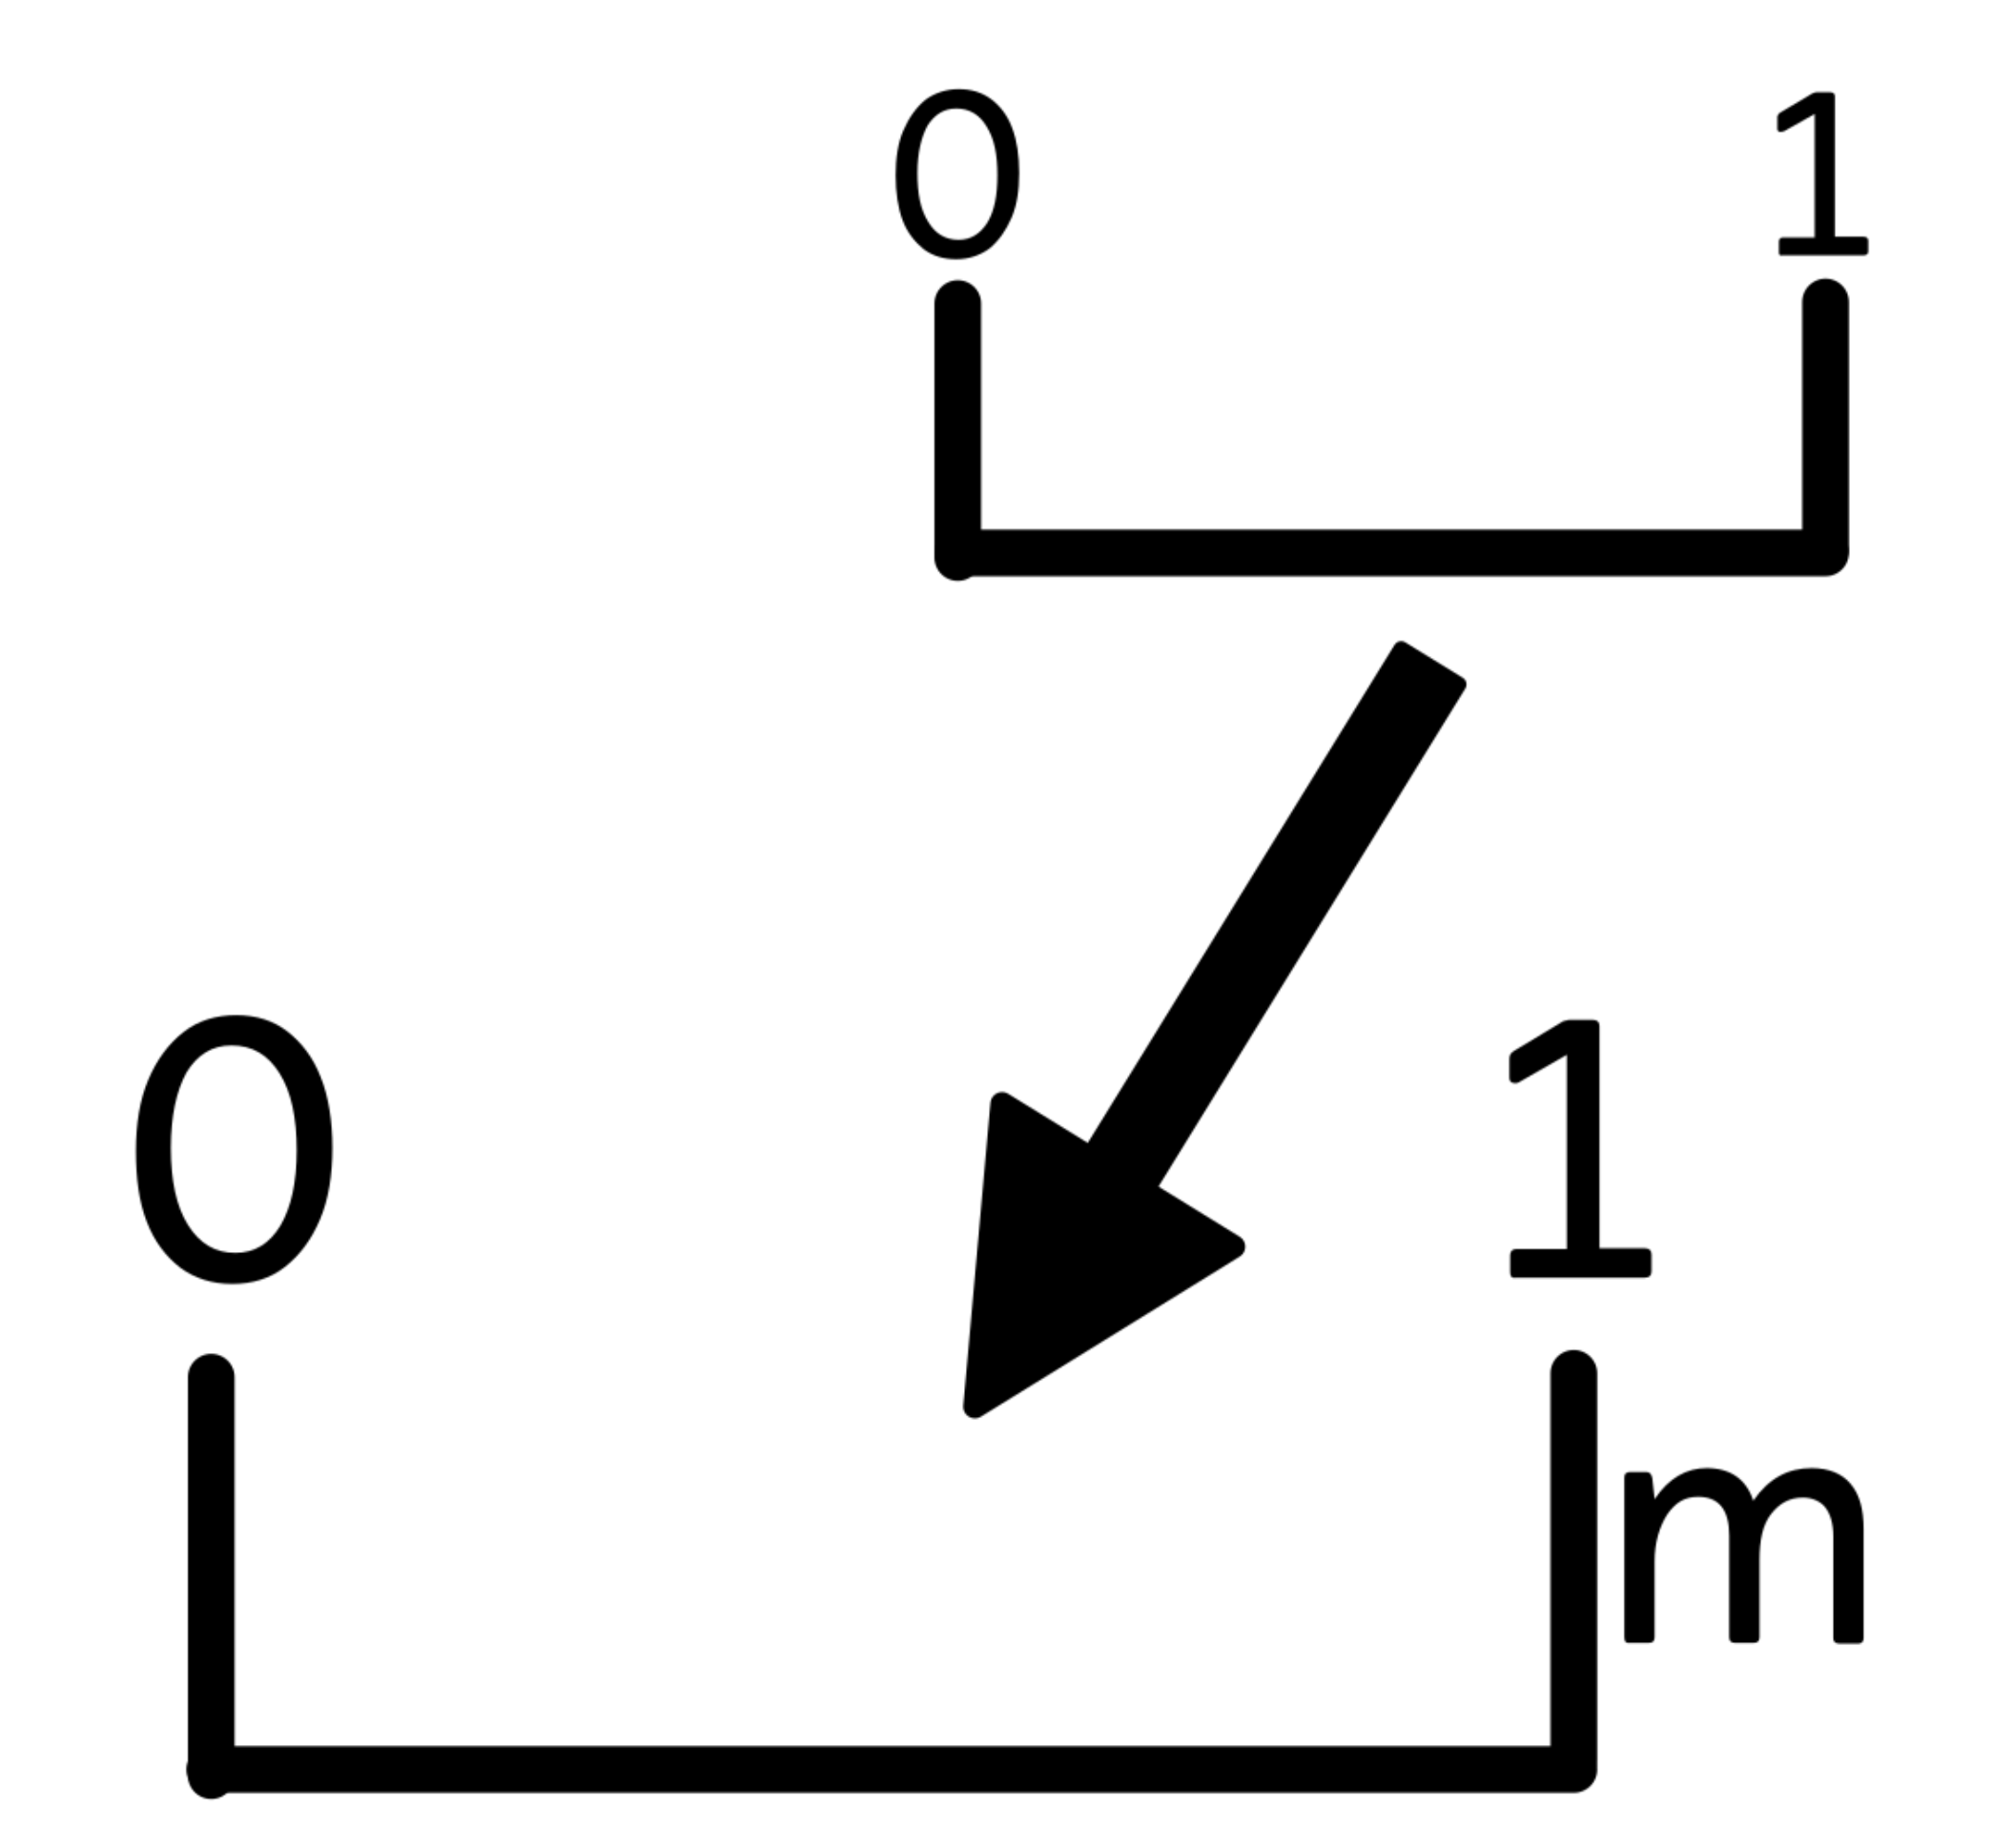
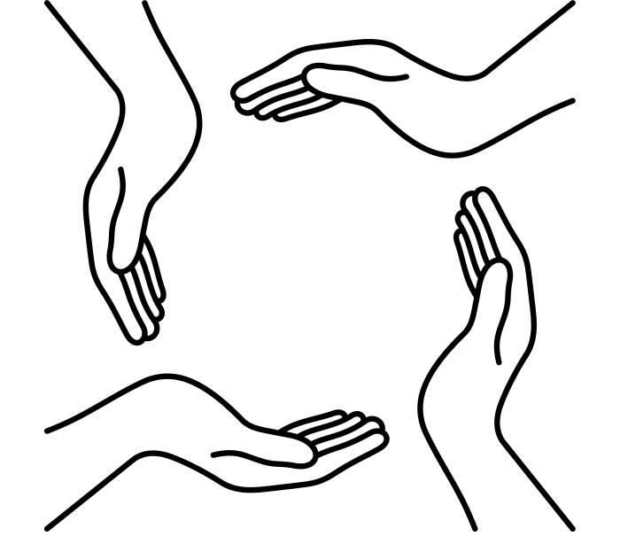
Connections
Places are spaces that have been defined by a given name. We can describe them by their location, shape, boundaries, features, physical and human characteristics.
Insert the lesson focus here.
Don’t make it too long, this is here to aid learners to understand how the lesson sequence fits together.
Insert the lesson focus here.
Don’t make it too long, this is here to aid learners to understand how the lesson sequence fits together.
Insert the lesson focus here.
Don’t make it too long, this is here to aid learners to understand how the lesson sequence fits together.
Insert the lesson focus here.
Don’t make it too long, this is here to aid learners to understand how the lesson sequence fits together.
Insert the lesson focus here.
Don’t make it too long, this is here to aid learners to understand how the lesson sequence fits together.
Insert the lesson focus here.
Don’t make it too long, this is here to aid learners to understand how the lesson sequence fits together.
Insert the lesson focus here.
Don’t make it too long, this is here to aid learners to understand how the lesson sequence fits together.
Insert the lesson focus here.
Don’t make it too long, this is here to aid learners to understand how the lesson sequence fits together.
Insert the lesson focus here.
Don’t make it too long, this is here to aid learners to understand how the lesson sequence fits together.
Insert the lesson focus here.
Don’t make it too long, this is here to aid learners to understand how the lesson sequence fits together.
Locating England and Brazil
Insert the lesson focus here.
Don’t make it too long, this is here to aid learners to understand how the lesson sequence fits together.
Insert the lesson focus here.
Don’t make it too long, this is here to aid learners to understand how the lesson sequence fits together.
Insert the lesson focus here.
Don’t make it too long, this is here to aid learners to understand how the lesson sequence fits together.
Insert the lesson focus here.
Don’t make it too long, this is here to aid learners to understand how the lesson sequence fits together.

Slide 5
Locate England and Brazil on a world map and describe their positions
geographers always begin by asking where a place is and what they expect to find there
locating both countries on a blank world map and writing two predictions about how they might differ

Slide 6
What knowledge am I bringing to this enquiry?
What would I like to find out?
Prior Knowledge and Skill | I am curious about...

Slide 7
hemisphere: one half of the Earth, divided either at the Equator (north/south) or the Prime Meridian (east/west)
longitude: imaginary lines running from the North Pole to the South Pole, measuring distance east or west of the Prime Meridian
latitude: imaginary lines running east to west around the Earth, measuring distance north or south of the Equator
continent: one of the seven large land masses on Earth (e.g. South America, Europe)
Equator: the imaginary line at 0° latitude that divides the Earth into the northern and southern hemispheres

Slide 8
Where on Earth are England and Brazil?
England sits in north-west Europe at around 52°N, 1°W. Brazil dominates the eastern side of South America, straddling the Equator between 5°N and 33°S. Because Brazil is so large, parts of it are in both the northern and southern hemispheres.

Slide 9
Locating both countries together
Using an atlas, find and label England and Brazil on a blank world map. Mark the Equator, the Tropic of Capricorn, and the Prime Meridian. Write the approximate latitude and longitude of London and Brasília.

Slide 10
Where in the world?
Complete the world map independently, adding compass directions and a key. Write three geographical facts about the position of each country.

