Slide 1

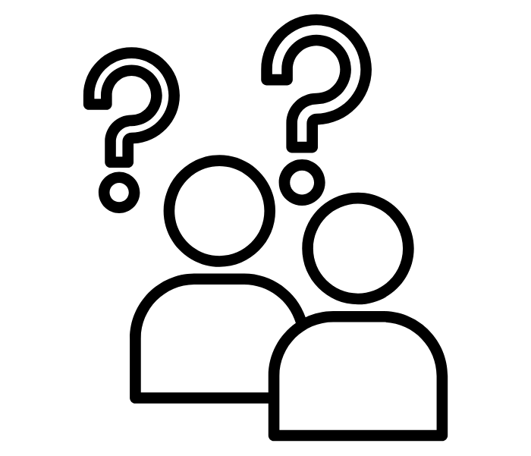

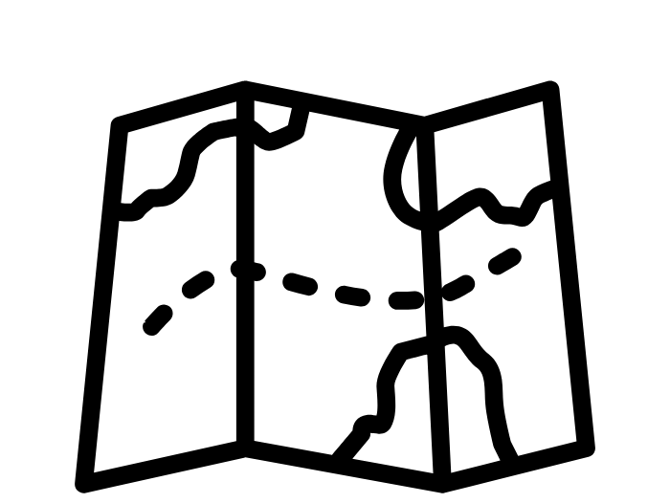
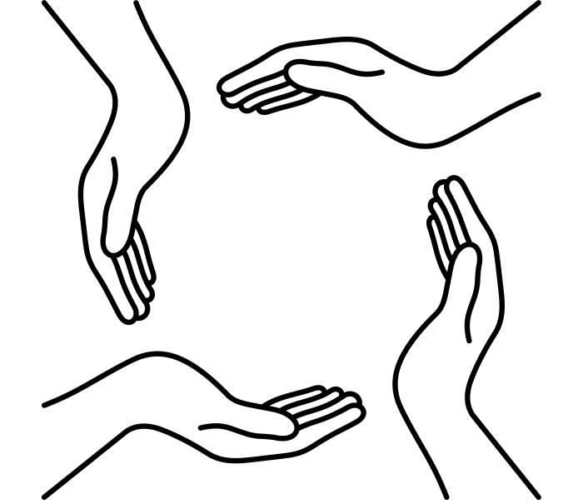
Lesson 12
Lesson 13
Lesson 14
Lesson 15
Lesson 6
Lesson 7
Lesson 8
Lesson 9
Lesson 10
Lesson 11
Lesson 1
Lesson 2
Lesson 3
Lesson 4
Lesson 5

