Slide 1
How did Egyptian civilisation shape the ancient world?
Create a museum exhibit that shows why Egyptian civilisation mattered.

Slide 2
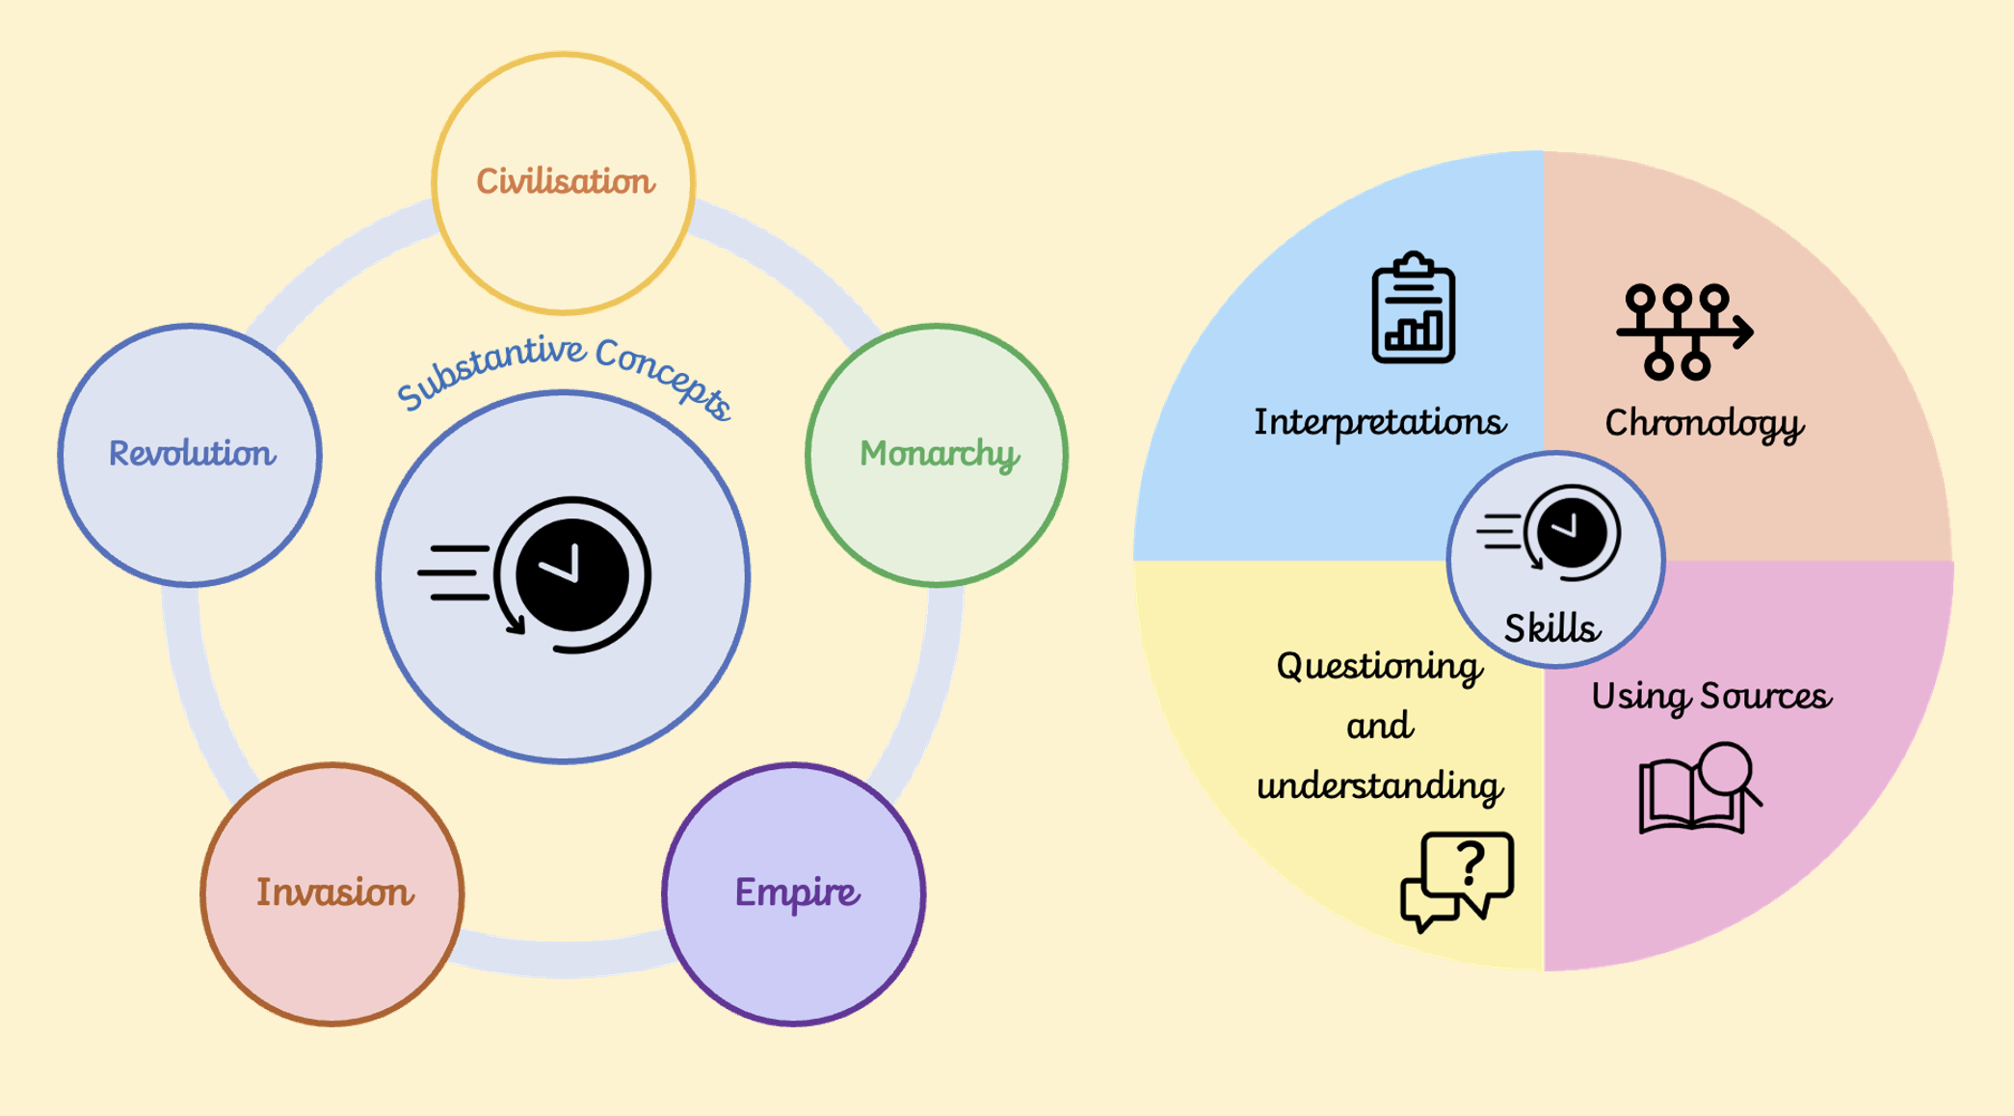

Slide 3


Civilisation
6
Ancient Egyptian Civilisation, Stone Age Britain, Ancient Greek Life
Civilisations today are built on the ideas and advancements that have been formed around the world over millions of years.
A group of people with their own languages and way of life. Civilised people live in organised groups like towns.
5
Roman Empire,
Ancient Egyptian Civilisation
The Ancient Egyptians and Romans were advanced civilisations who left a lasting legacy. The Romans made changes to the civilisation in Great Britain and this still impacts our way of life today.
Anglo Saxons & Vikings,
Maya Civilisation
Golden Age of Islam
There were different advanced civilisations around the world at the same time, not just in the West.
4
Tudors & Stuarts,
European Explorers
European explorers discovered other civilisations in different lands.
3
2
Victorian era
The civilisation in Great Britain became more advanced during the Victorian era.
Within living memory
I live in a community in Great Britain which has changed over time. Great Britain is an advanced civilisation.
1
Notes:
New enquiry session 1 – look back at the building blocks of learning explored so far for this substantive concept.

Slide 4
Our Enquiry…
Who were the Ancient Egyptians?

Slide 5
How did Egyptian civilisation shape the ancient world?
to make slides which are not utterly terrible every time.
I can make slides which are not utterly terrible every time.
making slides which are not utterly terrible.

Slide 6
What knowledge am I bringing to this enquiry? What would I like to find out?
Prior Knowledge and Skill | I am curious about…

Slide 7
Civilisation
A large group of people who live together and share a language, laws and a way of life.
Pharaoh
The ruler of Ancient Egypt, believed to be both a god and a king.
River Nile
The longest river in Africa, which gave Ancient Egyptians water, food and transport.
Word / Phrase 4
Definition 4
Word / Phrase 5
Definition 5

Slide 8
Where in the World is Egypt?
Egypt sits in North Africa on the banks of the River Nile. The Nile flows north into the Mediterranean Sea. Most Egyptian settlements clustered along the river because the land beyond was desert.

Slide 9
Reading a Map Together
Find the River Nile, the Mediterranean Sea, the Sahara Desert and the Red Sea. What do you notice about where Egyptians built their cities?

Slide 10
What Do We Already Know?
Discuss in trios: What do you already know about Ancient Egypt? Share one idea each. What would you like to find out?

Slide 11
Your Map of Egypt
Draw an outline map of Egypt and label: the River Nile, the Mediterranean Sea, the Sahara Desert, the Red Sea and the city of Memphis. Write one sentence explaining why most Egyptians chose to live near the Nile.

Slide 12
Learner A text
Learner B text
Learner C text

Slide 13
Learner 1 sentence stem
Learner 2 sentence stem
Learner 3 sentence stem

