Slide 1
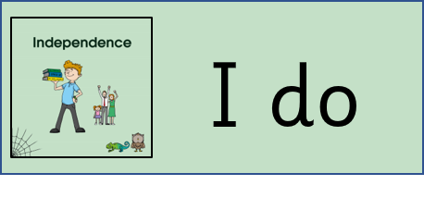
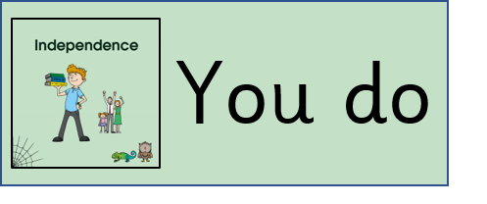

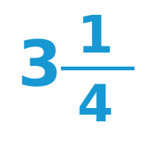
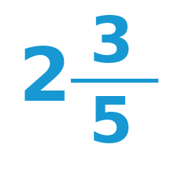
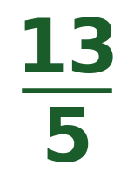

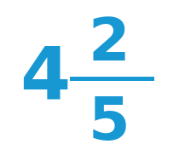
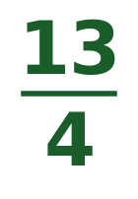
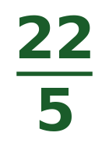
Fractions Recap — Mixed → Improper
Monday
Watch and follow the steps.
Now you try — convert to an improper fraction.
Step 1: Multiply whole × denominator
=
2 × 5 = 10
Step 2: Add the numerator
10 + 3 = 13
Answer:
=

Slide 2
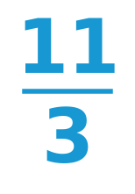
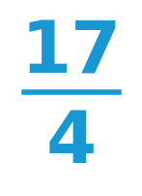
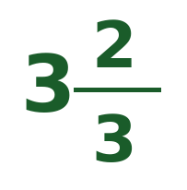
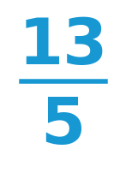
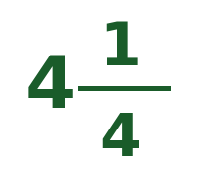
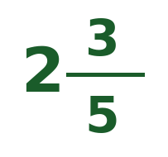
Fractions Recap — Improper → Mixed
Monday
Watch and follow the steps.
Now you try — convert to a mixed number.
Step 1: Divide numerator ÷ denominator
=
11 ÷ 3 = 3 remainder 2
Step 2: Whole = quotient, fraction = remainder / divisor
Answer:
=

Slide 3
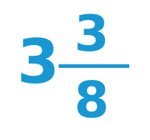
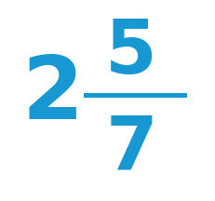
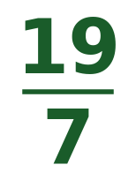
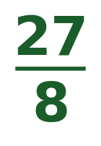
Fractions Recap — Mixed → Improper
Tuesday
Watch and follow the steps.
Now you try — convert to an improper fraction.
Step 1: Multiply whole × denominator
=
2 × 7 = 14
Step 2: Add the numerator
14 + 5 = 19
Answer:

Slide 4
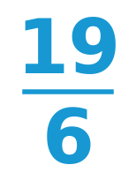
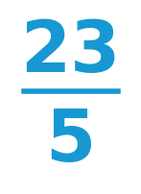
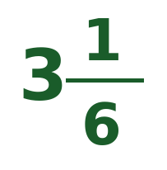
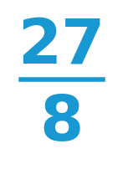
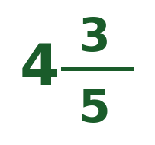
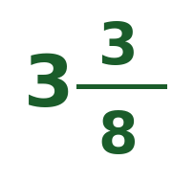
Fractions Recap — Improper → Mixed
Tuesday
Watch and follow the steps.
Now you try — convert to a mixed number.
Step 1: Divide numerator ÷ denominator
=
19 ÷ 6 = 3 remainder 1
Step 2: Whole = quotient, fraction = remainder / divisor
Answer:
=

Slide 5
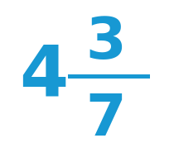
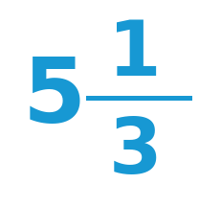
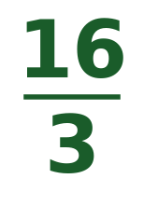
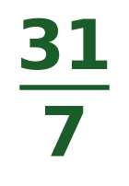
Fractions Recap — Mixed → Improper
Wednesday
Watch and follow the steps.
Now you try — convert to an improper fraction.
Step 1: Multiply whole × denominator
=
5 × 3 = 15
Step 2: Add the numerator
15 + 1 = 16
Answer:

Slide 6
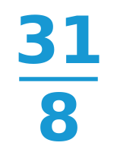
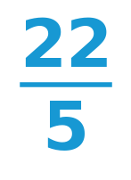
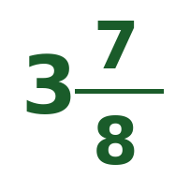
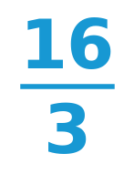

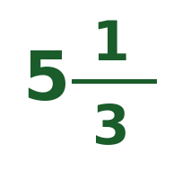
Fractions Recap — Improper → Mixed
Wednesday
Watch and follow the steps.
Now you try — convert to a mixed number.
Step 1: Divide numerator ÷ denominator
=
31 ÷ 8 = 3 remainder 7
Step 2: Whole = quotient, fraction = remainder / divisor
Answer:
=

