Slide 1
text

Slide 3

Insert the lesson focus here.
Don’t make it too long, this is here to aid learners to understand how the lesson sequence fits together.
Insert the lesson focus here.
Don’t make it too long, this is here to aid learners to understand how the lesson sequence fits together.

Slide 5

loukgjkgklj
kjhtfkyhfjyhfr
jyrfikjykfjy

Slide 7
gjhglg

Slide 8
iyliuyliu
Iyhpiyku`
Nj.jlkj

Slide 10

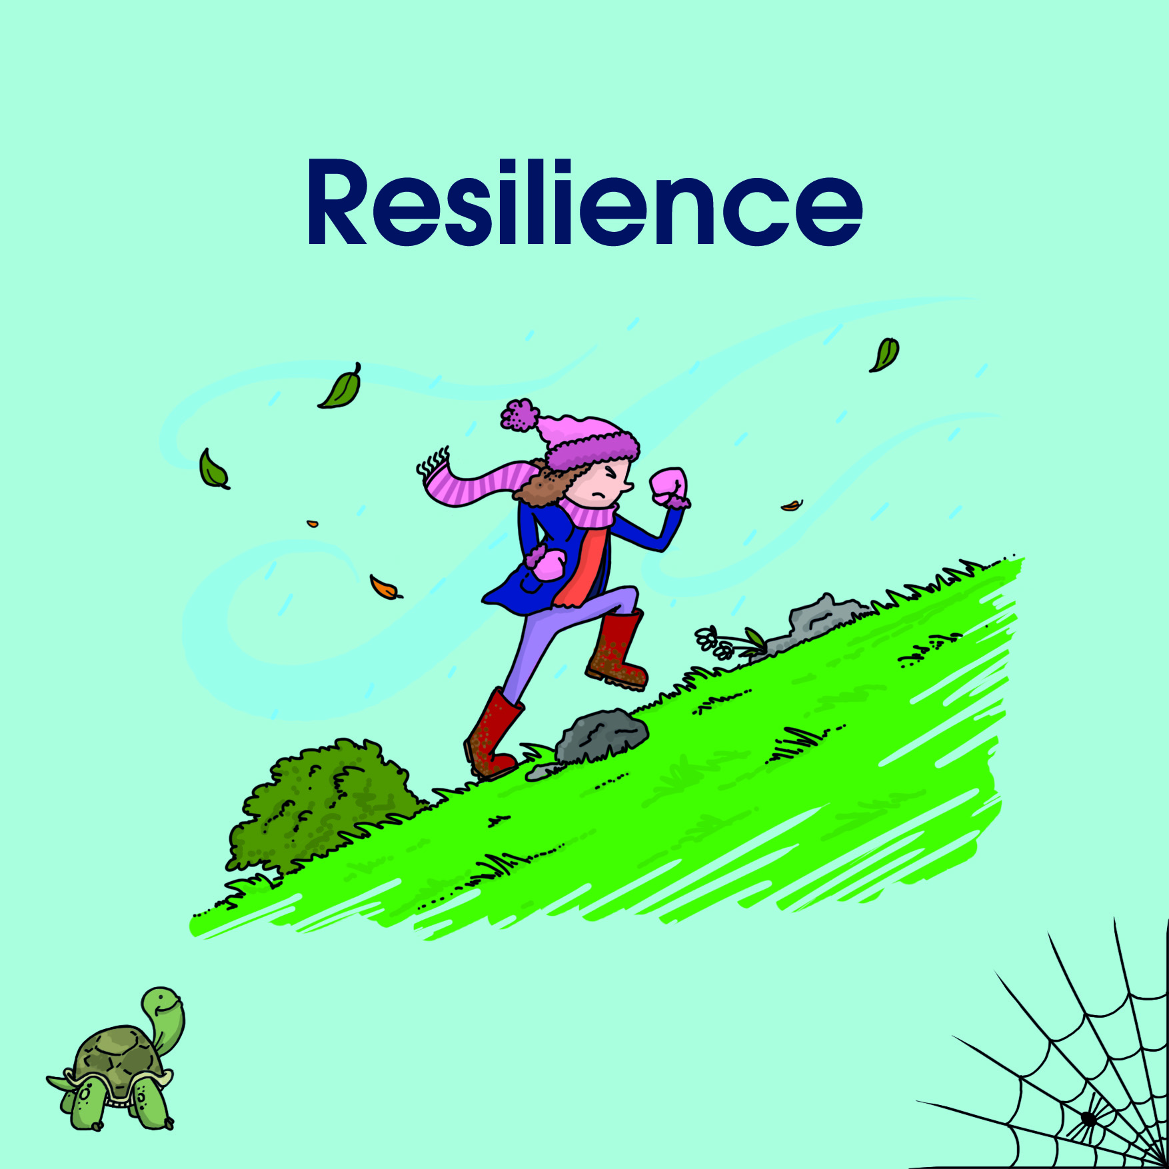
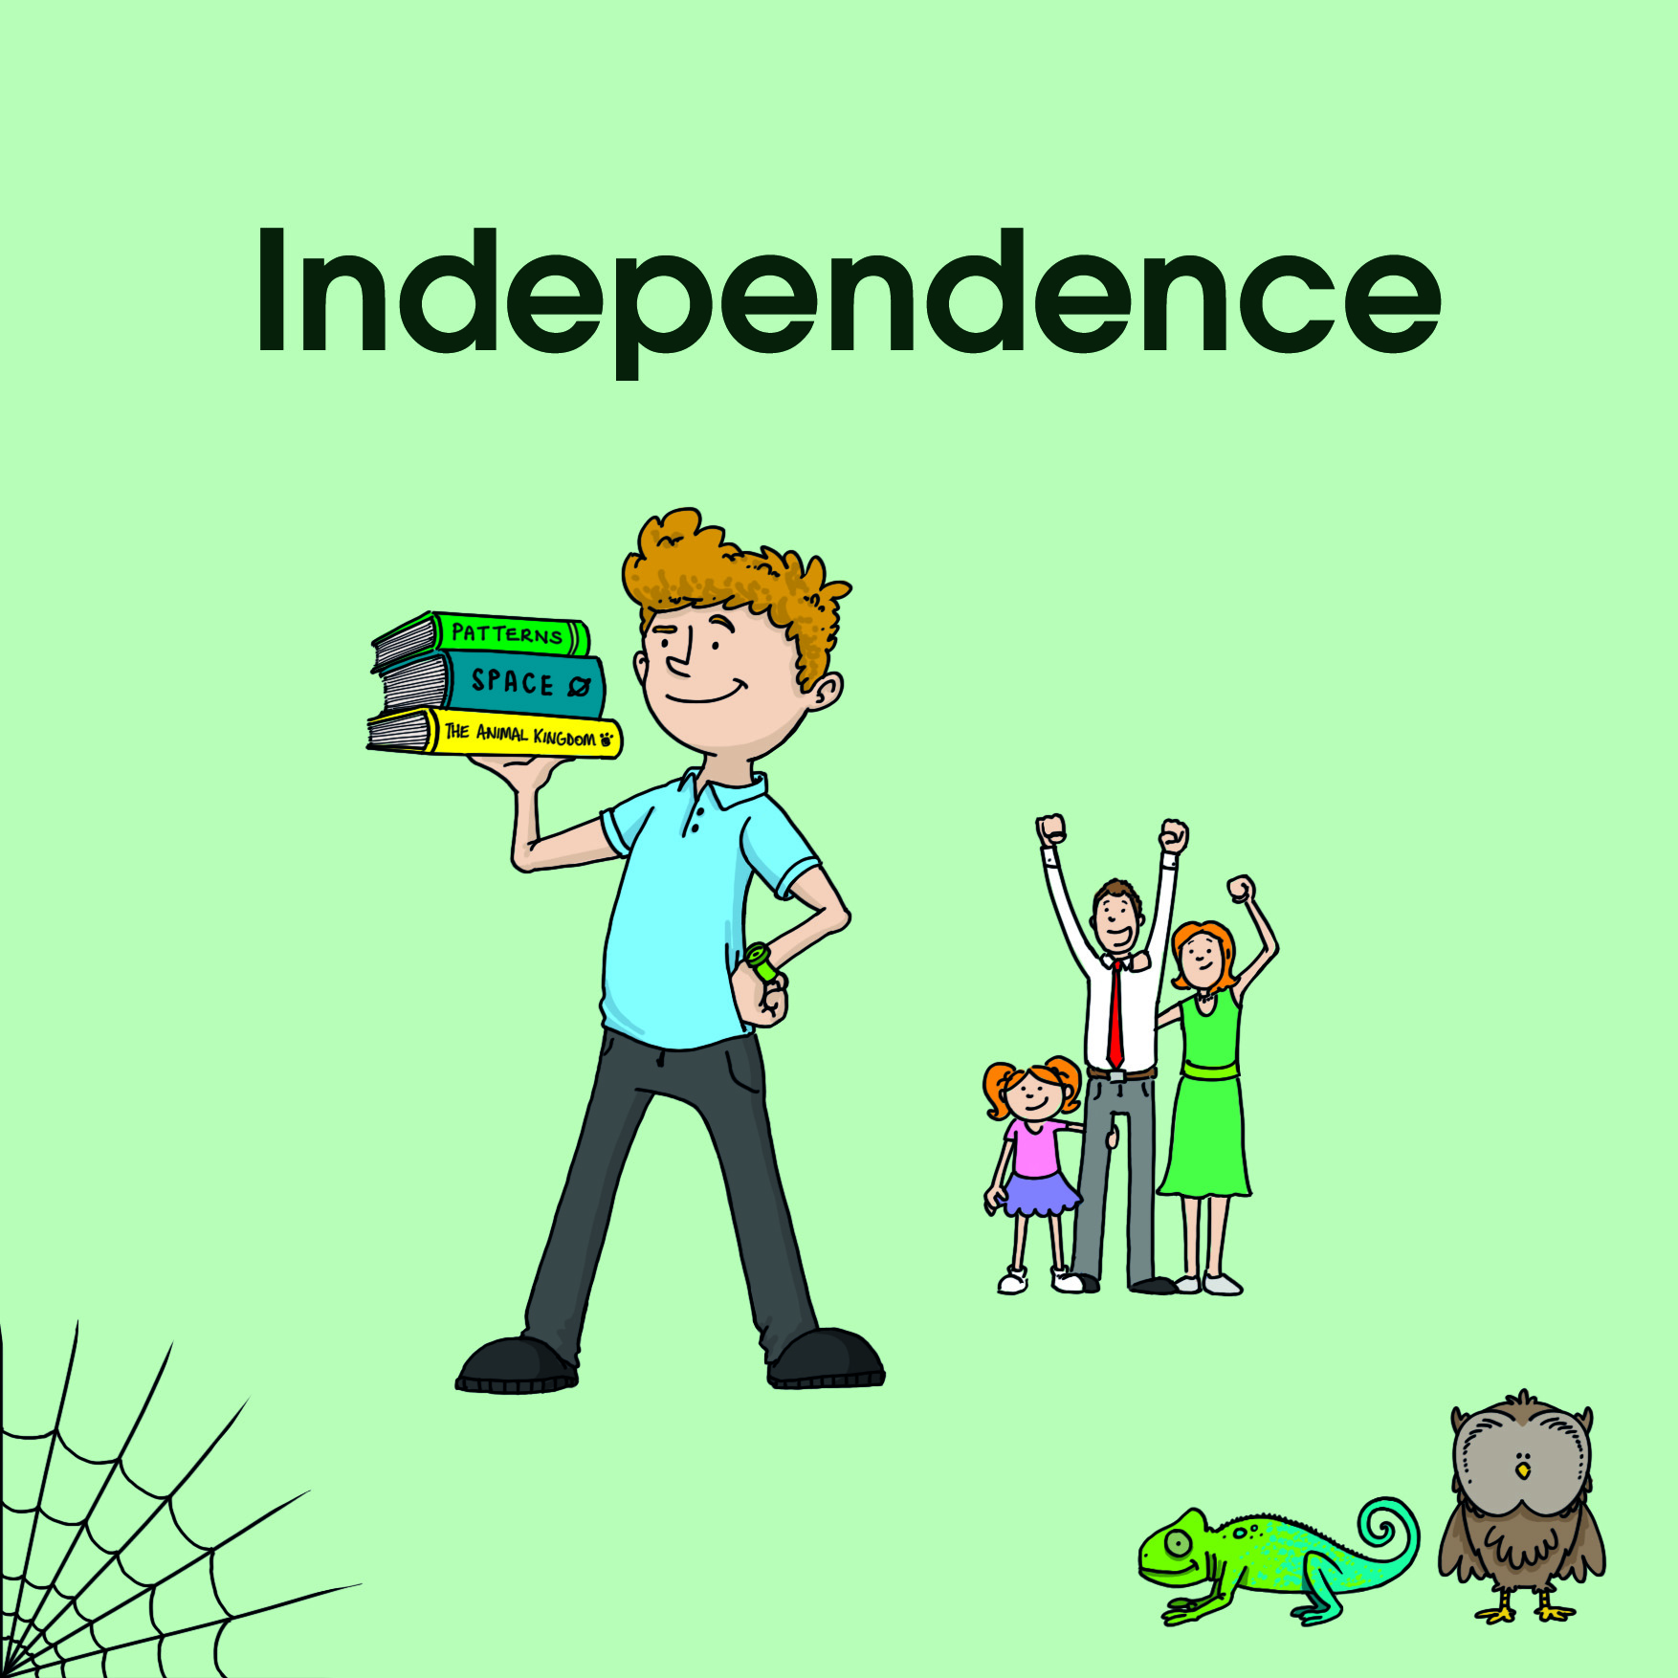
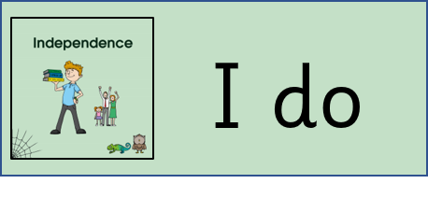


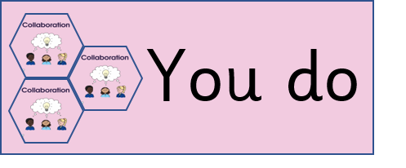


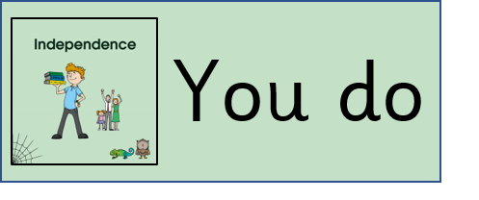
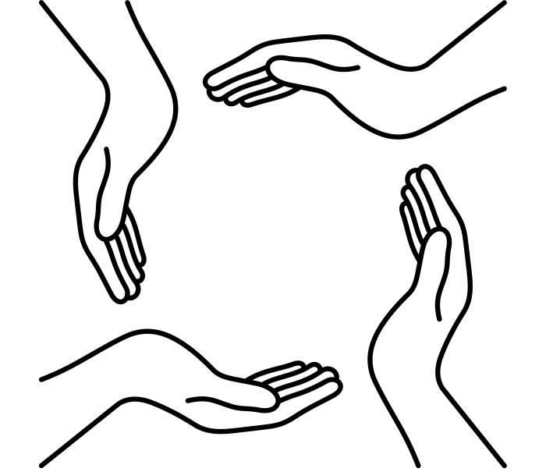








Insert the lesson focus here.
Don’t make it too long, this is here to aid learners to understand how the lesson sequence fits together.
Insert the lesson focus here.
Don’t make it too long, this is here to aid learners to understand how the lesson sequence fits together.
Insert the lesson focus here.
Don’t make it too long, this is here to aid learners to understand how the lesson sequence fits together.
Insert the lesson focus here.
Don’t make it too long, this is here to aid learners to understand how the lesson sequence fits together.
Insert the lesson focus here.
Don’t make it too long, this is here to aid learners to understand how the lesson sequence fits together.

Slide 11








The Oracy Framework
Voice 21 | Our Oracy Frameworks
Here are some things to think about when you are using your oracy skills:
Physical
Linguistic
Cognitive
Social & Emotional
Are you thinking about the speed and volume of your voice?
Is what you want to say
clear and organised?
Are you using sentence stems to link others’ ideas?
Are you taking turns to talk and listen and encouraging others to take part?
Are you using gestures and expression to help make your point?
Are you asking relevant questions and responding to others?
Are you using new and
appropriate vocabulary?
?
Are you giving reasons for what you are saying?
Are you talking confidently and thinking about your audience?
Are you facing who you are
speaking or listening to?
Voice 21 | KS1 Oracy Framework

Slide 12





LKS2
Sentence Stems for Talk
Talking To Inform
(retelling and description)
It appears…because…
It seems to be…due to…
It reminds me…
To conclude… / In conclusion… / To sum up…
Talking To Argue
An argument for is…
An argument against is…
In my opinion…
I understand…however…
Have you considered…
Have you thought about…
Talking To Explain
(Instruction and explanation)
Then, as a result of…
In contrast to…
…was successful / unsuccessful because…
Maybe it is due to…
Next time I would… as I think…

Slide 13


Lesson planning
Use this text box to describe the learning being led by the adult (including with learners – e.g. we do)
Use this text box to describe the learning being led by the adult (including with learners – e.g. we do)
Use this text box to describe the learning being led by the adult (including with learners – e.g. we do)
Use this text box to describe the learning being led by the adult (including with learners – e.g. we do)
Use this text box to describe the learning being led by the adult (including with learners – e.g. we do)
Use this text box to describe the learning being led by the adult (including with learners – e.g. we do)
Use this text box to describe the learning being led by the adult (including with learners – e.g. we do)
Use this text box to describe the learning being led by the adult (including with learners – e.g. we do)
Use this text box to describe the learning being led by the adult (including with learners – e.g. we do)
Use this text box to explain what the adult is doing at this point to support specific learners
Use this text box to explain what the adult is doing at this point to support specific learners
Use this text box to explain what the adult is doing at this point to support specific learners
Use this text box to explain what the adult is doing at this point to support specific learners
Use this text box to explain what the adult is doing at this point to support specific learners
Use this text box to explain what the adult is doing at this point to support specific learners
Use this text box to explain what the adult is doing at this point to support specific learners
Use this text box to explain what the adult is doing at this point to support specific learners
Use this text box to explain what the adult is doing at this point to support specific learners
time
time
time
time
time
time
time
time
time
time
time
time
time
time
time
time
time
time
Use this text box to describe the learning being led by children (independently, collaboratively with other learners.)
Use this text box to describe the learning being led by children (independently, collaboratively with other learners.)
Use this text box to describe the learning being led by children (independently, collaboratively with other learners.)
Use this text box to describe the learning being led by children (independently, collaboratively with other learners.)
Use this text box to describe the learning being led by children (independently, collaboratively with other learners.)
Use this text box to describe the learning being led by children (independently, collaboratively with other learners.)
Use this text box to describe the learning being led by children (independently, collaboratively with other learners.)
Use this text box to describe the learning being led by children (independently, collaboratively with other learners.)
Use this text box to describe the learning being led by children (independently, collaboratively with other learners.)

