Slide 1
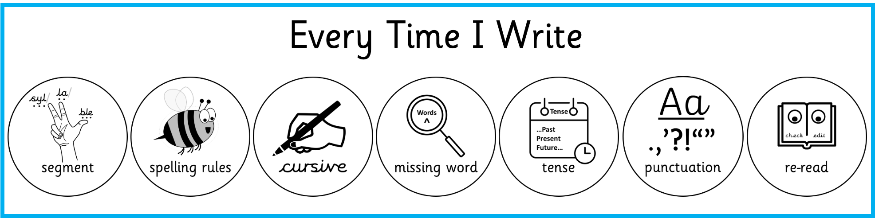
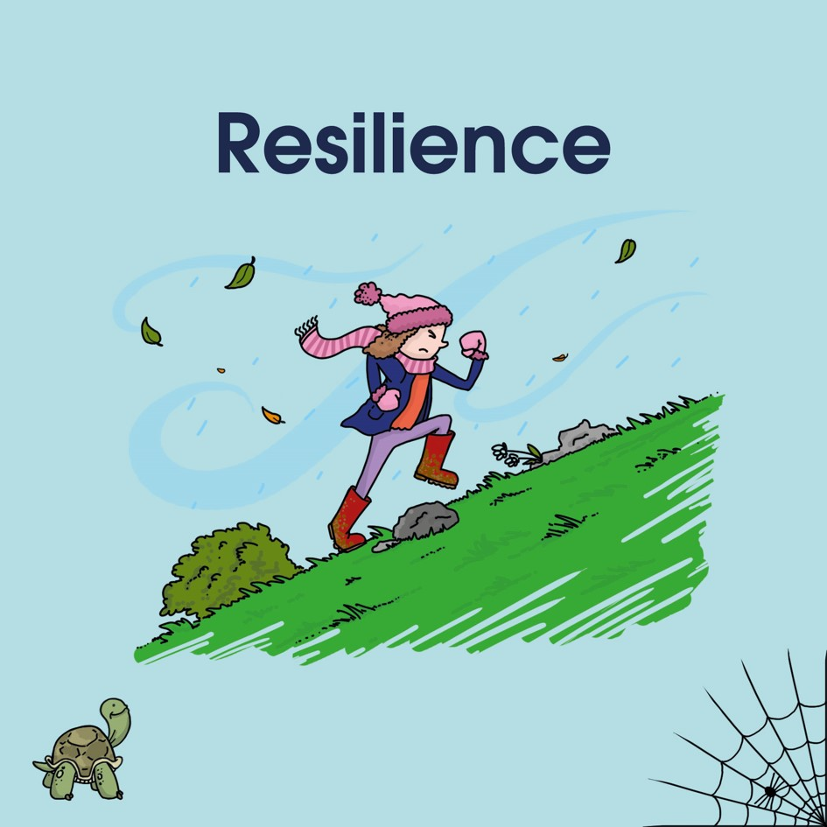
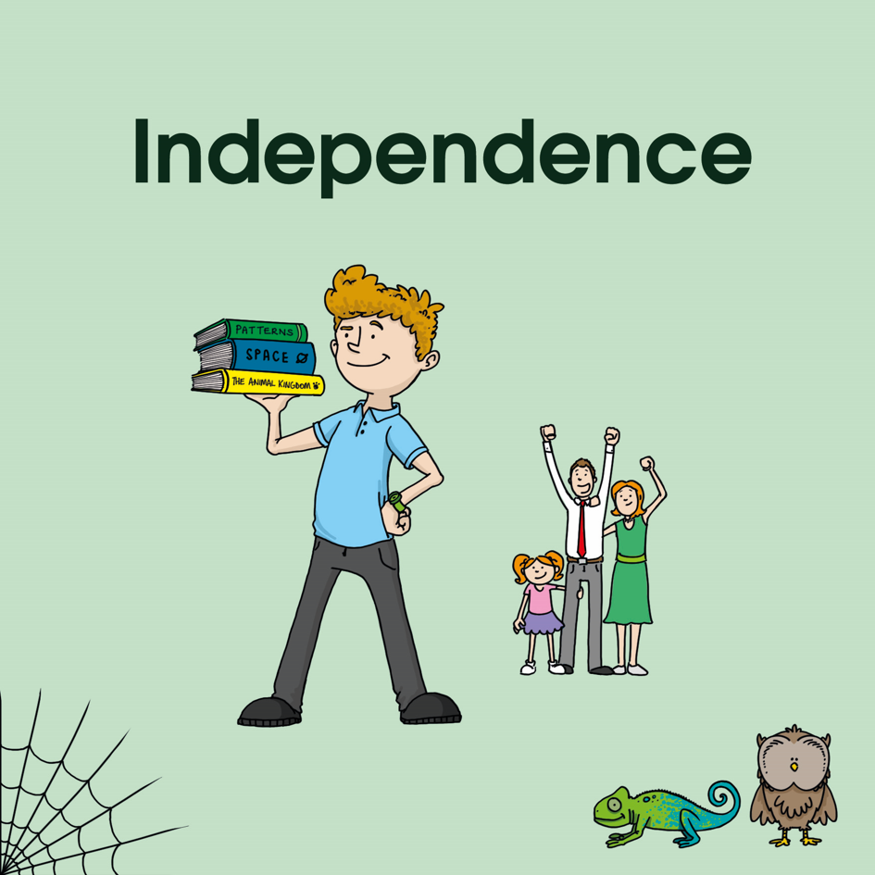

I will read short parts of the sentence(s) very slowly but not make it clear where sentences end or begin.
I will re-read parts so you will hear the words several times.
I won’t tell you any of the punctuation or spelling but you should use Every Time I write to help you while you are writing and when you have finished.
When we have finished, we will come to the home zone to review and edit our writing using our blue pens.

Slide 2

Review
Edit with your blue pen
Have you used cursive handwriting and written in pen?
Have you re-read your writing to check it make sense and spot errors? Did you check that each sentence is a complete idea? Did you check for run-on sentences?
Have you identified the sentences with capital letters and full-stops (or other ending punctuation)? Have you used capital letters correctly for names (proper nouns)? Commas after fronted adverbials? Apostrophes for possession?
Have you used all of your spelling strategies and checked words look right?
Quietly, the city’s church bells began to ring out across the valley. The priest’s voice carried magically as people gathered to celebrate. Historically, Christians give thanks at Easter for Jesus’s sacrifice.
Quietly, the city’s church bells began to ring out across the valley. The priest’s voice carried magically as people gathered to celebrate. Historically, Christians give thanks at Easter for Jesus’s sacrifice.

Slide 3
Teacher Copy
Teacher Copy
Teacher Copy
Read the text, slowly, in chunks, without making it clear where sentences start or end or adding any punctation in your reading.
Read the text, slowly, in chunks, without making it clear where sentences start or end or adding any punctation in your reading.
Read the text, slowly, in chunks, without making it clear where sentences start or end or adding any punctation in your reading.
Quietly, the city’s church bells began to ring out across the valley. The priest’s voice carried magically as people gathered to celebrate. Historically, Christians give thanks at Easter for Jesus’s sacrifice.
Quietly, the city’s church bells began to ring out across the valley. The priest’s voice carried magically as people gathered to celebrate. Historically, Christians give thanks at Easter for Jesus’s sacrifice.
Quietly, the city’s church bells began to ring out across the valley. The priest’s voice carried magically as people gathered to celebrate. Historically, Christians give thanks at Easter for Jesus’s sacrifice.

Slide 4
Name ___________________
Qietly the citys church bells began to ring out acros the _______. The preists _______ carried magicaly as people gathered to selebrate. Historicly, ________ give thanks at Easter for Jesuss sacrfice.
___________________
missing word

Slide 5
