Slide 1
Structure of Being a scientist Slides and LOE
Slide one – show curriculum (first lesson and start of 2nd week – make links
What is a scientist / being a scientist – focus on scientific skills
What, why, how? Of this lesson
Knowledge organisers – update from previous lesson’s learning self populated by learners or constructed as a whole class on slides
Linked questions (x2 key pieces of knowledge from previous lesson)
In 1st or 2nd lesson introduce subject specific vocabulary (activity idea fed in facts) and provide opportunities to use it through out to ensure acquisition.
lesson slides following I do, we do, you do structure max 20 mins
Plenary: 2 questions at the end of lesson that can be used at start of next lesson
Quiz at end of enquiry with all the 2x questions from plenaries

Slide 2
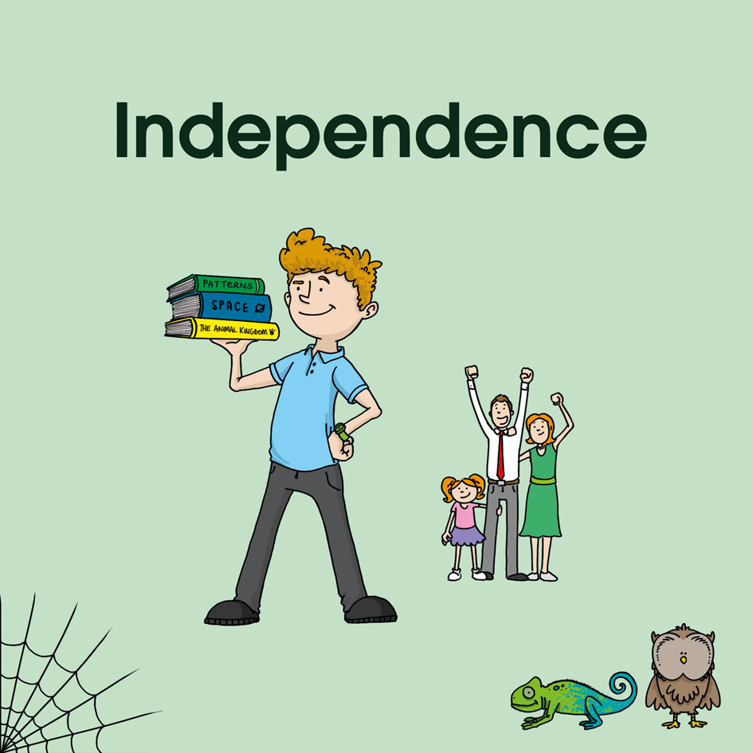
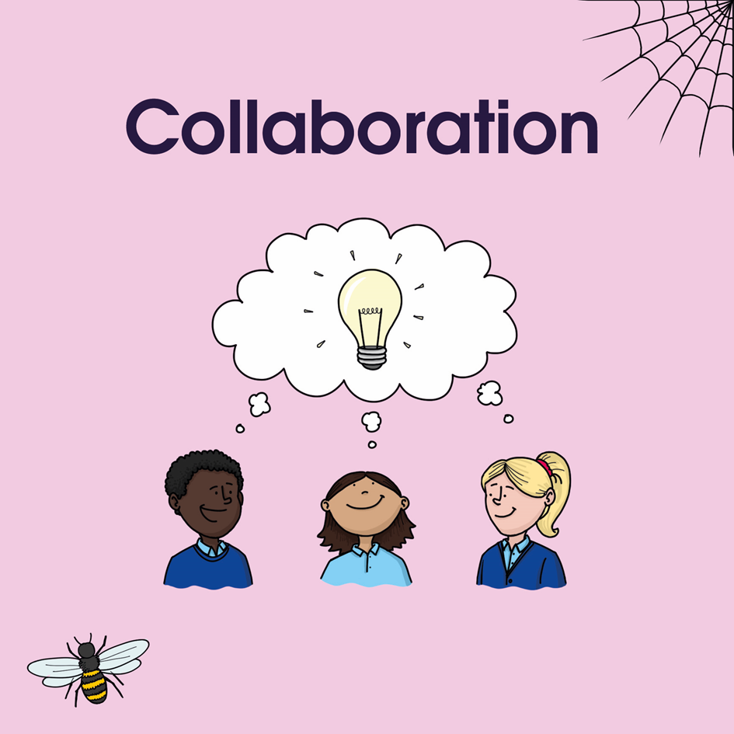


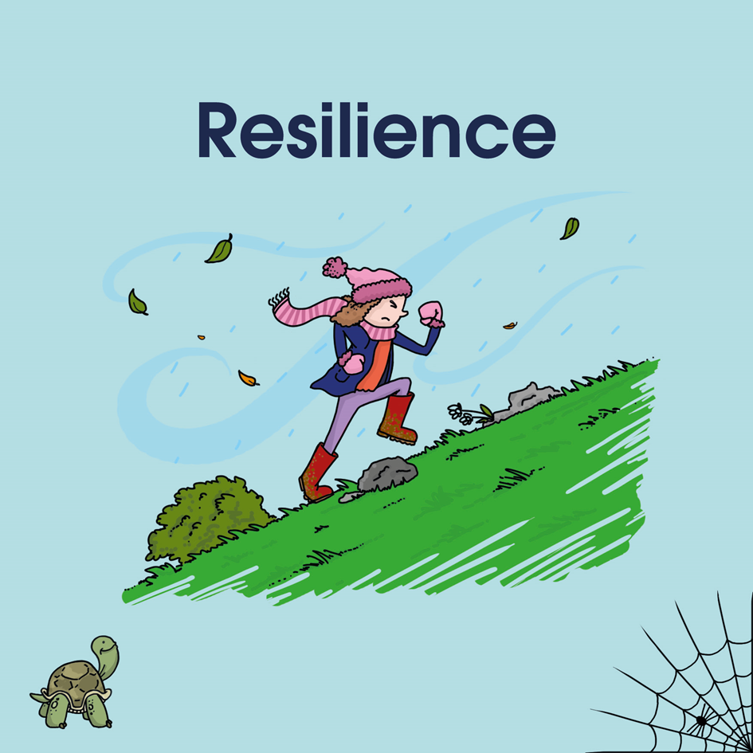
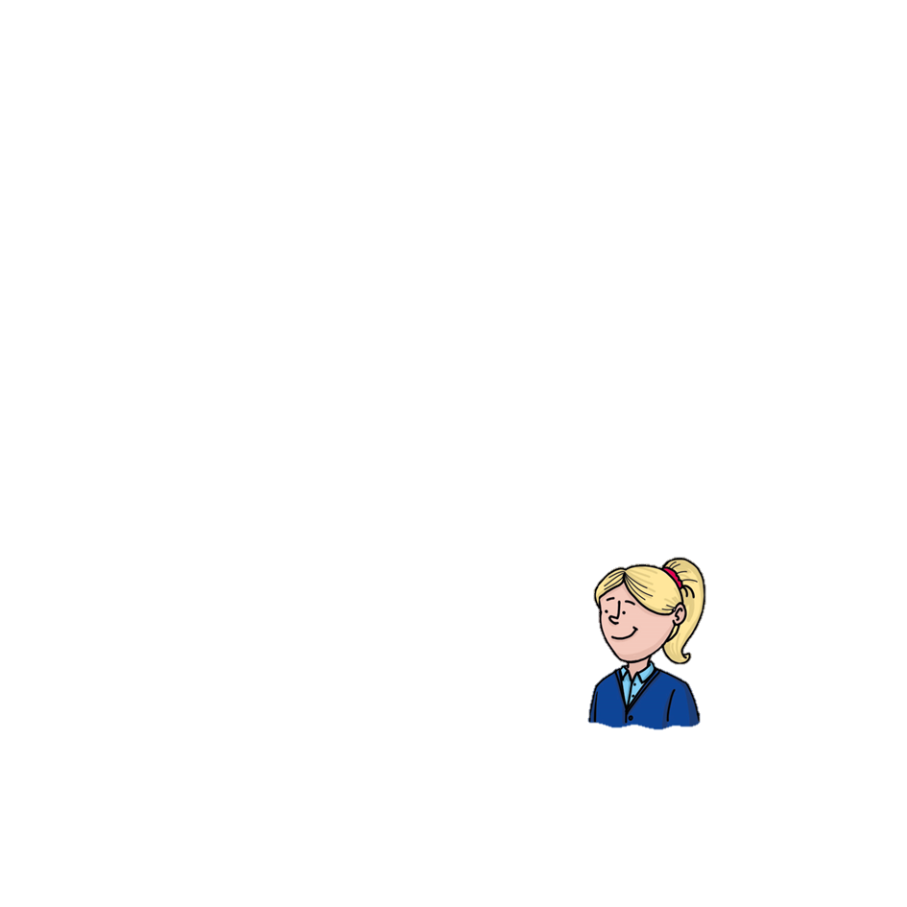




How does our planet compare to other planets?
21st Century Learning Skills
Our Challenge is:
Design a new planet
Insert any other states of being icons for the whole enquiry
Being a Scientist

Slide 3



Chemistry
Earth and Space
Biology
Physics
Plan and Question
Test
Observe and measure
Record and present
Conclude
?
Areas of Study
Skills
Notes:
New enquiry session 1 – discussion of the different substantive concepts and which one will be the focus for this enquiry. Talk through the different historical skills you will also be using.

Slide 4

What is Biology?
About 3.8 years ago, on a planet called Earth, certain molecules combined to form particularly large and intricate structures called organisms. The story of organisms is called biology.
Contexts
Plant Structures & Processes; Classifying Living Things; Human Body: Hormones & Reproduction, evolution & inheritance.
Key concepts:
6
All organisms share a common set of essential life processes
Species arise, change, and become extinct over time
5
Circulatory and Respiratory System. Life cycles and seasonal changes.
Organisms interact with each other and with their environment
4
Classification of animals. Muscular and skeletal system
The human body: Cells, systems, and health. Insects & Plants
3
Genetics maintain continuity plus allow for change
All organisms are classified based on how closely related they are on the tree of life.
2
Living things and their habitats environment; The Human Body & Systems
Animals, Humans & Plants
1
Notes:
New enquiry session 1 – look back at the building blocks of learning explored so far for this substantive concept.

Slide 5
What is Physics?
About 13.8 billion years ago, matter, energy, time and space came into being in what is known as the Big Bang. The story of these fundamental features of our universe is called Physics.
Contexts
Key concepts:
6
Matter and change; chemistry
The universe is made of matter and energy
Some quantities are conserved
5
Chemistry, Astronomy and Force
Waves carry energy
4
Sound & light, Materials, Electricity
3
Forces and magnets
There are four fundamental forces
The universe evolves by means of interactions
The Earth and its place in the solar system & Electricity
2
Magnetism
1
Notes:
New enquiry session 1 – look back at the building blocks of learning explored so far for this substantive concept.

Slide 6
What is Chemistry?
300, 000 years after their appearance matter and energy started to coalesce into complex structures called atoms, which then combined into molecules (13.2 billion years ago). The story of atoms, molecules and their interactions is called Chemistry
Contexts
Key concepts:
6
Chemistry & Matter change
All matter is made of particles
Chemistry is everywhere
5
Chemistry
4
Electricity and Materials
The properties of materials derive from the identity and arrangement of particles
Physics
3
Energy plays a key role in determining the changes that matter can undergo
2
Matter & Properties & Measurements; Electricity
1
Everyday materials & magnetism
Notes:
New enquiry session 1 – look back at the building blocks of learning explored so far for this substantive concept.

Slide 7
What is Earth and Space Science?
4.5 billion years ago a cloud of space dust coalesced to form a star surrounded by a group of planets and other material. The story of this is Earth and Space Science.
The study of the Earth itself is Geography.
Contexts
Key concepts:
6
he Earth is a single system with four dynamically interconnected 'spheres'
The Earth works in cycles
5
Life cycles & Seasonal cycles; Astronomy & Meteorology
All parts of the Earth system are constantly changing
4
3
Rocks; The Water Cycle
Distance/time scales in Earth and space systems vary greatly
Earth is dynamically part of the solar system and beyond
2
The Earth and its place in the solar system
1
Seasonal Changes; Animals & plants
Notes:
New enquiry session 1 – look back at the building blocks of learning explored so far for this substantive concept.

Slide 8
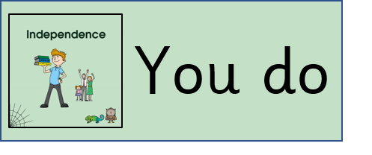


What am I learning?
Why am I learning this?
How will I know when I get there?
We will be working scientifically and developing our skill of testing

Slide 9

I know … I Remember…
I know a cell is…
I remember that cells..
I Wonder... I would like to know…
Notes:
This might be a learning paper / Sticker that is completed independently.

Slide 10
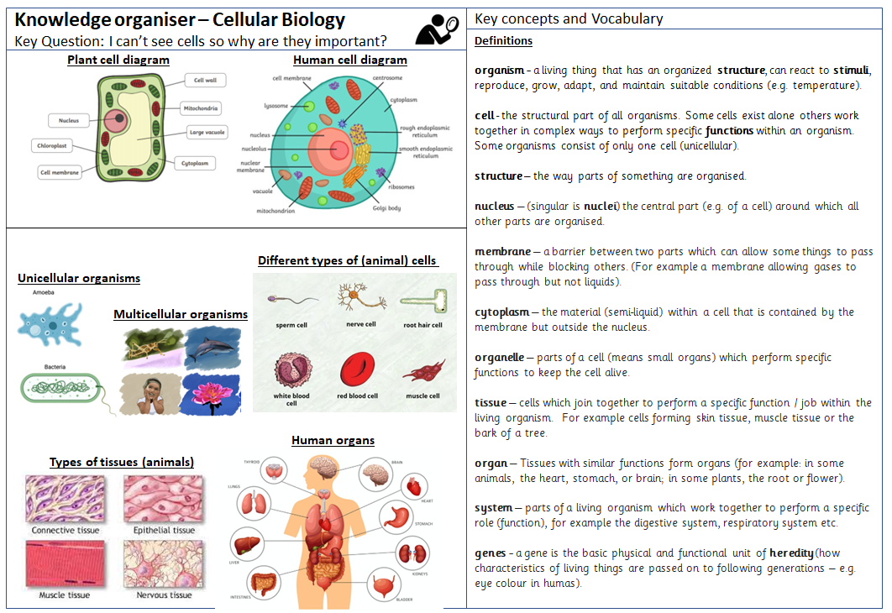
Knowledge organiser- please stick in your Learning Journey. We will add more detail to it this week.
Let’s have a look at the vocabulary and make sure we can read and say all of the new words.
Notes:
It is a good idea to build the KO together over the course of the enquiry either revealing or adding detail a piece at a time

Slide 11
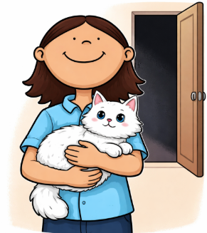

Who do you agree/disagree with and Why?
I will still be able to see the white cat in the dark room
Learner B
You will only be able to see it’s eyes – they shine in the dark.
Learner A
You won’t see anything unless you turn on the light.
Learner C
Notes:
. Learner c is correct but if there is even a small source of light the cat’s eyes will shine.

Slide 12


Who do you agree/disagree with and Why?
The seeds will start to grow if I put them in a dark cupboard.
The amount of light doesn’t make any difference.
Learner B
Learner A
They will start to grow better in the dark.
They will start to grow better under a bright light.
Learner C
Learner D
Notes:
Concept Cartoon example

Slide 13
Fed in Facts
Notes:
Concept Cartoon example

Slide 14
Quick Quiz!
Answer these questions on your whiteboard.
What is a cell?
Write down three things that are made of cells.
Write down the four components of animal cells
that we learnt about.
4. True or false? Cells are the smallest building blocks of life.

Slide 15
Quick Quiz!
What is a cell? Smallest building block of life.
Write down three things that are made of cells. Animals, plants, humans.
Write down the four components of animal cells
that we learnt about. Cell membrane, nucleus, mitochondria, cytoplasm.
4. True or false? Cells are the smallest building blocks of life. True.

Slide 16
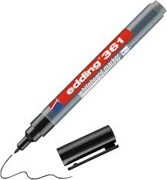
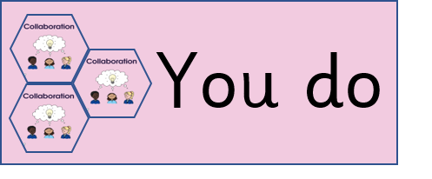
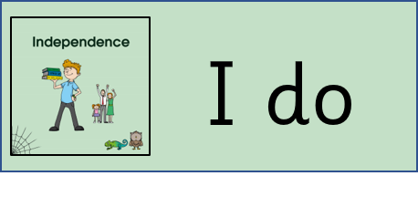

Agree or Disagree
I know … I Remember…
For planning and assessment support this is a fantastic free resource that covers the whole national curriculum: https://www.planassessment.com/
Notes:
Slide icons for use thoughout

Slide 17
Notes for the delivery of Science learning:
Each learning objective or every lesson should be recorded in the Learning journey in some form this might be photos of practical activities.
Please use Knowledge Organisers
Ks1 use whole class KOs
Vocabulary focused with oracy based teaching of the vocabulary
Ks2 individual with space and time to add details built into lessons
Adapted for individual needs (SEN, EAL)
How do we record the discussions that we have? Can we be strategic about how record discussion e.g. typed directly onto the plenary slide
How do we attend to misconceptions – questions at the start of each lesson.
Ensure that working scientifically skills are covered over the year and consider tasks and outcome to achieve this.
I know and I remember slides should be used to activate prior knowledge and can be a useful assessment tool at the start of an Enquiry.
Pick a skill to focus on and have several opportunities for learners to practise use the curriculum documents to support you to do this. There are a lot of ideas that work available.
Consider the outcome writing objectives can be met in short bursts throughout the enquiry so that the big challenge isn’t 3 days of writing.

Slide 18
Working Scientifically Skills by Key Stage
Plan, and Ask Questions
Asking simple questions
Recognise they can be answered in different ways
Test
Perform a simple test
Observe and measure
Observe using simple equipment
Record and present
Use observations to suggest answers to questions Gather and record to help answer a question Sort and classify information
Conclude
Say what you found out
KS1
Plan, and Ask Questions
• Ask relevant questions
• Answer relevant questions
• Select appropriate equipment to help answer
questions/enquiries
Test
• Set up simple fair
tests
Observe and measure
• Make careful
observations
• Take accurate
measurements
• Use a range of
equipment including
thermometers and data
loggers
Record and present
• Collect, record and present results, using bar charts and tables
• Suggest criteria for grouping, sorting and classifying/use a
simple key
• Write a simple scientific report with a plan, method, results
and conclusion
Conclude
• Draw conclusions
• Use scientific language in discussions
• Make predictions
• Look for patterns in results
LKS2
Record and Present
• Collect, record and present results, including the use of line graphs, scatter graphs, bar charts and tables where appropriate
• Suggest criteria for grouping, sorting and classifying/use a simple key
• Write a simple scientific report with a plan, method, results and conclusion
Conclude
• Draw conclusions
• Use scientific language in discussions
• Look and describe patterns in results
• Use patterns to make predictions and design further tests
• Reflect on the reliability of results​​
Plan and Questions
• Ask relevant questions
• Answer relevant questions
• Select appropriate enquiry to help answer questions/equipment
Test ​
• Set up simple fair tests by controlling variables
• Sort evidence into two categories: supporting or disproving a scientific idea
Observe and measure
• Make careful observations
• Take accurate measurements
• Use a range of precise scientific equipment​
UKS2

Slide 19











Being a historian
Being an artist
Being an athlete
Being a writer
Being an engineer
Being a writer
Being a geographer
Being a mathematician
Being a musician
Being a reader
Being a scientist
Being a citizen
Notes:
States of being icons to be included as necessary

