Slide 1
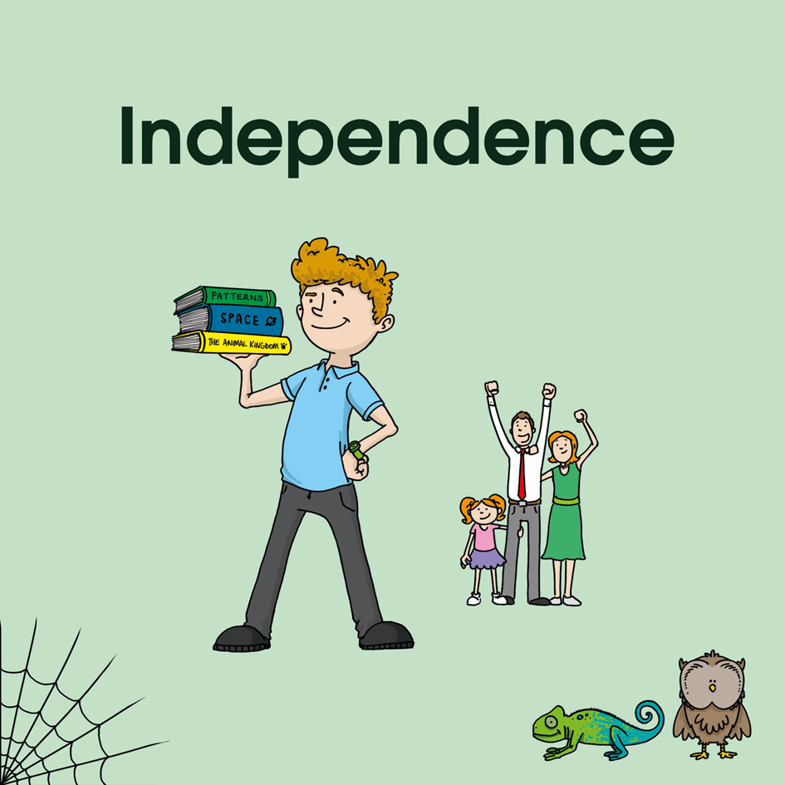









How does our planet compare to other planets?
21st Century Learning Skills
Our Challenge:
Write an information text about a chosen planet.
Being a Scientist

Slide 2
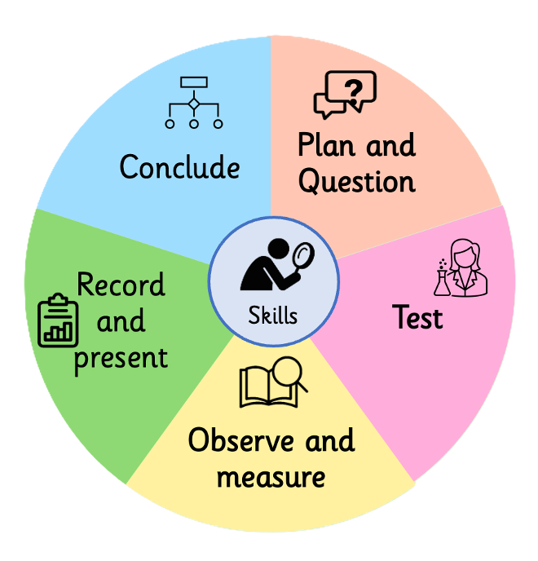
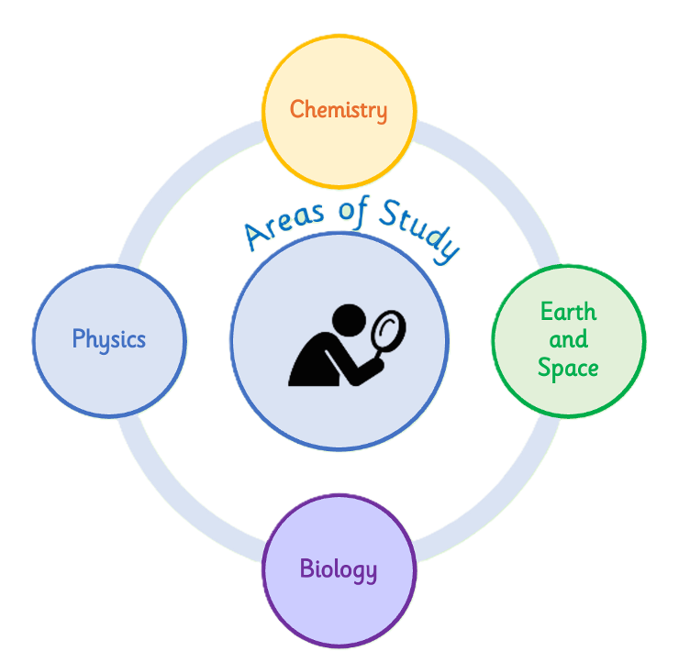

Being a Scientist

Slide 3

What is Earth and Space Science?
4.5 billion years ago a cloud of space dust coalesced to form a star surrounded by a group of planets and other material. The story of this is Earth and Space Science.
The study of the Earth itself is Geography.
Contexts
Key concepts:
6
he Earth is a single system with four dynamically interconnected 'spheres'
The Earth works in cycles
5
Life cycles & Seasonal cycles; Astronomy & Meteorology
All parts of the Earth system are constantly changing
4
3
Rocks; The Water Cycle
Distance/time scales in Earth and space systems vary greatly
Earth is dynamically part of the solar system and beyond
2
The Earth and its place in the solar system
1
Seasonal Changes; Animals & plants
Notes:
New enquiry session 1 – look back at the building blocks of learning explored so far for this substantive concept.

Slide 4
What is Earth and Space Science?
4.5 billion years ago a cloud of space dust coalesced to form a star surrounded by a group of planets and other material. The story of this is Earth and Space Science. The study of the Earth itself is Geography.
Sizes and Distances
3
Day, Night and the Seasons
4
The Universe
1
Astronomy
The Moon
5
2
Our Solar System

Slide 5

How does our planet compare to other planets?
Why am I learning this?
How will I know when I'm successful?
What am I learning?
I am learning to…
This is so…
I will be successful by…
describe the Moon's movement and explain what causes its phases and lunar eclipses
to understand how the Moon orbits Earth and correct common misconceptions about the Moon
describe the phases of the Moon and explain what causes them; explain what a lunar eclipse is; correct the misconception that the Moon is only visible at night

Slide 6

Recap Quiz
What causes day and night on Earth?
→ Earth's rotation on its axis.
What causes the seasons?
→ Earth's tilted axis as it orbits the Sun.
Where does the Sun appear to rise each morning?
→ In the east.

Slide 7
Key Vocabulary
satellite
a body that orbits a planet — the Moon is Earth's natural satellite
phase
the changing shape of the Moon as seen from Earth over the course of a month
eclipse
when one body in space moves into the shadow of another
lunar
relating to the Moon
reflect
the Moon does not produce its own light — it reflects light from the Sun

Slide 8
The moon: Key facts and misconceptions
The Moon is always in the sky — it can be seen during the day as well as at night.
The Moon does not produce its own light — it reflects sunlight.
The Moon orbits Earth once every 27–29 days, causing the phases.
The phases are not caused by Earth's shadow — they are caused by which part of the lit Moon we can see.

Slide 9
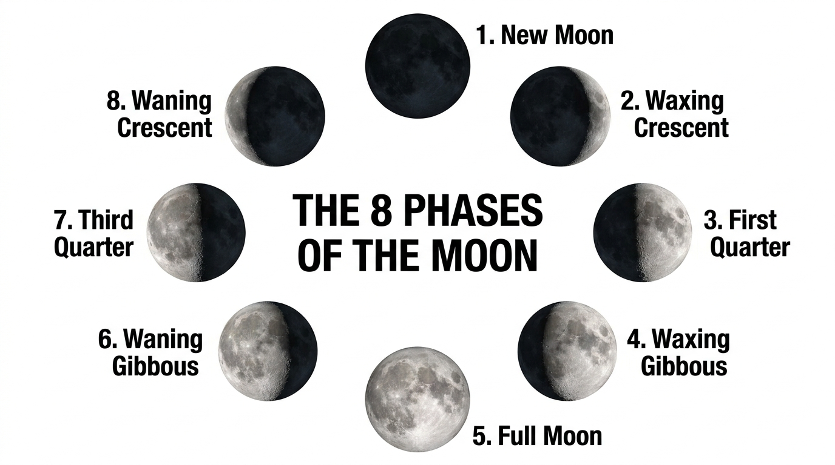
The eight phases of the Moon
Notes:
KEY TEACHING POINTS — talk through the diagram:
1. The Moon orbits Earth every 27–29 days. As it moves, we see different amounts of the lit half — these are the phases.
2. “Waxing” = the lit area is GROWING (right side). “Waning” = the lit area is SHRINKING (left side).
3. MISCONCEPTION: The phases are NOT caused by Earth’s shadow — that only happens during a lunar eclipse (see next slide). The phases are caused by which part of the Moon’s sunlit half we can see from Earth.
4. Walk through each phase: 1 New Moon → 2 Waxing Crescent → 3 First Quarter → 4 Waxing Gibbous → 5 Full Moon → 6 Waning Gibbous → 7 Third Quarter → 8 Waning Crescent.
Questions to ask: “What comes after the Full Moon?” (Waning Gibbous). “Why can’t we see the New Moon?” (dark side faces us). “What causes a First Quarter?” (Moon is 90° from the Sun in its orbit).

Slide 10
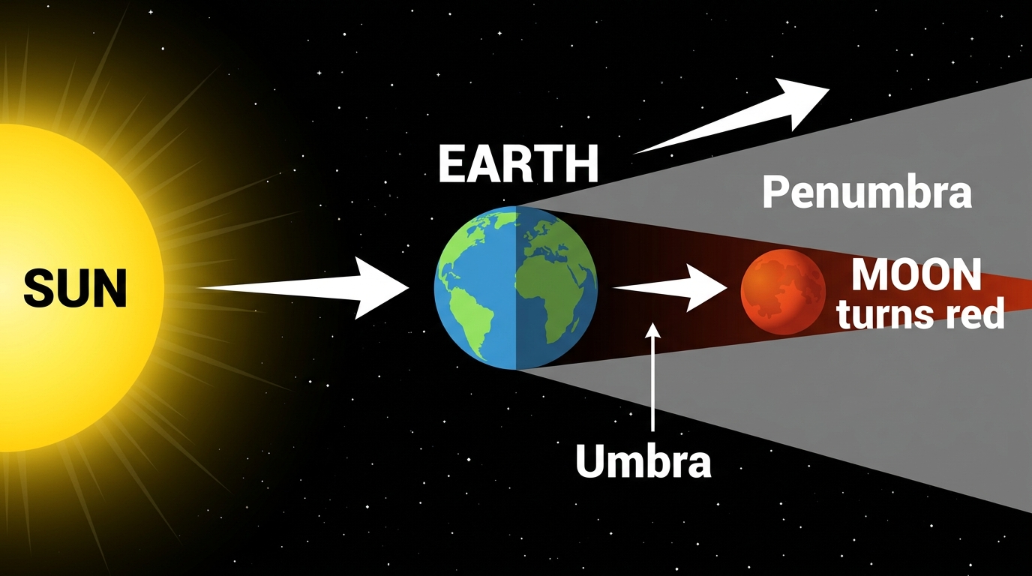
What is a lunar eclipse?
A lunar eclipse happens when Earth passes directly between the Sun and the Moon, casting its shadow on the Moon.
Earth’s shadow has two parts: the umbra (full shadow) and the penumbra (partial shadow).
During a total lunar eclipse the Moon turns red because Earth’s atmosphere bends red light onto it — this is called a Blood Moon.

Slide 11
The Moon investigation
Draw and label the eight phases of the Moon in order.
Explain in your own words what causes a lunar eclipse.
Challenge: Explain why the Moon appears to change shape — and what some people might think it IS caused by.

