Slide 1


How does a writer make a reader feel characters’ emotions?
Write a powerful narrative and survival guide inspired by Varjak Paw.
To Entertain
Other Y4 learners
Monday AM

Slide 2
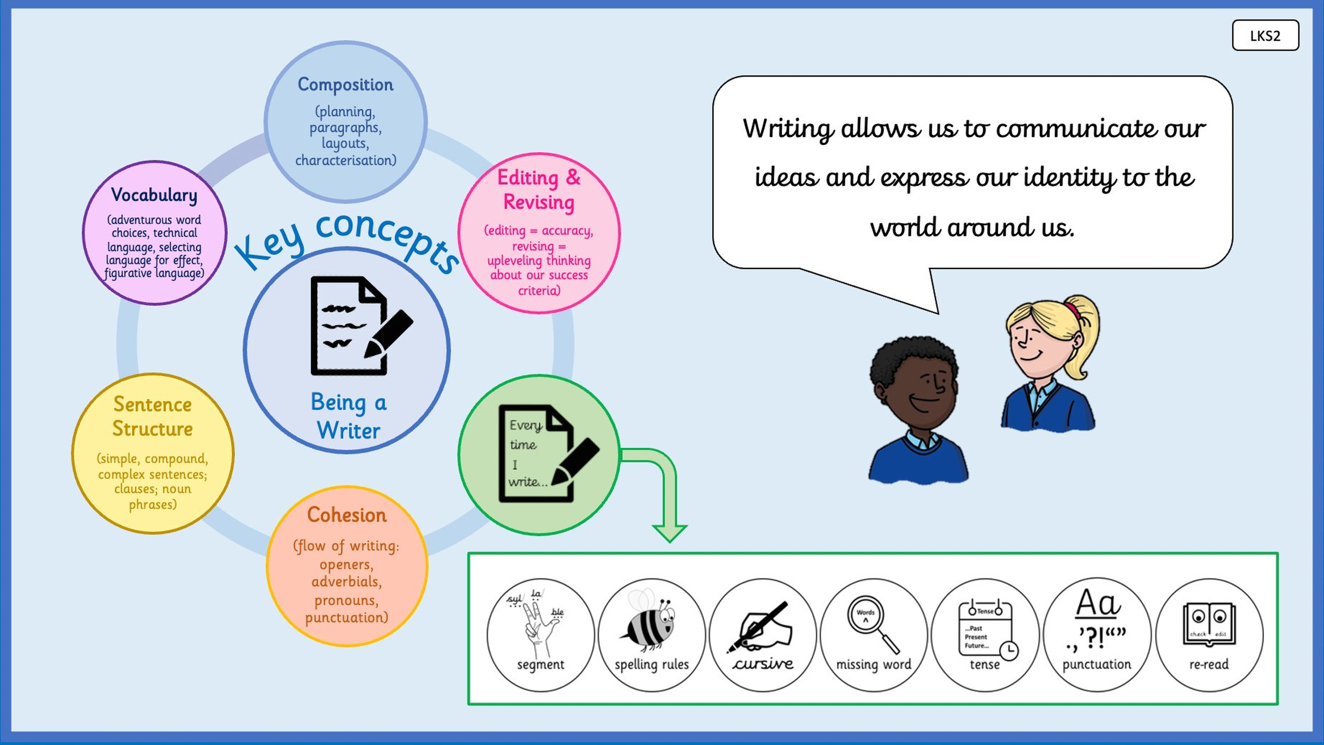

Slide 3
How does a writer make a reader feel characters’ emotions?
understand what an explanation text is and how it differs from a narrative
This is so I know the features I need to include when I plan and write this week.
reading the model text and identifying what the writer does differently to a story writer.

Slide 4
Grammar Warm-Up
Story, instructions or explanation? Decide which genre each extract belongs to.
Extract A
Extract B
Extract C
Varjak crept forward.
His paws made no sound.
The darkness pressed around him.
Which genre?
First, find a safe shadow.
Next, press your body low.
Then wait until the danger passes.
Which genre?
Slow-Time works by calming
the mind. As a result, danger
seems to move more slowly.
Which genre?

Slide 5
Back to Varjak’s world.
Remember Jalal and the Seven Skills of the Way of Jalal.
Re-read the sections where Jalal teaches each skill.
Think about this:
• Who needs to know this information?
• Why would a house cat new to the city need it?
• What is the most important thing they should understand?
Talk to your partner. Which skill do you think matters most?

Slide 6
A new kind of writing.
We have spent two weeks writing a narrative.
This week we are writing an explanation text.
An explanation text:
• tells you HOW and WHY something works
• is written in the present tense
• uses a formal, clear register
• has subheadings to organise sections
• links ideas using causal connectives
A story shows events. An explanation explains processes.

Slide 7
Reading the model text.
What the writer does
Look for this in our model
Starts with a rhetorical question
Uses a subheading for each skill
Explains how and why in present tense
Uses connectives to show cause and effect
Ends with a conclusion
“Have you ever imagined leaving
the safety of your home…”
“Open Mind” “Awareness” “Hunting”
“By calming your mind…
everything seems to move…”
“Therefore” “As a result” “Due to”
“However, by using the seven skills…”
→

Slide 8
Read the model text together.
Discuss these three questions:
1. Why does the writer open with a question instead of a statement?
What effect does this have on the reader?
2. Pick one skill section. How does the writer show both
WHAT the skill is AND WHY it helps?
3. What is different about reading this compared to reading
the chapters from Varjak Paw?
Be ready to share your best point with the class.

Slide 9
What was the trickiest difference to spot between a narrative and an explanation text?
Why does an explanation text use the present tense instead of the past tense?
Which part of the model text would you most like to try in your own writing?

Slide 10
How does a writer make a reader feel characters’ emotions?
Write a powerful narrative and survival guide inspired by Varjak Paw.
To Entertain
Other Y4 learners
Monday PM

Slide 12
How does a writer make a reader feel characters’ emotions?
identify the key features of an explanation text and use them to build a boxing-up grid
This is so I know exactly what to include when I write my own explanation text.
annotating the model text and completing the first row of the boxing-up grid together.

Slide 13
Grammar Warm-Up
Explanation text feature or not? Sort each item into the correct column.
Item 1
Item 2
Item 3
Written in the past tense
“He crept through the shadows”
Explanation text feature?
Yes or No?
Causal connective
“As a result, the cat can
escape undetected.”
Explanation text feature?
Yes or No?
Rhetorical question as a hook
“Have you ever wondered how
a cat survives the city?”
Explanation text feature?
Yes or No?

Slide 14
The rhetorical question.
“Have you ever imagined leaving the safety of your home
and stepping into the city for the very first time?”
Why does the writer start with a question?
• It pulls the reader in immediately.
• It makes the reader think from a cat’s point of view.
• It sets up the problem the text will explain how to solve.
You do not answer it straight away.
You make the reader want to read on.

Slide 15
Subheadings and register.
Each skill section has a one-word subheading.
What does the subheading do?
• It tells the reader exactly what the section is about.
• It makes the text easy to navigate.
What is the register of the writing?
• Formal but not cold.
• Third person — not ‘you should’ (that is instructions), not ‘I did’ (that is recount).
• Present tense throughout.
Find a sentence in the model text that shows this clearly.

Slide 16
How the connectives work.
Find these connectives in the model text:
therefore • as a result • due to
since • in that event • when this happens
For each one, ask:
1. What cause does it follow?
2. What effect does it introduce?
Notice: they do not all go in the same position in the sentence.
Some start the sentence. Some appear in the middle.
That variety is what makes the writing feel controlled, not mechanical.

Slide 17
Building the boxing-up grid.
Introduction
Each skill section
Rhetorical question
to hook the reader
One or two sentences:
who needs this? why?
Subheading (skill name)
What the skill is
How it works
What happens as a result
Conclusion: link all skills together
→

Slide 18
With your partner, annotate your copy of the model text.
Use three different colours or symbols:
● Mark the rhetorical question and introduction
● Mark every subheading
● Underline every causal connective you find
Then complete the boxing-up grid together for the
Open Mind and Awareness sections.
What goes in each box?
What does the skill is / how it works / what happens as a result?

Slide 19
Which explanation text feature did you find hardest to spot in the model text?
Why does the writer use a formal register rather than a chatty, friendly voice?
Looking at the boxing-up grid, which section of the model text do you think is the strongest? Why?

Slide 20
How does a writer make a reader feel characters’ emotions?
Write a powerful narrative and survival guide inspired by Varjak Paw.
To Entertain
Other Y4 learners
Wednesday AM

Slide 22
How does a writer make a reader feel characters’ emotions?
use causal connectives and fronted adverbials to explain how and why something happens
This is so my explanation text shows the link between cause and effect, not just what things are.
writing two or three sentences using at least two different connectives from the connective bank.

Slide 23
Grammar Warm-Up
Which connective fits? Choose the best word or phrase to complete each sentence.
Sentence 1
Sentence 2
Sentence 3
The cat keeps moving.
__________, enemies cannot
surround it.
therefore / however / suddenly
__________ staying silent,
the cat travels unnoticed
through the city.
By / Although / When
Danger can appear at any moment.
__________, you must pay
attention at all times.
As a result / Despite / Until

Slide 24
What is a causal connective?
A causal connective shows a link between CAUSE and EFFECT.
Cause: Slow-Time calms the mind.
Effect: Everything seems to move more slowly.
We join them with a connective:
“By calming your mind, everything seems to move more slowly.”
“As a result, you will have more time to dodge attacks.”
“Therefore, a skilled hunter waits for the perfect moment.”
Find two more examples of cause and effect in the model text.

Slide 25
The connective bank.
Mid-sentence connectives
Fronted adverbials
therefore
so
which means
which is why
As a result, ...
Due to this, ...
Because of this, ...
By [doing this], ...
When this happens, ...
→

Slide 26
The same idea, three ways.
The idea
Three versions
Skill: Moving Circles
Cause:
The cat keeps moving
in all directions.
Effect:
Enemies cannot
surround it.
The cat keeps moving, so enemies
cannot surround it.
As a result, it is much harder
for enemies to close in.
By staying in constant motion,
the cat makes itself a
difficult target.
→

Slide 27
Choose one skill from the Seven Skills of the Way of Jalal.
Write the cause and the effect in your own words.
Then write the same idea THREE times,
each time using a different connective from the bank:
Version 1: use a mid-sentence connective (therefore, so, which means)
Version 2: use a fronted adverbial (As a result, / Due to this, /
Because of this, ...)
Version 3: use a By + -ing fronted adverbial
Share your three versions. Which do you think sounds the strongest?

Slide 28
Now choose another skill.
Pick a different skill from the Seven Skills.
Write two or three sentences about it.
Use at least two different connectives from the bank.
Do not use the same connective twice.
Check:
• Does your sentence explain HOW or WHY the skill works?
• Is the present tense used throughout?
• Is the register formal?

Slide 29
Which connective did you find hardest to use naturally? What made it tricky?
What is the difference between a causal connective and a time connective? Give an example of each.
Which version of your three sentences do you think was the strongest? Why?

Slide 30
How does a writer make a reader feel characters’ emotions?
Write a powerful narrative and survival guide inspired by Varjak Paw.
To Entertain
Other Y4 learners
Thursday AM

Slide 32
How does a writer make a reader feel characters’ emotions?
plan an explanation text by choosing skills and organising information in a boxing-up grid
This is so my draft is focused and well-structured before I start writing.
completing a boxing-up grid with a chosen introduction, three or four skill sections and a conclusion.

Slide 33
Grammar Warm-Up
Odd one out. Which item in each group does NOT belong in an explanation text?
Group 1
Group 2
Group 3
A) A rhetorical question
B) A subheading
C) A time connective:
‘The next morning…’
Which is the odd one out?
A) Present tense verbs
B) Third person writing
C) A character’s feelings:
‘He felt afraid.’
Which is the odd one out?
A) ‘As a result,’
B) ‘Therefore,’
C) ‘Suddenly,’
Which is the odd one out?

Slide 34
Choosing your three or four skills.
You are writing for a house cat who has never left home.
They are stepping into the city for the first time.
Think carefully:
• Which skills keep a cat safe from the very start?
• Which skills would be hardest to learn without guidance?
• Which skills have the most interesting HOW and WHY to explain?
Talk to your partner. Choose three or four skills.
Be ready to explain WHY you chose those particular ones.

Slide 35
Building the boxing-up grid.
What I need in each box
Model: Open Mind
Introduction
• Rhetorical question
• 1–2 framing sentences
Skill section (x3 or x4)
• Subheading
• What the skill is
• How it works
• What happens as a result
Conclusion
• Link skills together
• Final message to the reader
Subheading: Open Mind
What it is: being ready to
change your plan
How it works: look at problems
in different ways
As a result: find solutions,
avoid danger
→

Slide 36
Planning together.
Let’s plan the Awareness section as a class.
Subheading: Awareness
What is the skill?
The city is full of sights, sounds and smells.
A cat must pay attention to everything around it.
How does it work?
Listen carefully, watch closely, trust your senses.
What happens as a result?
Spot trouble before it reaches you.
Now: how would you write the ‘how it works’ sentence using a connective?

Slide 37
Complete your boxing-up grid.
Fill in your boxing-up grid independently.
For each chosen skill, complete all four rows:
• Subheading
• What the skill is
• How it works
• What happens as a result
Do not write full sentences yet.
Notes and key words are enough.
When you have finished, discuss your plan with a partner.
Check: does each section explain both HOW and WHY?

Slide 38
Was it hard to choose which skills to include? What helped you decide?
Why is it important to include both HOW and WHY in each section, not just WHAT the skill is?
Looking at your plan, which section do you think will be the strongest in your draft?

Slide 39
How does a writer make a reader feel characters’ emotions?
Write a powerful narrative and survival guide inspired by Varjak Paw.
To Entertain
Other Y4 learners
Thursday AM

Slide 41
How does a writer make a reader feel characters’ emotions?
write a complete explanation text using the features and structure we have planned
This is so I produce a piece of writing that genuinely explains how the Way of Jalal works.
completing a full draft including introduction, all chosen skill sections and a conclusion.

Slide 42
Grammar Warm-Up
True or false? Decide whether each statement about explanation texts is correct.
Statement 1
Statement 2
Statement 3
An explanation text is
written in the past tense
because it describes things
that already happened.
True or False?
A rhetorical question at
the start of an explanation
text does not need an
answer in the text.
True or False?
Causal connectives show
the link between why
something is done and
what effect it has.
True or False?

Slide 43
Before we write: the checklist.
As you draft today, keep these in mind:
• Rhetorical question to open
• Subheading for each skill section
• Present tense throughout
• Formal register (not chatty, not instructions)
• Each section explains WHAT, HOW and WHY
• At least three different connectives across the piece
• Conclusion that links the skills together
Use the model text and your boxing-up grid.
Your draft should be complete by the end of today’s session.

Slide 44
Modelling the introduction.
My thinking
Model introduction
I need a rhetorical question
that makes the reader
imagine being a house cat.
Then a framing sentence:
what is this text about?
Then a purpose statement:
what will I explain?
Have you ever imagined stepping
outside the safety of your home
for the very first time?
The city is full of dangers that
a house cat has never faced.
Fortunately, the ancient Way of
Jalal teaches skills that can
help any cat survive.
→

Slide 45
Modelling a skill section.
My thinking
Shadow-Walking
Subheading: one word,
the name of the skill.
Sentence 1: what is it?
Sentence 2: how does it work?
Sentence 3: what happens
as a result?
Use a different connective
each time.
There are times when fighting
is not the best choice.
By staying silent and moving
through dark places, a cat can
travel completely unnoticed.
In this way, it can escape
trouble without anyone knowing
it was ever there.
→

Slide 46
Draft your explanation text.
Write your complete explanation text.
Work through your boxing-up grid:
1. Introduction (rhetorical question + framing)
2. Each skill section (subheading, what / how / why)
3. Conclusion (link skills together)
Keep your model text and plan visible as you write.
Your draft must be complete before the end of the session.

Slide 47
Which part of the draft was hardest to write? What made it tricky?
Did you manage to explain both HOW and WHY in every section? If not, which section needs more work?
Read back your introduction. Does the rhetorical question make a reader want to continue?

Slide 48
How does a writer make a reader feel characters’ emotions?
Write a powerful narrative and survival guide inspired by Varjak Paw.
To Entertain
Other Y4 learners
Friday AM

Slide 50
How does a writer make a reader feel characters’ emotions?
edit and improve an explanation text using a checklist, then share the finished piece
This is so my final piece is accurate, well-structured and shows everything I have learned this week.
using the editing checklist to improve your draft, then reading your writing aloud to a partner or the class.

Slide 51
Grammar Warm-Up
Spot the mistake. Each explanation text extract contains one error. Find it and fix it.
Extract 1
Extract 2
Extract 3
Open Mind meant that a cat
must be ready to change its
plan. Therefore, it found
solutions more easily.
What is wrong here?
By moving in circles, the cat
keep moving in all directions.
As a result, enemies cannot
surround it.
What is wrong here?
Awareness is important.
Awareness also helps.
Therefore awareness lets you
spot danger. Awareness saves you.
What is wrong here?

Slide 52
The editing checklist.
Read your draft aloud quietly to yourself.
Then check each point below:
• Does the rhetorical question open the piece?
• Is the present tense used consistently throughout?
• Does each skill section explain WHAT, HOW and WHY?
• Have you used at least three different connectives?
• Is the register formal? (No chatty phrases or ‘you should’)
• Does the conclusion link the skills together?
Make corrections in a different colour.
Aim to improve at least two things before the partner share.

Slide 53
Editing a section together.
First draft
Edited version
Hunting
Finding food is important.
You need to move quietly
and patiently. You should
wait for the right moment
before you strike.
What needs improving?
Hunting
Finding food is essential for
survival. A skilled hunter
moves quietly and patiently,
waiting for the perfect moment.
As a result, the prey has no
warning before it is caught.
→

Slide 54
Peer reading.
Swap drafts with your partner.
Read their explanation text carefully.
Give two specific pieces of feedback:
● One strength: what does their text do well?
Be specific — quote the sentence or connective.
● One suggestion: where could they explain HOW or WHY
more clearly, or use a different connective?
Then make any final improvements to your own draft.

Slide 55
Sharing our writing.
Two or three writers will read their explanation text aloud.
As you listen, think about:
• Which rhetorical question was the most effective?
• Which skill section explained HOW and WHY most clearly?
• Which connective use sounded the most natural?
Return to the key question:
How does a writer make a reader feel characters’ emotions?
How does the explanation text answer this question in a different way
to the narrative you wrote in weeks one and two?

Slide 56
What is the most important thing you changed when you edited your draft?
How is explaining something in writing different from just describing it?
Looking at both your narrative and your explanation text, which do you think shows your best writing this term?

