Slide 1
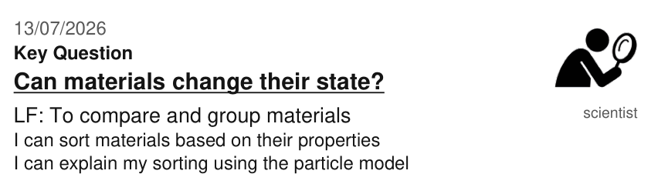
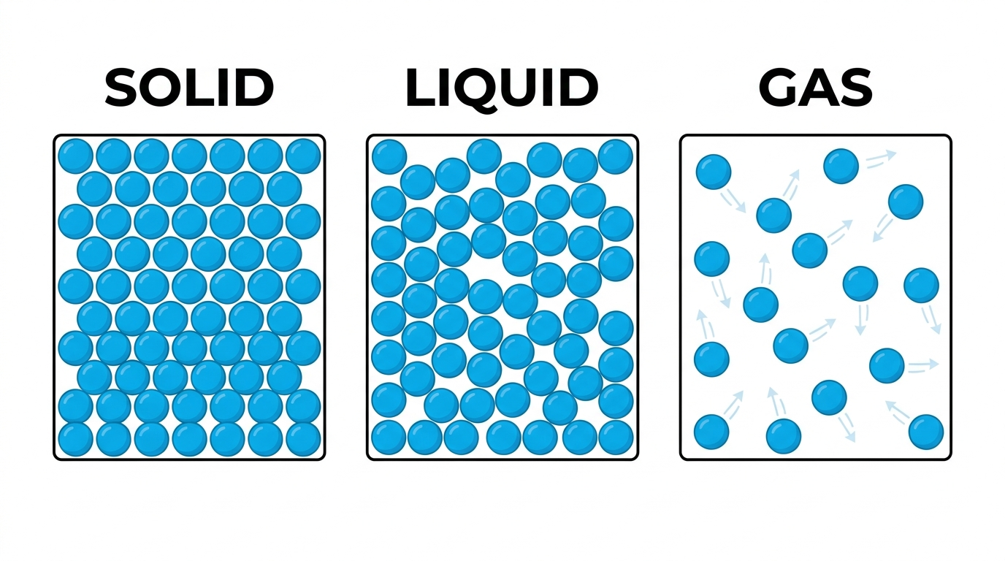
Part A Sort the materials
Sort each material into solid, liquid or gas. Write one reason for each, using the particle model below to help you.
Material
State?
Reason (use the particle model)
Ice
Water
Steam (water vapour)
Wood
Sand
Milk
Balloon (filled with air)
Honey
Part B Challenge
Can you find one material that is difficult to classify? Why?
Word bank: solid • liquid • gas • particles • closely packed • slide past • spread out • fixed shape • flows

Slide 2
Marking Station
Part A Answers
Material
State?
Reason (use the particle model)
Ice
Solid
Particles packed tightly in a fixed arrangement, so ice keeps its shape.
Water
Liquid
Particles are close but can slide past each other, so water flows and takes the shape of its container.
Steam (water vapour)
Gas
Particles move quickly and are spread far apart, so steam fills the space available.
Wood
Solid
Particles are fixed in place, so wood keeps its shape and does not flow.
Sand
Solid (tricky!)
Each grain is a solid with its own fixed shape, but lots of grains together can pour like a liquid.
Milk
Liquid
Particles slide past each other, so milk flows and takes the shape of its container.
Balloon (filled with air)
Gas
The air particles inside move quickly and spread out to fill the balloon.
Honey
Liquid (tricky!)
Honey flows very slowly, but it is still a liquid because it takes the shape of its container.
Part B Challenge - model answer
Sand and honey are the best examples.
Sand: a single grain is a solid with its own fixed shape, but a big pile of grains can be poured and takes the shape of its container - a bit like a liquid.
Honey: it is a liquid because it takes the shape of its container, but it flows so slowly it can look almost solid.

