Slide 1
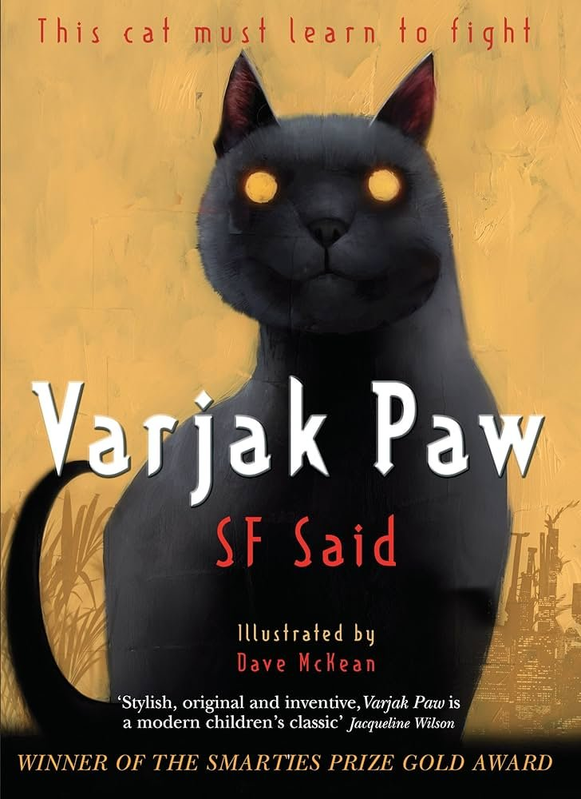

How does a writer make a reader feel characters’ emotions?
Write a powerful narrative and survival guide inspired by Varjak Paw.
To Entertain
Other Y4 learners
Monday AM

Slide 2
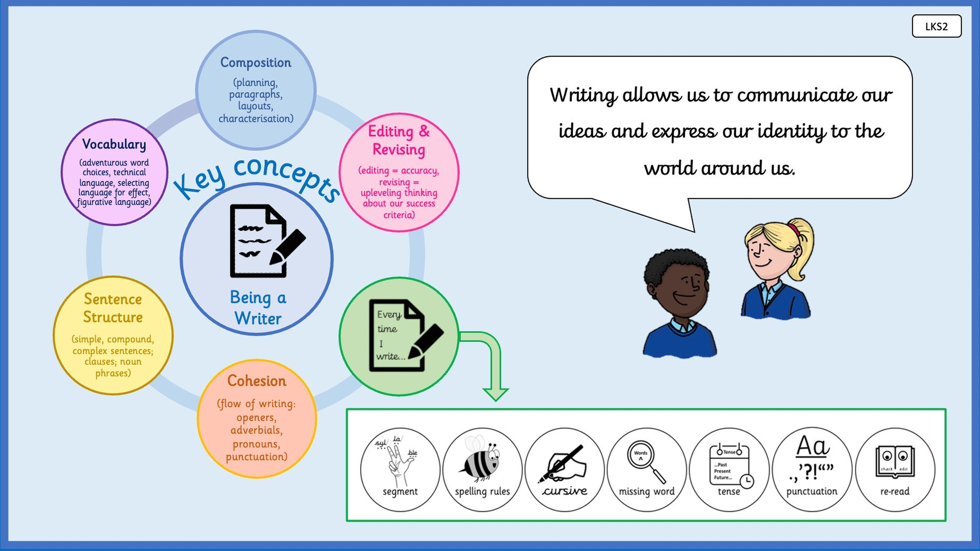

Slide 3
How does a writer make a reader feel characters’ emotions?
use similes and alliteration to make my descriptions more powerful
Figurative language helps readers picture a place and feel its mood, making descriptions come alive on the page.
writing at least three similes and three alliterative phrases that describe the city at night.

Slide 4
Grammar Warm-Up
Which technique? Identify the figurative language in each sentence.
Sentence A
Sentence B
Sentence C
The alleyway was as cold as a grave.
Simile or alliteration?
Dark shadows shifted and slid silently past.
Simile or alliteration?
The streetlamp glowed like a tiny captured sun.
Simile or alliteration?

Slide 5
Reading like a writer
S. F. Said writes the city through Varjak’s eyes.
Everything is new, strange and a little frightening.
As you listen to this passage, think:
• Can you spot any figurative language?
• What is the effect on the reader?
• How does the writer make the city feel alive?

Slide 6
[ INSERT BOOK SPREAD: Display a short passage from Varjak Paw that contains similes or alliteration ]
Display the double-page spread: Display a short passage from Varjak Paw that contains similes or alliteration

Slide 7
Simile
What is it?
Why use it?
A simile compares one thing to another
using the words like or as.
cars roared past like angry beasts
the street was as wide as a river
The comparison must make sense and
add something to the picture.
Similes help readers picture
something unfamiliar by linking it
to something they already know.
For Varjak, everything in the city
is new. A simile lets us see it
through his eyes for the first time.
→

Slide 8
Alliteration
What is it?
Why use it?
Alliteration repeats the same consonant
sound at the start of nearby words.
cracked concrete
shadows that shifted and slid
The repeated sound must be at the
start of the word, not in the middle.
Alliteration creates a rhythm and
draws attention to a moment or image.
It can make a sound feel louder
or a movement feel smoother.
Use it sparingly so it has impact.
→

Slide 9
Build your own figurative language.
Write three similes describing the city at night.
Write three alliterative phrases describing the city at night.
Think about:
• What does Varjak see, hear or smell?
• What would he compare it to?
• Which consonant sounds suit the mood?
The best examples will go straight onto the working wall.
Challenge: Write one sentence that contains both a simile AND alliteration.

Slide 10
Share and add to the working wall.
Listen to a few examples.
For each one, ask:
• Does the simile make you picture something more clearly?
• Does the alliteration create a sound or rhythm?
• Could we use this in our narrative?
Add the best examples to the working wall under
the right category: sights, sounds, smells or feelings.

Slide 11
Which of your similes are you most pleased with, and why?
How does alliteration change the way a sentence sounds when you read it aloud?
Which technique do you think you will use most in your narrative?

Slide 12
How does a writer make a reader feel characters’ emotions?
Write a powerful narrative and survival guide inspired by Varjak Paw.
To Entertain
Other Y4 learners
Monday PM

Slide 14
How does a writer make a reader feel characters’ emotions?
use hyperbole and the power of three to make my writing more powerful
Deliberate exaggeration and grouped descriptions help readers feel the full force of a moment in a narrative.
writing a hyperbolic sentence about Varjak’s panic and a power-of-three sentence about what he experiences.

Slide 15
Grammar Warm-Up
Fix it. Each power of three below has a problem. Rewrite to fix it.
A
B
C
He could see the cars, the lights, the tall.
Fix the third item.
The city was loud, cold and it smelled bad.
Fix so all three items match the pattern.
Varjak felt afraid, confused, the darkness.
Fix the third item so it fits.

Slide 16
Recap from this morning
Look at the working wall.
Find three similes and three alliterative phrases
we added this morning.
Which ones would work best
in the middle section of a narrative?
Today, we are adding two more techniques
to our toolkit: hyperbole and the power of three.

Slide 17
Hyperbole
What is it?
When does it work?
Hyperbole is deliberate exaggeration
to express very strong feeling.
his heart was beating a thousand times a second
the sound was loud enough to wake the dead
We know these are not literally true.
That is the point.
Hyperbole works when a feeling
is so big that ordinary words
are not enough.
Use it for moments of panic,
wonder or relief.
Use it too often and the effect
disappears. Once or twice,
precisely placed, is enough.
→

Slide 18
The power of three
What is it?
Why does it work?
Listing three things in a row
creates a cumulative effect.
He could see the cars,
the lights, the towering buildings.
the cold, dark, endless street
Three feels complete.
Two feels unfinished.
Four feels like too many.
Three items build a rhythm.
The reader feels the weight
of each one.
You can list three nouns,
three adjectives or three actions.
The items should match in form
so the rhythm feels right.
→

Slide 19
Apply both techniques.
1. Write a hyperbolic sentence about
Varjak’s panic when something scares him.
2. Write a power-of-three sentence
describing what Varjak sees, hears
or smells in the city.
Think about where in your narrative
these sentences might fit.
Challenge: Write a single sentence that uses the power of three inside a hyperbolic idea.

Slide 20
What is the difference between hyperbole and an ordinary description of fear?
Why does the power of three feel more satisfying than a list of two or four?
Which of your sentences today do you want to use in your final narrative?

Slide 21
How does a writer make a reader feel characters’ emotions?
Write a powerful narrative and survival guide inspired by Varjak Paw.
To Entertain
Other Y4 learners
Wednesday AM

Slide 23
How does a writer make a reader feel characters’ emotions?
write fronted adverbials to vary the way I start my sentences
Starting sentences in different ways keeps the reader engaged and gives my writing a more varied and controlled rhythm.
rewriting three sentences from my earlier writing using three different types of fronted adverbial.

Slide 24
Grammar Warm-Up
Where does the comma go? Write the sentence with the comma in the right place.
Sentence A
Sentence B
Sentence C
After what felt like hours Varjak crept
to the bottom of the steps.
Where does the comma go?
Trembling with cold he pressed himself
against the wall.
Where does the comma go?
Beneath the rusting fire escape a shadow moved.
Where does the comma go?

Slide 25
A problem with our sentences
Read these three sentences from earlier in the week:
He crept forward.
He heard a sound above.
He stopped and looked up.
What do you notice about how
each one starts?
How could we make them more varied?

Slide 26
Three types of fronted adverbial
The three types
The rule
Time — When did it happen?
After what felt like hours, ...
Before he could move, ...
Place — Where did it happen?
Beneath the rusting fire escape, ...
At the end of the alleyway, ...
Manner — How did it happen?
Trembling with cold, ...
Moving as quietly as he could, ...
A fronted adverbial comes
at the start of the sentence.
It is always followed by a comma.
The subject comes after the comma.
Trembling with cold,
Varjak pressed himself against the wall.
The comma separates the adverbial
from the main clause.
→

Slide 27
Let’s rewrite together.
Take this sentence:
Varjak crept forward.
Rewrite it three times using:
• a time fronted adverbial
• a place fronted adverbial
• a manner fronted adverbial
Which version changes the mood of the sentence most?

Slide 28
Rewrite your own sentences.
Choose three sentences from your
Lesson 5 cold task writing.
Rewrite each one using a different
type of fronted adverbial:
1. one with a time adverbial
2. one with a place adverbial
3. one with a manner adverbial
Remember the comma after the fronted adverbial.
Challenge: Write a sentence that uses a fronted adverbial and also contains a simile or alliteration from Monday.

Slide 29
Share and discuss.
Listen to a few examples.
For each one, decide:
• What type of fronted adverbial is it?
• Is the comma in the right place?
• Does it change the mood or pace of the sentence?
Which type of fronted adverbial works best
for moments of fear or tension in the narrative?

Slide 30
Which type of fronted adverbial did you find most useful for your narrative today?
Why is the comma after a fronted adverbial important for the reader?
Which sentence you rewrote today do you think is the strongest, and why?

Slide 31
How does a writer make a reader feel characters’ emotions?
Write a powerful narrative and survival guide inspired by Varjak Paw.
To Entertain
Other Y4 learners
Thursday AM

Slide 33
How does a writer make a reader feel characters’ emotions?
use subordinating conjunctions to write complex sentences
Complex sentences let me join two ideas together in a way that shows how they connect, making my writing more controlled.
writing three paired complex sentences about scenes from Varjak’s first night, each using a different conjunction.

Slide 34
Grammar Warm-Up
True or false? Decide whether each is a complex sentence and explain why.
Sentence A
Sentence B
Sentence C
Varjak crept forward and stopped at the corner.
Complex sentence? True or false?
Although it was dangerous,
Varjak crept out of the doorway.
Complex sentence? True or false?
He was afraid.
Complex sentence? True or false?

Slide 35
Recap: types of sentence
A simple sentence has one main clause.
Varjak crept forward.
A compound sentence joins two main clauses with and, but, or, so.
Varjak crept forward but he could not see anything.
A complex sentence has a main clause and a subordinate clause,
joined by a subordinating conjunction.
Although it was dark, Varjak crept forward.
What makes a subordinate clause different from a main clause?

Slide 36
Subordinating conjunctions
Words to use
The comma rule
as while
before after
until although
since even though
though because
whenever unless
These introduce the subordinate clause.
The subordinate clause cannot
stand alone as a sentence.
If the subordinate clause comes first,
use a comma after it:
Although it was dangerous,
Varjak crept out of the doorway.
If the main clause comes first,
no comma is needed:
Varjak crept out of the doorway
although it was dangerous.
→

Slide 37
Paired sentences
Here is one idea written two ways:
Although it was dangerous, Varjak crept out of the doorway.
Varjak crept out of the doorway, although it was dangerous.
Which changes the emphasis?
Which builds more tension?
Now try together:
Varjak heard a sound. He did not run away.
Can we rewrite this as one complex sentence,
two different ways?

Slide 38
Write three pairs of complex sentences.
Each pair should be about a different scene
from Varjak’s first night outside.
For each pair:
• Write the sentence with the subordinate clause first
• Write the same sentence with the main clause first
• Use a different conjunction for each pair
Then decide: which version of each pair
works better in the narrative, and why?
Be ready to share your best pair.

Slide 39
Share and discuss.
Listen to a few pairs.
For each one, decide:
• Which version builds more tension?
• Is the comma in the right place?
• Which conjunction works best for that moment?
Which conjunction do you think
you will use most in your narrative?

Slide 40
What is the difference between a coordinating conjunction and a subordinating conjunction?
When does placing the subordinate clause first create more tension in a narrative?
Which of your paired sentences do you want to use in your final write, and why?

Slide 41
How does a writer make a reader feel characters’ emotions?
Write a powerful narrative and survival guide inspired by Varjak Paw.
To Entertain
Other Y4 learners
Thursday AM

Slide 43
How does a writer make a reader feel characters’ emotions?
punctuate direct speech accurately in my writing
Speech punctuation helps the reader follow who is talking and makes dialogue feel purposeful and controlled.
punctuating a prepared exchange and writing my own short dialogue between Varjak and a cat he meets.

Slide 44
Grammar Warm-Up
Spot the correct version. Only one sentence in each pair is right.
Pair A
Pair B
Pair C
"You lost?" She said.
"You lost?" she said.
Which is correct?
"I am looking for a dog," said Varjak.
"I am looking for a dog." said Varjak.
Which is correct?
Said the cat "You have more courage than sense."
"You have more courage than sense," said the cat.
Which is correct?

Slide 45
Why does punctuation matter in dialogue?
Here is a passage without any speech punctuation.
Try reading it aloud.
You lost said the cat.
No said Varjak. I am looking for a dog.
A dog said the cat. You have more courage than sense.
What is difficult?
Where does the spoken part end?
Who says which line?

Slide 46
Five rules for direct speech
The rules
Example
1. Inverted commas around the spoken words.
2. Capital letter at the start of speech.
3. Punctuation before the closing inverted comma.
4. If a reporting clause follows, use a comma
(not a full stop) inside the inverted comma.
5. New speaker, new line.
"You lost?" she said.
"No," said Varjak.
"I am looking for a dog."
The cat stared at him.
Then she laughed.
"A dog?" she said.
"You have more courage than sense."
→

Slide 47
Punctuate together.
Here is an unpunctuated exchange.
Let’s add the punctuation together.
What are you doing out here said the cat.
Looking for someone said Varjak.
Who asked the cat.
I don’t know yet said Varjak.
But I’ll know when I find them.
Use the five rules.
Remember: new speaker, new line.

Slide 48
Punctuate, then write your own.
First: use your learning paper.
Punctuate the exchange between Varjak and Holly.
Use the five rules.
Then: write your own short exchange.
Varjak meets a cat for the first time.
Write three or four lines of dialogue.
At least one line must have
a reporting clause after the speech.
Challenge: Add a sentence of description between two speech lines to show how a character feels without interrupting the dialogue.

Slide 49
Which of the five rules do you find hardest to remember when you are writing quickly?
How does starting a new line for each new speaker help the reader?
What does the dialogue you wrote tell the reader about Varjak’s character?

Slide 50
How does a writer make a reader feel characters’ emotions?
Write a powerful narrative and survival guide inspired by Varjak Paw.
To Entertain
Other Y4 learners
Friday AM

Slide 52
How does a writer make a reader feel characters’ emotions?
analyse what makes a piece of writing effective and build our success criteria for the final write
Understanding exactly what a writer is doing and why helps me make deliberate, purposeful choices in my own writing.
annotating the model text for four features and recording the success criteria I will use for my final narrative.

Slide 53
Grammar Warm-Up
Which feature? Match each sentence to the writing technique it shows.
Sentence A
Sentence B
Sentence C
The smell hit him like a wall:
oil, rot and something sharp.
Simile? Power of three? Fronted adverbial?
Trembling with cold, he crept
to the edge of the step.
Simile? Fronted adverbial? Hyperbole?
Although he did not know her name,
Varjak felt something settle inside him.
Alliteration? Power of three? Complex sentence?

Slide 54
Introducing the model text
This week you have practised all the skills
you will need for your final narrative:
• Simile and alliteration
• Hyperbole and the power of three
• Fronted adverbials
• Subordinating conjunctions
• Speech punctuation
The model text brings all of these together.
Listen carefully. What do you notice?

Slide 55
[ INSERT BOOK SPREAD: Read aloud the model text. Pupils follow on their printed copy. ]
Display the double-page spread: Read aloud the model text. Pupils follow on their printed copy.

Slide 56
Annotation key
What to look for (use four colours)
Why annotate?
Colour 1: setting and character description
(expanded noun phrases, sensory detail,
thoughts and reactions)
Colour 2: figurative language
(simile, alliteration, hyperbole,
power of three)
Colour 3: sentence structure
(fronted adverbials, subordinating
conjunctions, short sentences for tension)
Colour 4: speech punctuation
Annotating forces you to slow down
and notice what the writer is doing.
Every choice in the model text is
there for a reason.
When you annotate, you are building
a toolkit you can borrow from
in your own writing.
A good reader is always also
a reader who is learning to write.
→

Slide 57
Annotate the model text with your partner.
Use the four colours from the annotation key.
Work through the text paragraph by paragraph.
When you have finished, discuss:
• Which feature appears most often?
• Which moment in the text did you find
most effective, and why?
• What will you borrow for your own writing?
Be ready to share one observation with the class.

Slide 58
Building our success criteria
Based on the model text, what must your
final narrative include?
Let’s build the success criteria together.
For each criterion, we need to know:
• What it is
• What it looks like in writing
Record the success criteria in your books.
You will use these as a checklist
throughout the Challenge phase.

Slide 59
Which feature in the model text surprised you most, and why?
What is one specific thing from the model text that you want to use in your narrative?
Which success criterion do you think will be the hardest to achieve in your own writing?

