Slide 1
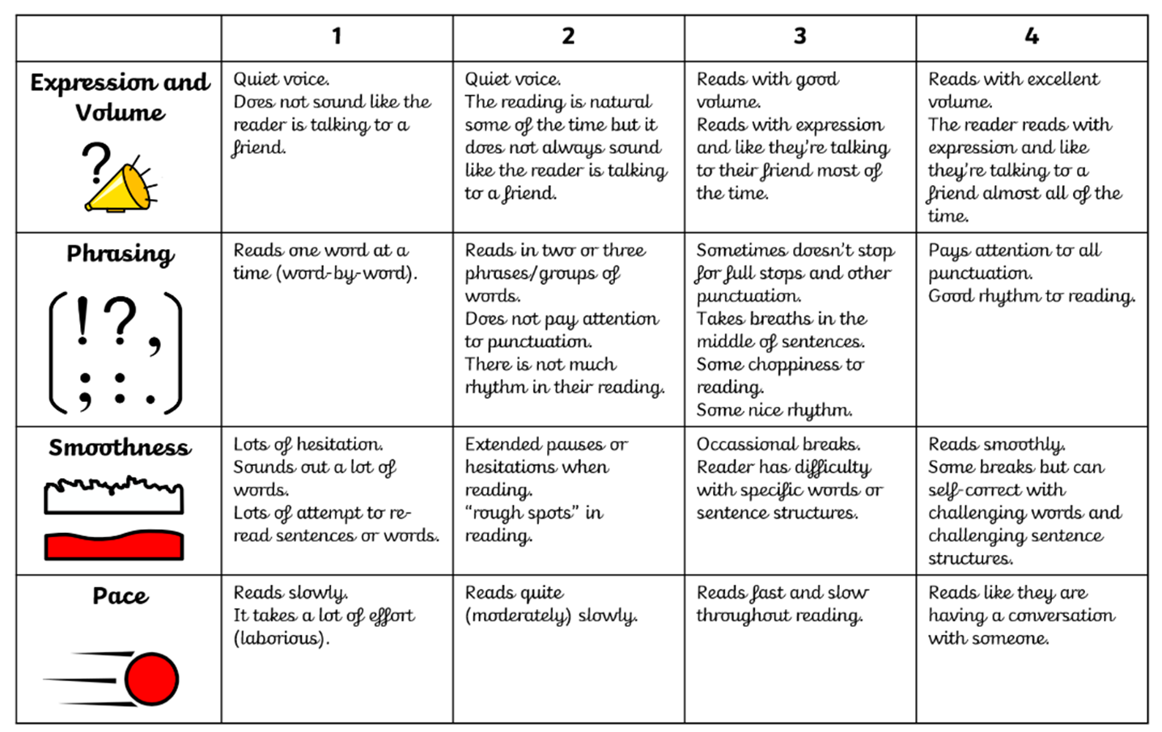

Slide 2


Being a Reader
Vocabulary
Monday

Slide 3
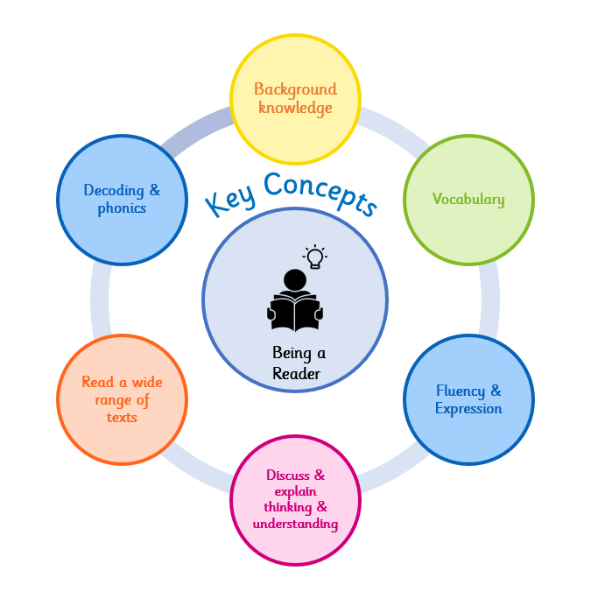
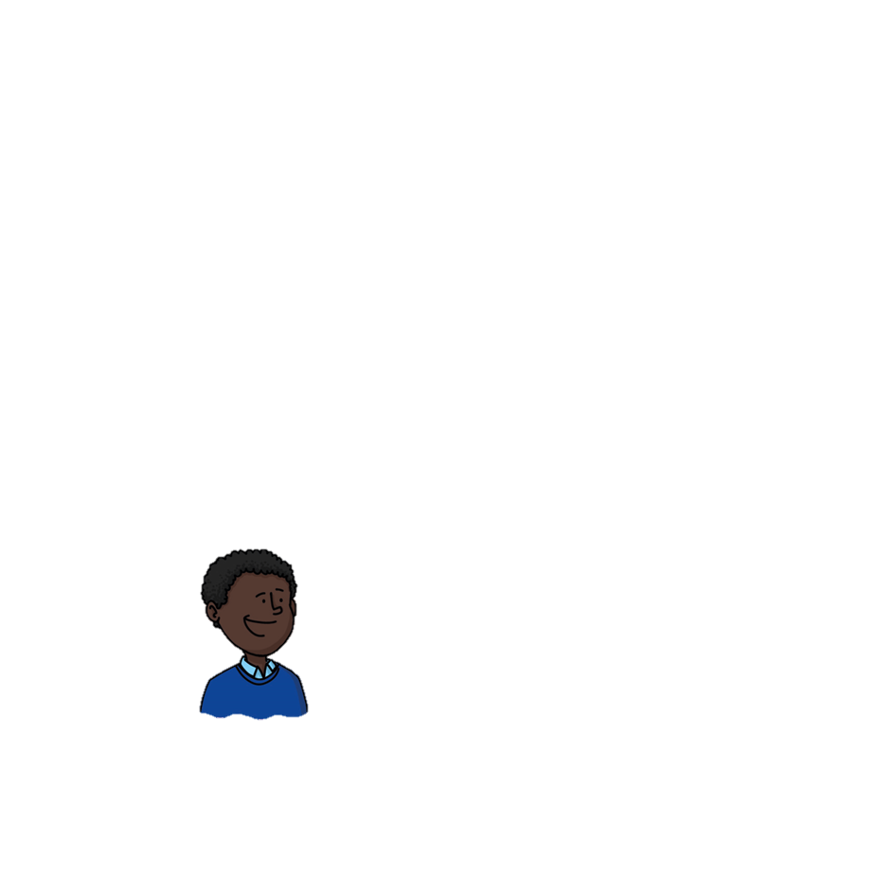

Why do we learn to read?
Reading makes me powerful because it helps me to understand the world around me.
At Wallscourt Farm Academy:
We love to read, learn to read and read to learn!
Notes:
Background knowledge – We use our background knowledge and experiences to help us with our reading
Vocabulary – we use new vocabulary when reading
Fluency & Expression – We read fluently and with expression to make our reading exciting
Discuss & explain thinking – We discuss and explain our thinking and understanding of our reading
Read a wide range of texts – We read a wide range of texts at WFA
Decoding and phonics – We use our phonics to help us decode and learn new words when we are reading

Slide 4

Vocabulary Focus
Vocabulary
Are there any words you feel confident to explain the meaning of (definition)? Are there any where you are less confident?
experiment | A test that a scientist does carefully to find out if something is true.
observe | To watch something very carefully to learn about it.
solid | A material that has a fixed shape and does not flow.
liquid | A material that flows and takes the shape of its container.
temperature | How hot or cold something is, measured in degrees.
?
?
?
?
?

Slide 5
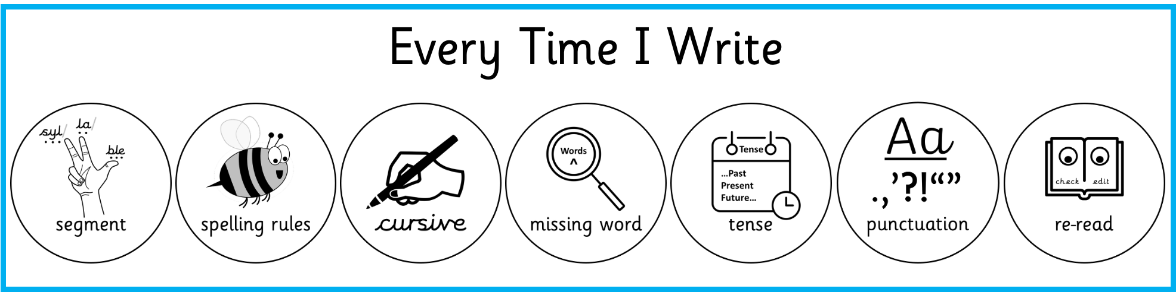
Vocabulary Focus
Vocabulary
Write it 5 times observe | Use it in a sentence
Other linked words
observe

Slide 6
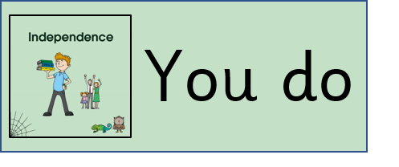
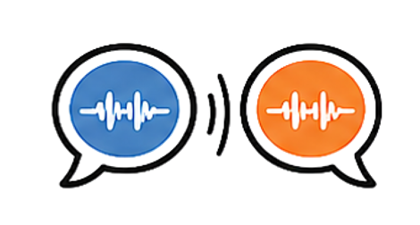
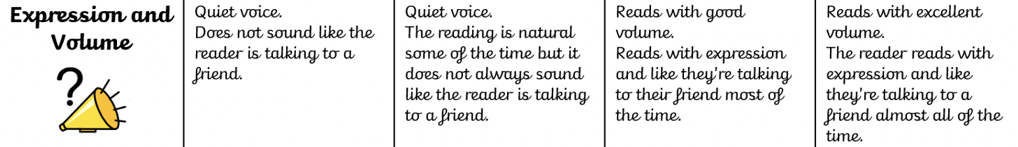
Fluency Activity
Echo read: read the same section taking turns, then echo back exactly how your partner read it — matching their pace, expression and phrasing as closely as you can.
Consider the correct volume for the audience that is listening
Consider parts of the text where specific expression is needed
Consider parts of the text where the volume should be louder or quieter

Slide 7

Discuss & explain thinking & understanding
I am learning to find and extract information from within a text.
What am I learning?
retrieve
I am learning this because it will help me to develop a clear understanding of what I am reading.
Why am I learning this ?
How will I know when I get there?
I will show this by answering questions, making reference to the text.

Slide 9
Being a Reader
Retrieval
Wednesday

Slide 10
Why do we learn to read?
Reading makes me powerful because it helps me to understand the world around me.
At Wallscourt Farm Academy:
We love to read, learn to read and read to learn!
Notes:
Background knowledge – We use our background knowledge and experiences to help us with our reading
Vocabulary – we use new vocabulary when reading
Fluency & Expression – We read fluently and with expression to make our reading exciting
Discuss & explain thinking – We discuss and explain our thinking and understanding of our reading
Read a wide range of texts – We read a wide range of texts at WFA
Decoding and phonics – We use our phonics to help us decode and learn new words when we are reading

Slide 11
Vocabulary Focus
Vocabulary
Are there any words you feel confident to explain the meaning of (definition)? Are there any where you are less confident?
procedure | A set of steps followed in a certain order to complete a task.
equipment | The tools and materials needed to carry out an experiment.
beaker | A glass container with a flat bottom used in science experiments.
record | To write down information so it is not forgotten.
prediction | A sensible guess about what will happen before an experiment begins.
?
?
?
?
?

Slide 12
Vocabulary Focus
Vocabulary
Write it 5 times procedure | Use it in a sentence
Other linked words
procedure

Slide 13
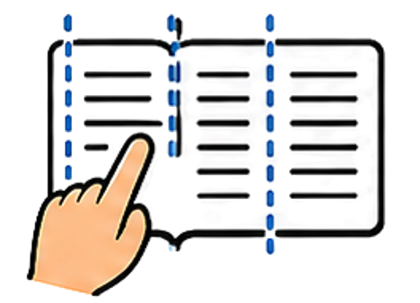
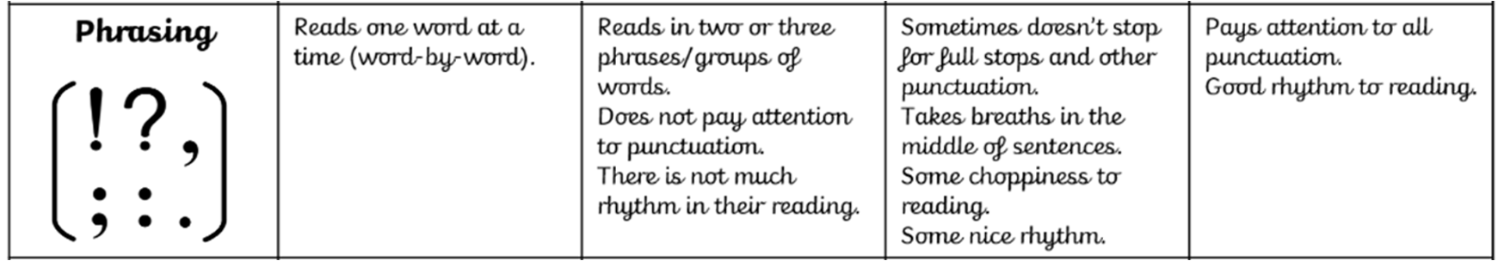
Fluency Activity
Chunk it: before reading, partners agree where to pause by marking phrase boundaries on the page. Read together pausing at the same points, then discuss whether the pauses helped the meaning land.
Make words flow into each other
Use the punctuation to pause or stop
Adapt your rhythm to the text (fast pace, slow pace…)
Show / Hide Extract

Slide 14
Vocabulary
I am learning to understand and take meaning from a text.
What am I learning?
I am learning this because it will help me to develop my understanding of vocabulary at a sentence and text level.
Why am I learning this ?
How will I know when I get there?
I will show this by answering questions which relate to the vocabulary used throughout the text.

Slide 16
Being a Reader
Inference
Friday

Slide 17
Why do we learn to read?
Reading makes me powerful because it helps me to understand the world around me.
At Wallscourt Farm Academy:
We love to read, learn to read and read to learn!
Notes:
Background knowledge – We use our background knowledge and experiences to help us with our reading
Vocabulary – we use new vocabulary when reading
Fluency & Expression – We read fluently and with expression to make our reading exciting
Discuss & explain thinking – We discuss and explain our thinking and understanding of our reading
Read a wide range of texts – We read a wide range of texts at WFA
Decoding and phonics – We use our phonics to help us decode and learn new words when we are reading

Slide 18
Vocabulary Focus
Vocabulary
Are there any words you feel confident to explain the meaning of (definition)? Are there any where you are less confident?
conclude | To decide something is true based on what you have found out.
variable | Something in an experiment that can change or be changed.
evidence | Information or facts that help prove whether something is true.
accurate | Completely correct and without mistakes.
investigate | To find out about something by looking closely and asking questions.
?
?
?
?
?

Slide 19
Vocabulary Focus
Vocabulary
Write it 5 times evidence | Use it in a sentence
Other linked words
evidence

Slide 20

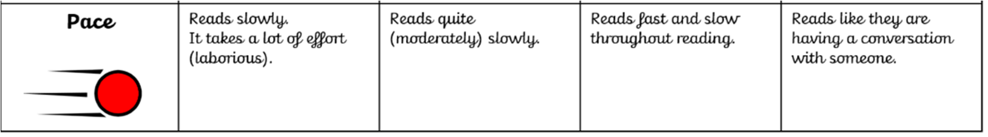
Fluency Activity
Key ideas: use pace deliberately to help your listener catch the important parts — slow down for key facts, move more quickly through supporting detail.
Aim to read at a pace which sounds like you are talking, not reading
Re-read sentences where words or phrases impacted you pace
Identify parts of the text which should be read with more, or less pace
Show / Hide Extract

Slide 21
Vocabulary
I am learning to understand and take meaning from a text.
What am I learning?
I am learning this because it will help me to develop my understanding of vocabulary at a sentence and text level.
Why am I learning this ?
How will I know when I get there?
I will show this by answering questions which relate to the vocabulary used throughout the text.

