Slide 1
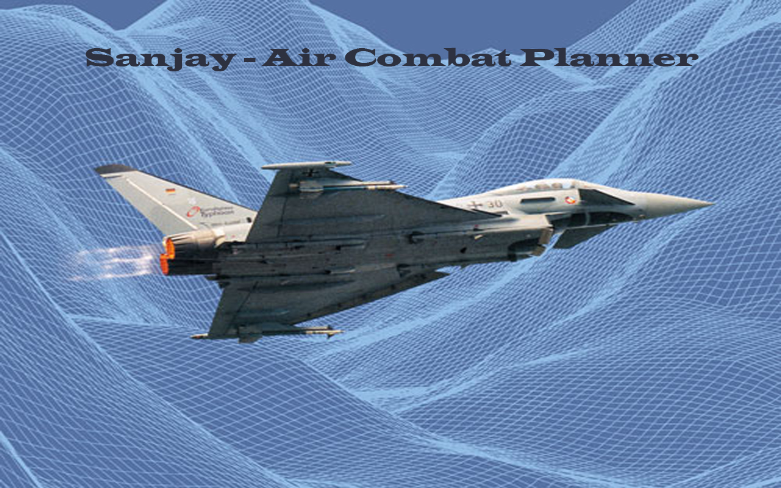
SaNJAY – AIR MISSION PLANNER

Slide 2
SERIOUS GAMES – 1/2
WHAT ?
WHY ?
Advanced Computer Games Techniques used for some purpose. Defense, Health , Education, City Planning, Scientific Exploration | Faster Build Time Cheaper Run on Low End Systems
GAMES
FACTS
Display complex geometries (million polygons) in real time. Can simulate Physical Objects & Real life situations precisely Allow multiple people to collaborate together at same time.

Slide 3
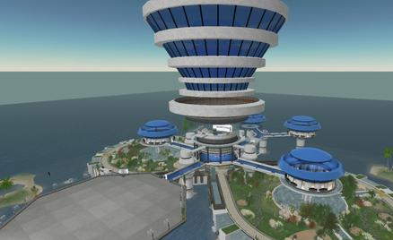
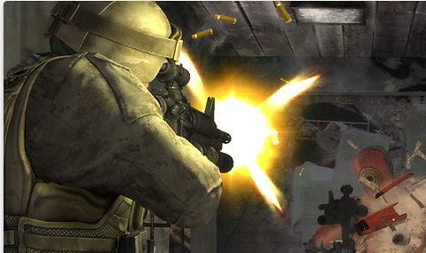
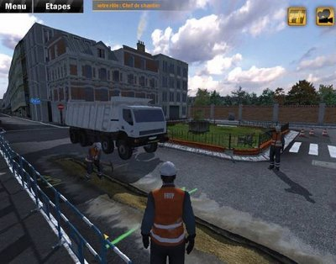

SERIOUS GAMES – 2/2
Defense
ECONOMY PLANNING
HEALTH
CIVIL PLANNING

Slide 4
Sanjay – Air Mission Planner
Flights Visualizer
Training Simulator

Slide 5
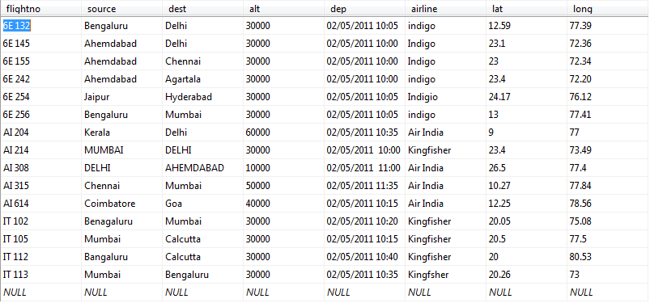
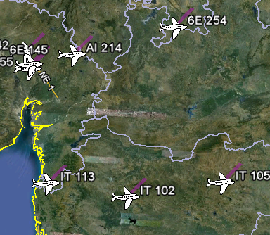
Flights Visualizer
PROBLEM STATEMENT
Interactively Visualize the status of flights above entire Indian Subcontinent in real time + flight information.
CURRENT SYSTEM
SOLUTION

Slide 6
Flights Visualizer
PROJECT SCOPE
Flights positioning system can be used by
Defence especially air force for planning out their operations.
Air traffic Controllers for info while managing air traffic.
Airports for knowing traffic details.
Hobbyist Passengers to track their flights.

Slide 7
Flights Visualizer
FEATURES DEMO
Login System

Slide 8
Flights Visualizer
FEATURES DEMO
Login System
New User Account Creation

Slide 9
Flights Visualizer
FEATURES DEMO
Login System
New User Account Creation
Check for Valid Input Data

Slide 10
Flights Visualizer
FEATURES DEMO
Login System
New User Account Creation
Check for Valid Input Data
Loading Geographical Information

Slide 11
Flights Visualizer
FEATURES DEMO
Login System
New User Account Creation
Check for Valid Input Data
Loading Geographical Information
Display Flights Over Geo Graphical Information

Slide 12
Flights Visualizer
FEATURES DEMO
Login System
New User Account Creation
Check for Valid Input Data
Loading Geographical Information
Display Flights Over Geo Graphical Information
Navigation Controls – Manually/ Geo- Mapping

Slide 13
Flights Visualizer
FEATURES DEMO
Login System
New User Account Creation
Check for Valid Input Data
Loading Geographical Information
Display Flights Over Geo Graphical Information
Navigation Controls – Manually/ Geo- Mapping
Display Flights Path

Slide 14
Flights Visualizer
FEATURES DEMO
Login System
New User Account Creation
Check for Valid Input Data
Loading Geographical Information
Display Flights Over Geo Graphical Information
Navigation Controls – Manually/ Geo- Mapping
Display Flights Path
Display Altitude of Flight

Slide 15
Flights Visualizer
FEATURES DEMO
Login System
New User Account Creation
Check for Valid Input Data
Loading Geographical Information
Display Flights Over Geo Graphical Information
Navigation Controls – Manually/ Geo- Mapping
Display Flights Path
Display Altitude of Flight
Display Information of flight when Clicked

Slide 16
Flights Visualizer
FEATURES DEMO
Login System
New User Account Creation
Check for Valid Input Data
Loading Geographical Information
Display Flights Over Geo Graphical Information
Navigation Controls – Manually/ Geo- Mapping
Display Flights Path
Display Altitude of Flight
Display Information of flight when Clicked
Flight Position Update Every 60 sec.

Slide 17
Flights Visualizer
IMPLEMENTATON
Secure Login System
Google Earth API
Google Maps API
From Radar(Simulated using
MySQL Database)
GE API + JavaScript +
Asp.net + C#
Refreshing display at 60 sec
with new information
Authorized Access
GEOGRAPHICAL INFORMATION
Political INFORMATION
Flights Data
Overlay Flights + Flight Information
Update Information Real Time

Slide 18
Flights Visualizer
ISSUES
Browser Issues
Mozilla Firefox 3.5 – Information Error
Opera 10 – No support for GE plug-in
IE – Google Maps not working.
Geographical Information taken from google.
Geographical Information taken online.
Real Radar Data not available.

Slide 19
Flights Visualizer
Deliverables
Final System ready to deploy over local server.
Mr. Sudeep Malhotra (Indian Air Force Wing Commander, Gandhinagar)
“This solves the purpose.”
FEEDBACK

Slide 20
Flights Visualizer
Contribution
Mentoring / Guidance
Prof. Sethuraman
Project Sponsorship
Mr. Ronak Raval (Director, Khel Online, Ahemdabad)
System Requirements/Feedback
Mr. Sudeep Malhotra (Indian Air Force Wing Commander, Gandhinagar)
Implementation/Design/Coding
Abhijeet Goel (Student , DA-IICT)

Slide 21
Flights Visualizer
REFERENCES
WhitePapers
www.aeronautics.nasa.gov/docs/nextgen_whitepaper_06_26_07.pdf
Project Gagan - http://en.wikipedia.org/wiki/GPS_Aided_Geo_Augmented_Navigation
Web Links
http://www.economist.com/node/15063872?story_id=15063872
http://en.wikipedia.org/wiki/Serious_game
http://www.brahmand.com/news/Indias-GAGAN-project-likely-to-be-completed-in-2013/4607/1/10.html
http://en.wikipedia.org/wiki/Next_Generation_Air_Transport_System
Videos
NextGen - http://www.youtube.com/watch?v=_DcfXh33r1Y

Slide 22
TRAINING SIMULATOR

Slide 23
TRAINING SIMULATOR
INTRODUCTION
Why do we need Simulators?
Hardware Based Simulations Limitations
Learning and Practice
Test New Strategies
Avoid Real Damage
Minimize Cost
Difficult to make
Too Costly
Lengthy Process
Limited in final result

Slide 24
TRAINING SIMULATOR
Problem Statement
Demonstrate possibility of use of Game Technology in defense simulations by creating a prototype.
Create a sample mission where player needs to destroy enemy Bunkers in a given time while flying a fighter airplane/Helicopter.
Also Deploy it on various platforms to test the hardware limitations.

Slide 25
TRAINING SIMULATOR
Project SCOPE
Defense Simulator can be used for
Training new Personnel
Testing new Strategies
Teamwork planning
Simulating entire battle scenario

Slide 26
TRAINING SIMULATOR
FEATURES DEMO
Menu System

Slide 27
TRAINING SIMULATOR
FEATURES DEMO
Menu System
Mission Briefing

Slide 28
TRAINING SIMULATOR
FEATURES DEMO
Menu System
Mission Briefing
Display Information about Airplanes visually

Slide 29
TRAINING SIMULATOR
FEATURES DEMO
Menu System
Mission Briefing
Display Information about Airplanes visually
Simulated Helicopter

Slide 30
TRAINING SIMULATOR
FEATURES DEMO
Menu System
Mission Briefing
Display Information about Airplanes visually
Simulated Helicopter
Information Display

Slide 31
TRAINING SIMULATOR
FEATURES DEMO
Menu System
Mission Briefing
Display Information about Airplanes visually
Simulated Helicopter
Information Display
Navigate to a desired destination

Slide 32
TRAINING SIMULATOR
FEATURES DEMO
Menu System
Mission Briefing
Display Information about Airplanes visually
Simulated Helicopter
Information Display
Navigate to a desired destination
Simulated Weather

Slide 33
TRAINING SIMULATOR
FEATURES DEMO
Menu System
Mission Briefing
Display Information about Airplanes visually
Simulated Helicopter
Information Display
Navigate to a desired destination
Simulated Weather
Drop Bombs/Fire Guns

Slide 34
TRAINING SIMULATOR
FEATURES DEMO
Menu System
Mission Briefing
Display Information about Airplanes visually
Simulated Helicopter
Information Display
Navigate to a desired destination
Simulated Weather
Drop Bombs/Fire Guns
Destroy Barrack

Slide 35
TRAINING SIMULATOR
FEATURES DEMO
Menu System
Mission Briefing
Display Information about Airplanes visually
Simulated Helicopter
Information Display
Navigate to a desired destination
Simulated Weather
Drop Bombs/Fire Guns
Destroy Barrack
Pause Menu/Quit Mission

Slide 36
TRAINING SIMULATOR
FEATURES DEMO
Menu System
Mission Briefing
Display Information about Airplanes visually
Simulated Helicopter
Information Display
Navigate to a desired destination
Simulated Weather
Drop Bombs/Fire Guns
Destroy Barrack
Pause Menu/Quit Mission
Simulated Airplane

Slide 37
TRAINING SIMULATOR
FEATURES DEMO
Menu System
Mission Briefing
Display Information about Airplanes visually
Simulated Helicopter
Information Display
Navigate to a desired destination
Simulated Weather
Drop Bombs/Fire Guns
Destroy Barrack
Pause Menu/Quit Mission
Simulated Airplane
Platforms it can run on (Web, PC, Mac, Consoles, Mobiles)

Slide 38
TRAINING SIMULATOR
IMPLEMENTATON
PhysX + JavaScript
Unity 3.3 Game Engine
Google WareHouse,3Ds Max
Freely Available Sounds
Free Available + Photoshop
Unity 3.3 provides such functionality.
Simulate Physical Object
Rendering the Graphics
3D Models
Sounds
Textures
Multi Platform

Slide 39
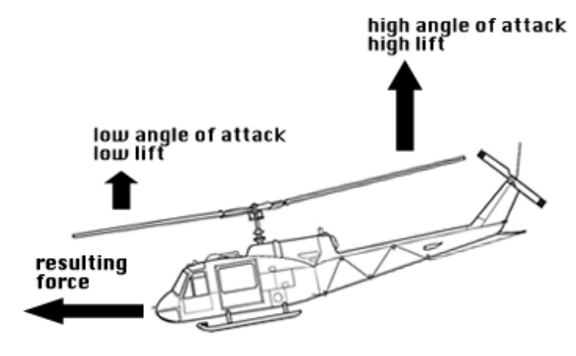
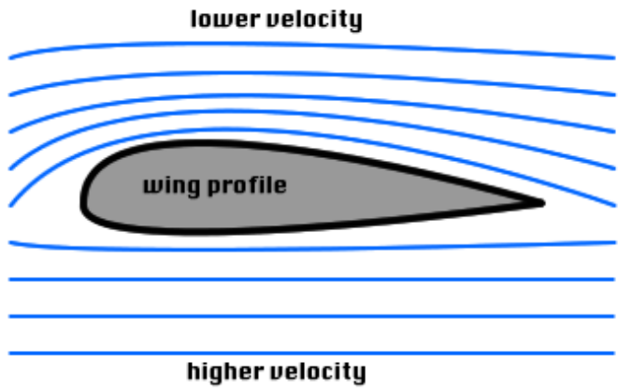
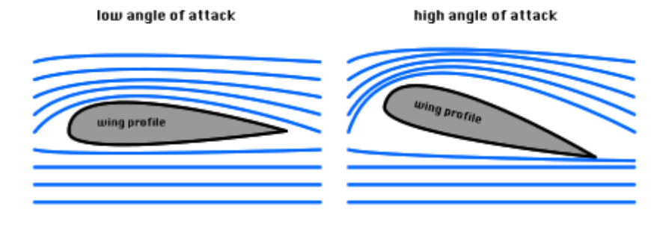
TRAINING SIMULATOR
Implementation
Lift force
turn force

Slide 40
TRAINING SIMULATOR
ISSUES
Airplane Mode does not restart once crashed.
3D Models and textures are not realistic.
Free Version of Unity does not allow to deploy on Android.

Slide 41
TRAINING SIMULATOR
Contribution
Mentoring / Guidance
Prof. Sethuraman
Project Sponsorship
Mr. Ronak Raval (Director, Khel Online, Ahemdabad)
Implementation/Design/Coding
Abhijeet Goel (Student , DA-IICT)

Slide 42
Flights Visualizer
Deliverables
A Executable File ready to run on Windows Platform.
A Web Deployable System
Android Compatible Mobile Version

Slide 43
Flights Visualizer
References
http://www.freefalcon.com/forum/showthread.php?17590-FreeFalcon-5.5-Screen-Shots
http://www.freefalcon.com/forum/showthread.php?20099-Free-Falcon-Development
http://www.forums.unity3d.com
http://www.gotow.net/andrew/wordpress/
http://science.howstuffworks.com/transport/flight/modern/helicopter.htm
http://sketchup.google.com/3dwarehouse/

