Slide 1
Visualizing Data with Processing
November 21st, 2013
itp.nyu.edu/residents/data_processing
Roopa Vasudevan
roopa.vasudevan@nyu.edu
Danne Woo
dannewoo@nyu.edu

Slide 2
Data Types
CSV – Comma Separated Values
TSV – Tab Separated Values
JSON – JavaScript Object Notation
XML – Extensible Markup Language
And tons more.
Notes:
Twitter Bootstrap, general CSS and JavaScript framework.
960 is for grid systems.
Foundation is for responsive web development.

Slide 3
Clean Data
Clean up your data!

Slide 4
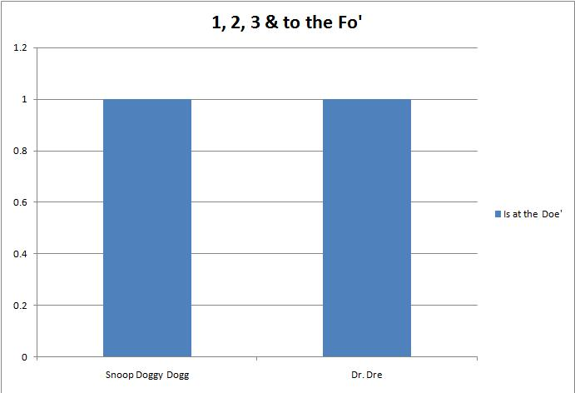
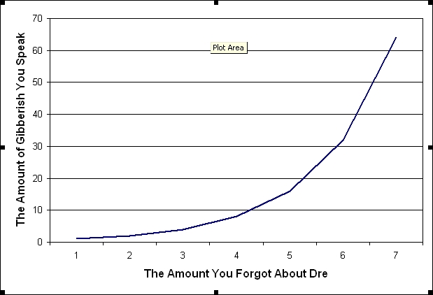
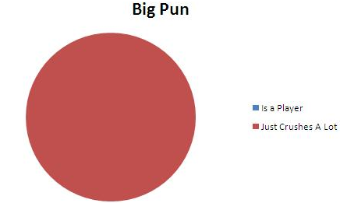
Analyze and Determine Best Way to Visualize

Slide 5
What Can Data Modify?
Height
Width
Position (X, Y and Z)
Duplication
Color (HSB)
Opacity
Rotation
Basically replace all arguments with elements from your data and see what happens.
Notes:
Twitter Bootstrap, general CSS and JavaScript framework.
960 is for grid systems.
Foundation is for responsive web development.

Slide 6
Helpful Libraries
GUI
Control P5
Geometry
Geomerative
ToxicLibs
Color
ToxicLibs
Text Analysis
RiTa
APIs
Twitter4j blprnt.nytimes
Notes:
Twitter Bootstrap, general CSS and JavaScript framework.
960 is for grid systems.
Foundation is for responsive web development.

Slide 7
Other Helpful Languages
Python
Data parsing and collection
JavaScript (D3 and ThreeJS)
Visualizing data for the web
R
Data Analysis
Notes:
Twitter Bootstrap, general CSS and JavaScript framework.
960 is for grid systems.
Foundation is for responsive web development.

Slide 8
What we will be covering
Arrays
Loading CSVs
Hashmaps
APIs (Twitter and NYTimes)
SVG Import and Manipulation
Notes:
Twitter Bootstrap, general CSS and JavaScript framework.
960 is for grid systems.
Foundation is for responsive web development.

