Slide 1


Hardware Virtual Texturing
Graham Sellers, AMD
graham.sellers@amd.com
@grahamsellers

Slide 2
Hardware Virtual Texturing
Virtual Texturing
Virtual textures are textures that are not all in video memory at one time
Software Virtual Textures (SVTs) have been around for a while
The goal is to provide support in hardware

Slide 3
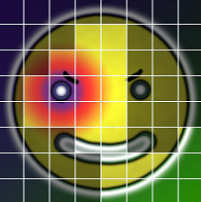

Virtual Textures
Divide texture up into tiles
Commit only used tiles to memory
Store data in separate physical texture
Physical Texture
Virtual Texture

Slide 4
Virtual Textures
Memory requirements set by number of resident tiles, not texture dimensions
 | Virtual | Physical
Memory | 4096 kB | 1536 kB
RGBA8, 1024x1024, 64 tiles

Slide 5
Virtual Textures
Use indirection table to map virtual to physical
This is also known as a page table

Slide 6
Virtual Textures
Software Virtual Textures
uniform sampler2D samplerPageTable; // page table texture
uniform sampler2D samplerPhysTexture; // physical texture
in vec4 virtUV; // virtual texture coordinates
out vec4 color; // output color
vec2 getPhysUV(vec4 pte); // translation function
void main()
{
vec4 pte = texture(samplerPageTable, virtUV.xy); // (1)
vec2 physUV = getPhysUV(pte); // (2)
color = texture(samplerPhysTexture, physUV.xy); // (3)
}

Slide 7
GPU Virtual Memory
Virtual Memory for GPUs
Very similar to virtual memory on CPUs
Page tables in video memory
Address translation handled by hardware

Slide 8
GPU Virtual Memory
texture(sampler, uv);
uv
data
virtual address
physical address
Texture Unit
…
virtual address
data
Memory Controller
physical address
data
Physical Memory
Page Table

Slide 9
Sparse Textures
Paging
The process of making resources resident in GPU-visible memory
Handled by the operating system or lower level system components
Non-sparse resources paged in and our with resource granularity

Slide 10
Sparse Textures
Sparse textures depend on 3 core components:
GPU virtual memory
Shader core feedback
Software driver stack

Slide 11
Sparse Textures and GPU Virtual Memory
Texture Unit
UV to virtual address translation
Hardware filtering
Cache
Memory Controller
Virtual to physical address translation
Page table management
Cache

Slide 12
Virtual Textures
Software Virtual Textures (Recap)
uniform sampler2D samplerPageTable; // page table texture
uniform sampler2D samplerPhysTexture; // physical texture
in vec4 virtUV; // virtual texture coordinates
out vec4 color; // output color
vec2 getPhysUV(vec4 pte); // translation function
void main()
{
vec4 pte = texture(samplerPageTable, virtUV.xy); // (1)
vec2 physUV = getPhysUV(pte); // (2)
color = texture(samplerPhysTexture, physUV.xy); // (3)
}

Slide 13
Sparse Textures and GPU Virtual Memory
Hardware Virtual Textures
uniform sampler2D samplerPRT // partially-resident texture
in vec4 virtUV; // virtual texture coordinates
out vec4 color; // output color
void main()
{
color = vec4(0.0);
sparseTexture(samplerPRT, virtUV.xy, color); // (3)
}

Slide 14
Sparse Textures and Shaders
Virtual Address Space
Segmented into 64KiB pages
Each tile can be mapped (resident) or unmapped (non-resident)
Mapping controlled by the driver and application
x
x
x
x
x
x
x
x
x
x
x
x
x
x
x

Slide 15
Sparse Textures and Shaders
texture(sampler, uv);
uv
NACK
virtual address
Texture Unit
NACK
…
virtual address
NACK
Memory Controller
Physical Memory
Page Table

Slide 16
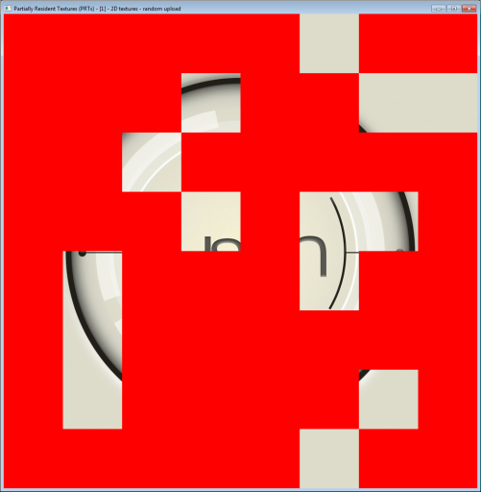
Sparse Allocations
What can be sparse?
Any tile-aligned region of a texture level

Slide 17
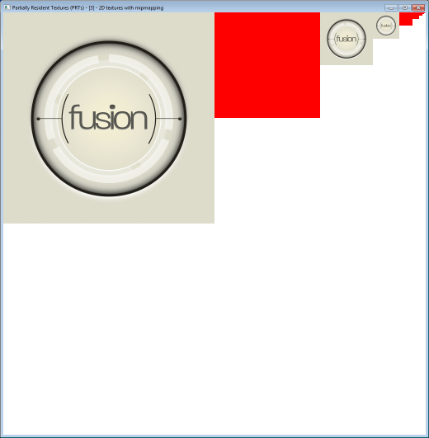
Sparse Allocations
What can be sparse?
Full mip-levels

Slide 18
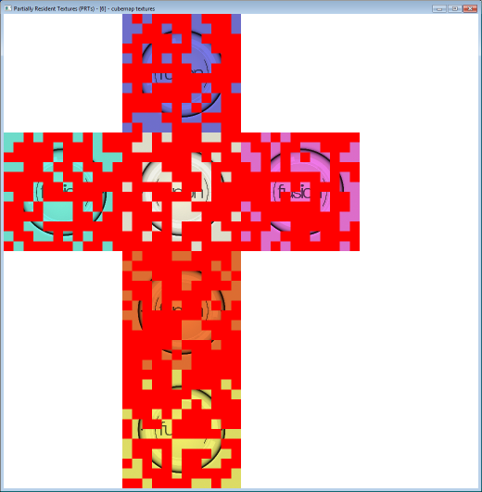
Sparse Allocations
What can be sparse?
Cube map faces

Slide 19
Sparse Allocations
What can be sparse?
Any combination of the above, plus...
Slices of 3D textures, array layers, etc., etc.
... so long as it meets tile alignment requirements

Slide 20
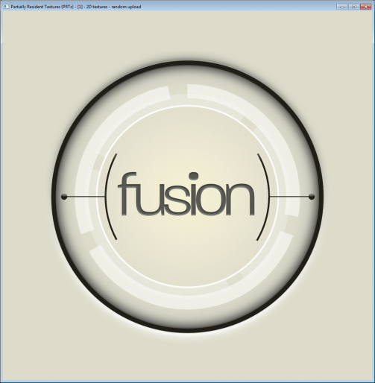
Sparse Textures and Shaders
NACKs in shaders
void main()
{
vec4 outColor = vec4(1.0, 1.0, 1.0, 1.0);
int code = sparseTexture(sampler, texCoordVert.xy, outColor);
if (sparseTexelResident(code))
{
// data resident
gl_FragColor = vec4(outColor.rgb, 1.0);
}
else
{
// NACK
gl_FragColor = vec4(1.0, 0.0, 0.0, 1.0);
}
}

Slide 21
Sparse Textures – Drivers
Driver responsibilities
Create and destroy sparse resources
Map and un-map tiles
Back virtual allocations with physical allocations

Slide 22
Sparse Textures – Drivers
Backing storage
A set of physical allocations containing texture data
Don’t want one physical allocation per tile
Driver manages pools of tiles
Each application will have different requirements

Slide 23
Physical Texture Pools
0
1
2
3
x
8
9
10
11
x
16
17
18
19
x
20
21
22
23
x
12
13
14
15
x
28
29
30
31
x
x
x
x
x
x
x
x
x
x
x
4
5
6
7
x
x
x
x
x
x
x
x
x
x
x
x
x
24
25
x
x
x
x
x
x
x
x
26
27
x
x
x
x
x
x
x
x
x
x
x
Sparse Texture
Chunk 1
0
1
2
3
4
5
6
7
8
9
10
11
12
13
14
15
Chunk 2
16
17
18
19
20
21
22
23
24
25
26
27
28
29
30
31

Slide 24
Physical Texture Pools
0
1
2
3
x
8
9
10
11
x
16
17
18
19
x
20
21
22
23
x
12
13
14
15
x
28
29
30
31
x
x
x
x
x
x
x
x
x
x
x
4
5
6
7
x
x
x
x
x
x
x
x
x
x
x
x
x
24
25
x
x
x
x
x
x
x
x
26
27
x
x
x
x
x
x
x
x
x
x
x
Sparse Texture
Chunk 1
0
1
2
3
4
5
6
7
8
9
10
11
12
13
14
15
Chunk 2
16
17
18
19
20
21
x
x
x
22
23
24
25
26
27
28
29
30
x
31

Slide 25
Tile Pool Management
Let the application deal with it!
Introduce new objects called tile pools
Non-virtual allocations
Huge arrays of tiles
Look like array textures
Application gets to ‘place’ tiles into textures

Slide 26
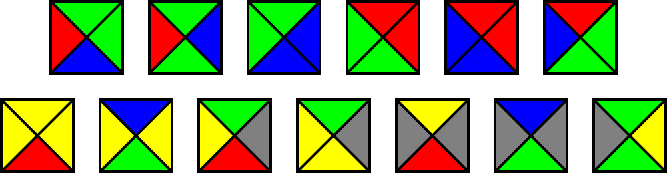
Tile Pool Management
Tile pools enable several things
Tight, application controlled memory management
Aliases – using the same tile at multiple places
Sharing a single pool amongst many virtual textures
Wang tiles in hardware

Slide 27
Hardware Virtual Textures
Summary
 | SVTs | HVTs
Address translation | Shader code | HW page table
Filtering | HW + shader code | HW only
# of texture fetches | 2, dependent | 1
Supported formats | The ones implemented | All supported by HW
Supported texture types | The ones implemented | All supported by HW

Slide 28
Accessing the Feature
Exposed through OpenGL extensions
GL_AMD_sparse_texture
Enables basic driver managed virtual textures
GL_AMD_texture_tile_pool
Adds tile pool support
Still in the pipeline...

Slide 29
Sparse Textures in OpenGL
Use of immutable texture storage
Existing OpenGL immutable storage API
Declare storage, specify image data
GLuint tex;
glGenTextures(1, &tex);
glBindTexture(GL_TEXTURE_2D, tex);
glTexStorage2D(GL_TEXTURE_2D, 10, GL_RGBA8, 1024, 1024);
glTexSubImage2D(GL_TEXTURE_2D, 0, 0, 0, 1024, 1024,
GL_RGBA, GL_UNSIGNED_BYTE, data);

Slide 30
Sparse Textures in OpenGL
Use of sparse texture storage
glTexStorageSparseAMD is a new function
GLuint tex;
glGenTextures(1, &tex);
glBindTexture(GL_TEXTURE_2D, tex);
glTexStorageSparseAMD(GL_TEXTURE_2D, GL_RGBA, 1024, 1024, 1,
1, GL_TEXTURE_STORAGE_SPARSE_BIT_AMD);
glTexSubImage2D(GL_TEXTURE_2D, 0, 0, 0, 1024, 1024,
GL_RGBA, GL_UNSIGNED_BYTE, data);

Slide 31
Sparse Textures in OpenGL
Previous example uses glTexSubImage2D
Driver allocates storage on demand
Manages physical tile pools for application
Pass NULL to glTexSubImage*D to de-allocate
Advantages and disadvantages:
Pros: simple, easy to integrate, backwards compatible
Cons: not much control, driver overhead, etc.
glTexSubImage2D(GL_TEXTURE_2D, 0, 0, 0, 256, 256,
GL_RGBA, GL_UNSIGNED_BYTE, NULL);

Slide 32
OpenGL Texture Tile Pools
Application control of tile pools
Created new texture targets:
GL_TEXTURE_1D_TILE_POOL
GL_TEXTURE_2D_TILE_POOL
GL_TEXTURE_3D_TILE_POOL
These resemble array textures
Fixed element size, unlimited elements
Cannot directly texture from or render to them
3D = 3D ‘array’, which otherwise isn’t supported

Slide 33
OpenGL Texture Tile Pools
Steps to using tile pools:
Create texture using pool target
Allocate storage as if it were an array texture
Associate pool tiles with virtual textures

Slide 34
OpenGL Texture Tile Pools
Create a tile pool
Set properties of pool
Select the type of pool (1D, 2D, 3D)
Select internal format and tile size
Set the number of tiles
GLuint tex;
glGenTextures(1, &tex);
glBindTexture(GL_TEXTURE_2D_TILE_POOL, tex);
glTexStoragePoolAMD(GL_TEXTURE_2D_TILE_POOL, // Type of pool
GL_RGBA8, // Internal format
0, // Tile size index
10000); // Number of tiles

Slide 35
OpenGL Texture Tile Pools
Put data in pools
2D tile pool looks like 2D array texture
Manipulate pools directly using views
glTexSubImage3D(GL_TEXTURE_2D_TILE_POOL,
0, 0, 0, tile,
256, 256, 1,
GL_RGBA, GL_UNSIGNED_BYTE,
data);
glTextureView(tex, GL_TEXTURE_2D_ARRAY, // Create 2D array texture view
pool, // from this pool
GL_RGBA8, // in this format
0, 1, // with no mipmaps
9000, 1000); // from tile 9000 for 1000 tiles

Slide 36
OpenGL Texture Tile Pools
Map pool tiles into textures
Specify an array of tiles to map
Each has an x, y, z offset and an index
glTexTilePlacementAMD(GL_TEXTURE_2D, // Target
0, // Level
100, // Tile count
xoffsets, yoffsets, zoffsets, // Arrays of offsets
pool, // Pool object
tileindices); // Indices of tiles

Slide 37
Sparse Textures in Shaders
First and foremost
IT IS NOT NECESSARY TO MAKE SHADER CHANGES TO USE SPARSE TEXTURES

Slide 38
Extending GLSL – Samplers
Texture type in GLSL is the ‘sampler’
Several types of samplers exist...
sampler2D, sampler3D, samplerCUBE, sampler2DArray, etc.
We didn’t add any new sampler types
Sparse textures look like regular textures in shaders

Slide 39
Reading from Textures
Read textures using ‘texture’
Built-in function with several overloads:
gvec4 texture(gsampler1D sampler, float P [, float bias]);
gvec4 texture(gsampler2D sampler, vec2 P [, float bias]);
gvec4 texture(gsampler2DArray sampler, vec3 P [, float bias]);
gvec4 textureLod(gsampler2D sampler, vec2 P, float lod);
gvec4 textureProj(gsampler2D sampler, vec4 P [, float bias]);
gvec4 textureOffset(gsampler2D sampler, vec2 P, ivec2 offset [, float bias]);
// ... etc.

Slide 40
Extending GLSL
Added new built-in functions
Return residency information along with data
Most texture functions have a sparse version
Mix-and match is possible:
Non-sparse (ordinary) textures appear fully resident
Sparse textures return undefined data in unmapped regions
int sparseTexture(gsampler2D sampler, vec2 P, inout gvec4 texel [, float bias]);
int sparseTextureLod(gsampler2D sampler, vec2 P, float lod, inout gvec4 texel);
// ... etc.

Slide 41
Extending GLSL | Sparse Texture
sparseTexture returns two pieces of data:
Residency status code
Texel data via inout parameter
int sparseTexture(gsampler2D sampler, vec2 P, inout gvec4 texel [, float bias]);

Slide 42
Extending GLSL | Sparse Texture
Texel data is returned via inout parameter
If texel fetch fails, original value is retained
This is like a CMOV operation
Return code is hardware dependent
Encodes residency information
New built-in functions to decode it

Slide 43
Extending GLSL | Sparse Texture
Residency information returned from fetch
New built-in functions decode it
vec4 texel = vec4(1.0, 0.0, 0.7, 1.0); // Default value
int code;
code = sparseTexture(s, texCoord, texel);
bool sparseTexelResident(int code);
bool sparseTexelMinLodWarning(int code);
int sparseTexelLodWarningFetch(int code);

Slide 44
Extending GLSL | Sparse Texture
Was texel resident?
Texel miss is generated if any required sample is not resident, including:
Texels required for bilinear or trilinear sampling
Missing mip maps, anisotropic filter taps, etc.
bool sparseTexelResident(int code);

Slide 45
Sparse Textures – Use Cases
Drop-in replacement for traditional SVT
Almost... maximum texture size hasn’t grown
Extremely large texture arrays
Only populate a sub-set of the slices
Can eliminate texture binds in some applications

Slide 46
Sparse Textures – Use Cases
Large volume textures
Voxels, medical applications
Distance fields + raymarching
Use maximum step size as ‘default’ value
Variable size texture arrays
Create a large array texture
Populate different mip levels in each slice

Slide 47
Sparse Textures – ARB Extension
The OpenGL ARB adopted sparse textures
Recent development – released this week
Slightly different semantics
Smaller feature set

Slide 48
Sparse Textures – ARB Extension
ARB version of sparse texture
Uses texture params + glTexStorage
No new API
No shader support
No tile pool support
Page sizes queryable
Uses glGetInternalformativ
Able to expose more than one selectable page size

Slide 49
Sparse Textures – Future Work
Increase maximum texture size
Finer control over edge effects
Better residency feedback
Standardize tile shapes

Slide 50
Thanks!

