Slide 1
EasyMock
Mock Testing
Notes:
Good Morning Everyone, Today we will have a look at the concepts related to Mock Testing. The tool that we are focusing on today to perform mock testing is called Easy Mock we will learn more about it in this presentation.

Slide 2
What is Mock Testing?
Mock testing is a technique used in software development to simulate the behavior of real objects or components.
It helps isolate units of code for testing by replacing dependencies with mock objects.
Mock testing enables developers to verify the interactions and behaviors of the tested code without relying on real implementations.
Notes:
SO what is mock testing? Imagine you are developing a banking application that includes a module responsible for processing transactions. This module interacts with external systems, such as a payment gateway, to process payments. In order to test the functionality of this module, including error handling and different scenarios, you can use mock testing.
Mock testing involves creating simulated or mock objects that mimic the behavior of the real objects the module interacts with. In our example, you can create a mock object that simulates the behavior of the payment gateway without actually making any real payment transactions. This allows you to isolate and test the module's functionality without relying on the availability or stability of the actual payment gateway.
Using a mock object, you can define expected behaviors and responses. For instance, you can instruct the mock payment gateway to return a successful payment response or simulate specific error conditions to verify how your module handles those situations. By controlling the behavior of the mock object, you can systematically test various scenarios, including edge cases and exceptional conditions, to ensure the robustness of your module.

Slide 3
Why Use Mock Objects?
Allows testing of individual components in isolation.
Reduces dependencies on external systems or services during testing.
Enables testing of error conditions and edge cases.
Improves test reliability and speed.
Facilitates parallel development and continuous integration.
Notes:
Why use mock object? As we discussed in our banking example mock objects helps us test individual components in isolation. Also it allows testing of the error conditions and test cases most importantly we do not need the actual implementation of the external system or service that we are testing.

Slide 4
Introducing EasyMock
EasyMock is a popular open-source Java library for creating mock objects.
It provides a simple and intuitive API for defining and manipulating mock objects.
EasyMock is widely used for unit testing and integration testing in Java applications.
It integrates seamlessly with popular test frameworks like JUnit and TestNG.
Notes:
To perform mock testing one of the tools that we can use is Easy Mock. It is an open source java library to create mock objects. It easily integrates with the popular test frameworks such as Junit and TestNG. After this presentation I will show an implementation of Easy Mock with Junit framework.

Slide 5
Key Features of EasyMock
Easy-to-use API for creating mock objects.
Record and replay approach for defining mock behaviors.
Support for strict and nice mocks with varying degrees of behavior verification.
Argument matchers for flexible parameter matching.
Integration with popular test frameworks.
Support for partial mocks and mocking of collaborators.
Notes:
The most important feature of easy mock is the record and replay approach/ The "record" phase is where you set up the expectations for the mock object. This involves defining the methods that you expect to be called, along with any specific arguments and return values. EasyMock provides a set of methods to record these expectations, allowing you to define the desired behavior of the mock object.
Once the expectations are recorded, you enter the "replay" phase. In this phase, you instruct EasyMock to switch the mock object to the playback mode. Here, the mock object will act according to the expectations you have set during the record phase. When the methods are invoked on the mock object, it will return the predefined values or perform the predefined actions, simulating the behavior of the real object.

Slide 6
Other Tools
Mockito
MoQ
JustMock etc.
You can use other tools but explanation will be required on what is the difference between EasyMock and the tool you are planning to use.
Notes:
Here is the list of some other tools that can be used to perform mock testing. But if you plan to use something else other than Easy mock make sure to mention the differences between both these tools.

Slide 7
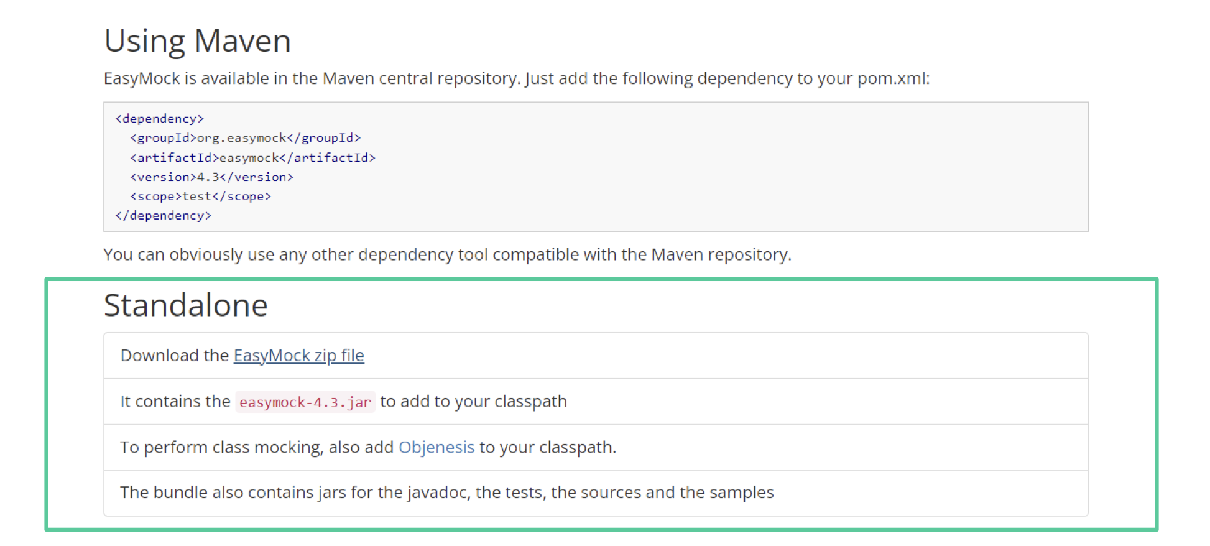
Tutorial Link(s)
https://easymock.org/user-guide.html
Notes:
Here are some tutorial links which are highly recommended

Slide 8
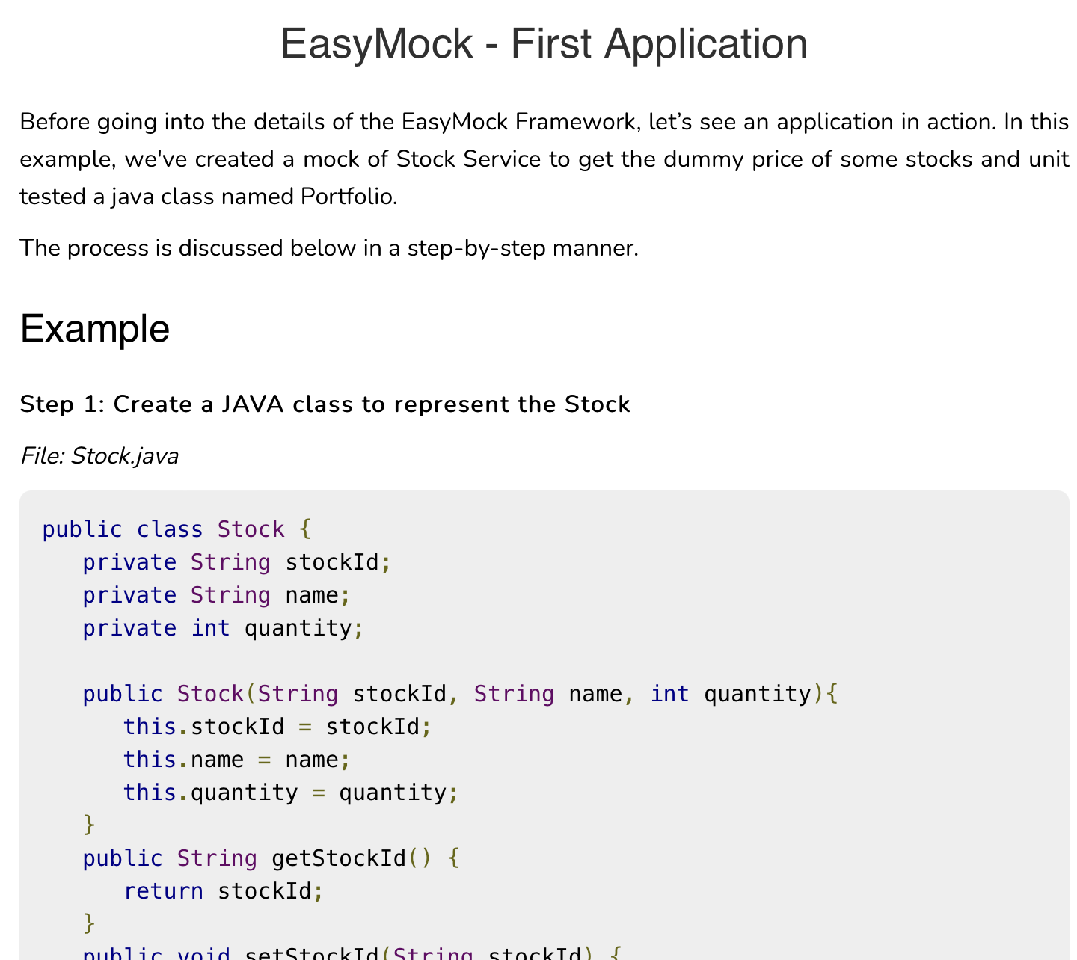
Tutorial Link(s)
https://www.tutorialspoint.com/easymock/easymock_quick_guide.htm

