Slide 1

Python Scripting with Network
Day 3

Slide 2
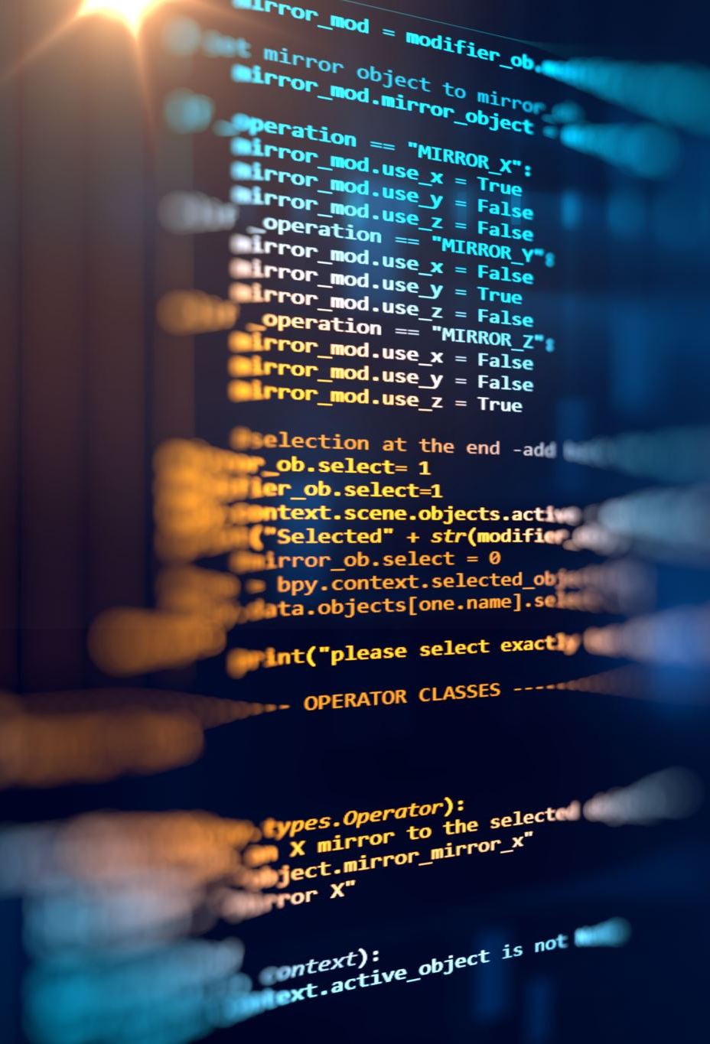
Agenda
Variables in Python
Operators in Python
Python Loops
Conditional statements
Python Files
Python Exception Handling
Python Classes
Python Functions

Slide 3
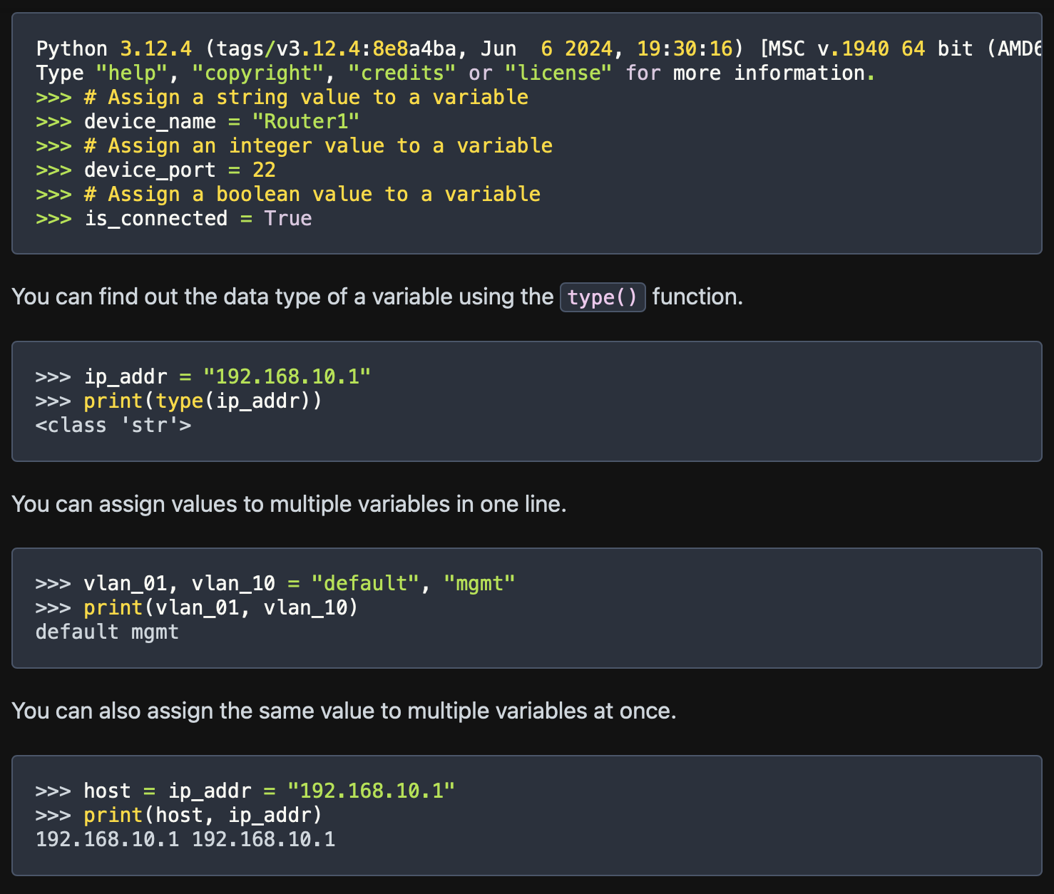
Python variables
A python variable is like a container which stores data temporarily.
Variables keep values accessible.
Variables make changes easy
Variables have data types.

Slide 4
Python Operators
Operators in Python are used to perform operations on variables and values. They are the following types –
Arithmetic operators
Assignment operators
Comparison operators
Logical operators
Identity operators
Memebership operators

Slide 5
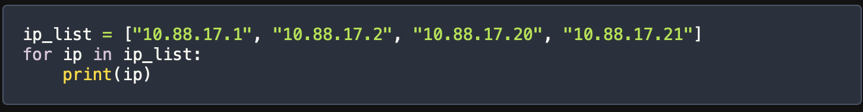
Loops in Python
For Loop
The for loop lets you run a block of code of each item in an iterable like a list, string, tuple, set or dictionary.
For keyword: This starts the loop. It tells python you want to begin the loop.
Loop variable - n for ip in ip_list:, ip is the loop variable. It’s a temporary variable that represents each item in the iterable during each loop cycle.
Looping object - (ip_list): ip_list is the list you want to loop over. In each loop cycle, the loop variable ip takes the value of the next item in the list.
Indented block - The indented code under the for loop is what runs in each loop cycle. Here, it’s print(ip).

Slide 6
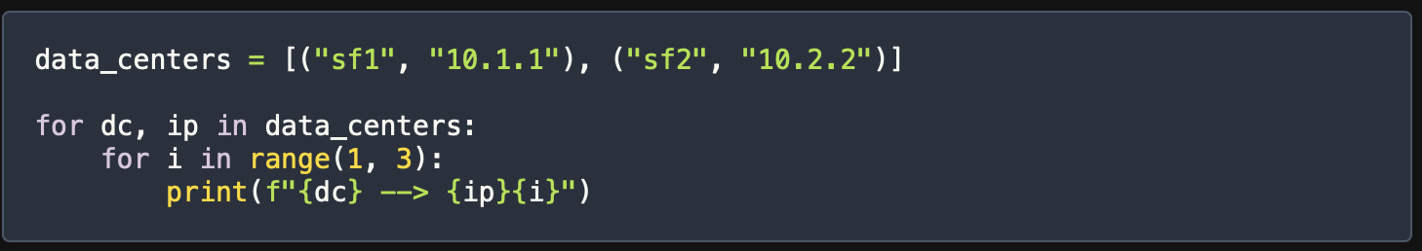
Nesting Loops in Python
Nesting loops in Python means putting one loop inside another. This lets you create more complex patterns and work with multiple levels of data.
Outer Loop – The outer for loop goes through data_centers list. In each loop_cycle, dc gets the first value of the tuple and ip gets the second value.
Inner for loop – Inside the outer loop, there’s another for loop, the inner loop generates numbers 1 to 2. In each cycle of inner loop, i gets the number in the range.

Slide 7
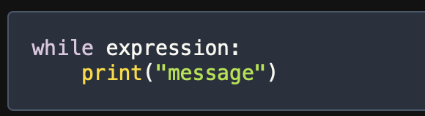
While Loop in Python
A while loop is a powerful tool in Python lets you repeatedly run a block of code as long as certain condition is true.
A while loop has an expression followed by a colon and an indented block of code.

Slide 8
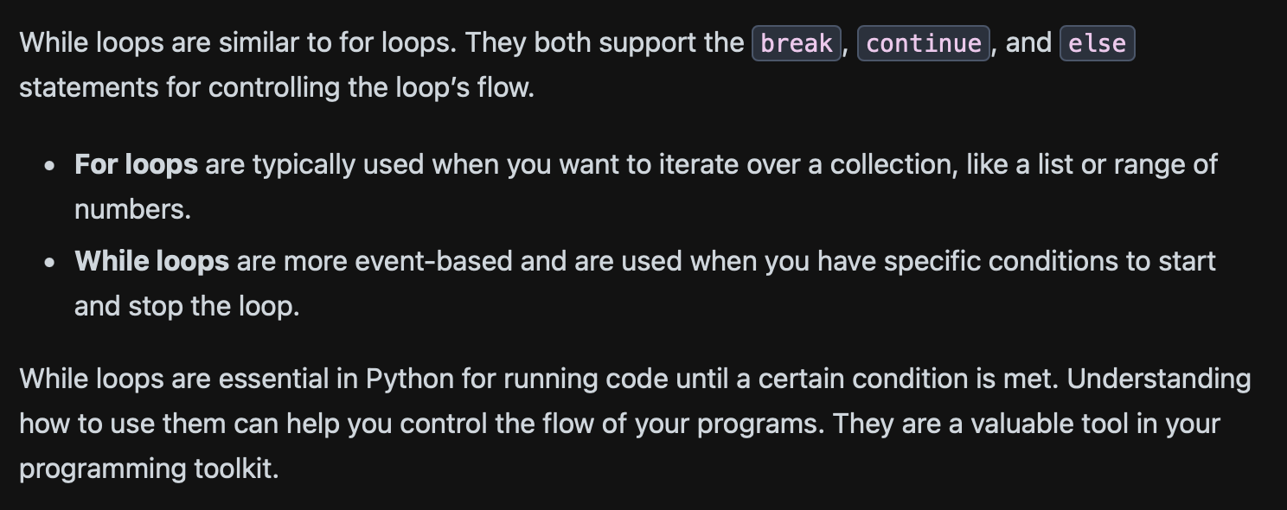
Difference between For & While Loop

Slide 9
Conditional Statements in Python
Conditional statements in Python help control the flow of your program. They let you run specific blocks of code based on whether certain conditions are true or false.
If statement: This runs a block of code if a condition is true.
Elif statement: This checks multiple conditions one after another, if one condition is true , it runs the corresponding block of code.
Else statement: this statement runs a block of code if none of the previous conditions are true.

Slide 10
Truthy & Falsy Values in Python
In Python, every value is either truthy or falsy. Truthy values are considered True in conditions, while falsy values are considered False.
Common truthy values:
Non-zero numbers
Non-empty strings
Non-empty collections
Common falsy values:
0 (zero)
0.0 (zero float)
‘’ (empty string)
None
Empty collections (lists, dictionaries, sets)

Slide 11
Python Lists
Maintains Order: The order in which you add items is the order in which you can access them.
Holds Mixed Data Types: You can mix different types of data in a single list, like strings, numbers, and more.
Is Mutable: You can change the items, size, and structure of a list after creating it.
A list is a collection of Items
Which maintains order – the order in which you add items in the order you can access them
Holds Mixed Data types – You can mix different types of data in a single list like strings, numbers and more.
Is Mutable – you can change the items, size and structure of the list after creating it.

Slide 12
Tuples in Python
A tuple is a collection of items that are ordered and can be of different types. You create a tuple using parentheses (), with items separated by commas.
my_tuple = (1, "hello", 22, None, 2.7)
Tuples can hold items of various types. In the example above, my_tuple includes integers, a string, None, and a floating-point number. This makes tuples very flexible.

Slide 13
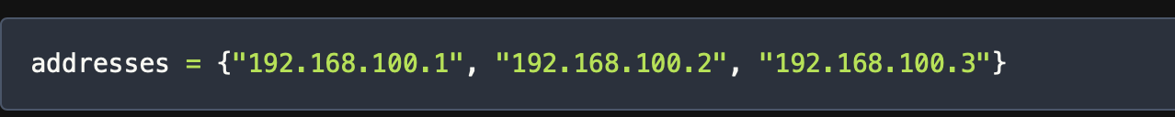
Sets in Python
Sets are a handy and flexible data structure in Python that can handle collections of unique elements. Unlike lists or tuples, sets are unordered and mutable, meaning you can change their content after creating them. Sets also support operations like union, difference, and intersection, similar to mathematical sets.
To create a set, use curly braces {} and separate the elements with commas. For example, you can create a set of IP addresses like this:

Slide 14
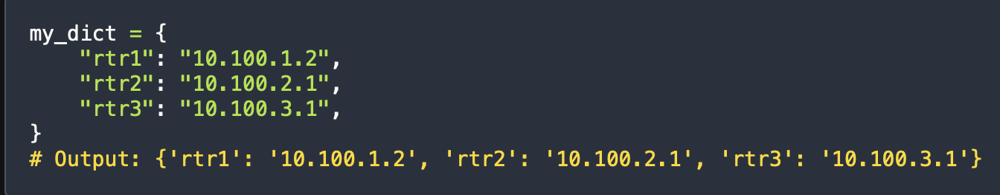
Python Dictionaries for Network Engineers
Dictionaries in Python are like special containers that store data as key-value pairs. They keep the order of items and are very useful for many programming tasks. You can create dictionaries using curly braces {} and access values by their keys. From Python 3.7 onwards, dictionaries are ordered by default, making them even more powerful for writing organized code.
The easiest way to create a dictionary is by using curly braces. You define key-value pairs within these braces. Here’s an example:

Slide 15
Python Files
File Reading in Python
Open the file with open() function
Reading the file
Closing the file
File writing in Python
Opening the file
Writing the file
Closing the file

Slide 16
Python Exception Handling
Exceptions are events when something goes wrong in the code. Such as syntax error, division by zero, missing file etc.
Exceptions are objects which represent the abnormal conditions that interrupts the normal flow of program.
Exceptions are handled through try() & catch() block.

Slide 17
Python Classes
In Python, everything is an object, everything we create in python associated with functions/methods or attributes.
A class serves as a blueprint for creating objects.
While a class is blueprint, an instance of object is built from the blueprint, containing data.
Instance methods are functions defined inside the class, callable only from an instance of that class.

Slide 18
Python Functions for Network Automation
In Python, the concept of functions plays a crucial role, allowing developers to encapsulate and reuse code efficiently. Functions provide a way to create modular and maintainable code, as specific tasks can be performed by calling a function multiple times, eliminating the need for redundant code.
Python’s functions are blocks of organized code designed to be reusable for specific tasks. They allow the efficient reuse of code segments and the creation of customized functions is straightforward. The syntax for defining a function in Python involves using the def keyword.
There are two types of functions in Python:
Built-in Functions
User-defined Functions

Slide 19
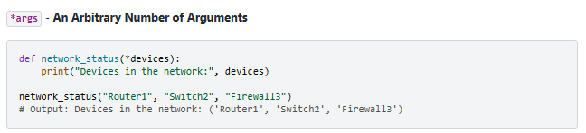
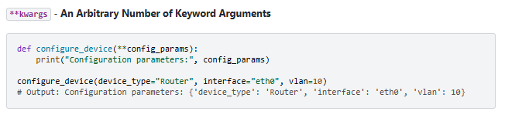
Python Functions Arguments
In functions, flexibility is key, and Python supports the concept of handling an arbitrary number of arguments and keyword arguments through *args and **kwargs.
With *args, the function network_status can accept an arbitrary number of devices, making it suitable for scenarios where the number of devices in the network is not fixed.
Using **kwargs, the function configure_device can handle an arbitrary number of keyword arguments, allowing for a more dynamic configuration approach.

Slide 20
Wrap Up
Python Automation for Network engineering
Python Variables & Data types
Python Loops
Conditional Statements & Python Collections

