Slide 1

Python Scripting with Network
Day 4

Slide 2

Agenda
Python Lists
Python Tuples
Python Sets
Python Dictonaries
Conditional statements
Python Files
Python Exception Handling
Python Classes
Python Functions

Slide 3
Python Lists
A python Lists is a basic & flexible way to store a collection of items.
Python lists maintains order
Holds mixed data
Is mutable
Lists use zero based indexing.

Slide 4
Python Tuples
A tuple is a way to store a collection of items in a specific order
Tuples can hold collection of items which are ordered & can be different types
Tuples are immutable in nature
Tuples are often used for pairs & small sets of related data

Slide 5
Sets in Python
Sets are a type of data structure in python which can store collections of unique items
Sets can use the in operator to check if an element in set
Sets support ops like union, intersection, difference for comparing or combining of sets
Sets can manage IP address, VLAN Ids, network devices.

Slide 6

Dictionaries in Python
Dictionaries in Python are like special containers that store data as key-value pairs. They keep the order of items and are very useful for many programming tasks.
You can create dictionaries using curly braces {} and access values by their keys

Slide 7
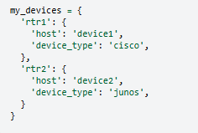
Nested Dictionaries in Python
Nested dictionaries in Python help you structure and organize data efficiently, making it easier to model complex relationships.
Python dictionaries are versatile and essential for organizing data.
Their dynamic features and support for nested structures make them powerful tools in Python programming and network engineering

Slide 8
Conditional Statements in Python
Conditional statements in Python help control the flow of your program. They let you run specific blocks of code based on whether certain conditions are true or false.
If statement: This runs a block of code if a condition is true.
Elif statement: This checks multiple conditions one after another, if one condition is true , it runs the corresponding block of code.
Else statement: this statement runs a block of code if none of the previous conditions are true.

Slide 9
Truthy & Falsy Values in Python
In Python, every value is either truthy or falsy. Truthy values are considered True in conditions, while falsy values are considered False.
Common truthy values:
Non-zero numbers
Non-empty strings
Non-empty collections
Common falsy values:
0 (zero)
0.0 (zero float)
‘’ (empty string)
None
Empty collections (lists, dictionaries, sets)

Slide 10
Python Lists
Maintains Order: The order in which you add items is the order in which you can access them.
Holds Mixed Data Types: You can mix different types of data in a single list, like strings, numbers, and more.
Is Mutable: You can change the items, size, and structure of a list after creating it.
A list is a collection of Items
Which maintains order – the order in which you add items in the order you can access them
Holds Mixed Data types – You can mix different types of data in a single list like strings, numbers and more.
Is Mutable – you can change the items, size and structure of the list after creating it.

Slide 11
Tuples in Python
A tuple is a collection of items that are ordered and can be of different types. You create a tuple using parentheses (), with items separated by commas.
my_tuple = (1, "hello", 22, None, 2.7)
Tuples can hold items of various types. In the example above, my_tuple includes integers, a string, None, and a floating-point number. This makes tuples very flexible.

Slide 12
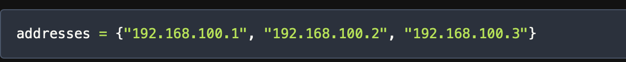
Sets in Python
Sets are a handy and flexible data structure in Python that can handle collections of unique elements. Unlike lists or tuples, sets are unordered and mutable, meaning you can change their content after creating them. Sets also support operations like union, difference, and intersection, similar to mathematical sets.
To create a set, use curly braces {} and separate the elements with commas. For example, you can create a set of IP addresses like this:

Slide 13
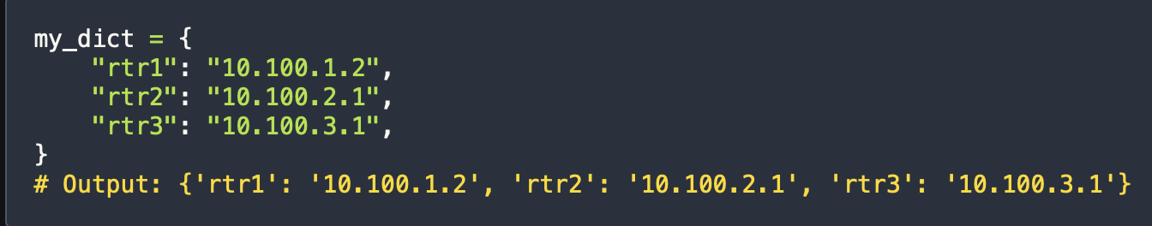
Python Dictionaries for Network Engineers
Dictionaries in Python are like special containers that store data as key-value pairs. They keep the order of items and are very useful for many programming tasks. You can create dictionaries using curly braces {} and access values by their keys. From Python 3.7 onwards, dictionaries are ordered by default, making them even more powerful for writing organized code.
The easiest way to create a dictionary is by using curly braces. You define key-value pairs within these braces. Here’s an example:

Slide 14
Python Files
File Reading in Python
Open the file with open() function
Reading the file
Closing the file
File writing in Python
Opening the file
Writing the file
Closing the file

Slide 15
Python Exception Handling
Exceptions are events when something goes wrong in the code. Such as syntax error, division by zero, missing file etc.
Exceptions are objects which represent the abnormal conditions that interrupts the normal flow of program.
Exceptions are handled through try() & catch() block.

Slide 16
Python Classes
In Python, everything is an object, everything we create in python associated with functions/methods or attributes.
A class serves as a blueprint for creating objects.
While a class is blueprint, an instance of object is built from the blueprint, containing data.
Instance methods are functions defined inside the class, callable only from an instance of that class.

Slide 17
Python Functions for Network Automation
In Python, the concept of functions plays a crucial role, allowing developers to encapsulate and reuse code efficiently. Functions provide a way to create modular and maintainable code, as specific tasks can be performed by calling a function multiple times, eliminating the need for redundant code.
Python’s functions are blocks of organized code designed to be reusable for specific tasks. They allow the efficient reuse of code segments and the creation of customized functions is straightforward. The syntax for defining a function in Python involves using the def keyword.
There are two types of functions in Python:
Built-in Functions
User-defined Functions

Slide 18
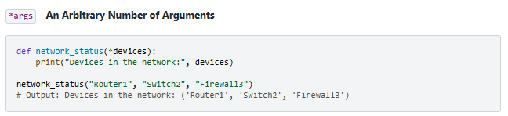
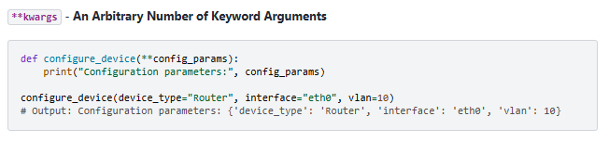
Python Functions Arguments
In functions, flexibility is key, and Python supports the concept of handling an arbitrary number of arguments and keyword arguments through *args and **kwargs.
With *args, the function network_status can accept an arbitrary number of devices, making it suitable for scenarios where the number of devices in the network is not fixed.
Using **kwargs, the function configure_device can handle an arbitrary number of keyword arguments, allowing for a more dynamic configuration approach.

Slide 19
Wrap Up
Python Automation for Network engineering
Python Variables & Data types
Python Loops
Conditional Statements & Python Collections

