Slide 1

Python Scripting with Network
Day 1

Slide 2

Agenda
Overview of Python
Object Oriented Programming (OOPs) Concepts
Python Installation
Python Data Types
Variables in Python
Operators in Python
Python Loops
Conditional statements

Slide 3
Overview of Python
Python is a versatile and powerful programming language that has become essential for network engineers. Whether you’re new to networking or an experienced professional, Python offers numerous benefits for network-related tasks. Let’s explore the key aspects of Python for network engineering.
Python for Network Automation
Network Automation - Python helps network engineers automate repetitive tasks such as making configuration changes, creating backups, and monitoring networks.
Configuration Management – Python based tools like Ansible, NAPALM, Netmiko are widely used for configuration management.
Monitoring & Troubleshooting – Python allows network engineers to create custom tools for monitoring and troubleshooting ensuring smooth health of network.
Network Security – Python allows implementing strong security policies, analyzing network traffic, responding to security incidents.
Cross –platform Compatibility – Python involves various OS and devices, streamlining operations, improve network efficiency and enhance security.

Slide 4

Python Benefits
Massive Library Ecosystem
Netmiko – Simplifies SSH connections for network devices
Paramiko – A low level library for SSH V2 protocol support
NAPALM – provides a unified API to interact with different OS
Scapy – Powerful tool for packet manipulation, sniffing/forging.
Low level socket support – building custom clients & servers and protocols like HTTP, FTP, TCP.

Slide 5
Object Oriented Programming(OOPS) Concepts
OOPs in Python is a paradigm which organizes the software design around objects, real world entities with specific data & objects.
Inheritance - Allows a "child" class to derive attributes and methods from a "parent" class, promoting code reusability.
Encapsulation: Bundles data and methods into a single unit (the class) and restricts direct access to some components to protect the internal state.
Polymorphism – Enables different classes to be treated as an instance of same general class through same interface.
Abstraction – Hides complex implementation details & shows only the essential features to the user

Slide 6
OOPs with Python
The building blocks of Object-oriented programming are classes and objects.
Classes – A blueprint or template for creating objects. It defines the attributes and methods.
Objects – A specific instance of a class, If “Router” is the class, you specified “cisco” is the object.
Methods – Functions defined inside a class which defines the actions an object can perform.
Attributes – Variables which hold data specific to the class (class attributes) or instance attributes.

Slide 7
Python Installation
Pip is the package installer for Python. You can use pip to install packages from python package index and other repositories.
Installation
Working in a virtual environment
Using Python downloaded from python.org
Using Python which has not been modified by a redistributor to remove ensurepip.
Python Virtual Environment
Python’s virtual environment allows to install third-party packages without affecting python installation.
Built-in venv module
The virtualenv package

Slide 8
Python’s venv library
To use venv module, you can run Python with the –m flag which tells Python to load the specific module.
Python –m venv test
This command creates a folder named test in your current directory, to activate the virtual environment navigate to the test folder, run the command in Linux / macOS.
source bin/activate
The virtualenv package is faster & it can create virtual environments for multiple python versions.
It can upgraded via pip.
pip install virtualenv
Virtualenv <Folder_Name>

Slide 9
Python Basic Data types
Lists – Ordered sequences of elements which are mutable
Sets – Collections of unordered elements which are immutable
Tuples – Similar to sets but use parentheses and also mutable.
Sequences:
String: str()
List: list()
Tuple: tuple()
Range: range()
Mapping:
e) Dictionary: dict()
Set: set()
Numbers:
f) Integer: int()
g) Boolean: bool()
h)float: float()

Slide 10
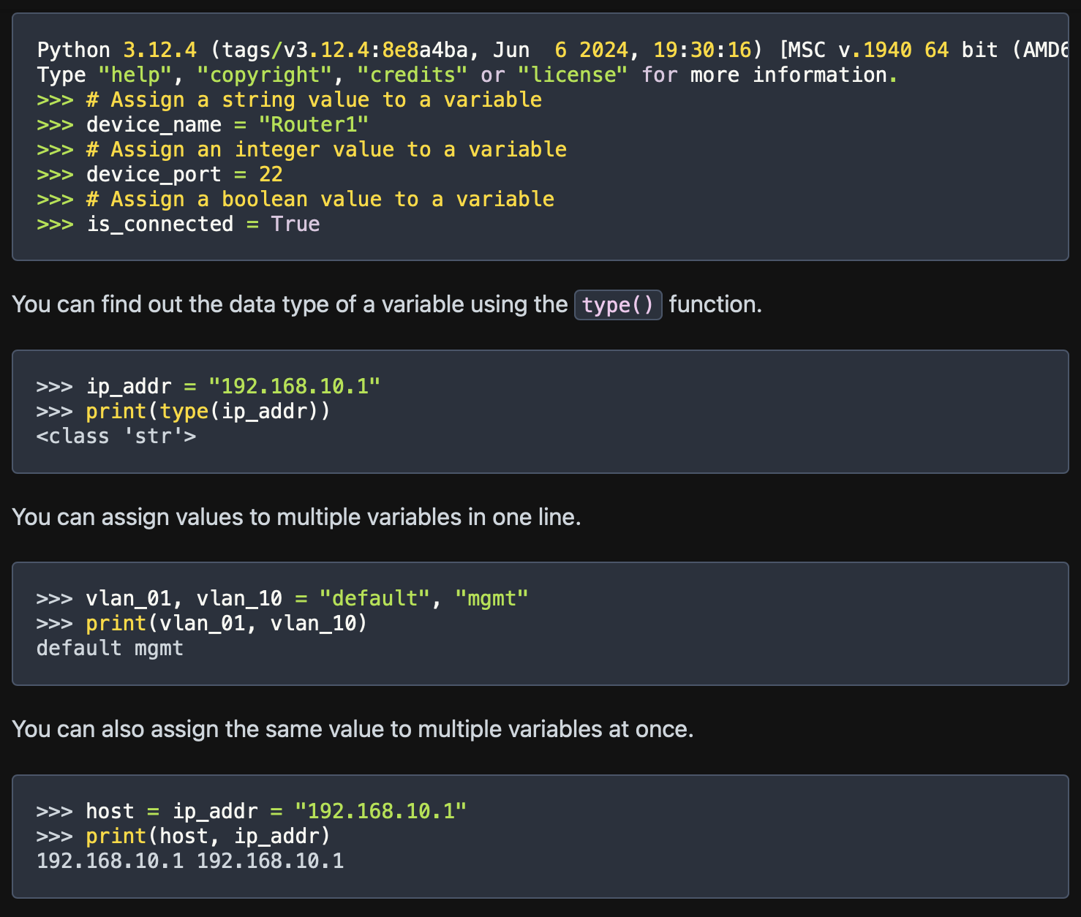
Python variables
A python variable is like a container which stores data temporarily.
Variables keep values accessible.
Variables make changes easy
Variables have data types.

Slide 11
Python Operators
Operators in Python are used to perform operations on variables and values. They are the following types –
Arithmetic operators
Assignment operators
Comparison operators
Logical operators
Identity operators
Memebership operators

Slide 12
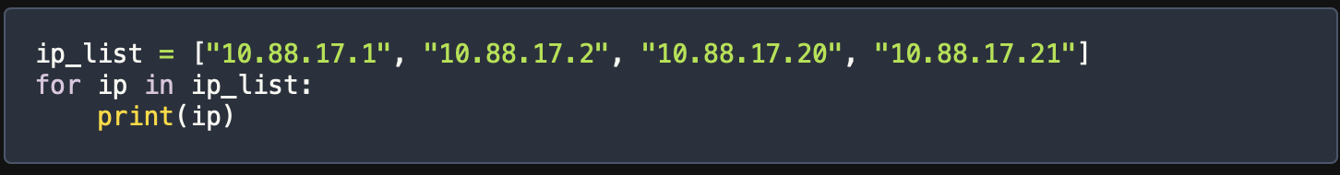
Loops in Python
For Loop
The for loop lets you run a block of code of each item in an iterable like a list, string, tuple, set or dictionary.
For keyword: This starts the loop. It tells python you want to begin the loop.
Loop variable - n for ip in ip_list:, ip is the loop variable. It’s a temporary variable that represents each item in the iterable during each loop cycle.
Looping object - (ip_list): ip_list is the list you want to loop over. In each loop cycle, the loop variable ip takes the value of the next item in the list.
Indented block - The indented code under the for loop is what runs in each loop cycle. Here, it’s print(ip).

Slide 13
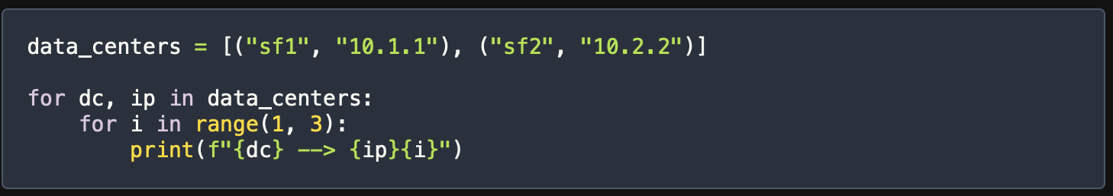
Nesting Loops in Python
Nesting loops in Python means putting one loop inside another. This lets you create more complex patterns and work with multiple levels of data.
Outer Loop – The outer for loop goes through data_centers list. In each loop_cycle, dc gets the first value of the tuple and ip gets the second value.
Inner for loop – Inside the outer loop, there’s another for loop, the inner loop generates numbers 1 to 2. In each cycle of inner loop, i gets the number in the range.

Slide 14
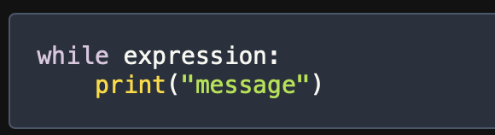
While Loop in Python
A while loop is a powerful tool in Python lets you repeatedly run a block of code as long as certain condition is true.
A while loop has an expression followed by a colon and an indented block of code.

Slide 15
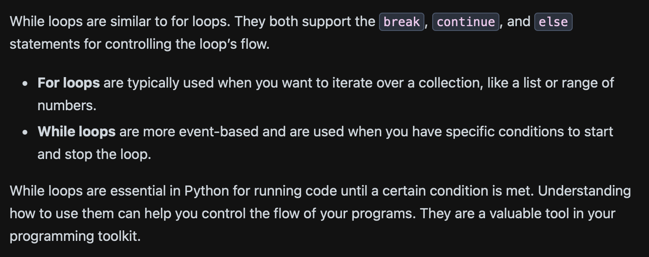
Difference between For & While Loop

Slide 16
Conditional Statements in Python
Conditional statements in Python help control the flow of your program. They let you run specific blocks of code based on whether certain conditions are true or false.
If statement: This runs a block of code if a condition is true.
Elif statement: This checks multiple conditions one after another, if one condition is true , it runs the corresponding block of code.
Else statement: this statement runs a block of code if none of the previous conditions are true.

Slide 17
Truthy & Falsy Values in Python
In Python, every value is either truthy or falsy. Truthy values are considered True in conditions, while falsy values are considered False.
Common truthy values:
Non-zero numbers
Non-empty strings
Non-empty collections
Common falsy values:
0 (zero)
0.0 (zero float)
‘’ (empty string)
None
Empty collections (lists, dictionaries, sets)

Slide 18
Python Lists
Maintains Order: The order in which you add items is the order in which you can access them.
Holds Mixed Data Types: You can mix different types of data in a single list, like strings, numbers, and more.
Is Mutable: You can change the items, size, and structure of a list after creating it.
A list is a collection of Items
Which maintains order – the order in which you add items in the order you can access them
Holds Mixed Data types – You can mix different types of data in a single list like strings, numbers and more.
Is Mutable – you can change the items, size and structure of the list after creating it.

Slide 19
Tuples in Python
A tuple is a collection of items that are ordered and can be of different types. You create a tuple using parentheses (), with items separated by commas.
my_tuple = (1, "hello", 22, None, 2.7)
Tuples can hold items of various types. In the example above, my_tuple includes integers, a string, None, and a floating-point number. This makes tuples very flexible.

Slide 20
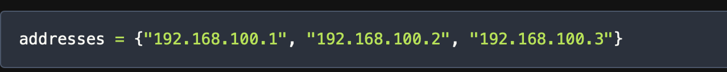
Sets in Python
Sets are a handy and flexible data structure in Python that can handle collections of unique elements. Unlike lists or tuples, sets are unordered and mutable, meaning you can change their content after creating them. Sets also support operations like union, difference, and intersection, similar to mathematical sets.
To create a set, use curly braces {} and separate the elements with commas. For example, you can create a set of IP addresses like this:

Slide 21
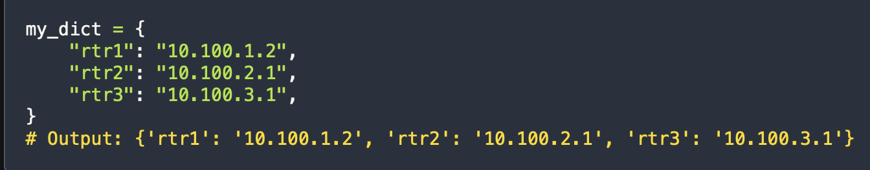
Python Dictionaries for Network Engineers
Dictionaries in Python are like special containers that store data as key-value pairs. They keep the order of items and are very useful for many programming tasks. You can create dictionaries using curly braces {} and access values by their keys. From Python 3.7 onwards, dictionaries are ordered by default, making them even more powerful for writing organized code.
The easiest way to create a dictionary is by using curly braces. You define key-value pairs within these braces. Here’s an example:

Slide 22
Wrap Up
Python Automation for Network engineering
Python Variables & Data types
Python Loops
Conditional Statements & Python Collections

