Slide 1
All I Want For Christmas…
Is a CUDA ASIC
Scott Le Grand
Senior Principal Technologist
slegrand@A9.com

Slide 2
Disclaimer
These are my personal views and they do not represent my employer in any way

Slide 3
Outline
The CUDA Effect
DSSTNE: Deep Learning For Recommendations
ASIC Prognostication

Slide 4
CUDA Effect Part 1: Things I don’t believe…
GPUs are hard to program!
GPUs are barely faster than CPUs!
“Google’s TPU is orders of magnitude faster than GPUs!”
“GPUs can only do one (parallel) thing at a time efficiently because of divergent threads”

Slide 5
CUDA Effect Part 2: Things I do believe
CUDA/OpenCL automagically subsumes SIMD, multithreaded, and multi-core programming
Even naïve implementations in CUDA are faster than equivalent multi-threaded C++
Orders of magnitude faster than *any* Python implementation

Slide 6
The CUDA Effect: Example
Toy Strawman: write code to multiply 2 4096 x 4096 matrices
Edward Kandrot covers this in detail here: http://ekandrotcode.blogspot.com/2017/06/cuda-rocks-perf.html
TLDR: 98 ms in CUDA on a GTX 1080Ti, 11 minutes multithreaded on an Intel Core i7 CPU (8 cores), 3 minutes on dual Xeons (80 cores)
Where do you want to spend your engineering hours?

Slide 7
Naïve C++ Code
struct threaded_matmul : worker {
float *_a, *_b, *_c;
threaded_matmul(float *a, float *b, float *c) : _a(a), _b(b), _c(c) {}
void do_work(int work) {
int x = work % 4096;
int y = work / 4096;
// same code as cached kernel
float t = 0;
for (int k=0; k<4096; ++k) {
t += _a[k + y*4096] * _b[x + k*4096];
}
_c[x + y*4096] = t;
}
};

Slide 8
Naïve CUDA Code
__global__ void shared_matmulx2(const float *a, const float *b, float *c) {
__shared__ float sa[TD*2][TD+1];
__shared__ float sb[TD][TD*2+1];
const int x = threadIdx.x + blockIdx.x * blockDim.x;
const int y = threadIdx.y + blockIdx.y * blockDim.y;
const int tx = threadIdx.x;
const int ty = threadIdx.y;
float t = 0;
for (int chunk=0; chunk < gridDim.x; chunk += 2) {
sa[tx][ty] = a[tx+chunk*TD + y*4096];
sb[tx][ty] = b[x + (ty+chunk*TD)*4096];
sa[tx+TD][ty] = a[tx+(chunk+1)*TD + y*4096];
sb[tx][ty+TD] = b[x + (ty+(chunk+1)*TD)*4096];
__syncthreads();
for (int k=0; k<2*TD; ++k) {
t += sa[k][ty] * sb[tx][k];
}
__syncthreads();
}
c[x + y*4096] = t;
}

Slide 9
Fail Fast
Want to try new things, not so much different combinations of old things
Deep Learning frameworks and libraries induce engineering-driven data science
What runs quickly converges sooner
What converges sooner can be searched further
Frameworks are great but they abstract away low-level performance and theoretical opportunities

Slide 10
CUDA Programming Model Rocks
Sure, you can use hand-coded VHDL and dirty tricks to beat a $700 consumer GPU at training AlexNet in FP16/32 (sort of) on your fancy ASIC
Or even 12-bit weights and 11% of the original weights to beat that GPU running an LSTM in FP32 on an FPGA
Is that really how your want to spend your days?
Late stage optimizations
You can learn CUDA and build 100% reproducible code targeted at the problems of interest to your employer/advisor, then chase the GPU Roadmap

Slide 11
Woulda… Shoulda… CUDA…
OpenCL disabled on IOS and on Android (Why?)
Could have run inference on phones in 2013
IOS fixed this with metal and GPUs
Google broke this further with RenderScript
Google fixing with TensorFlow
The race is on to ship TFLOP low-power inference ASICs for mobile and IoT

Slide 12
DSSTNE
Short for Deep Sparse Scalable Tensor Network Engine
DSSTNE is not TensorFlow, MXNet, Torch, Theano, Chainer, or Caffe
DSSTNE is a deep learning framework optimized to serve a very specific vertical
Very very very sparse data in very very large networks
But of course, with cuDNN/Neon code out there, all things are possible

Slide 13
Product Recommendations
What are people who bought items A, B, C…Z likely to purchase next?
Traditionally addressed with classical machine learning approaches such as Matrix Factorization, Logistic Regression, Naïve Bayes, etc.
So why not try Deep Learning?

Slide 14
Deep Learning For Product Recommendations
Output (10K-10M)
Hidden (100-1K)
Input (10K-10M)

Slide 15
Huge I/O, Tiny Hidden Layers
Output (10K-10M)
Hidden (100-1K)
Input (10K-10M)
Existing frameworks were not designed to handle neural networks with input (purchase history) and output (recommendations) layers 10K to 10M units wide because…

Slide 16
Huge Sparse Data Problem
Uncompressed sparse data eats memory, bandwidth, or both depending on how it’s managed
Naively running networks with lots of empty data leads to lots of multiplications by zero, wasting memory, math, power and time
Product recommendation networks can have billions of parameters that cannot fit in a single GPU
Purchase data is too sparse to rely on existing libraries such as cuSparse

Slide 17
2014 Framework Requirements
Efficient support for enormous input and output layers
Compressed sparse data
Automagic multi-GPU support for large networks and scaling
Avoid unnecessary math and moves
<24 hours training and recommendations cycle
Human-readable for data scientists

Slide 18
DSSTNE
Deep Learning framework released to OSS (Apache License) by Amazon in May of 2016
Optimized for huge sparse data problems
Efficient automagic model-parallel support
Single GPU ~6x faster than TensorFlow 0.98 on such datasets, ~15x faster on 4 GPUs
100% Deterministic Training and Inference
No shortcuts/hacks, only avoid multiplies by and storing zeroes
Works on any Kepler or later GPU (K80 onwards)

Slide 19
Key Features
Models and data stored in netcdf with HDF5 support
Multi-GPU collectives handled with MPI 1.0 operations and CUDA Interprocess P2P copies
Convolution and pooling layer Support added through cuDNN 6.0
Dependencies are C++11, CUDA 8.x, netcdf, a C++11-aware MPI library, libjsoncpp, and cuDNN

Slide 20
JSON used to describe networks
{
"Version" : 0.81,
"Name" : "AlexNet",
"Kind" : "FeedForward",
"LocalResponseNormalization" :
{
"k" : 2,
"n" : 5,
"alpha" : 0.0001,
"beta" : 0.75
},
"Layers" : [
{ "Kind" : "Input", "Type" : "Convolutional", "N" : "auto", "DataSet" : "input"},
{ "Kind" : "Hidden", "Type" : "Convolutional", "N" : 96, "Kernel" : [11, 11], "KernelStride" : [4, 4], "Activation" : "Relu" },
{ "Kind" : "Hidden", "Type" : "Pooling", "Function" : "LRN" },
{ "Kind" : "Hidden", "Type" : "Pooling", "Function" : "Max", "Kernel" : [3, 3], "KernelStride" : [2, 2]},
{ "Kind" : "Hidden", "Type" : "Convolutional", "N" : 256, "Kernel" : [5, 5], "Activation" : "Relu" },
{ "Kind" : "Hidden", "Type" : "Pooling", "Function" : "LRN" },
{ "Kind" : "Hidden", "Type" : "Pooling", "Function" : "Max", "Kernel" : [3, 3], "KernelStride" : [2, 2] },
{ "Kind" : "Hidden", "Type" : "Convolutional", "N" : 384, "Kernel" : [3, 3], "Activation" : "Relu" },
{ "Kind" : "Hidden", "Type" : "Convolutional", "N" : 384, "Kernel" : [3, 3], "Activation" : "Relu" },
{ "Kind" : "Hidden", "Type" : "Convolutional", "N" : 256, "Kernel" : [3, 3], "Activation" : "Relu" },
{ "Kind" : "Hidden", "Type" : "Pooling", "Function" : "Max", "Kernel" : [3, 3], "KernelStride" : [2, 2] },
{ "Kind" : "Hidden", "Type" : "FullyConnected", "N" : 4096, "Activation" : "Relu", "pDropout" : 0.5 },
{ "Kind" : "Hidden", "Type" : "FullyConnected", "N" : 4096, "Activation" : "Relu", "pDropout" : 0.5 },
{ "Kind" : "Output", "Type" : "FullyConnected", "N" : "auto", "DataSet" : "output", "Activation" : "SoftMax" }
],
"ErrorFunction" : "CrossEntropy"
}
*Caffe description of AlexNet is ~280 lines (2014)

Slide 21
Key Features of DSSTNE
Sparse Training and Inference
Deterministic Training and Inference
Scaling Large Networks

Slide 22
Deep Learning in 3 Equations
X_{L+1} = X_{L} * W_{L→L+1}
δ_{L} = δ_{L+1} * W_{L→L+1}
ΔW_{L→L+1} = X^{T}_{L} * δ_{L+1}

Slide 23
1. Sparse Neural Network Training
X_{L+1} = X_{L} * W_{L→L+1}
ΔW_{L→L+1} = X^{T}_{L} * δ_{L+1}

Slide 24
Sparse X_{L+1} = X_{L} * W_{L→L+1}
Equivalent to summing embedding vectors in NLP
Embeddings are the weights of the input layer
Inputs are 1/0 or count-encoded
Much faster than a naïve SGEMM/SGEMV of mostly zero data
“Sparse input layers are free”

Slide 25
Sparse ΔW = X^{T}_{L} * δ_{L+1}
Need to transpose X_{L} matrix in parallel
Easy to do with atomic ops on GPUs
But the transpose ordering is not deterministic, floating point math is not associative (A + B + C) != (C + A + B)
Solution: use 64-bit fixed point summation because fixed point accumulation is associative (A + B + C) == (C + A + B)
64-bit fixed point adds are also 32-bit instructions on NVIDIA GPUs (that means they aren't stupid slow on consumer GPUs)

Slide 26
2. Deterministic Training/Inference
Consumer GPU failure rate is up to 20%
Tesla ECC only covers system memory, so run twice
2 consumer GPUs cost $1400 vs $9000 for Tesla GPU
W/o determinism race conditions are undetectable
W/o determinism, results cannot be reproduced
W/determinism, data scientists can provide bug repros
W/determinism, nondeterministic execution is a bug
Invest engineering hours upfront, save big later

Slide 27
3. Scaling Large Networks
“My belief is that we’re not going to get human-level abilities until we have systems that have the same number of parameters in them as the brain.” - Geoffrey Hinton

Slide 28
Model-Parallel vs Data-Parallel
Amazon Product Categories range from 10K to 10M items
The Amazon catalog is billions of items (holy grail)
But GPUs only have up to 12 (2015) $ I mean 24 (2016) $$ oops I mean 32 GB (2016) $$$ of memory
All the interesting problems need >12 GB of memory for their models, ruling out data-parallel
Data Parallel Implementation unacceptably slow for networks with fully connected layers (GBs of weight gradients)

Slide 29
“Automagic” Model Parallel
Uses same network descriptor/data
1 GPU/process because of its simplicity
DSSTNE engine automatically distributes the network across multiple GPUs/machines
./trainer (serial job, 1 GPU)
mpirun -np 3 ./trainer (model parallel, 3 GPUs)
mpirun -np n ./predictor (model parallel, n GPUs)

Slide 30
One Weird (Model Parallel) Trick
To parallelize an SGEMM operation, first one shards the input data across all N GPUs (N = 4 here)
W1
X_{L}
X_{L1}
X_{L2}
X_{L3}
X_{L4}

Slide 31
Two Ways to Shard Weights
1
W₁
W₂
W
W₁
W₂
W₃
W₄
W
W₃
W₄

Slide 32
Output > Input Layer? allGather2D* Inputs Then SGEMM
X_{L+1}
X_{L}
W1
1
W1
=
X_{L1}
X_{L2}
X_{L3}
X_{L4}
*
W₁
X_{L+1 1}
*Using custom 2D allGather code which is O(D)

Slide 33
Input > Output Layer? SGEMM Then Reduce2D Outputs*
X_{L+1}
X_{L}
W1
W₁
*
=
X_{L+1 1}
X_{L1}
*Using custom 2D partial reduction code which is also O(D)

Slide 34
Mixing Math and Moves
W1
W1
W1
X_{L:1}
X_{L:2}
X_{L:3}
X_{L:4}
X
W_{L->L+1:1}
=
X_{L+1:1}
1
2
1
2
1
2
1
2
4
3
4
3
4
3
4
3
*Scatter the inputs over N-1 communication steps if the model inputs are smaller than the model outputs

Slide 35
Mixing Math and Moves
W_{L->L+1:1}
W1
X_{L:1}
X
=
X_{L+1:1}
X_{L+1:2}
X_{L+1:3}
X_{L+1:4}
1
2
1
2
1
2
1
2
4
3
4
3
4
3
4
3
* Reduce the outputs over N-1 communication steps if the model outputs
are smaller than the model inputs

Slide 36
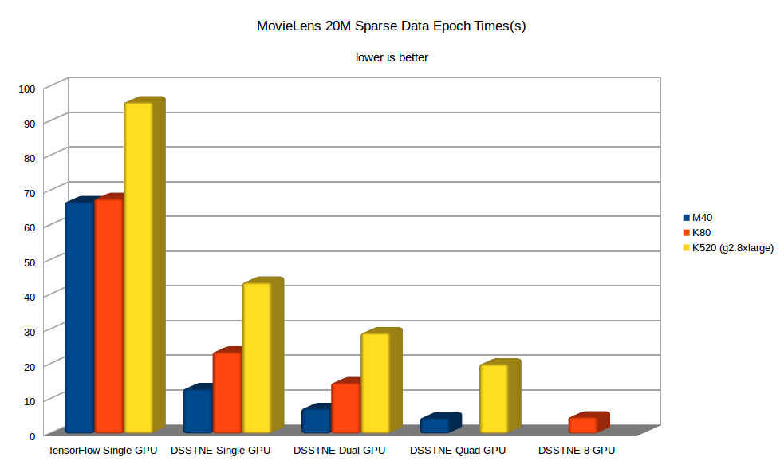
How Well Does This Work?

Slide 37
How Good Are The Recommendations?
“I think Amazon does a way better job of recommending
books to me than even my wife does.” – Andrew Ng*
*From “Artificial Intelligence is the New Electricity” around 1:22:47

Slide 38
Prognostication
“Prediction is very difficult,
especially if it’s about the
future” – Niels Bohr

Slide 39
DSSTNE’s ASIC Requirements
100% bitwise-reproducible training and inference
Automagic model parallelism
Efficient handling of extremely sparse data
Fine-grained scheduling of larger operations to achieve better cache coherence and task-level parallelism
At least 5x faster than a contemporary GPU

Slide 40
Reading The Tea Leaves
Besides what DSSTNE needs
Lots of multiplies and adds (FP32 preferred)
No need for full IEEE compliance, just NaNs
Lots of L1/L2 cache
A flexible memory controller
Lots of grouped functional units, but each independently schedulable
And a simpler programming model than VHDL…

Slide 41
I WANT A CUDA ASIC
“If you cut out all the graphics transistors, you could probably double or triple CUDA performance” – Anonymous NVIDIA HW Engineer, 2012

Slide 42
What I don’t want…
Unprogrammable piles of transistors with heroic synthetic perf
“Statistically” reproducible execution
Arbitrarily unspecified reduced precision models
Apples to Oranges Benchmarks i.e. FP12 vs FP32
Comparisons of closed source libraries to hand-coded VHDL plus clever tricks

Slide 43
So in Summary…
I JUST WANT A CUDA ASIC…
(or an OpenCL ASIC)

Slide 44
Acknowledgments
Amazon: Edward Kandrot, David Dubinski, Srikanth Thirumulai, Rejith George Joseph, Kiuk Chung, Leo Dirac, Tristan Penman, Jane You, Oleg Rybakov, Avishkar Misra, Henri Yandell, Vijai Mohan, Sebastian Gunningham, Cesar Romero, Matias Benitez
NVIDIA: Duncan Poole, Mark Berger, Paulius Micikevicius
AMD: Greg Stoner, Ben Sander, Michael Mantor

