Slide 1
iDEE-Databricks Metadata-Driven ELT Framework
Technical Architecture

Slide 2
Engineering Problem Statement
Today:
Multiple metadata patterns (Custom: Gen A, Gen B, V4-for-gold)
Pain:
Execution logic and metadata contracts are fragmented => Slow data onboarding
Duplicted DQ/audit logic => Slow deployment time
Target:
One reusable iDEE-based framework driven by metadata with flexible companents
Outcome:
Onboard new datasets by configuration, not custom engineering
Multiple onboarding frameworks and metadata standards have created inconsistent implementation patterns, requiring custom engineering for each new dataset instead of leveraging a reusable metadata-driven approach.

Slide 3
Prerequisites for a New User
Before building with the framework, every new user needs two things in place, the right access and the right local toolkit.
Required Access
Recommended Local Tools
Provisioned by the platform and security teams
Installed on the developer's own machine
Bitbucket repository access
Databricks workspace access
Unity Catalog development permissions
Approved compute or serverless access
Permission to deploy and run development resources
Access to approved source systems or sample data
Access to approved secret references
Git
VS Code (or another IDE)
Python
Databricks CLI extension
Approved Databricks authentication method
Optional Python virtual environment (.venv)
Guardrail: deploy and test in development, production write access is not granted automatically.
Note: the optional .venv isolates local dependencies for testing only; Lakeflow does not run inside it.
With both in place, a new developer can clone, deploy, and validate the framework in development on day one.

Slide 4
Where is the Framework Installed?
The complete framework exists across three locations
Component | Location
Source code | Bitbucket
Local working copy | VS Code or another IDE
Deployment definitions | databricks.yml and resource YAML
Jobs and pipelines | Databricks workspace
Metadata tables | Unity Catalog
Bronze, Silver, Gold | Unity Catalog
Optional landing files | ADLS Gen2 or Unity Catalog Volumes
Secrets | Managed identity, Unity Catalog connections, Key Vault, or another approved mechanism
Tests | Repository and Databricks test jobs
Documentation | README.md and docs/
1
BITBUCKET
Permanent source of truth
Code, SQL, YAML, tests, templates, documentation
clone
2
LOCAL DEV ENVIRONMENT
VS Code, Git, Databricks CLI, optional .venv
Used to edit, test, validate, and deploy
bundle deploy
3
DATABRICKS WORKSPACE
Lakeflow Jobs & Pipelines, metadata tables, Bronze / Silver / Gold, audit, and monitoring
VS Code is the development environment. Databricks is the runtime environment.

Slide 5
The LEGO Design Philosophy
The framework is built as interchangeable LEGO bricks. Each brick is self-contained, well-defined, and replaceable.
Metadata controls which bricks activate and how they connect, swapping one brick does not require redesigning the rest.
CONNECTORS
INGESTION
METADATA
ORCHESTRATION
Stream
Flat Files
DBs
APIs
Auto Loader
JDBC
LF Connect
Kafka Conn.
API Conn.
source_config
object_config
column_config
quality_rules
gold_config
Lakeflow Jobs
Schedule
Retry
Monitor
Alert
TRANSFORMATION
QUALITY
AUDIT
Operators
Custom Transformations
Rule engine
SQL booleans
Quarantine
Warn / Drop
pipeline_audit
Metrics
Run history
Alerting
Notes:
Operators – describe what they are incremental?? Or full???

Slide 6
End-to-End Runtime Flow
1
Source Systems
Oracle · SAP · CSV / JSON · Parquet · Kafka · API · Salesforce
2
Metadata Configuration populated by DE team
source_config · object_config · column_config
quality_rule_config · gold_model_config
Lakeflow Job Orchestration LEGO
3
Task 1 — Initialize run (run_id, STARTED audit)
Task 2 — Validate metadata (pre-flight checks)
Task 3 — Run Bronze + Silver pipeline
Task 4 — Run Gold models
Task 5 — Reconcile counts + audit
Task 6 — Notify on success or failure
landing_required
YES · Files UC Volume / ADLS · Vendor Drop Zone
NO · DB/Stream JDBC / Lakeflow Connect · Kafka / API
AUTO LOADER (cloudFiles) Incremental · Checkpointed · Schema-evolving
4
Bronze Tables Raw LEGO
Raw Delta · Append-only · Near-source fidelity
_ingestion_timestamp · _source_file · _object_id · run_id
Silver Transformation + Quality LEGO
5
column_config → rename, cast to target_type, trim
quality_rule_config → evaluate SQL boolean expressions
CDC / SCD2 when load_type = CDC
VALID SILVER RECORDS
Clean · Typed · Deduped
QUARANTINE TABLES
Rejected rows + violation tags · _failed_rule · _failure_reason
6
Gold Models Business LEGO
gold_model_config → SQL or Python files
Facts · Dimensions · KPIs · Aggregations
7
Consumption
Power BI · SQL Analytics · ML Feature Pipelines · AI Apps
Audit spans every layer pipeline_audit → Metrics dashboards → Alerts → Notifications

Slide 7
Control Plane: Six Metadata Tables
Config File | How it helps
source_config | Defines Sources + Connectors
object_config | What to ingest + And how to process
column_config (DO WE REALLY NEED THIS?) | Schema standardization after cleaning
quality_rule_config | DQ rules + Action + Severity
gold_model_config (Not Needed) | Business data aggregation
pipeline_audit | Observability and Traceability​

Slide 8
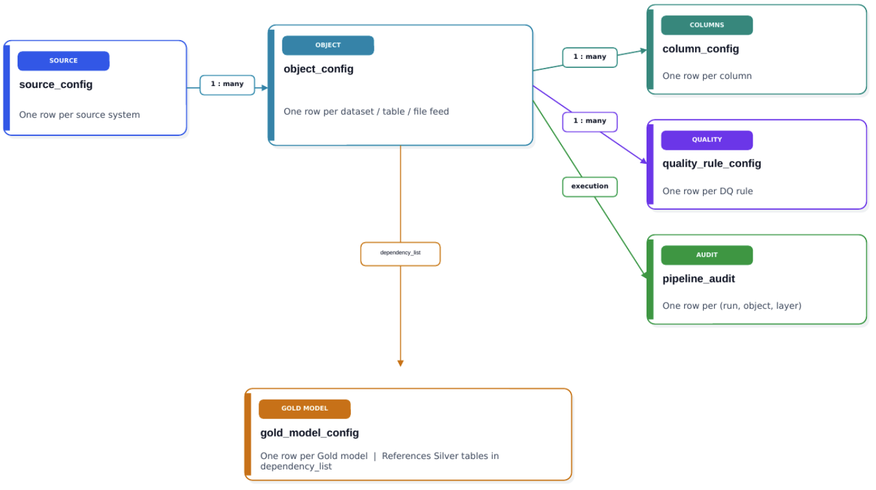
Configuration Flow
Config Files Relationship
Parent-Child tree structure
Flow
Source -> Tables -> DQ -> Table Standardization -> Audit -> Business models

Slide 9
Databricks Runtime Design (Execution Plane)
Bootstrap
Validate metadata
Bronze
Raw ingestion
Silver
Clean + DQ split
Gold
Business models
Quarantine
Rejected rows + violation tags
Data-Quality Boundary
• Framework runs the rules; it does not hardcode business logic
• Row-level rules route pass/fail to clean vs quarantine
• Dataset-level rules (uniqueness) run an aggregate check phase
• Rule outcomes persist for audit and incident triage
Cross-Cutting Contracts
• Audit row per run, object, and layer
• Deterministic checkpoints; idempotent, safe reruns
• Error taxonomy with alert routing
• Observability dashboard over pipeline_audit

Slide 10
Deployment and SDLC Pattern
Single source of truth — Bitbucket: code + metadata schemas + docs
DEV
• Deploy via Asset Bundle
• Iterate on a feature branch
• Run smoke + integration tests
QA
• Production-like data shapes
• Integration + acceptance tests
• Approval gate before release
PROD
• Deploy with service principal
• Immutable, tagged artifacts
• Automated — no manual edits
Pull request + policy checks
CI validate + approval
Deploy mechanism
Databricks Asset Bundle promotes the same artifact to each environment.
Rollback
Restore a prior state through versioned metadata and a tagged release.

Slide 11
Open Technical Risks and Decisions
Open Decision | Recommended Direction
Execution engine (Phase 5) | Decide between plain PySpark jobs and native Lakeflow Declarative Pipelines,or a flexibility of both, then document the choice with the design team. Lakeflow Jobs run the procedural outer loop; SDP handles declarative dataset dependencies.
Canonical load semantics | Standardize FULL / INCREMENTAL / CDC / SNAPSHOT precedence and required fields — INCREMENTAL needs an incremental_column, CDC needs a primary_key plus sequence column.
Contract versioning | Keep IngestionSpec as the neutral, generation-agnostic contract so the metadata model can evolve without breaking the stage generators.
Secrets across connectors | Reference secrets through connection_ref and Unity Catalog connections; never store credentials as plaintext.
Governance and ownership | Preserve the responsibility model across source, platform, data engineering, governance, and CI/CD; the framework standardizes onboarding but does not bypass enterprise access controls.
Performance guardrails | Bound high-volume object parallelism with execution_order and parallel_group in object_config.

Slide 12
Expected Business Value
Operational Benefits
• Faster dataset onboarding
• Lower engineering rework
• Reusable cross-project architecture
• Consistent DQ and audit contracts
Look into Databricks time travel
What do you want to track?
Every small thing that was changed in a table?
That’s a lot of overhead (holding lots of data), think it through carefully
This shouldn’t be available for all tables.
Governance Benefits
• Versioned metadata and code
Versioning database migration
• Traceable change history
There should be a table or record of the version of iDEE for DB.
• Standardized templates
No custom architectures
• Improved reliability and accountability
Lego acrchitecture helps speed up RCA during downtime

Slide 13
Next Steps
A phased roadmap from metadata foundation to developer experience.
1
Metadata Foundation
Immediate
Create the six metadata tables, seed DEV data, and implement the metadata reader with validated ingestion specs.
2
Stage Implementation
Short-term
Build the Bronze, Silver, and Quality generators from metadata config, with audit writes wired in.
4
Orchestration
Medium-term
Add execution order and parallel groups to the runner, wire the six-task Lakeflow job, and deploy to QA.
5
Execution Engine Decision
Design
Decide between plain PySpark jobs or native Lakeflow Declarative Pipelines, then document the call with the design team.
6
Developer Experience
Enablement
Finalize the provisioning guide and publish seed templates and an onboarding checklist for new teams.

Slide 14
Q & A

Slide 15
END

Slide 16
Supplemental Slides

Slide 17
The LEGO Design Philosophy
The framework is built as interchangeable LEGO bricks. Each brick is self-contained, well-defined, and replaceable.
Metadata controls which bricks activate and how they connect, swapping one brick does not require redesigning the rest.
CONNECTORS
INGESTION
METADATA
ORCHESTRATION
L E G O
L E G O
L E G O
L E G O
Stream
Flat Files
DBs
APIs
Auto Loader
JDBC
LF Connect
Kafka Conn.
API Conn.
source_config
object_config
column_config
quality_rules
gold_config
Lakeflow Jobs
Schedule
Retry
Monitor
Alert
TRANSFORMATION
QUALITY
AUDIT
CONSUMPTION
L E G O
L E G O
L E G O
L E G O
Operators – describe what they are incremental?? Or full???
Rule engine
SQL booleans
Quarantine
Warn / Drop
pipeline_audit
Metrics
Run history
Alerting
Power BI
SQL queries
ML pipelines
AI apps

Slide 18
Engineering Problem Statement
Current state has multiple metadata patterns (Gen A, Gen B, iDEE config paths)
Execution logic and metadata contracts are fragmented across implementations
Operational controls (DQ, audit, onboarding, deploy) are inconsistent
Target is one canonical runtime contract with adapter-based compatibility

Slide 19
Architecture Decision: Canonical Contract
Canonical Runtime Contract
• Single dataset spec consumed by runtime engine
• Stable fields for source, load policy, target, governance
• Pre-validation before execution
• Versioned and promotable across environments

Slide 20
Architecture Decision: Canonical Contract + Adapters
Canonical Runtime Contract
• Single dataset spec consumed by runtime engine
• Stable fields for source, load policy, target, governance
• Pre-validation before execution
• Versioned and promotable across environments
Current Adapters
• Gen A tables -> contract
• Gen B tables -> contract
• iDEE JSON/Postgres -> contract
• Legacy metadata retained during migration

Slide 21
Control Plane: Six Metadata Objects
connector_profile: native connector + auth references
dataset_contract: one canonical dataset definition
ingestion_policy: full/incremental/cdc/checkpoint behavior
quality_profile: DQ ruleset references + thresholds
transform_profile: Silver/Gold model behavior references
governance_profile: ownership, classification, SLA, approval

Slide 22
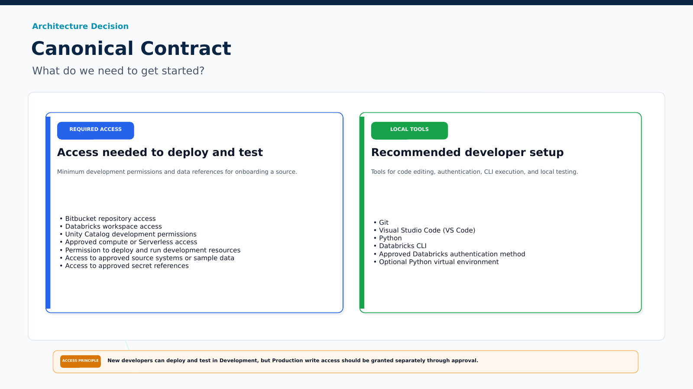
Architecture Decision: Canonical Contract What do we need to get started?
Required Access
Bitbucket repository access
Databricks workspace access
Unity Catalog development permissions
Approved compute or Serverless access
Permission to deploy and run development resources
Access to approved source systems or sample data
Access to approved secret references
Recommended Local Tools
Git Visual Studio Code (VS Code)
Python Databricks CLI
Approved Databricks authentication method
Optional Python virtual environment

Slide 23
End-to-End Runtime Flow
1
Source Systems
Oracle · SAP · CSV / JSON · Parquet · Kafka · API · Salesforce
2
Metadata Configuration
source · object · column · quality-rule · gold-model configs
3
Lakeflow Job
Validate metadata → ingest → transform → reconcile counts → notify
4
Bronze — Raw Load
Raw Delta · append-only · near-source fidelity with lineage columns
5
Silver — Transform + Quality
Typed & cleaned · DQ rules · CDC / SCD2 · valid vs. quarantine split
6
Gold Models
Facts · dimensions · KPIs · aggregations in SQL or Python
7
Consumption
Power BI · SQL Analytics · ML feature pipelines · AI apps
Audit spans every layer · pipeline_audit → metrics dashboards · alerts · notifications

Slide 24
Migration Strategy (No Big-Bang Rewrite)
Phase 1
• Introduce canonical contract and validators
• Run adapters for Gen A/Gen B/iDEE in parallel
• Pilot 3-5 datasets end-to-end
• Lock audit schema and naming standards
Phase 2/3
• Migrate remaining datasets by domain
• Deprecate legacy direct-runtime paths
• Move to contract-only runtime ingestion
• Retire obsolete metadata fields after cutover

Slide 25
30-Day Technical Deliverables
Canonical metadata schema + validation pack
Adapter conformance tests (Gen A, Gen B, iDEE)
Reference Lakeflow job graph with DQ + SCD2 + audit
Pilot metrics: onboarding time, run reliability, DQ coverage
Engineering readiness review for broader rollout

