Slide 1
Human-Computer Interaction
and Digital Accessibility
An overview of how people and computers interact

Slide 2
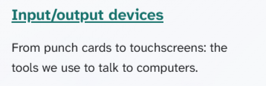
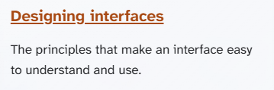
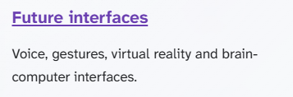
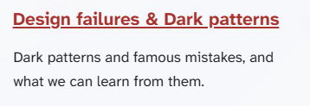
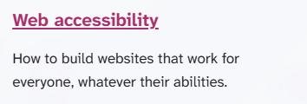
TOPICS (To refresh your memory…)

Slide 3
Timeline
Article research
Pages development
Global Style
Go/No-Go
Midway
(today)
Final deadline

Slide 4
Did everything go as planned?
no.

Slide 5
So… what went wrong?
5 different CSS leaders (in total)
a slow start in general

Slide 6
Are we on track?
yes!
Notes:
We have both General Style and reaserches ready

Slide 7
Feedback from our Teams
Notes:
We have both General Style and reaserches ready

Slide 8
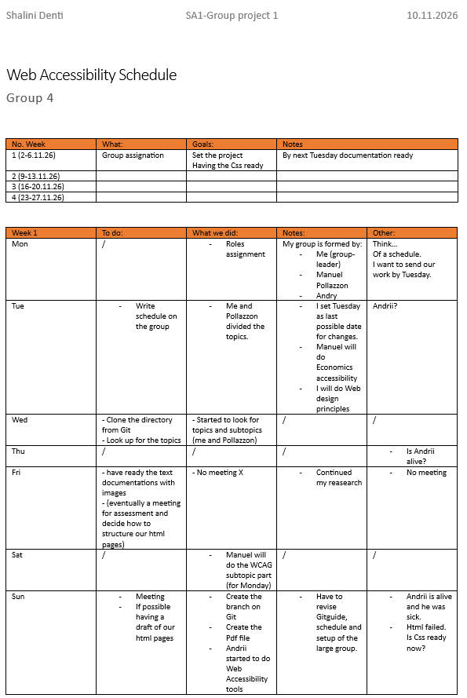
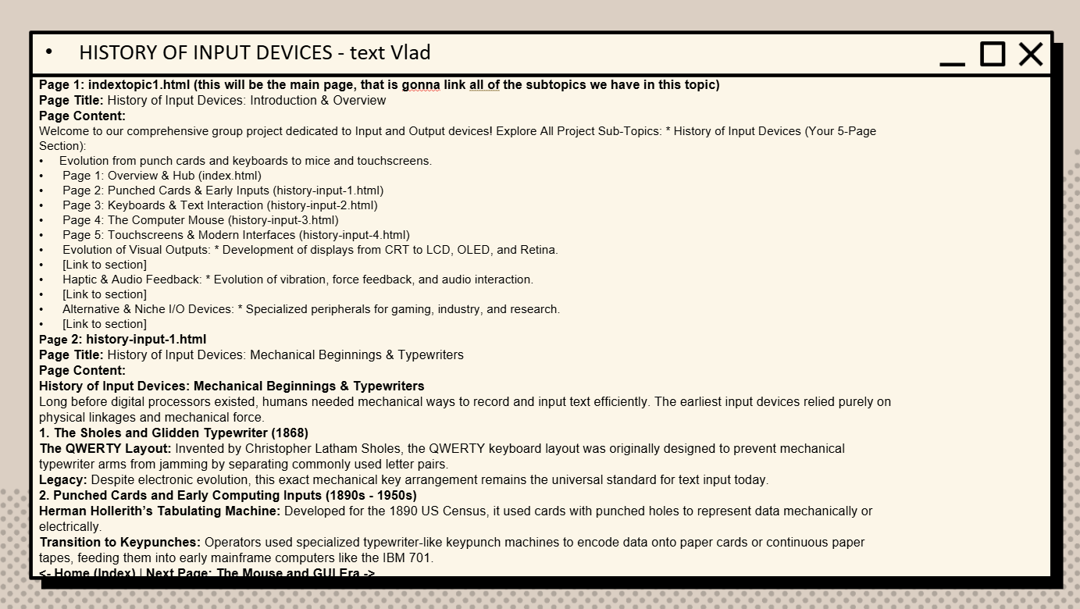
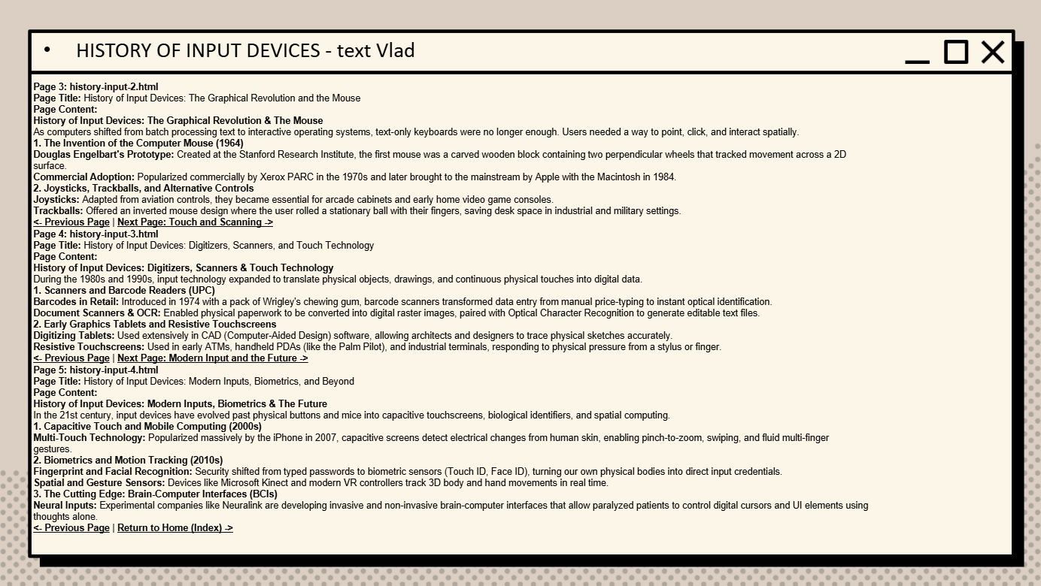
Feedback from our Teams
And more…
Notes:
We have both General Style and reaserches ready

Slide 9

Let’s check out the website now
https://sa1.daliia.ch/html/
Notes:
We have both General Style and reaserches ready

Slide 10
What comes next?
HTML pages must be implemented by next week (based on example-article.html)
Notes:
We have both General Style and reaserches ready

Slide 11
Thanks for your attention
Notes:
We have both General Style and reaserches ready

