Slide 1
6. join

Slide 2
join 종류
inner join
- natural join
- using
- on
outer join
- left outer join
- right outer join
- full outer join

Slide 3
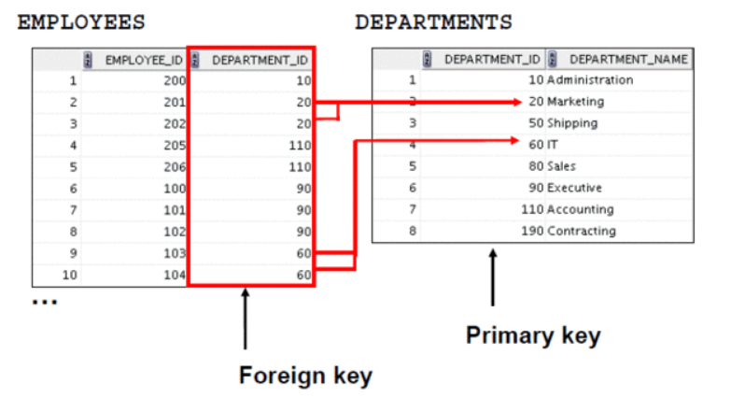
equijoin

Slide 4
natural join
select department_id, department_name, location_id, city
from departments natural join locations;
select department_id, department_name, location_id, city
from departments natural join locations
where department_id in (20,50);

Slide 5


using
select employee_id, last_name, location_id, department_id
from employees join departments
using (department_id);
select employee_id, last_name, location_id, department_id
from employees natural join departments;

Slide 6
접두사
select city, department_name
from locations l join departments d
using(location_id)
where location_id=1400;
select l.city, d.department_name
from locations l join departments d
using(location_id)
where location_id=1400;
select locations.city, departments.department_name
from locations join departments
using(location_id)
where location_id=1400;

Slide 7
접두사
select l.city, d.department_name
from locations l join departments d
using(location_id)
where d.location_id=1400; --error
select l.city, d.department_name, d.location_id
from locations l join departments d
using(location_id)
where location_id=1400; --error
- using 에 사용된 칼럼에 접두사를 붙이지 못한다.

Slide 8
접두사
select e.last_name, d.department_name
from employees e join departments d
using(department_id)
where department_id=60;
select e.last_name, d.department_name
from employees e join departments d
using(department_id)
where d.department_id=60; --error
select e.last_name, d.department_name
from employees e join departments d
using(department_id)
where d.manager_id=60;
select e.last_name, d.department_name
from employees e join departments d
using(department_id)
where manager_id=60; --error
- using 에 사용되지 않은 공통 칼럼엔 접두사를 붙여야 한다.

Slide 9

접두사
select e.last_name, d.department_name
from employees e join departments d
using(department_id)
where employee_id=100;
select e.last_name, d.department_name
from employees e join departments d
using(department_id)
where e.employee_id=100;
- 비공통칼럼은 접두사를 자유롭게 붙일 수 있다.

Slide 10
on
select e.employee_id, e.last_name, e.department_id,
d.department_id, d.location_id
from employees e join departments d
on (e.department_id = d.department_id);

Slide 11
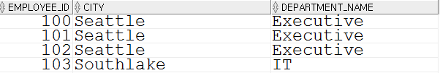
3개 이상 테이블 join
select employee_id, city, department_name
from employees e
join departments d
on d.department_id = e.department_id
join locations l
on d.location_id = l.location_id;
select e.employee_id, l.city, d.department_name
from employees e
join departments d
using (department_id)
join locations l
using (location_id);

Slide 12

레코드 선별 조건 추가
select e.employee_id, e.last_name, e.department_id,
d.department_id, d.location_id
from employees e join departments d
on e.department_id = d.department_id
and e.manager_id=149;
select e.employee_id, e.last_name, e.department_id,
d.department_id, d.location_id
from employees e join departments d
on e.department_id = d.department_id
where e.manager_id=149;

Slide 13

self join
select worker.last_name emp, manager.last_name mgr
from employees worker join employees manager
on worker.manager_id = manager.employee_id;
select worker.last_name emp, manager.last_name mgr
from employees worker join employees manager
on manager_id = employee_id; -- error
select last_name emp, last_name mgr
from employees worker join employees manager
on worker.manager_id = manager.employee_id; -- error
- self join 에선 칼럼명에 접두사를 붙여야 한다.

Slide 14

nonequijoin
select e.last_name, e.salary, e.job_id
from employees e join jobs j
on e.salary between j.min_salary and j.max_salary
where j.job_id='IT_PROG';
select e.last_name, e.salary, e.job_id
from employees e
where e.salary between 4000 and 10000;

Slide 15



outer join
select count(*)
from employees
where department_id=190;
select department_id, department_name
from departments
where department_id=190;
select employee_id, last_name, department_id
from employees
where department_id is null;

Slide 16

outer join
select e.last_name, e.department_id, d.department_name
from employees e left outer join departments d
on e.department_id = d.department_id;
select e.last_name, d.department_id, d.department_name
from employees e right outer join departments d
on e.department_id = d.department_id;
select e.last_name, d.department_id, d.department_name
from employees e full outer join departments d
on e.department_id = d.department_id;

Slide 17
과거 문법, equijoin
select d.department_id, d.department_name, d.location_id, l.city
from departments d, locations l
where d.location_id = l.location_id;
select d.department_id, d.department_name, d.location_id, l.city
from departments d, locations l
where d.location_id = l.location_id
and d.department_id in (20,50);

Slide 18

3개 이상 테이블 join
select e.last_name, d.department_name, l.city
from employees e, departments d, locations l
where e.department_id = d.department_id
and d.location_id = l.location_id;

Slide 19

nonequijoin
select e.last_name, e.salary, e.job_id
from employees e, jobs j
where e.salary between j.min_salary and j.max_salary
and j.job_id='IT_PROG';

Slide 20
outerjoin
select e.last_name, e.department_id, d.department_name
from employees e, departments d
where e.department_id(+) = d.department_id;
select e.last_name, e.department_id, d.department_name
from employees e, departments d
where e.department_id = d.department_id(+);
- full outer join 은 없다.

Slide 21

selfjoin
select worker.last_name||
' works for '||
manager.last_name
from employees worker, employees manager
where worker.manager_id = manager.employee_id;

