Slide 1
7. subquery

Slide 2


subquery
select last_name, salary
from employees
where salary > (select salary
from employees
where last_name='Abel');
- main query ( sub query )
outer query ( inner query )

Slide 3
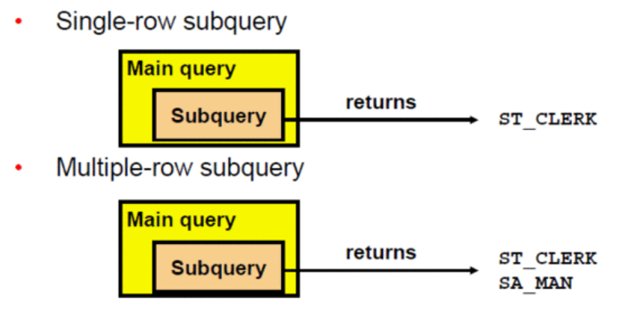
subquery 종류

Slide 4
단일행 subquery 관련 연산자
연산자 | 의미
= | 같다
> | 크다
>= | 이상이다
< | 작다
<= | 이하이다
<> | 다르다

Slide 5



단일행 subquery
select last_name, job_id, salary
from employees
where job_id = (select job_id
from employees
where last_name='Ernst')
and salary > (select salary
from employees
where last_name='Ernst');

Slide 6


그룹함수 포함한 subquery
select last_name, job_id, salary
from employees
where salary = (select min(salary)
from employees);

Slide 7




having 절에서 subquery
select department_id, min(salary)
from employees
group by department_id
having min(salary)>(select min(salary)
from employees
where department_id=50);
select job_id, avg(salary)
from employees
group by job_id
having avg(salary) = (select min(avg(salary))
from employees
group by job_id);

Slide 8

다중행 subquery 관련 연산자
select employee_id, last_name
from employees
where salary = (select min(salary)
from employees
group by department_id); --error
연산자 | 의미
in | 목록 중의 한 요소와 일치하다.
any | =, !=, >, <, <=, >= 와 결합해서 사용한다. subquery 에서 리턴되는 row 가 없으면 false 로 계산한다.
all | =, !=, >, <, <=, >= 와 결합해서 사용한다. subquery 에서 리턴되는 row 가 없으면 true 로 계산한다.

Slide 9


in, any
select last_name, salary, department_id
from employees
where salary in (select min(salary)
from employees
group by department_id);
select last_name, salary, department_id
from employees
where salary =any (select min(salary)
from employees
group by department_id);

Slide 10


any, all
select employee_id, last_name, job_id, salary
from employees
where salary <any (select salary
from employees
where job_id='IT_PROG')
and job_id<>'IT_PROG';
select employee_id, last_name, job_id, salary
from employees
where salary <all (select salary
from employees
where job_id='IT_PROG')
and job_id<>'IT_PROG';

Slide 11


subquery 에서 no row를 리턴한 경우
select last_name, salary, department_id
from employees
where salary >any(select salary
from employees
where employee_id=1000);
select last_name, salary, department_id
from employees
where salary >all(select salary
from employees
where employee_id=1000);

Slide 12



exists
select count(*) from departments;
select count(*) from departments d
where exists (select * from employees e
where e.department_id=d.department_id);
select count(*) from departments d
where not exists (select * from employees e
where e.department_id=d.department_id);

Slide 13



subquery 에서 리턴한 null
select emp.last_name
from employees emp
where emp.employee_id in (select mgr.manager_id
from employees mgr);
select emp.last_name
from employees emp
where emp.employee_id not in (select mgr.manager_id
from employees mgr);
select emp.last_name
from employees emp
where emp.employee_id <>all (select mgr.manager_id
from employees mgr);

Slide 14

subquery 에서 리턴한 null
select emp.last_name
from employees emp
where emp.employee_id not in (
select mgr.manager_id
from employees mgr
where manager_id is not null);

