Slide 1
8. set

Slide 2
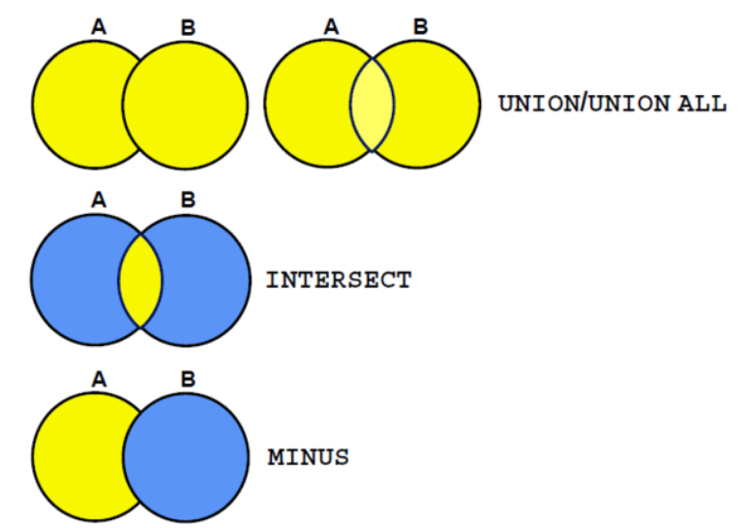
집합 연산자

Slide 3


union, union all
select employee_id, job_id
from employees
union
select employee_id, job_id
from job_history;
select employee_id, job_id
from employees
union all
select employee_id, job_id
from job_history;

Slide 4


intersect
select employee_id, job_id
from employees
intersect
select employee_id, job_id
from job_history;
select employee_id, job_id, department_id
from employees
intersect
select employee_id, job_id, department_id
from job_history;

Slide 5

minus
select employee_id
from employees
minus
select employee_id
from job_history;

Slide 6


칼럼 개수 일치
select location_id, department_name, null
from departments
union
select location_id, null, state_province
from locations;
select location_id, department_name, null province
from departments
union
select location_id, null, state_province
from locations;

Slide 7


칼럼 개수와 datatype 일치, 정렬
select employee_id, job_id, salary
from employees
union
select employee_id, job_id, 0
from job_history
order by job_id;
select employee_id, job_id, salary
from employees
union
select employee_id, job_id, 0
from job_history
order by 2;

