Slide 1
11.view, sequence

Slide 2
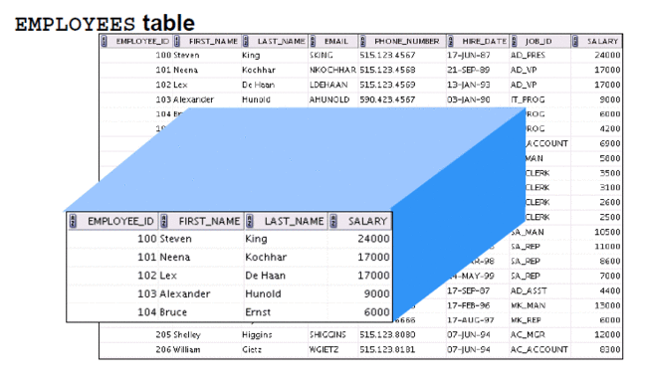
view

Slide 3

view 생성
create view empvu80 as
select employee_id, last_name, department_id
from employees
where department_id = 80;
desc empvu80
select * from empvu80;
select * from (
select employee_id, last_name, department_id
from employees
where department_id = 80);

Slide 4

view 교체
create or replace view salvu50 as
select employee_id emp_id, last_name,
salary*12 ann_sal, department_id
from employees
where department_id=50;
desc salvu50
select * from salvu50;

Slide 5
with check option 1/2
drop table teams;
drop view team50;
create table teams as
select department_id team_id, department_name team_name
from departments;
create view team50 as
select * from teams
where team_id=50;
insert into team50 values(300,'Marketing');

Slide 6
with check option 2/2
select * from team50;
select * from teams where team_id=300;
create or replace view team50 as
select * from teams
where team_id=50
with check option;
insert into team50 values(301,'IT Support'); --error
insert into team50 values(50,'IT Support');

Slide 7
with read only
create or replace view empvu10(
employee_number, employee_name, job_title)
as select employee_id, last_name, job_id
from employees
where department_id = 10
with read only;
select * from empvu10;
insert into empvu10
values(501, 'abel', 'Sales'); --error

Slide 8

sequence
drop sequence team_teamid_seq;
create sequence team_teamid_seq
increment by 10
start with 400
maxvalue 9999
nocache
nocycle;
select team_teamid_seq.nextval from dual;
select team_teamid_seq.currval from dual;
insert into teams values(team_teamid_seq.nextval,'Marketing');
insert into teams values(team_teamid_seq.nextval,'Marketing');
select * from teams where team_id>=400;

Slide 9

index
drop index emp_lastname_idx;
create index emp_lastname_idx
on employees(last_name);
select last_name, rowid
from employees;
select index_name, index_type, table_owner, table_name
from user_indexes
where index_name='EMP_LASTNAME_IDX';

Slide 10

synonym
create synonym team for departments;
select * from team;

