Slide 1

Sign Language Detection and Conversion to Text Using CNN and OpenCV
Debayan Das(19MCA0070)
Master of Computer Application
Vellore Institute of Technology, Vellore

Slide 2
Problem Description:
This paper focuses on making an interface between the normal people and that deaf and dumb people with the help of computer vision. To do so first a classification model is built to identify the sign alphabet using CNN and then for real time application the hand gesture sign is detected using OpenCV and fed to the model to make the final prediction. And after recognition it is converted to text for further use.

Slide 3
Previous Work:
In the previous researches we found either of CNN or OpenCV is used to recognize sign language. Using CNN the classification model gets better accuracy whereas using OpenCV image processing features the application becomes real time but in this case accuracy is less and using CNN the application does not become real time it stays static.
Our Work:
In our case we tried to merge the advantages of both the processes. Using CNN we are getting better accuracy and using OpenCV the application becomes real time that will be helpful for the society.

Slide 4
Dataset Description:
The dataset is the American Sign Language dataset that is collected from Kaggle datasets. The dataset contain 1825 images that are already labeled in 36 classes A-Z[26] and 0-9[10].

Slide 5
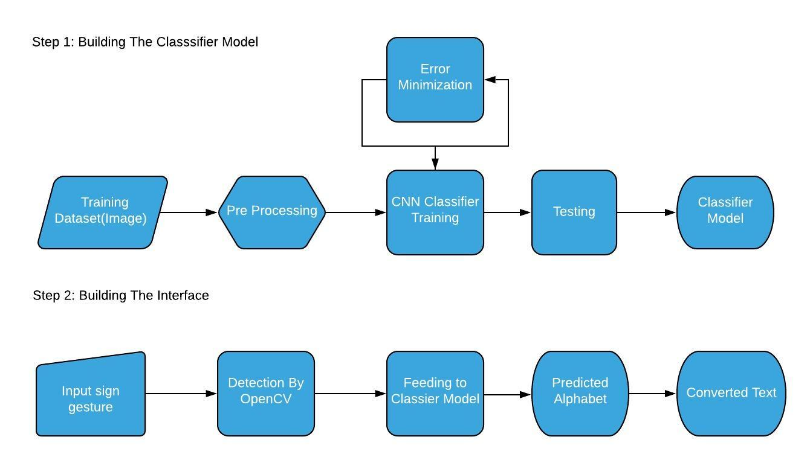
Work Plan:

Slide 6
Module Description:
The modules for the project are:
Preprocessing
Training the CNN model
Making the Interface

Slide 7
Preprocessing:
The first task is to preprocess the images. In order to do so first a background of dark is pasted around all the images and the images are converted to ‘RGB’ format to make the image channels similar. Next all the images are transformed to similar dimension 400x400. At the end images are saved but while saving the images extension of the images are changed to .jpeg from .png.

Slide 8
Training the CNN model:
In the second step the CNN model is trained with the images which are classified to 36 classes (A-Z and 0-9) previously.
Making the Interface:
The 3rd step is to make the interface that will interpret the sign language and will convert to text. This will be made using OpenCV library of python. The image will be captured and will be made ready so that it can be fade to the CNN model and the output of the model will be displayed in the screen.

Slide 9
Work Progress:
Till now the first two modules have been completed. The images are preprocessed and the classifier model is trained with the processed images. The model is giving almost 99% accuracy. The CNN model contain total 9 layers. First two are two convolution layers followed by 1 maxpool layer. Then again two convolution layer followed by 1 maxpool layer. Then there is on flatten layer which is followed by two fully connected layer(dense). For optimizing the model stochastic gradient descent(SGD) method is used and the model is trained for 10 epochs.

Slide 10
Thank You

