Slide 1
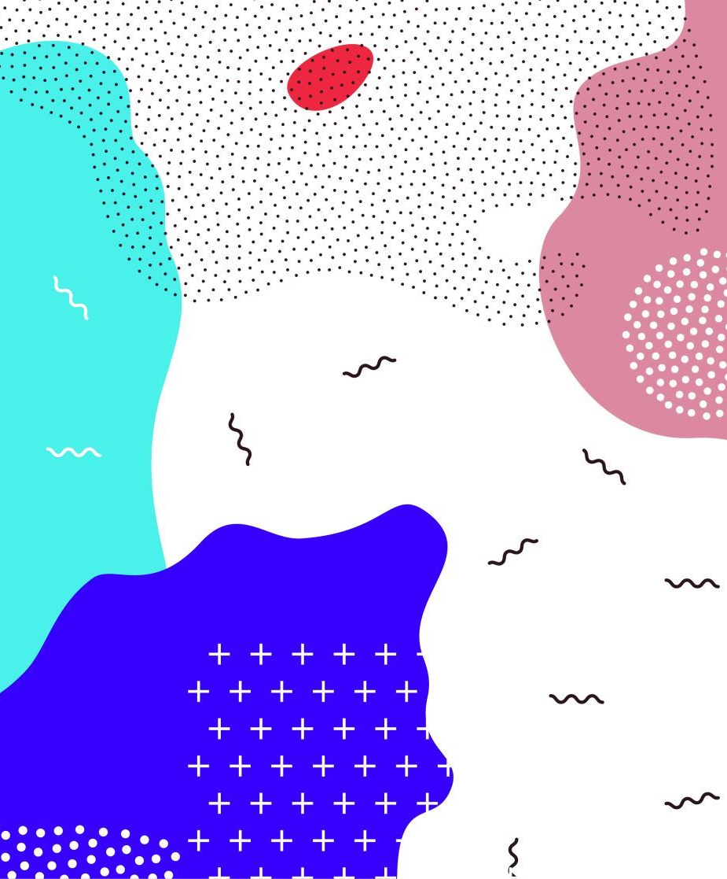
Improving Healthcare Content Management Using Generative AI
Developed By: Dipa Khadka
University: University Of New Haven , CT
Intern Assessment

Slide 2
Problem Statement
Current Challenges
Large healthcare policy documents
Manual document review
Frequent policy updates
Difficult policy comparison
Time-consuming information retrieval

Slide 3
Why Generative AI and RAG?
✔ Understands natural language in healthcare documents
✔ Generates summaries and answers to user questions
✔ Retrieves relevant information from uploaded documents
✔ Produces evidence-based responses instead of relying only on general AI knowledge

Slide 4
Solution Architecture
Healthcare PDFs
│
▼
Document Processing
│
▼
Searchable Knowledge Base
│
▼
Retrieve Relevant Content
│
▼
Generative AI
│
▼
Evidence-Based Response

Slide 5
Key Features
✅ Upload healthcare documents
✅ Policy Question Answering
✅ Document Summarization
✅ Policy Comparison
✅ Rule Extraction

Slide 6

Technology Stack
Streamlit
LangChain
ChromaDB
Google Gemini
PyMuPDF
Sentence Transformers

Slide 7
Live Demonstration
Upload healthcare policy
↓
Ask a question
↓
AI retrieves relevant information
↓
Generate answer with evidence
↓
Compare two policies
↓
Extract healthcare rules

Slide 8
Business Value
Without AI | With AI Assistant
Manual review | Faster search
Read hundreds of pages | Automatic summaries
Manual comparison | Instant comparison
Difficult rule identification | Automated rule extraction

Slide 9
Conclusion
Healthcare Content Management Assistant
AI-powered document understanding
Evidence-based question answering
Policy comparison
Rule extraction
Improved productivity

Slide 10

Thank you!
Questions?
Email: deepakhadka500@gmail.com

