Slide 1

Movie Review Sentiment Analysis Using Machine Learning
Presented By: Dipa Khadka & Manish Chaudhary
Dataset: IMDb 50,000 Movie Reviews
Models: Logistic Regression, SVM, KNN

Slide 2


introduction
Sentiment analysis is a powerful Natural Language Processing (NLP) technique used to automatically determine whether a piece of text expresses a positive or negative opinion.
It is a form of text classification that helps computers understand human emotions.
Have you ever wanted to know whether a movie is worth watching without reading thousands of reviews?
This project solves that problem by training a machine learning model that automatically predicts whether a movie review is positive or negative.

Slide 3
Why This Project?
Sentiment analysis helps summarize overall audience opinions
Thousands of movie reviews can be overwhelming to read manually
Useful for:
Movie studios
Streaming platforms
Recommendation engines
Viewers deciding what to watch
build a machine learning model that predicts sentiment of movie reviews.

Slide 4
Dataset overview
We used the IMDb Movie Review Dataset, which contains:
50,000 movie reviews
Each labeled as positive or negative
Balanced dataset: equal number of each class
After removing a few duplicates (~0.8%), the final dataset contains 49,582 reviews
sentiment — positive (1) or negative (0)
This makes it an excellent dataset for binary sentiment classification.

Slide 5

Data cleaning
Removal of HTML tags
Lowercasing all text
Removing punctuation & special characters
Removing extra spaces
Removing stopwords
Creating a new column: clean_review
➡️ Result: Clean, standardized text ready for modeling.

Slide 6

TF-IDF Vectorization
TF-IDF converts text into meaningful numerical features.
Parameters used:
max_features = 50,000
Ngram range = (1,2) (unigrams + bigrams)
Stop words = "english"
Why TF-IDF?
Highlights important words
Works extremely well for ML models
Produces high-dimensional sparse vectors ideal for Logistic Regression & SVM

Slide 7
Models Used in This Project
✔ Logistic Regression
Fast and highly effective for text data
Performs well with TF-IDF representations
✔ LinearSVC (Support Vector Machine)
Best model for high-dimensional text
Often achieves the highest accuracy
Works superbly with sparse TF-IDF vectors
✔ K-Nearest Neighbors (KNN)
Simple and intuitive algorithm
Performance depends on the choice of K value
Lower accuracy compared to linear models on text, but useful for demonstrating overfitting vs. generalization behavior
We used TF-IDF Vectorization to convert text into numerical features suitable for machine learning.

Slide 8

Machine learning Model Training
Each model was trained using an 80/20 train-test split on the cleaned dataset.
4. Evaluation Metrics
We calculated:
Accuracy
Precision
Recall
F1-score
Confusion matrix
These metrics help understand how well the model distinguishes positive vs negative reviews.

Slide 9
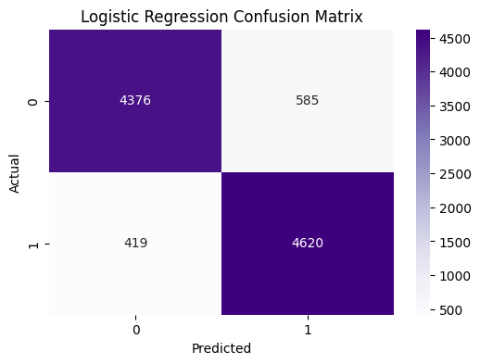
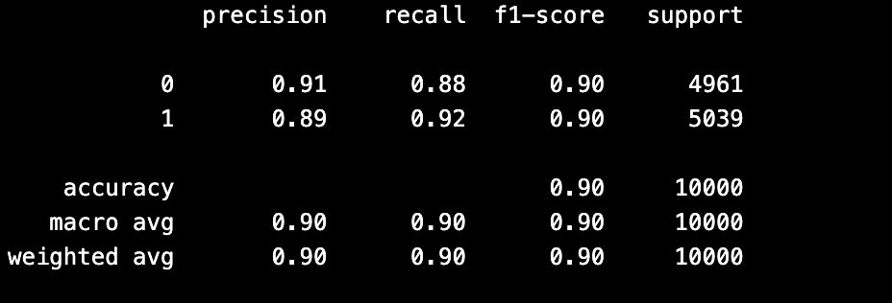
MODEL 1- LOGISTIC REGRESSION
Logistic Regression Accuracy: 0.8996
Why Logistic Regression Performs Well:
Works extremely well on high-dimensional TF-IDF features
Very fast and efficient
Avoids overfitting due to regularization
Creates a strong baseline for text classification
Confusion Matrix Insight:
Predicts both positive and negative reviews with high accuracy
Errors are low and evenly distributed

Slide 10
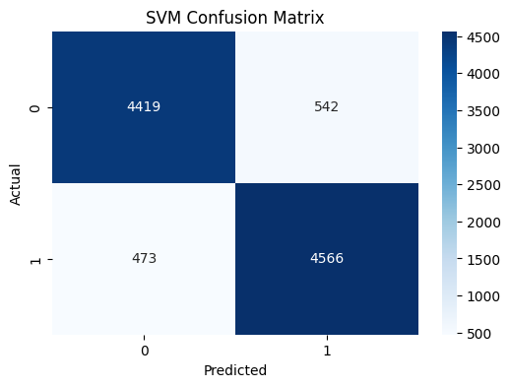
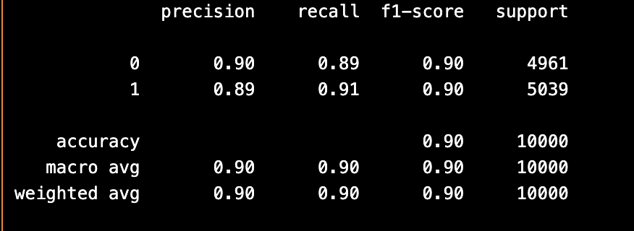
MODEL 2-SVM (Linear SVC)
SVM Accuracy: 0.8985
The SVM model achieved an accuracy of 89.85% on the test data.
The precision and recall values for both positive and negative sentiment are close to 0.90, showing balanced and reliable performance.
The confusion matrix indicates that SVM correctly classifies most reviews, with very few misclassifications.
SVM performs especially well on TF-IDF text data because it handles high-dimensional features effectively.

Slide 11
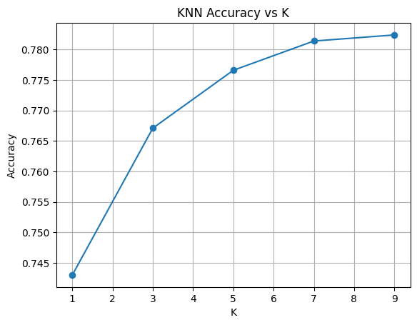
KNN
KNN performance depends heavily on the value of K (number of neighbors).
Low K (e.g., K=1) → High variance → Overfitting
Higher K → More stable predictions
Accuracy improved as K increased from 1 → 9
Best accuracy in this experiment: K = 9 (≈ 78%)
KNN performs weaker compared to Logistic Regression and SVM because text data is high-dimensional.

Slide 12
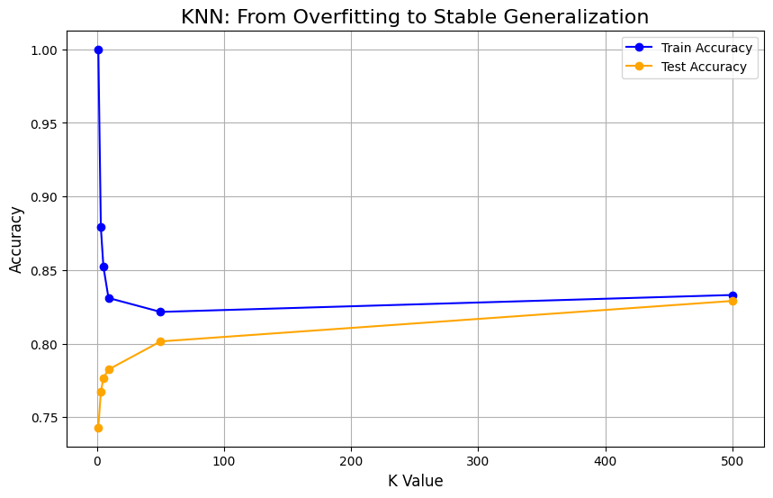
knn

Slide 13
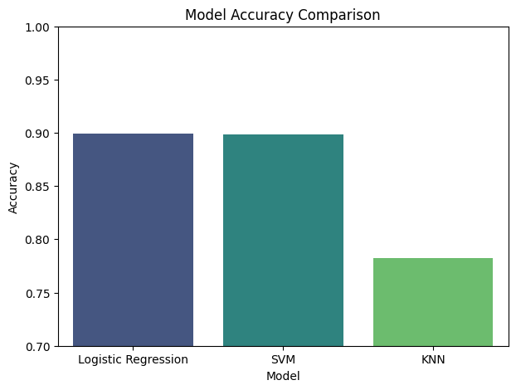
Model comparison

Slide 14
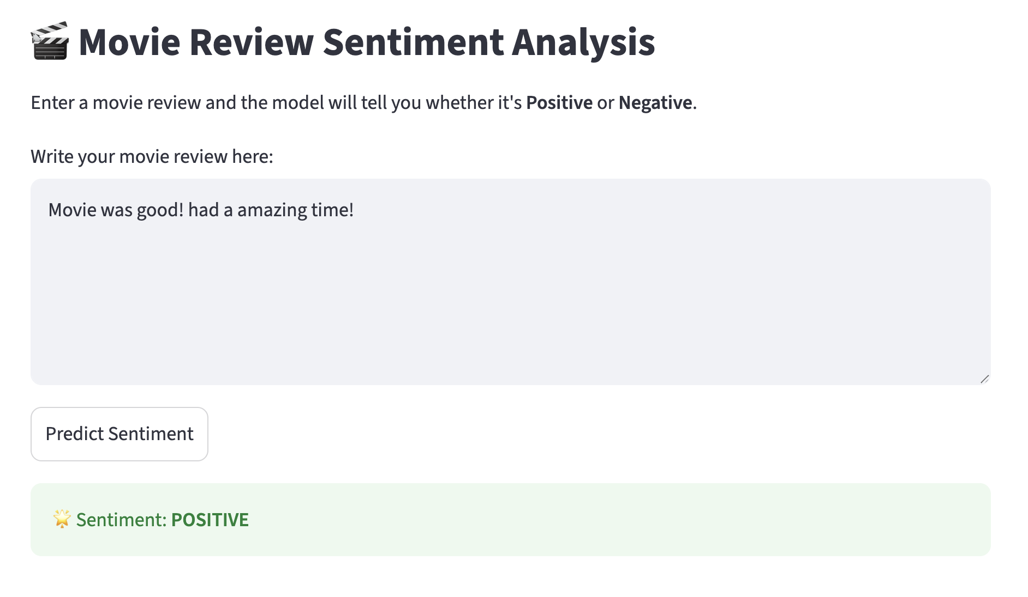
streamlit

Slide 15

Any questions?
Project Link:
https://github.com/imdeepa99/movie-review-sentiment-analysis-project

Slide 16
Thank you! Have a good day!

