Slide 1


Design Pattern
State

Slide 2

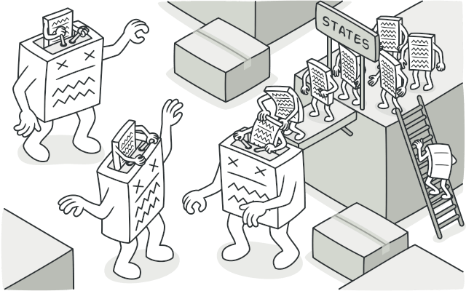
State Design Pattern adalah Design Pattern yang termasuk ke dalam behavioral pattern yang dapat mengubah behaviornya ketika internal state-nya berubah.

Slide 3
Problem
The biggest weakness of a state machine based on conditionals reveals itself once we start adding more and more states and state-dependent behaviors to the class. Most methods will contain monstrous conditionals that pick the proper behavior of a method according to the current state. Code like this is very difficult to maintain because any change to the transition logic may require changing state conditionals in every method.
The problem tends to get bigger as a project evolves. It’s quite difficult to predict all possible states and transitions at the design stage. Hence, a lean state machine built with a limited set of conditionals can grow into a bloated mess over time.

Slide 4
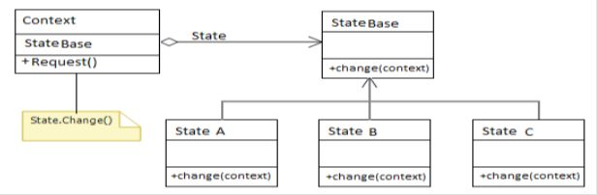

Structure
This pattern has three main parts, context, statebase and concrete state (State A, State B, State C and so on). The Context is also called Client. Client does not access any state directly. It only holds a concrete state object that provides the current behavior of the context object. StateBase is the base class of all concrete states. It may be an abstract class or an interface. Concrete class (State A, State B and State C) is provided functionality that will be used for change and hold the behavior of the context object.
The basic code structure of the State Design Pattern implementation uses C# as in the following. Here starting state of context is passed through a constructor. A "Request" method of Context is used to change the current state to the next state. Internally it calls the StateBase.Chage() method. The StateBase.Chage() method switches the state of the passed context object to the next state. In this example the state change sequence is as below.

Slide 5
Applicability
Use the State pattern when you have an object that behaves differently depending on its current state, the number of states is enormous, and the state-specific code changes frequently.
The pattern suggests that you extract all state-specific code into a set of distinct classes. As a result, you can add new states or change existing ones independently of each other, reducing the maintenance cost.
Use the pattern when you have a class polluted with massive conditionals that alter how the class behaves according to the current values of the class’s fields.
The State pattern lets you extract branches of these conditionals into methods of corresponding state classes. While doing so, you can also clean temporary fields and helper methods involved in state-specific code out of your main class.
Use State when you have a lot of duplicate code across similar states and transitions of a condition-based state machine.
The State pattern lets you compose hierarchies of state classes and reduce duplication by extracting common code into abstract base classes.

Slide 6
Pros and Cons
Open/Closed Principle. Introduce new states without changing existing state classes or the context.
Single Responsibility Principle. Organize the code related to particular states into separate classes.
Simplify the code of the context by eliminating bulky state machine conditionals.
Applying the pattern can be overkill if a state machine has only a few states or rarely changes.

