Slide 1


Design Pattern
State

Slide 2

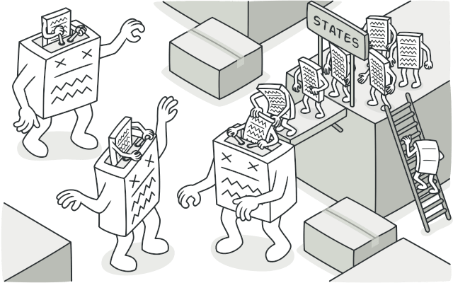
State is a behavioral design pattern that lets an object alter its behavior when its internal state changes. It appears as if the object changed its class.

Slide 3
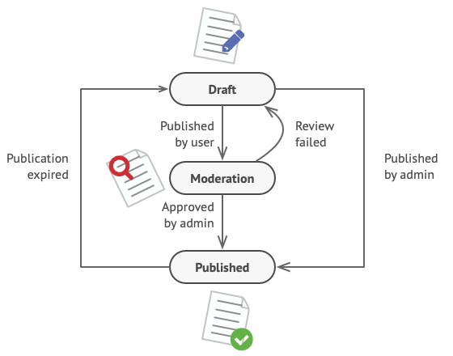
Problem
State are usually implemented with lots of conditional statements (if or switch) that select the appropriate behavior depending on the current state of the object. Usually, this “state” is just a set of values of the object’s fields.
class Document
{ private string state;
public void publish(){
switch (state){
case "draft":
state = "moderation";
break;
case "moderation":
if (currentUser.role == "admin"){
state = "published";
}
break;
case "published":
break;
}
}
}
The biggest weakness of a state machine based on conditionals reveals itself once we start adding more and more states and state-dependent behaviors to the Document class. Most methods will contain monstrous conditionals that pick the proper behavior of a method according to the current state. Code like this is very difficult to maintain because any change to the transition logic may require changing state conditionals in every method.

Slide 4
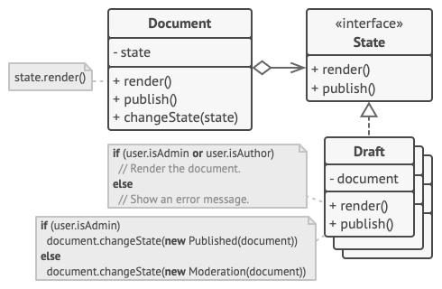
Solution
State pattern suggests that you create new classes for all possible states of an object and extract all state-specific behaviors into these classes.
Instead of implementing all behaviors on its own, the original object, called context, stores a reference to one of the state objects that represents its current state, and delegates all the state-related work to that object.
To transition the context into another state, replace the active state object with another object that represents that new state. This is possible only if all state classes follow the same interface and the context itself works with these objects through that interface.

Slide 5
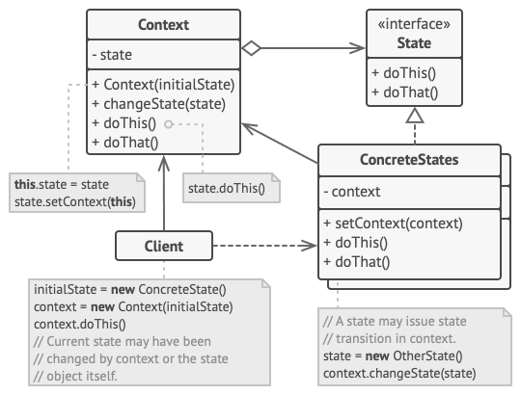
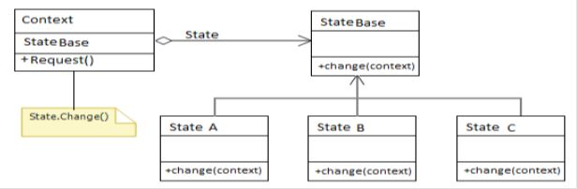

Structure
A "Request" method of Context is used to change the current state to the next state. Internally it calls the StateBase.Change() method. The StateBase.Chage() method switches the state of the passed context object to the next state. In this example the state change sequence is as below.

Slide 6
Real world analogy
behavior of a package changes based on its delivery state. Example : Package is in the ordered state. Package is in the shipped state. Package is in the destination state.
behavior of a game changes based on its game status state. Example : Game is in the waiting state. Game is in the playing state. Game is in the game over state.

Slide 7
Pros and Cons
Open/Closed Principle. Introduce new states without changing existing state classes or the context.
Single Responsibility Principle. Organize the code related to particular states into separate classes.
Simplify the code of the context by eliminating bulky state machine conditionals.
Applying the pattern can be overkill if a state machine has only a few states or rarely changes.
Conclusion
The State design pattern provides an elegant way to manage state-specific behaviors and enables objects to adapt their behavior dynamically.

