Slide 1

Predicting bike sharing
Alif Muhammed K S Devakumar K P Vivek L Alex Yogesh Kumar Selvan

Slide 2
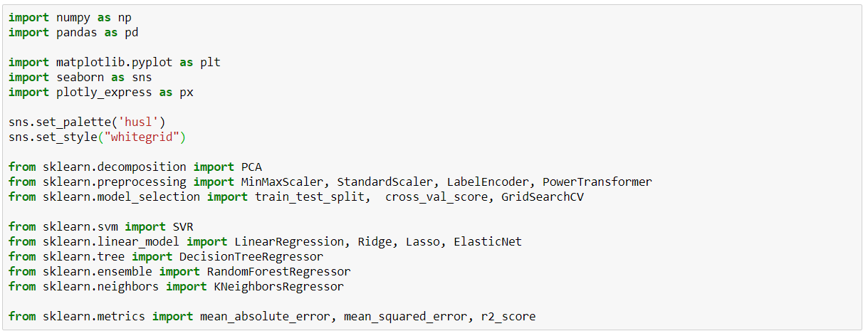
Libraries

Slide 3

Dataset

Slide 4
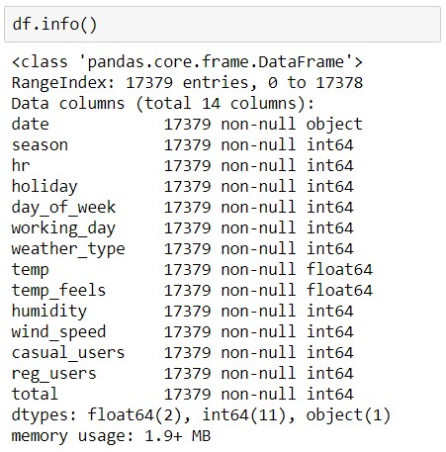
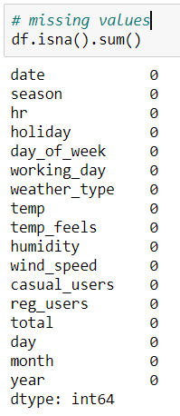
Temperature
Feeling temperature
Humidity
Windspeed

Slide 5
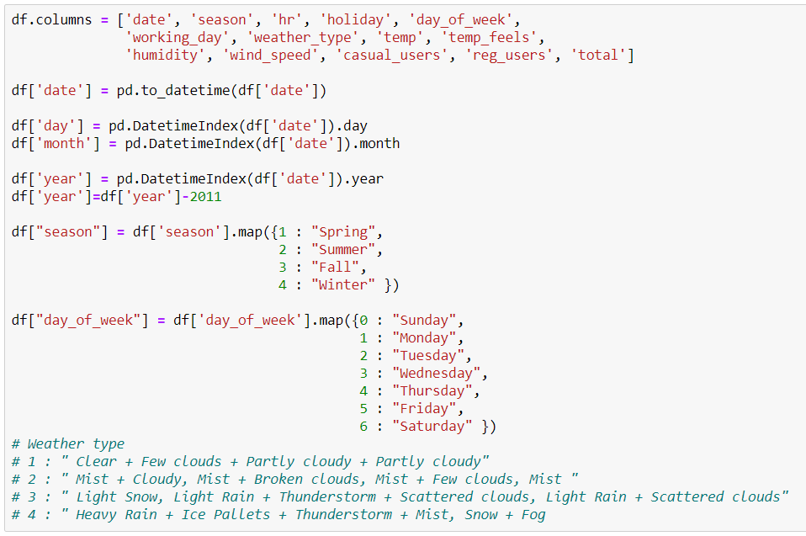
Data Cleaning

Slide 6
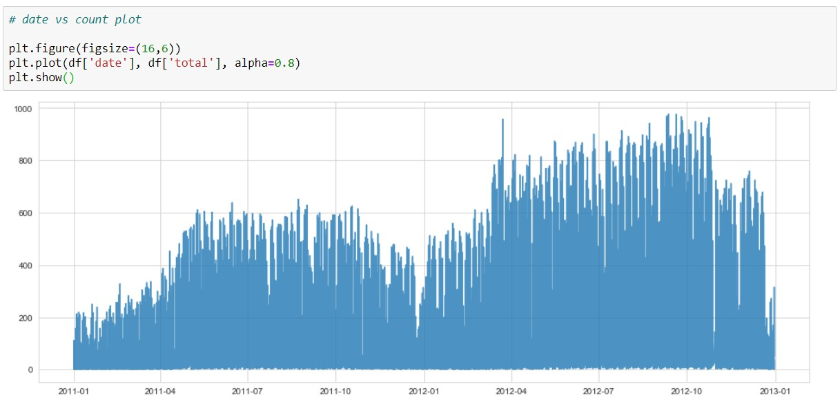
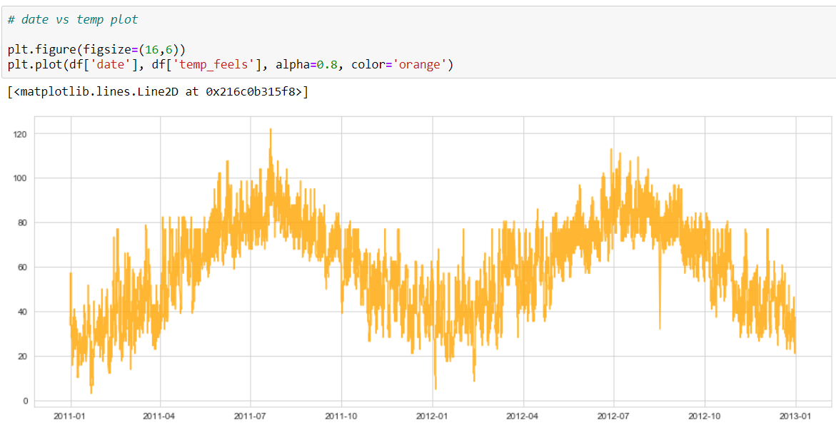

Slide 7
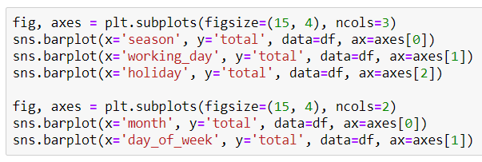
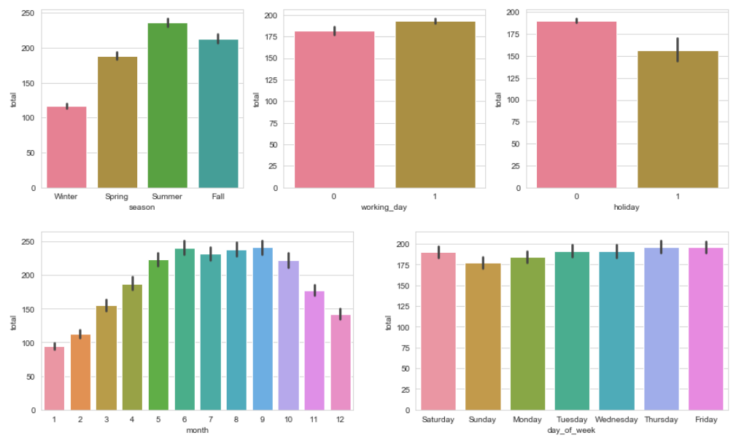

Slide 8

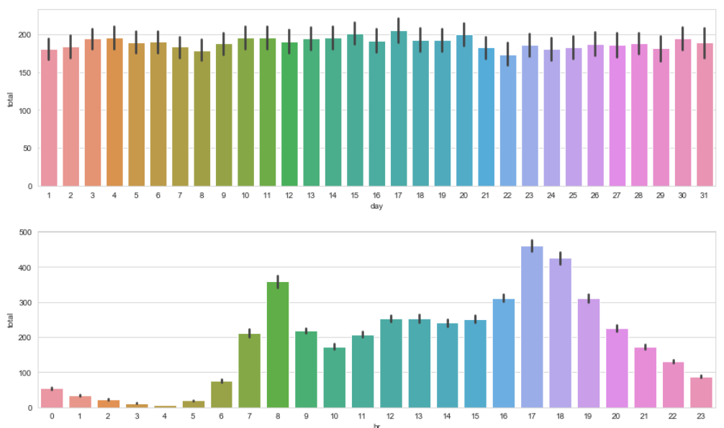

Slide 9

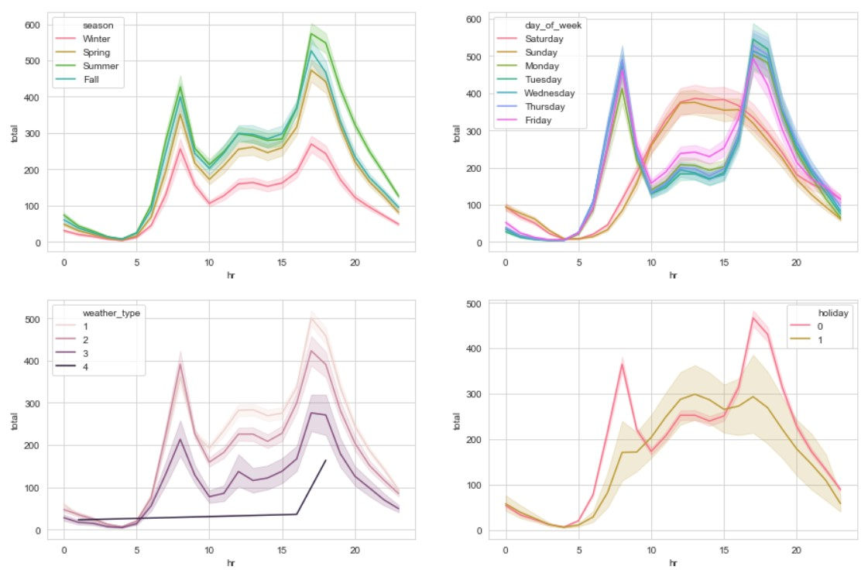

Slide 10
Pre-processing
Min- Max Scaling
Initializing Model
Cyclic Encoding
PCA

Slide 11
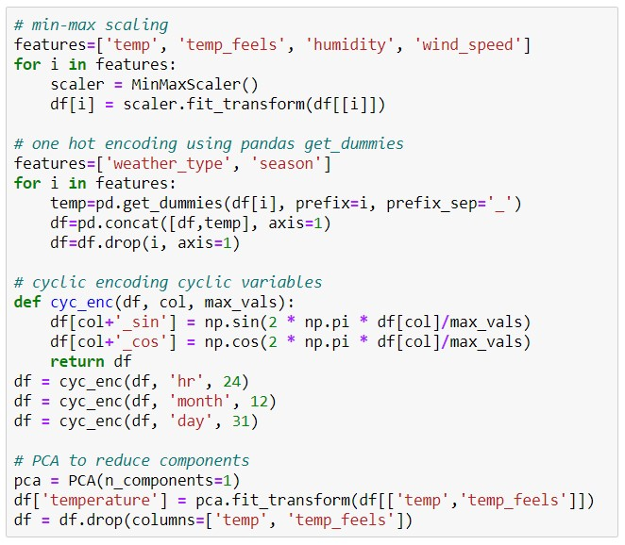

Slide 12
ML Models
Train – Test Split
One – Hot Encoding
Model Fit
Predict
Accuracy Metrics
Plotting

Slide 13

