Slide 1

Retail Analysis & Customer Segmentation
Alif Muhammed K S Devakumar K P Vivek L Alex Yogesh Kumar Selvan

Slide 2
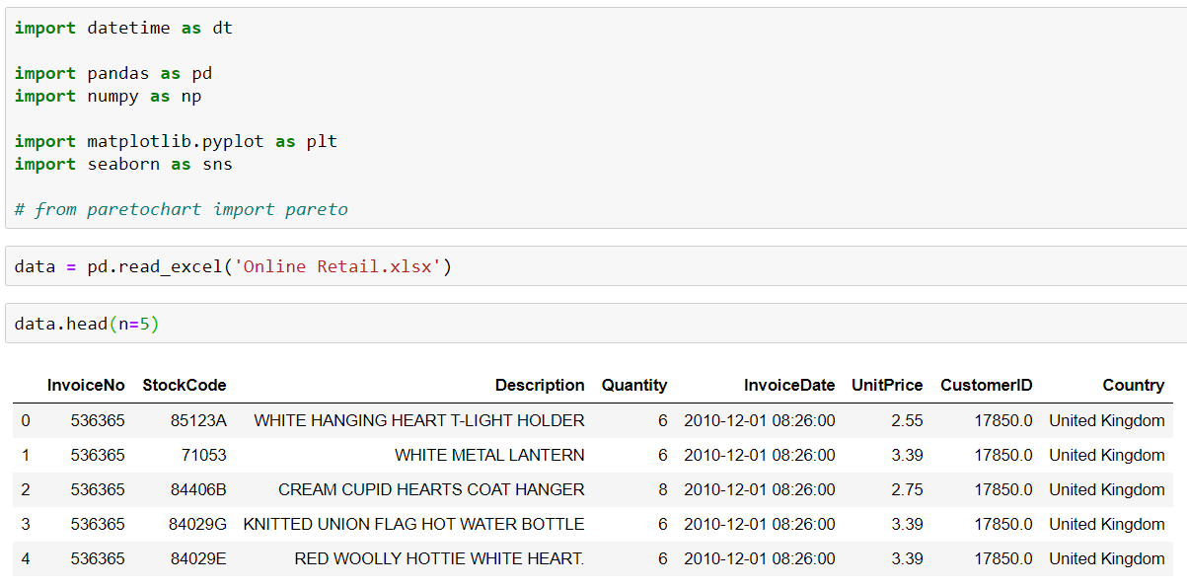
Libraries and Dataset

Slide 3
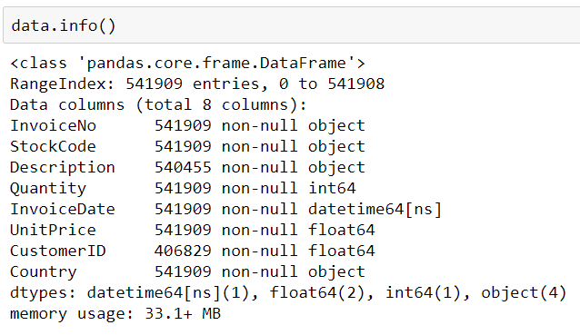
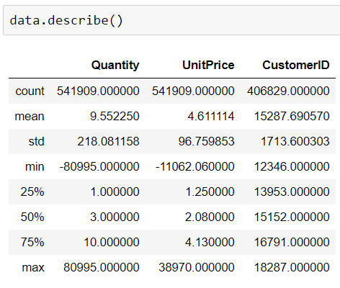
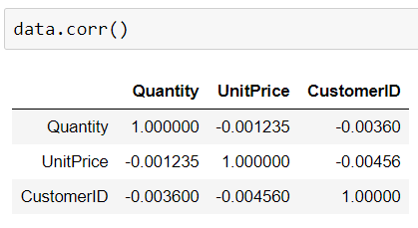
Overview of the Dataset

Slide 4
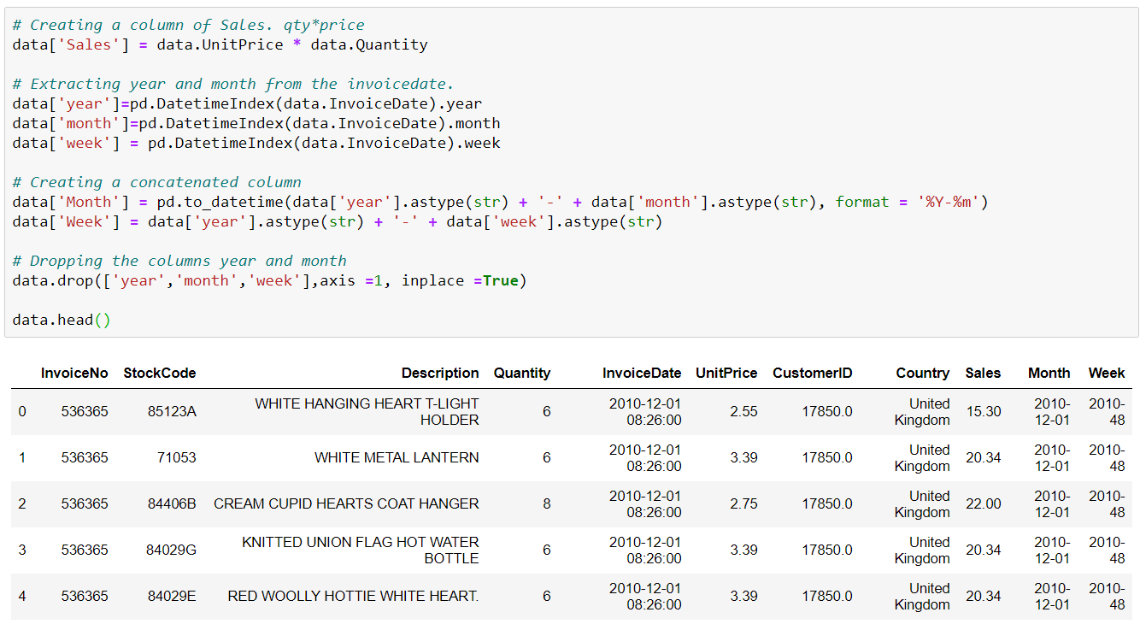
Pre-processing

Slide 5
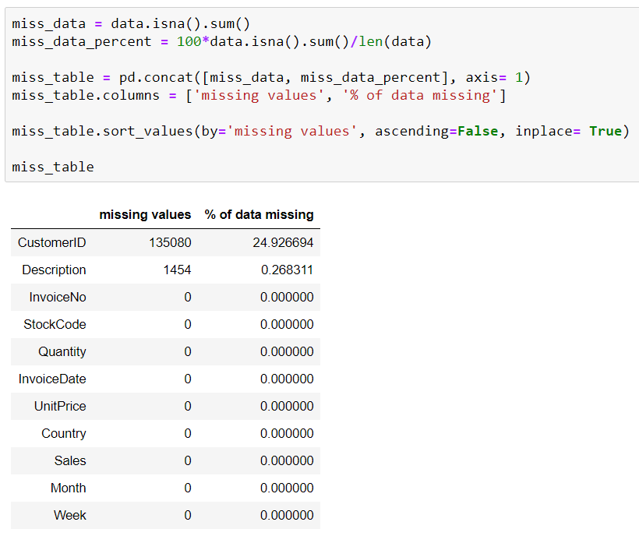
Data Cleaning

Slide 6
Pareto Rule
What % of customers gives us the 80% of the revenue

Slide 7
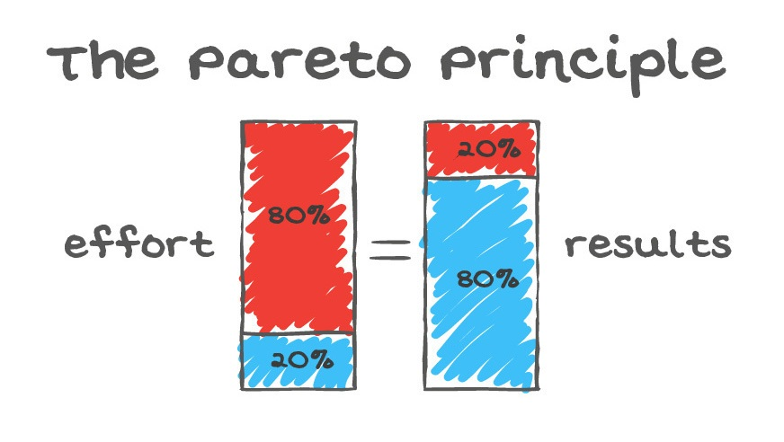

Slide 8
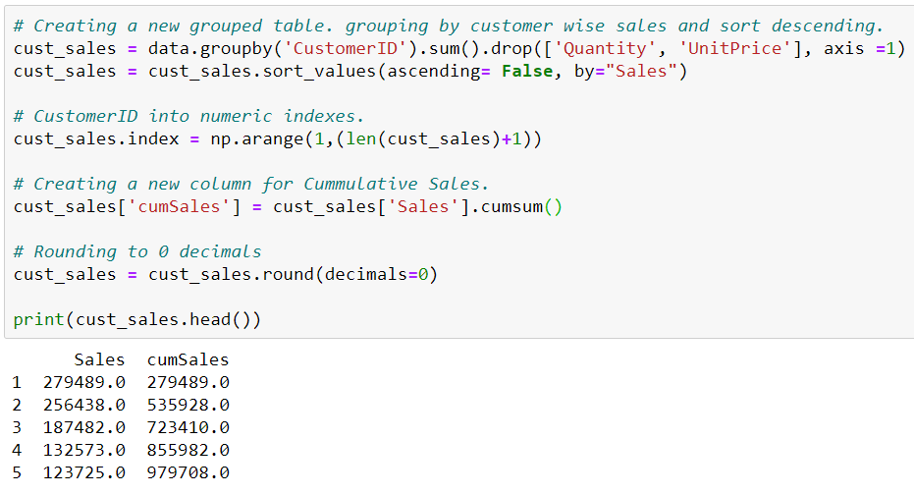
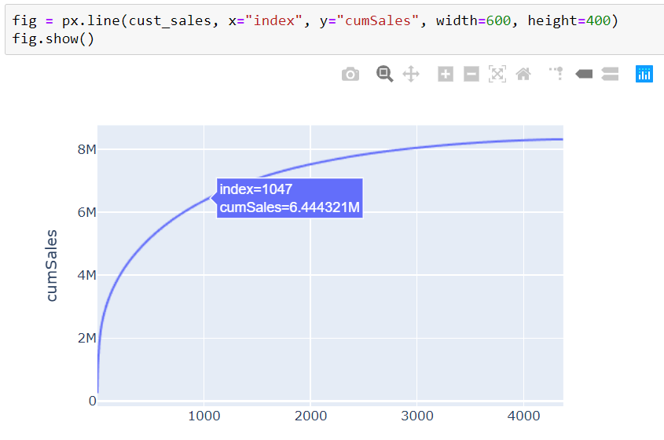

Slide 9
Cohort Analysis
What % of the each month’s customers comes back

Slide 10
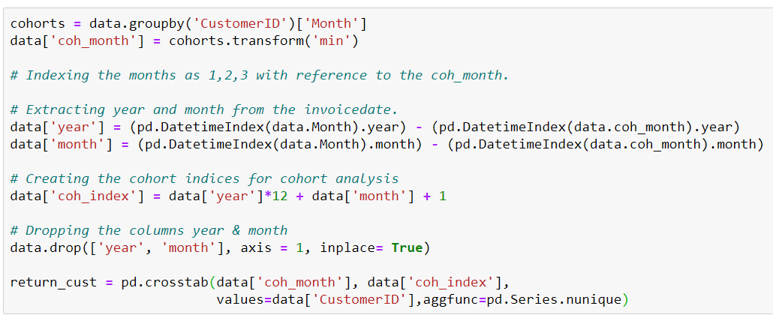
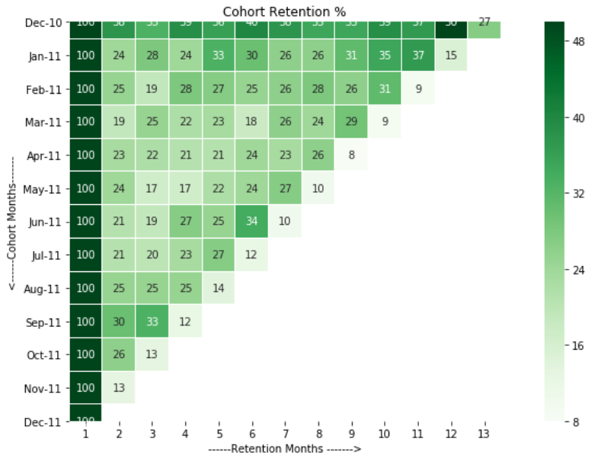
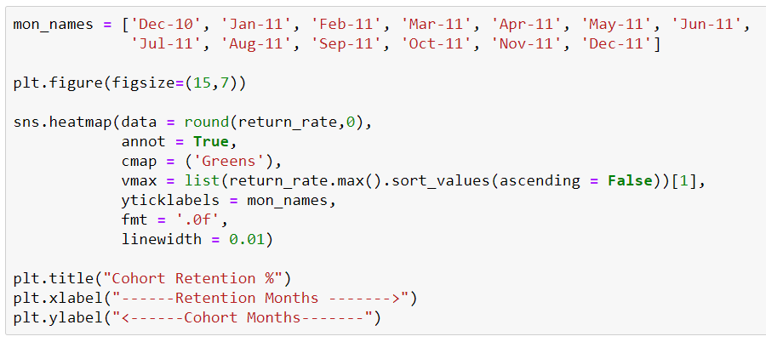

Slide 11
RFM Analysis
Recency, Frequency, Monitory of each customer

Slide 12


Slide 13
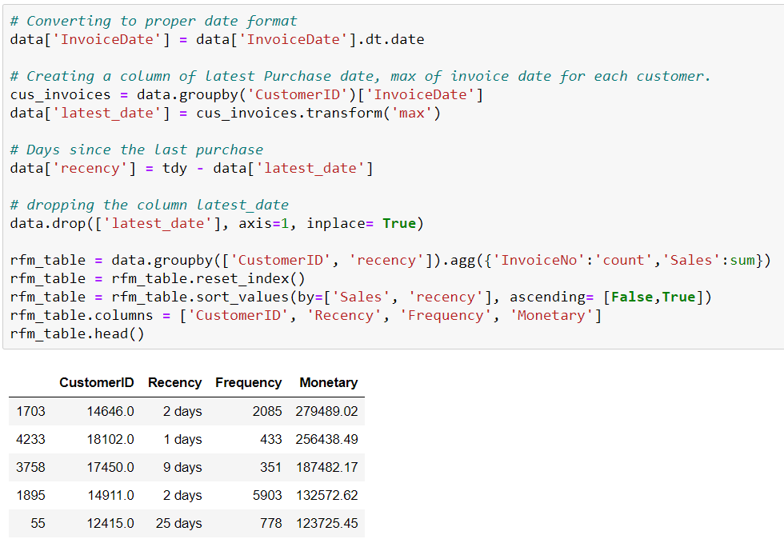

Slide 14
K Means Clustering
Unsupervised Clustering of customers based on RFM

Slide 15
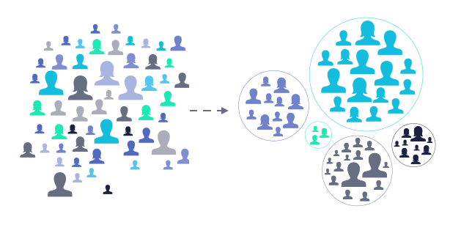

Slide 16
