Slide 1
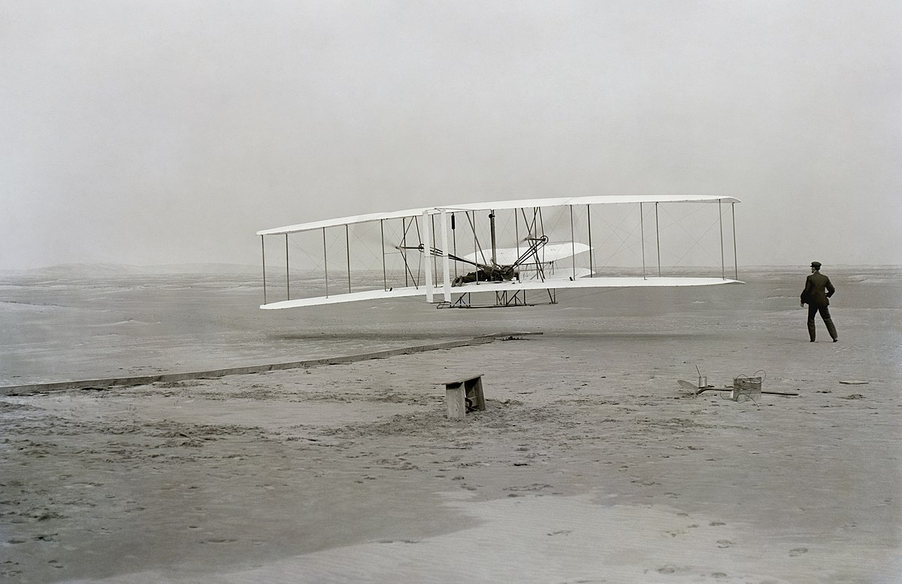
* Wilbur and Orville Wright made four brief flights at Kitty Hawk with their first powered aircraft.
Alif Muhammed K S
Devakumar K P
Vivek L Alex
Yogesh Kumar Selvan
How safe is air travel?

Slide 2
Number of flights last year
In the past year there were on average
9,728
planes in the air at any moment, carrying
1,270,406 passengers.
38.4 M
Number of passengers last year
4.1 B

Slide 3
The aviation accident database throughout the world, from 1908-2019.
Date -Date of accident
Time - Local time
Location - Location of Crash
Operator - Airline or operator of the aircraft
Flight # - Flight number assigned by the aircraft operator
Route - Complete
AC Type - Aircraft type
Registration -ICAO Registration of the aircraft
cn/ln - Construction or serial number / Line or fuselage number
Aboard - Total aboard (passengers / crew)
Aboard Passengers - Passengers aboard
Aboard Crew - Crew aboard
Fatalities - Total fatalities aboard (passengers / crew)
Fatalities Passengers - Total fatalities aboard – passengers
Fatalities Crew - Total fatalities aboard –crew
Ground - Total fatalities on ground
Summary - Brief description of the accident and cause if known
https://www.kaggle.com/cgurkan/airplane-crash-data-since-1908

Slide 4
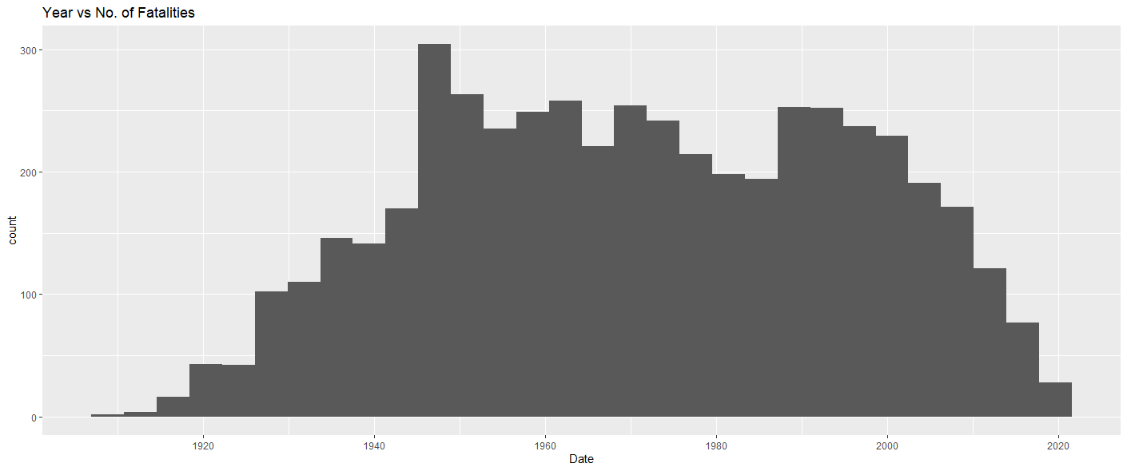

Slide 5
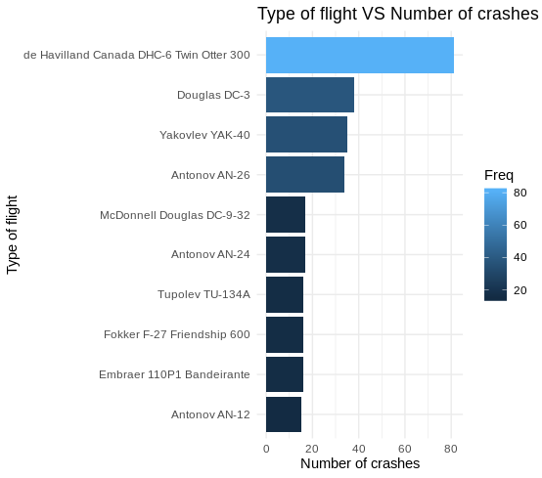
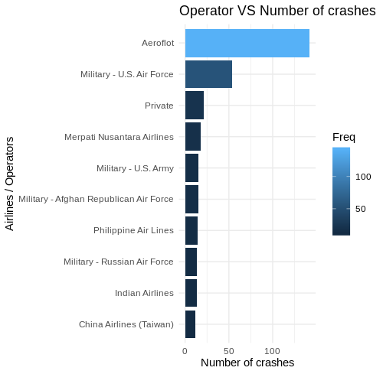

Slide 6
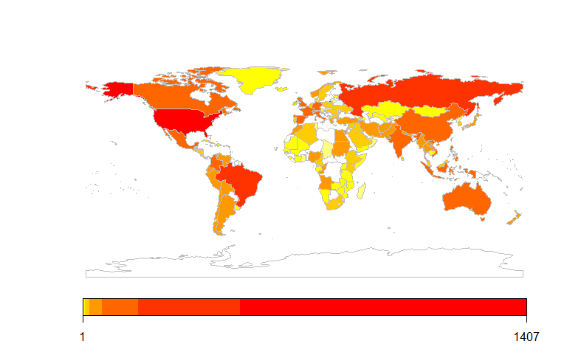
Country wise crash report

Slide 7
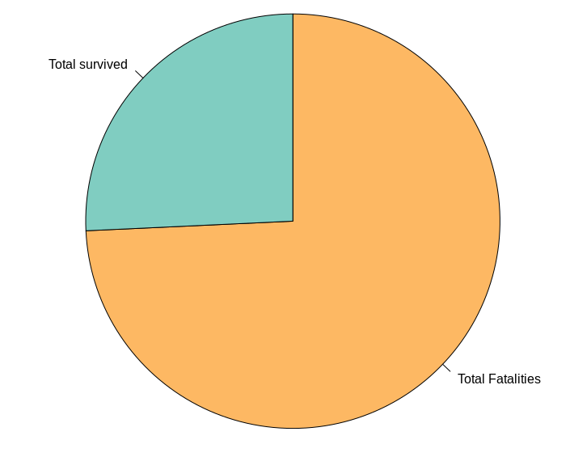
Survival Rate in a Crash

Slide 8
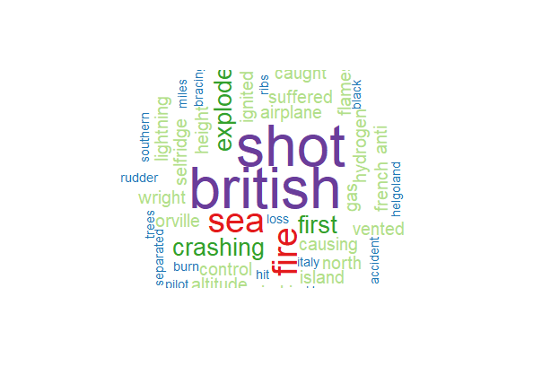
Word cloud on description of crash data before 1950

Slide 9
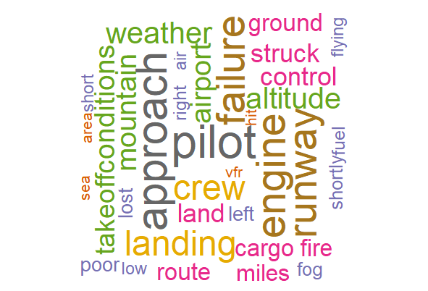
Word cloud on description of crashes that resulted in ground fatalities

Slide 10
1. The Most Disastrous Airline Crashes ever
583
2750
On Air
Ground

Slide 11
2. How many times did all the people died or no one died at all
3514
34

Slide 12
3. How many crashes during training, testing, and sight seeing
81
29
17

Slide 13
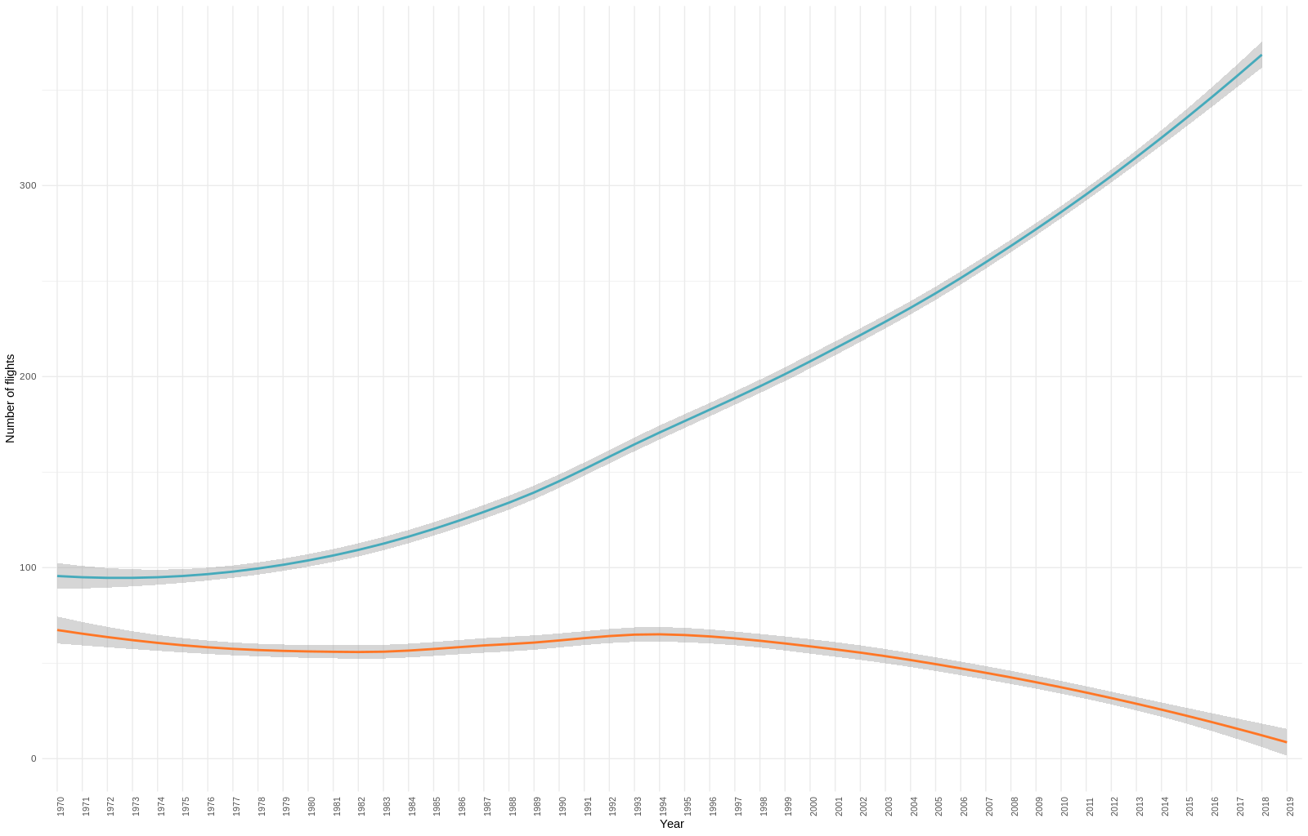
No. of Flights (in Lakhs) & Crashes

Slide 14
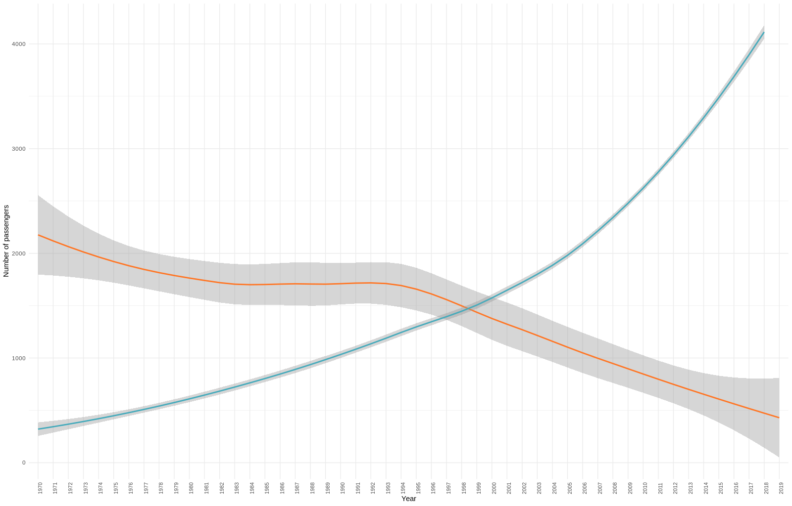
No. of Passengers (in Lakhs) & Crashes

Slide 15
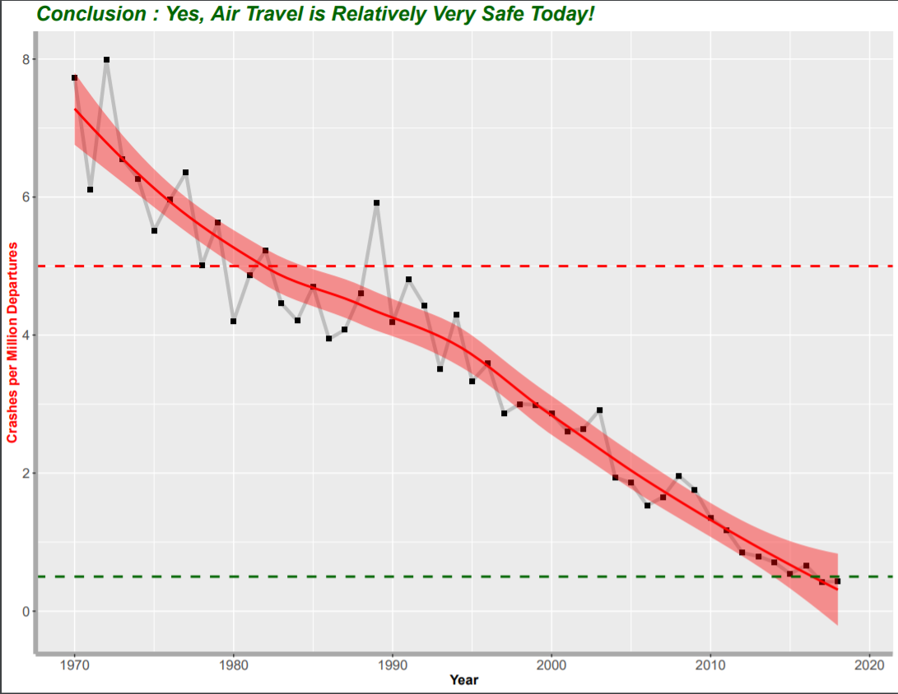

Slide 16
