Slide 1
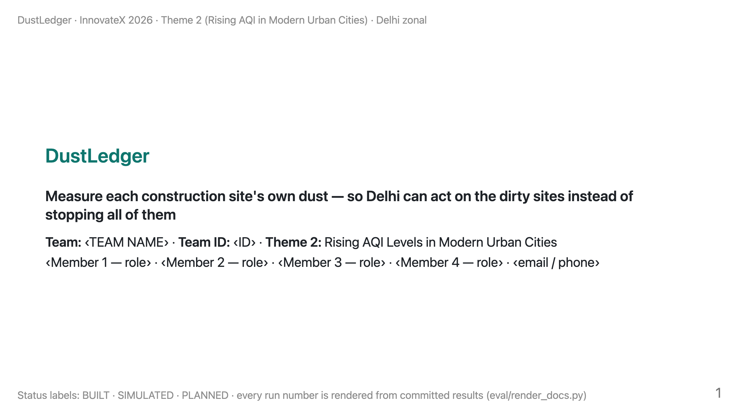
Notes:
TIME 0:00–0:20 (20 s). LOGISTICS: present zonal-deck.pdf from your own laptop, with demo/dustledger-demo.html pre-opened in a second tab (offline); backup slides B1–B7 follow the last main slide. Cue card: presenter-card.pdf.
SAY: "We're ‹team›. Every winter Delhi stops every construction site, clean or dirty, because it can't tell them apart. We propose a way to measure each site's own dust. Today we have the data pipeline and a stress-tested simulation; the sensor ring is our Round-2 build."

Slide 2
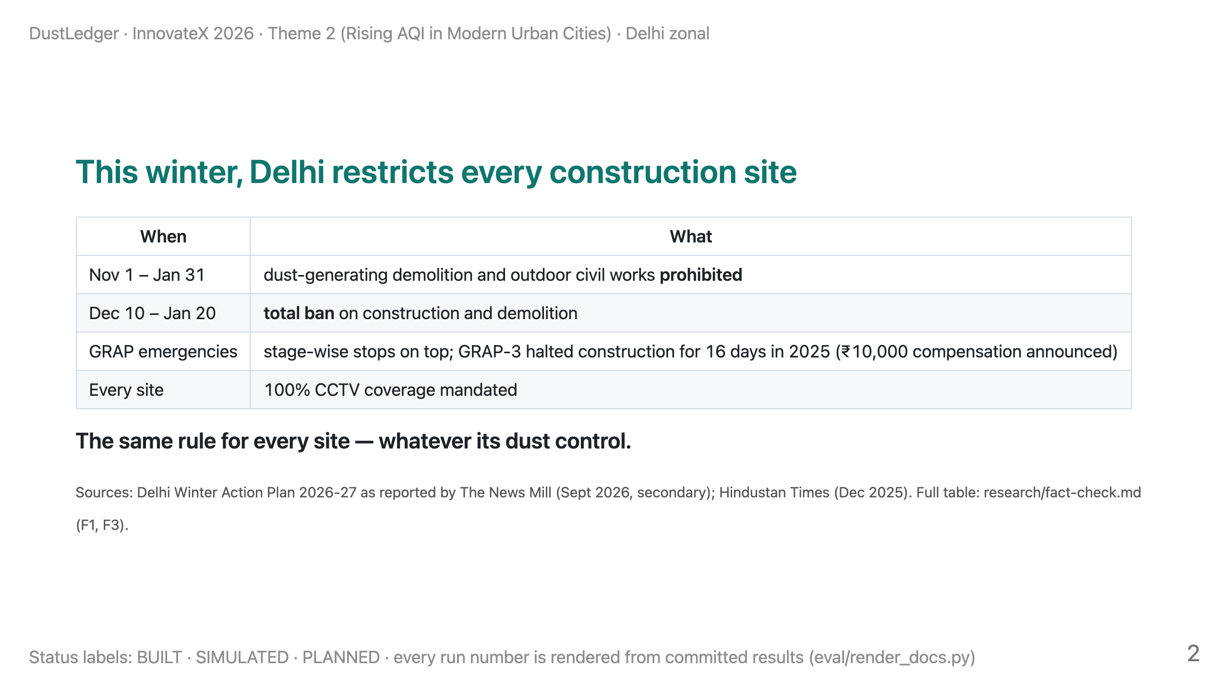
Notes:
TIME 0:20–1:10 (50 s).
SAY: "Delhi's Winter Action Plan for this year prohibits dust-generating demolition and outdoor civil works from November first to January thirty-first, and bans all construction from December tenth to January twentieth. GRAP emergencies stop sites on top of that: last year GRAP-3 halted construction for sixteen days. Every site is treated the same, whatever it does about dust."

Slide 3
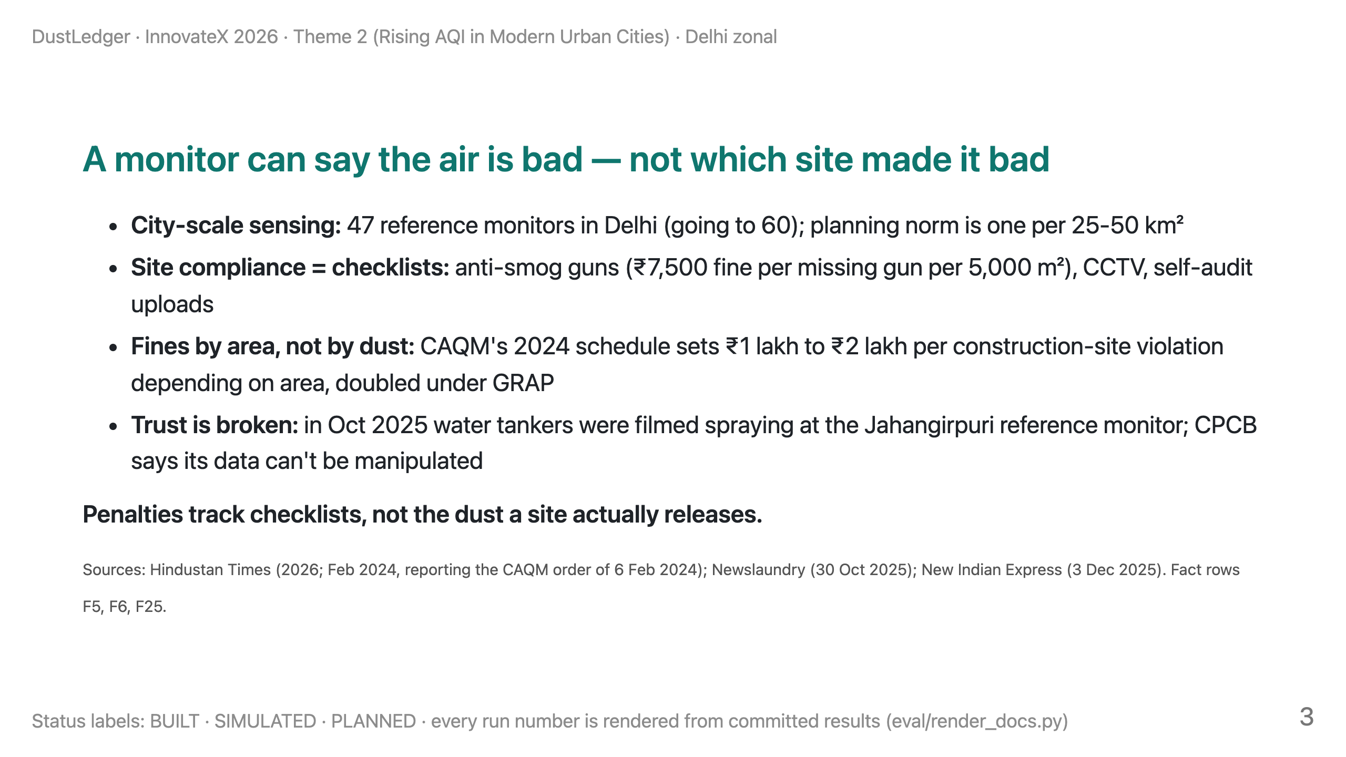
Notes:
TIME 1:10–2:00 (50 s).
SAY: "Delhi measures air at city scale: forty-seven reference monitors, roughly one per twenty-five to fifty square kilometres. A monitor can tell you the air is bad; it can't tell you which of the sites around it made it bad. So compliance is a checklist — anti-smog guns, CCTV, self-audits — and fines are set by site area, not by how much dust a site actually releases. And when tankers are filmed spraying a reference monitor, people stop trusting the numbers."

Slide 4
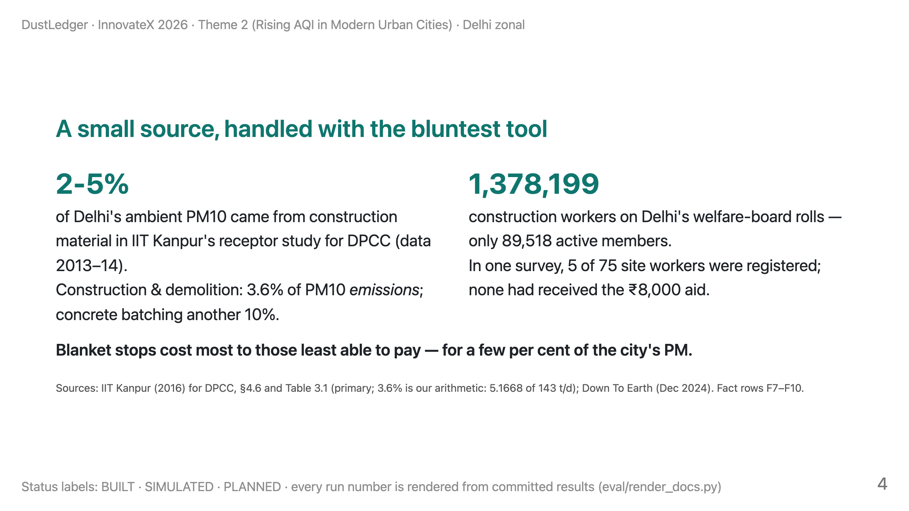
Notes:
TIME 2:00–3:00 (60 s).
SAY: "Here's the honest size of the problem. In IIT Kanpur's source study for the Delhi government, construction material was two to five per cent of ambient PM10. It's a real source, but a small one. Yet it gets the bluntest tool there is. The cost falls on workers: nearly fourteen lakh are on Delhi's welfare-board rolls but only about ninety thousand are active members, and in one survey most site workers weren't even registered for the aid. So we are not promising to clean Delhi's air. We're proposing to make enforcement on this source fair and targeted."

Slide 5
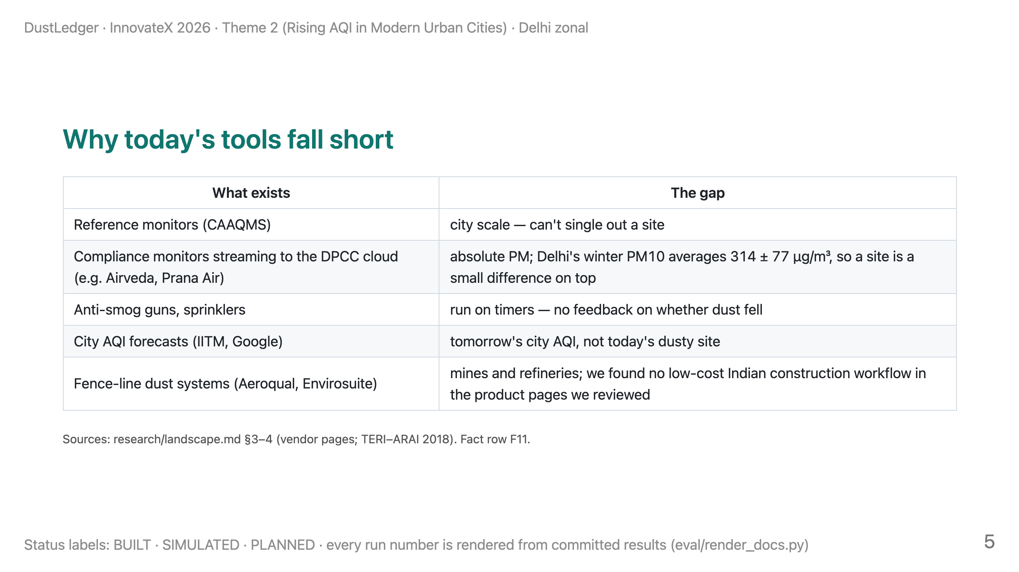
Notes:
TIME 3:00–3:50 (50 s).
SAY: "Indian compliance monitors stream a PM number to the DPCC cloud. But in Delhi's winter, background PM10 averages around three hundred micrograms, so a sensor at the fence mostly measures Delhi, not the site. Anti-smog guns run on timers. Forecasts predict the city, not the site. Fence-line attribution exists — for mines and refineries — and we'd borrow it, but we didn't find it packaged for Indian construction sites at low cost."

Slide 6
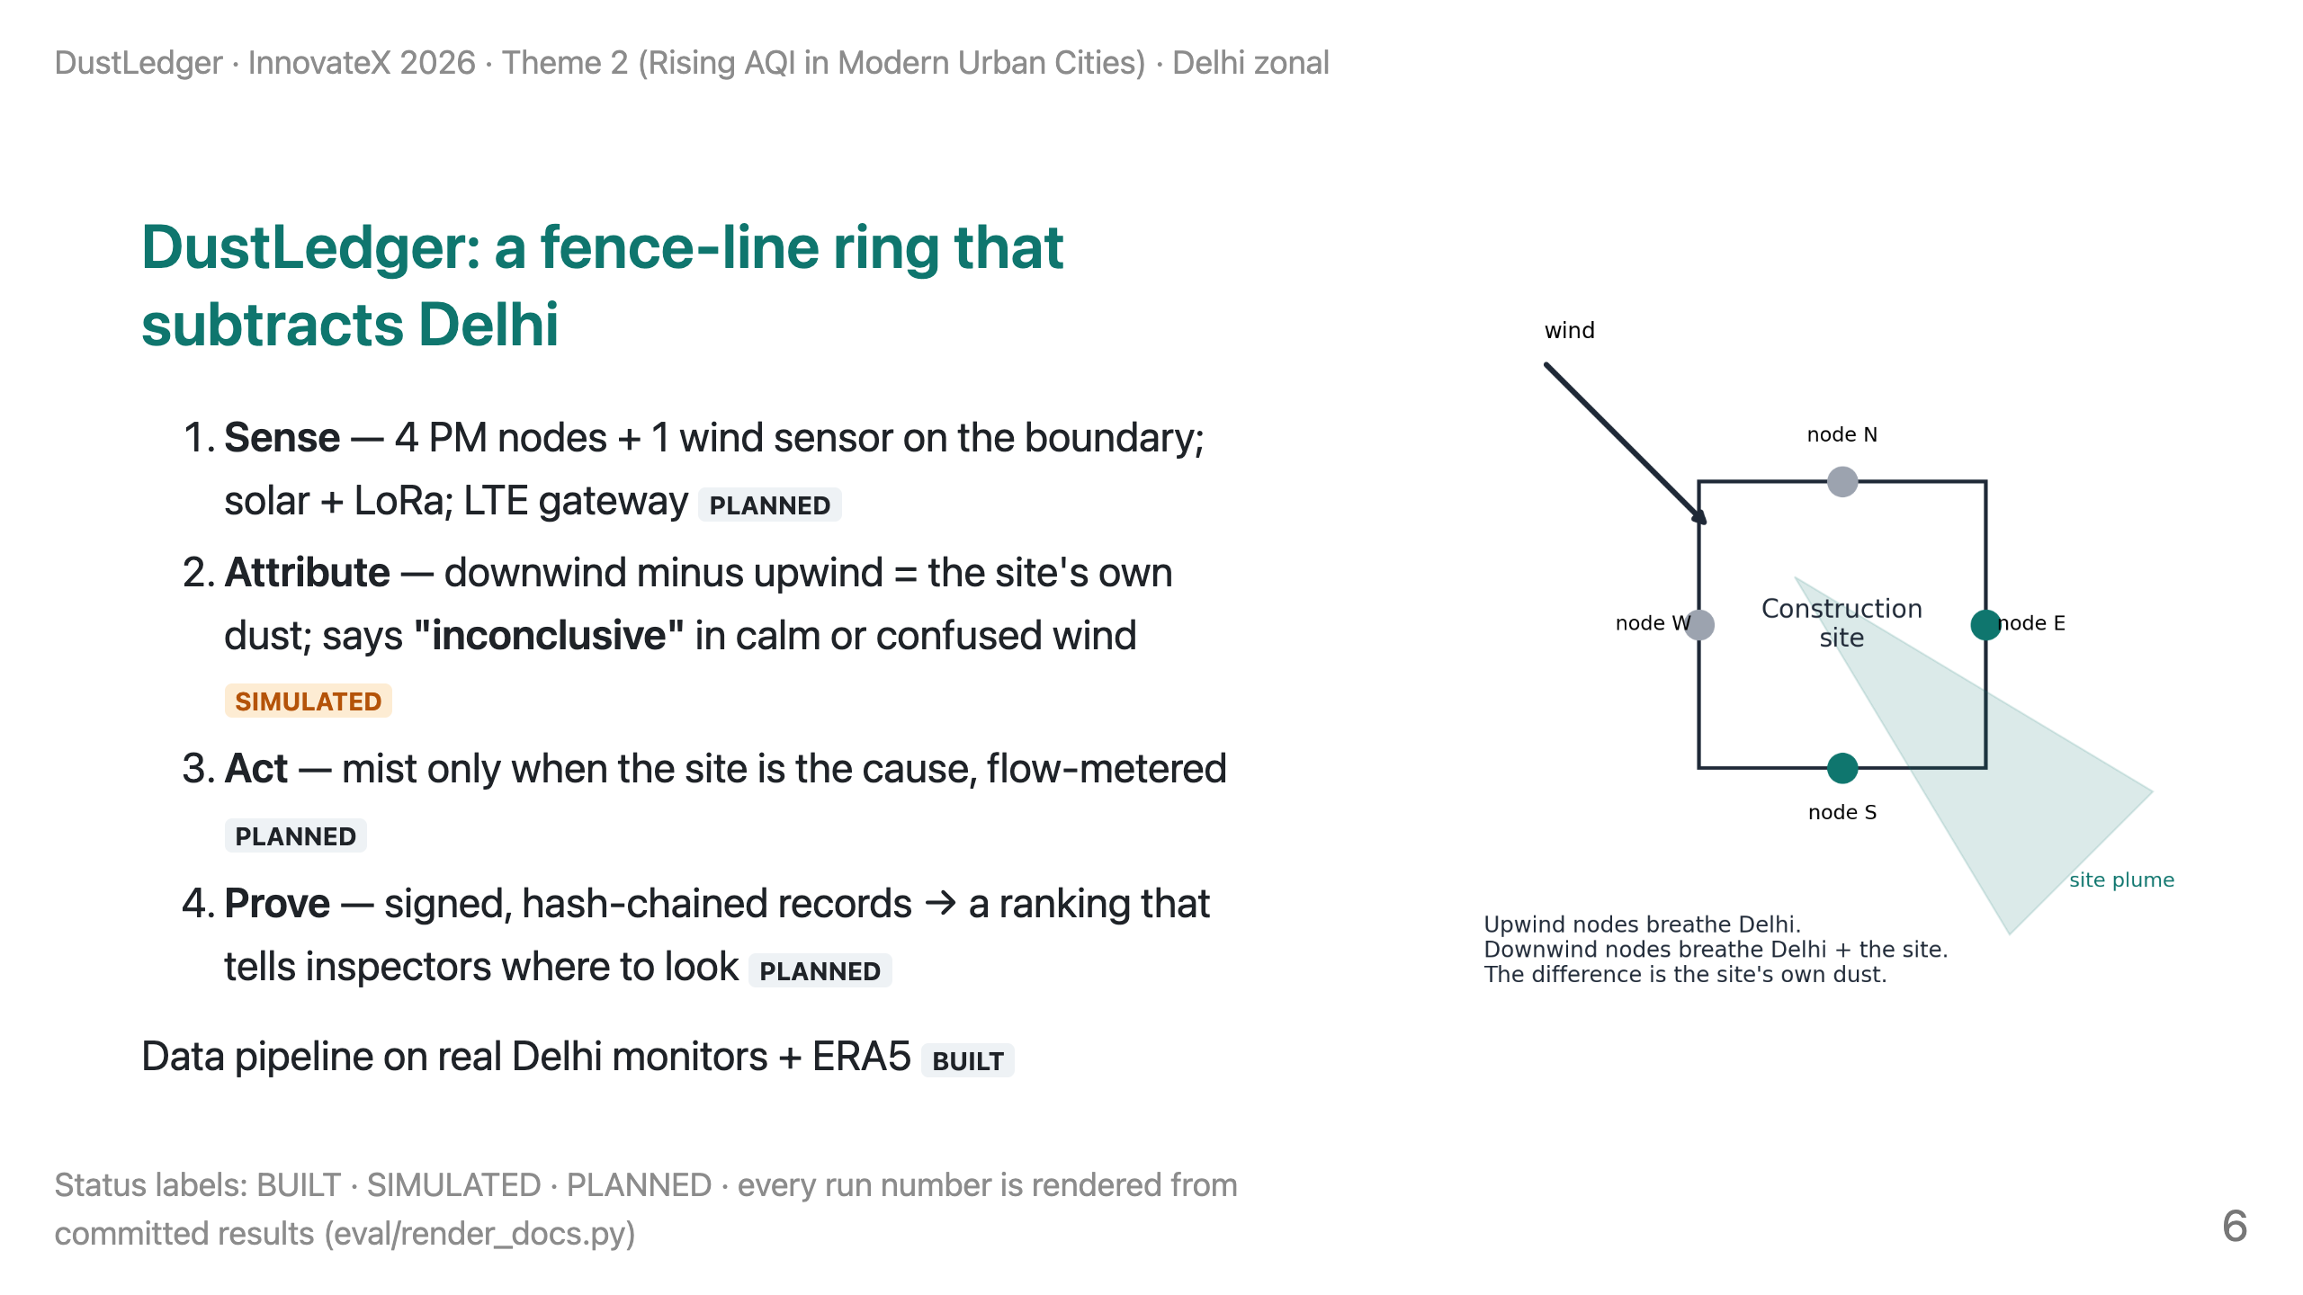
Notes:
TIME 3:50–5:10 (80 s).
SAY: "Four cheap sensors on the boundary and a wind sensor. Delhi's background reaches all four; the site's own dust reaches only the downwind ones. The difference is the site's contribution. When the wind is calm or swirling we say 'inconclusive' instead of guessing — and inconclusive never means clean. When the site is the cause, the misting line turns on; not on a timer. Records are signed on the device and hash-chained, so edits become detectable. The output is a ranking that tells inspectors where to look; penalties still need DPCC's own verification."

Slide 7
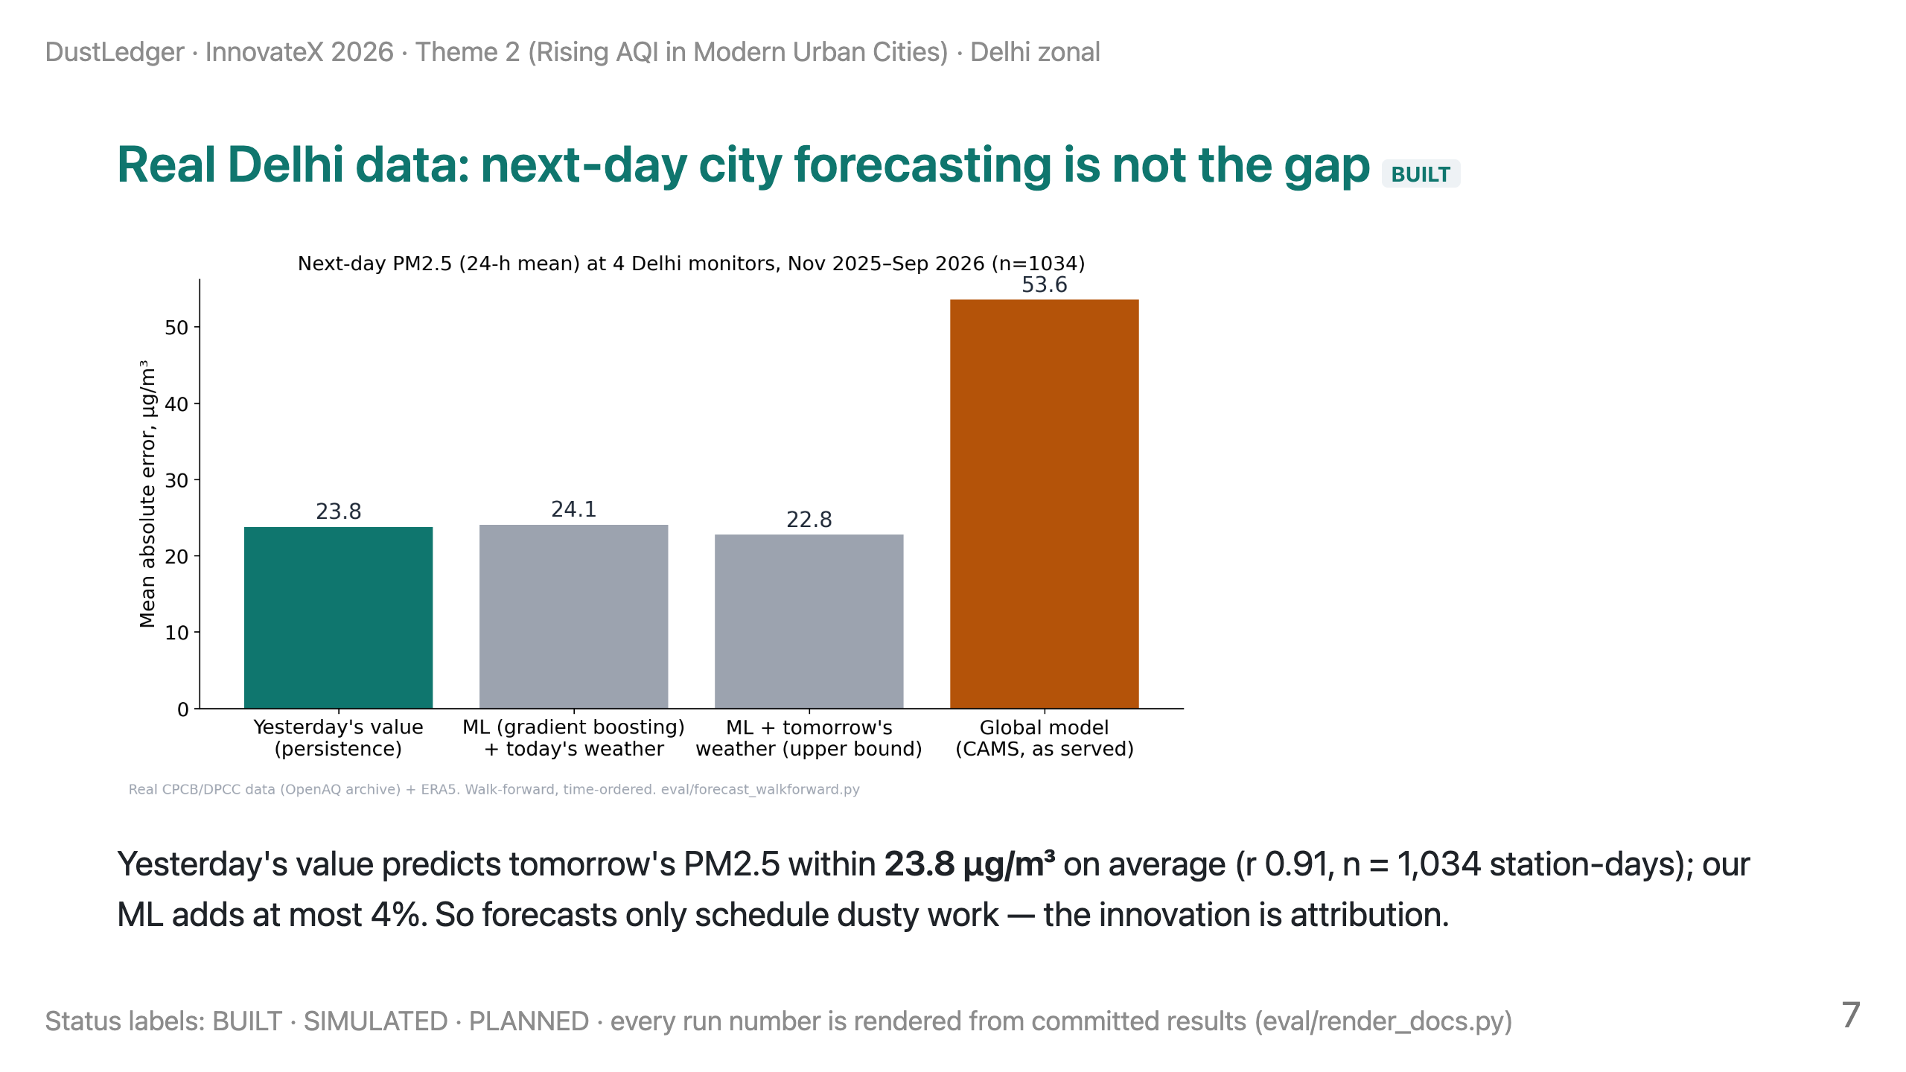
Notes:
TIME 5:10–5:50 (40 s).
SAY: "Here's real data: four CPCB and DPCC monitors, two years, a strict time-ordered test. Yesterday's value predicts tomorrow's PM2.5 within about twenty-four micrograms. With one year of history, our gradient-boosting model added at most four per cent. IITM already runs city forecasting. So we use forecasts only to schedule dusty work, and put the innovation where nobody is: at the site."

Slide 8
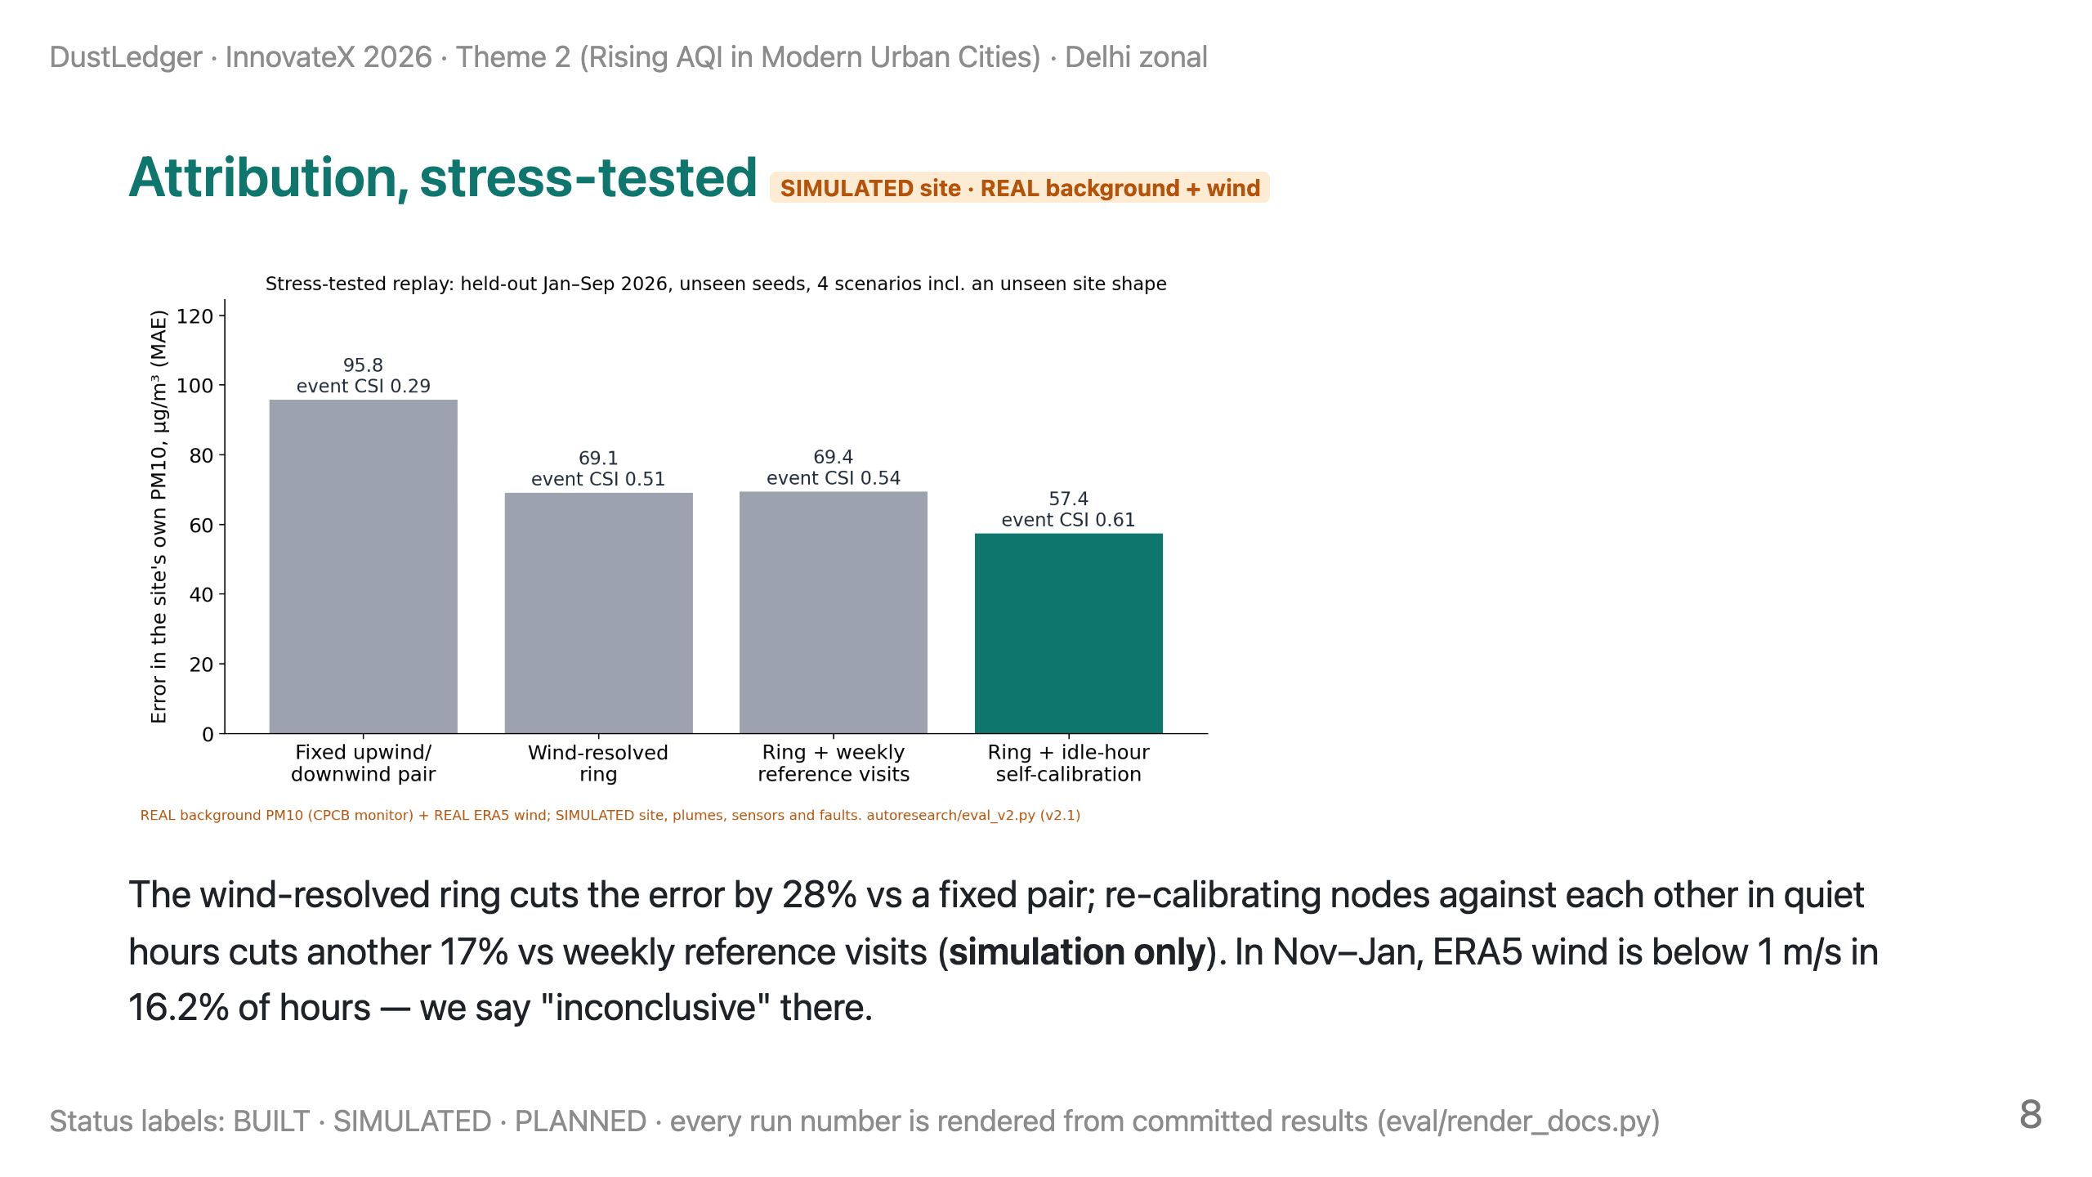
Notes:
TIME 5:50–7:00 (70 s).
SAY: "This is the core test. The background PM and the wind are real Delhi data; the site, its dust and the sensor faults are simulated. An independent reviewer made the simulator harder — sensor fouling, dust responding differently from ambient air, dirty nights, a neighbouring site, a biased wind vane — and we ran the held-out test once. A fixed upwind-downwind pair is off by about ninety-six micrograms; the wind-resolved ring by sixty-nine; adding self-calibration from the site's quiet hours, fifty-seven. That last step is seventeen per cent better than weekly reference visits — but it's simulation. A controlled dust test decides it. And in Delhi's winter, the wind is under one metre per second about one hour in six; there we say 'inconclusive'."

Slide 9
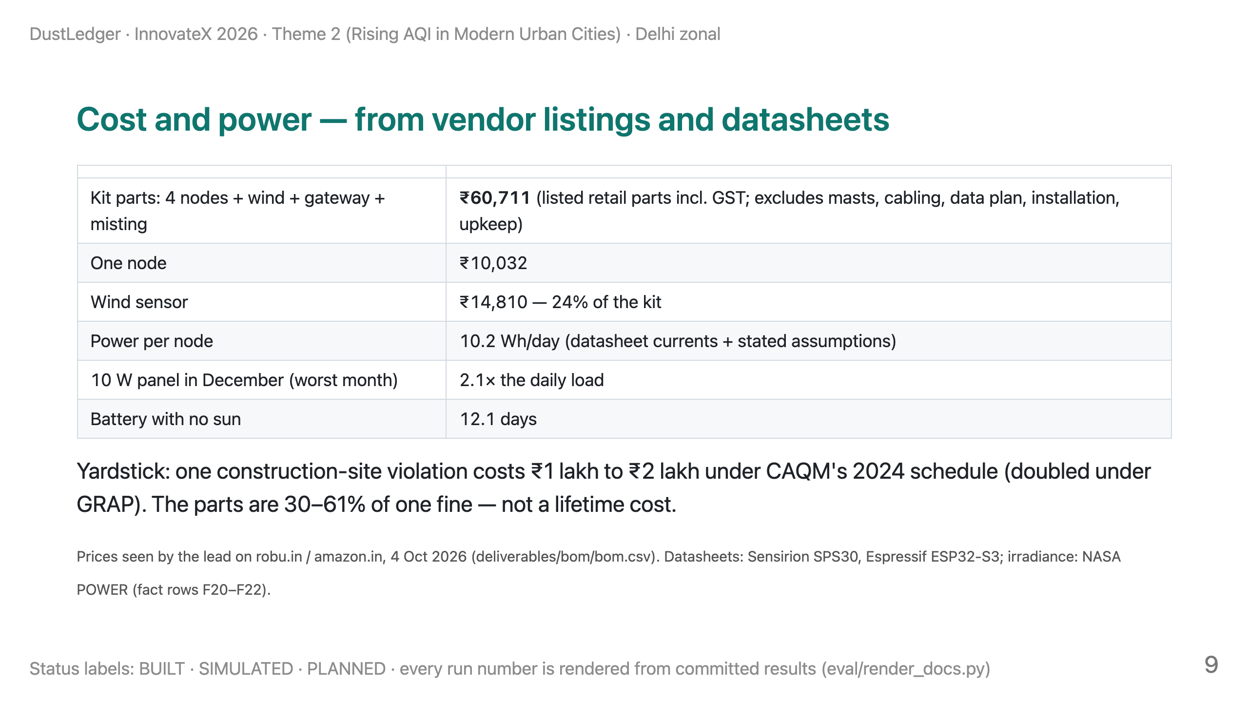
Notes:
TIME 7:00–7:50 (50 s).
SAY: "Costs come from vendor listings we opened: about sixty-one thousand rupees of parts for a four-node ring, wind sensor, gateway and misting line. That's parts only — not installation or upkeep. The wind sensor is a quarter of it. Power comes from datasheets: about ten watt-hours a day per node, so a ten-watt panel covers about twice the load even in December, and the battery lasts about twelve days without sun. Compare that with one violation: one to two lakh rupees under CAQM's schedule, doubled under GRAP."

Slide 10
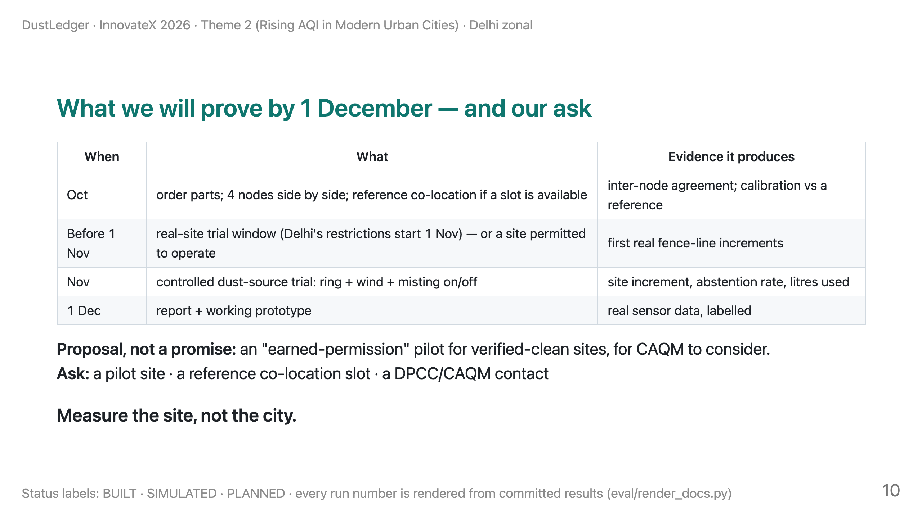
Notes:
TIME 7:50–9:15 (85 s). Then stop: 45 s reserve.
SAY: "Here's what we'll prove, and when. In October, four nodes side by side and, if we get a slot, next to a reference monitor. A real-site trial has to happen before November first, when Delhi's restrictions start, or at a site that's allowed to operate. Otherwise our evidence is a controlled dust-source trial on campus, with misting on and off, measuring the site's own dust, how often we abstain, and the water used. On the first of December: a working prototype with real sensor data. One proposal — not a promise: an earned-permission pilot for sites that prove they're clean. Our ask: a pilot site, a reference co-location slot, and a contact at DPCC or CAQM. Measure the site, not the city."

Slide 11
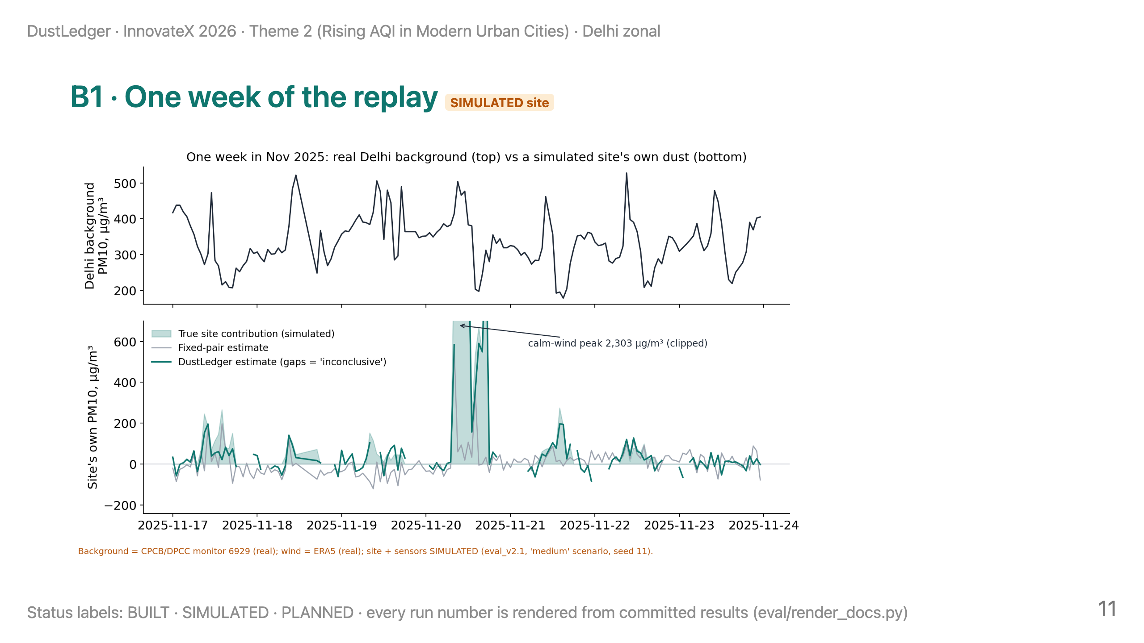
Notes:
BACKUP. Use for "show me how it behaves". Top: real Delhi background PM10 at a DPCC monitor. Bottom: a simulated site's true contribution vs the fixed pair and DustLedger; gaps are 'inconclusive' hours. The clipped peak is a calm-wind hour in the simulation.

Slide 12
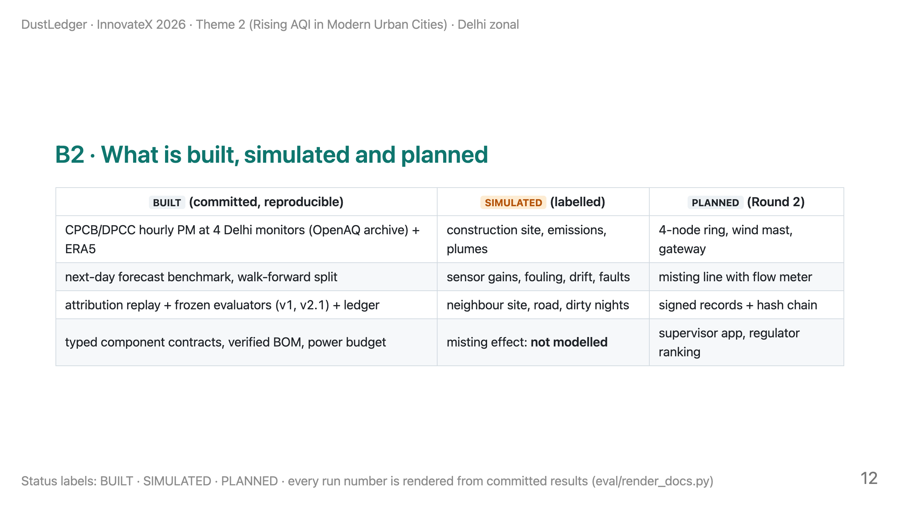
Notes:
BACKUP. Use for "what have you actually built?" Answer: the data pipeline, the forecast benchmark and the stress-tested replay are real and reproducible; the site and sensors in the replay are simulated; the hardware is the Round-2 build.

Slide 13
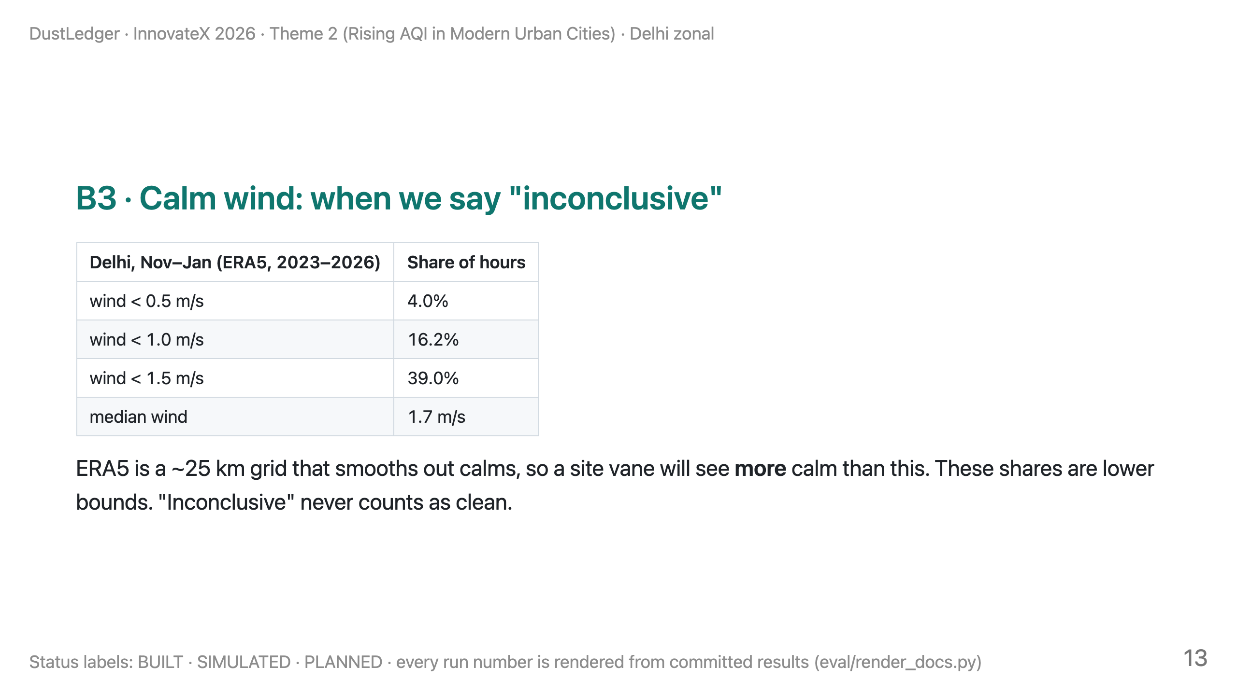
Notes:
BACKUP. Use for "what about Delhi's calm winter nights?" The replay abstains below 0.5 m/s (coverage 0.95); with a 1 m/s threshold, expect at least one winter hour in six to be inconclusive. Improving calm-wind handling is on the backlog, not a claim.

Slide 14
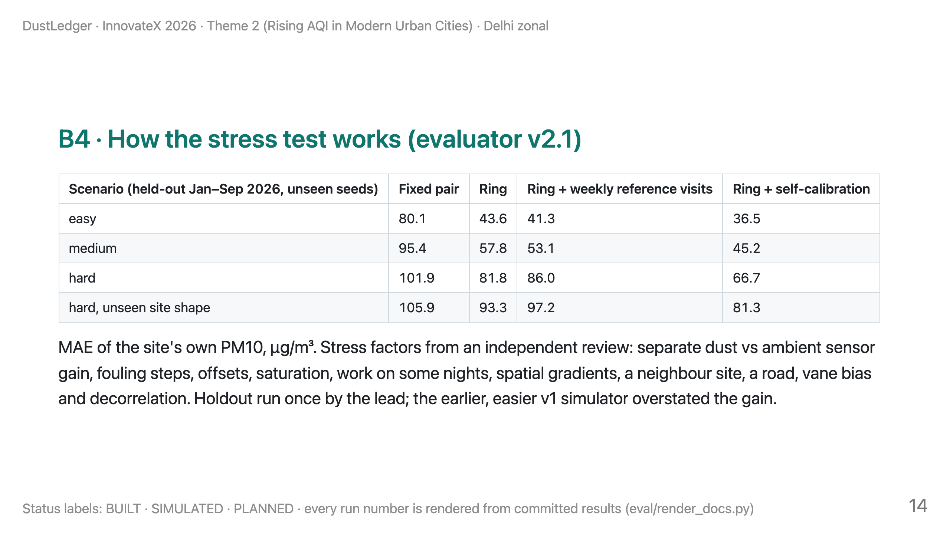
Notes:
BACKUP. Use for "isn't your simulator rigged?" Answer: an independent reviewer found v1 favoured our method; v2.1 adds those failure modes and a fair baseline (weekly reference visits). Self-calibration still wins in all four scenarios, by less. It remains a simulation until the dust test.

Slide 15
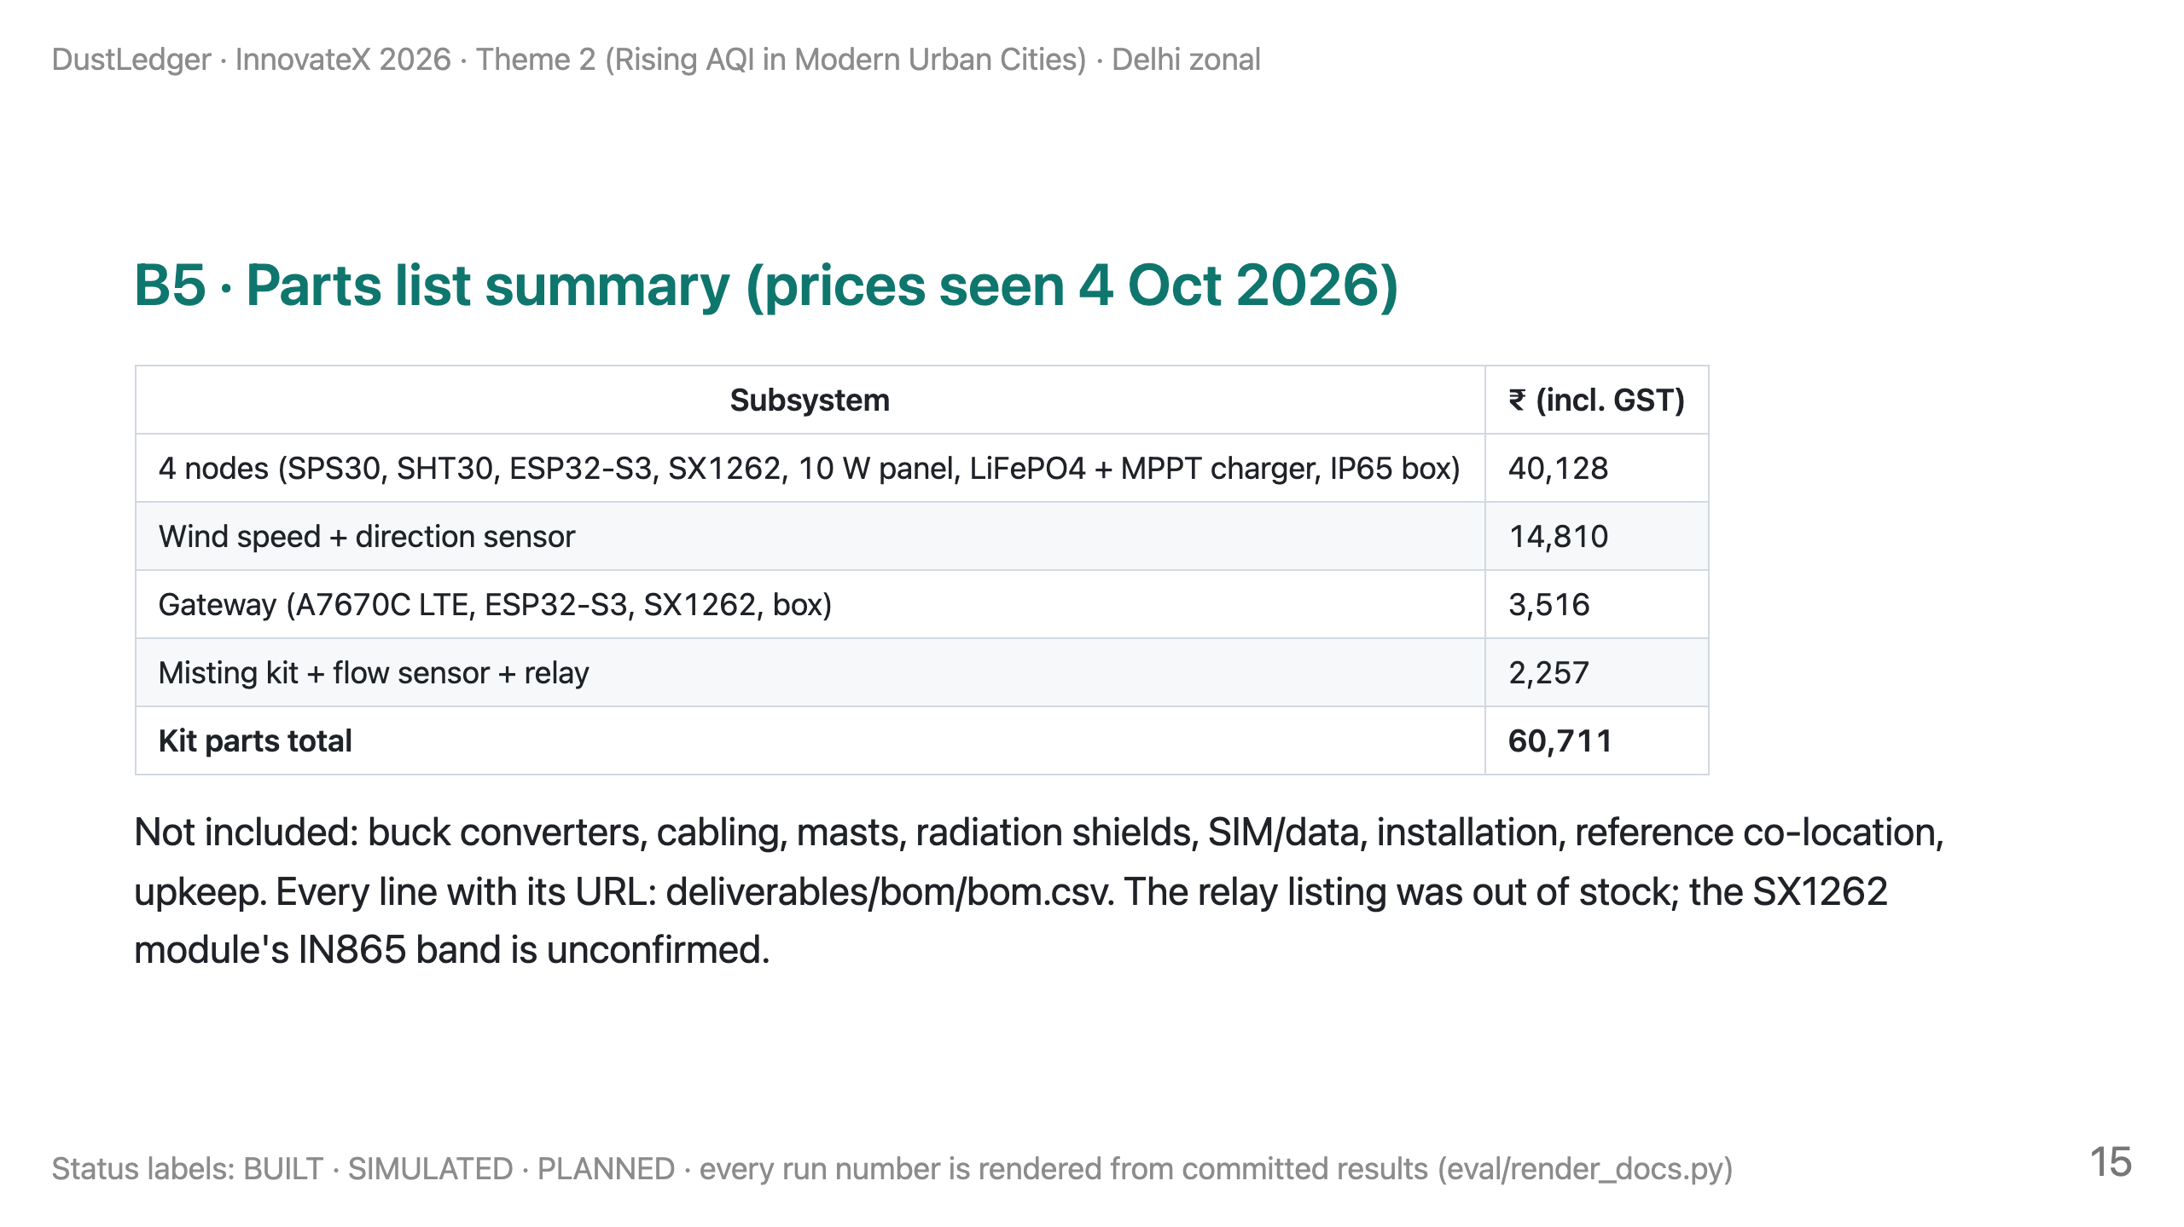
Notes:
BACKUP. Use for "how much does it cost?" Say "parts" every time; installed and lifetime costs are not known yet.

Slide 16
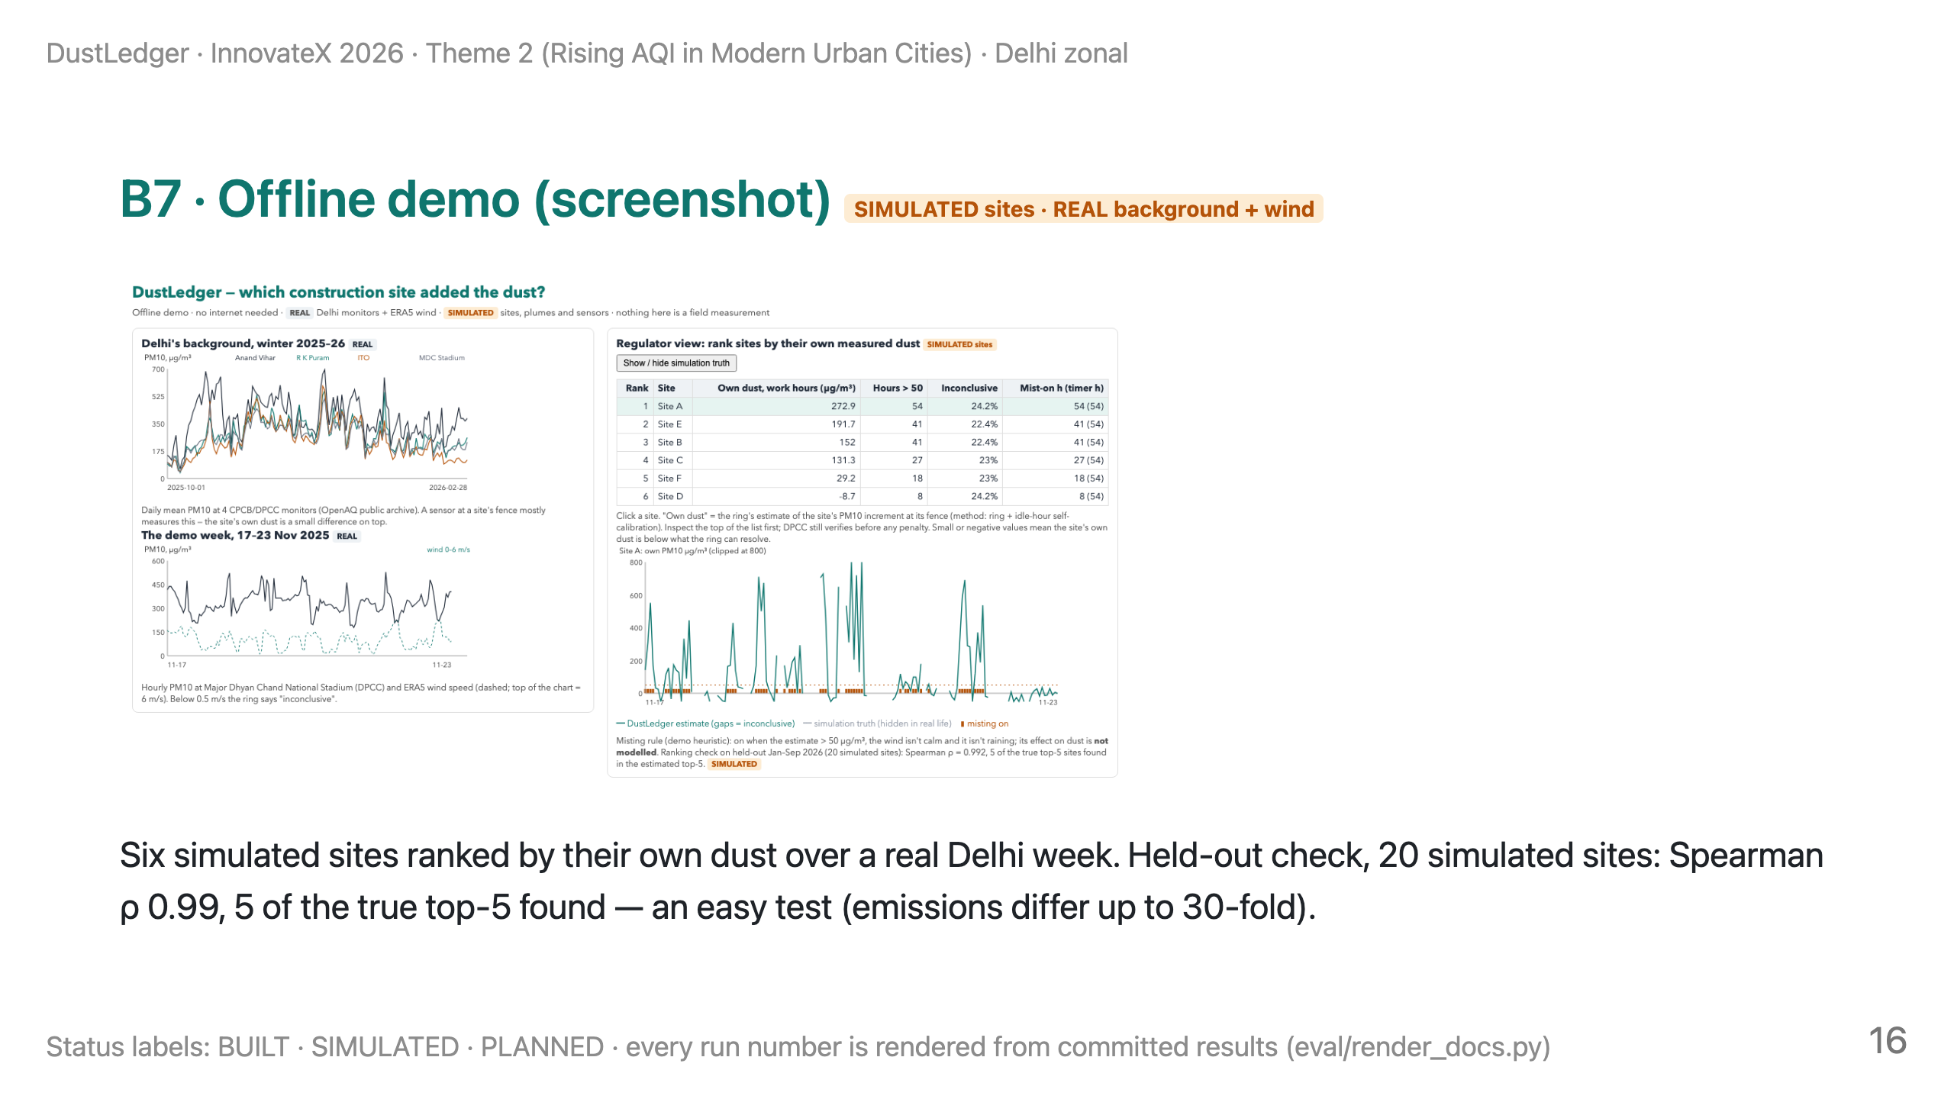
Notes:
BACKUP. If the demo tab fails, show this. Say: "Real background and wind; simulated sites. The list tells an inspector where to look first; the truth toggle shows where the ring is wrong — Site D and F swap places because both are near the noise floor."

Slide 17
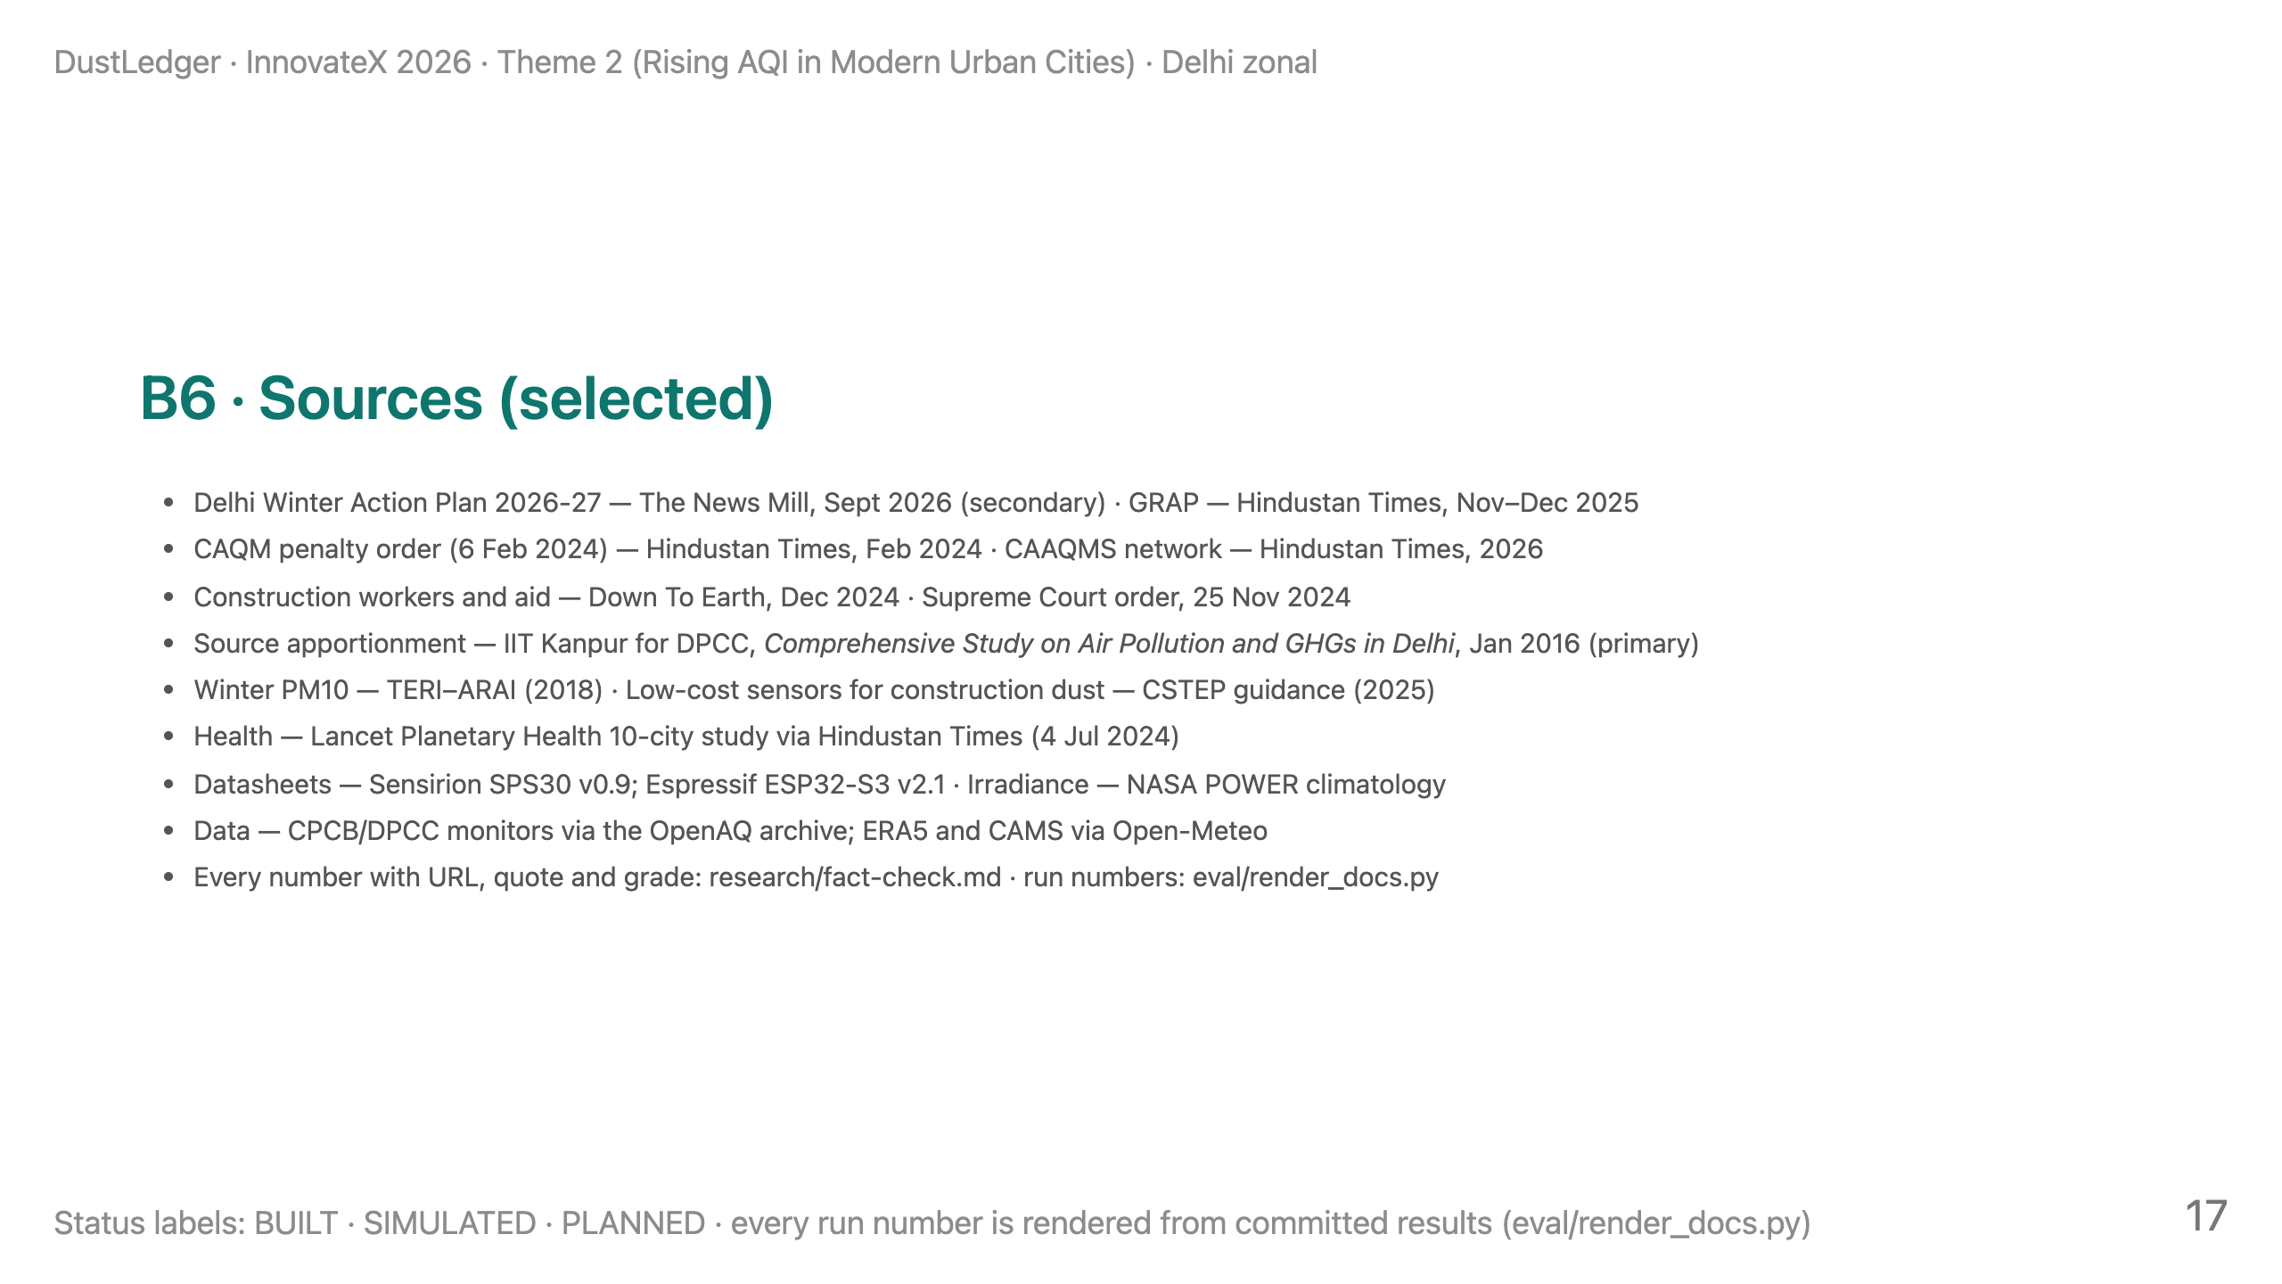
Notes:
BACKUP. Sources slide.

