Slide 1
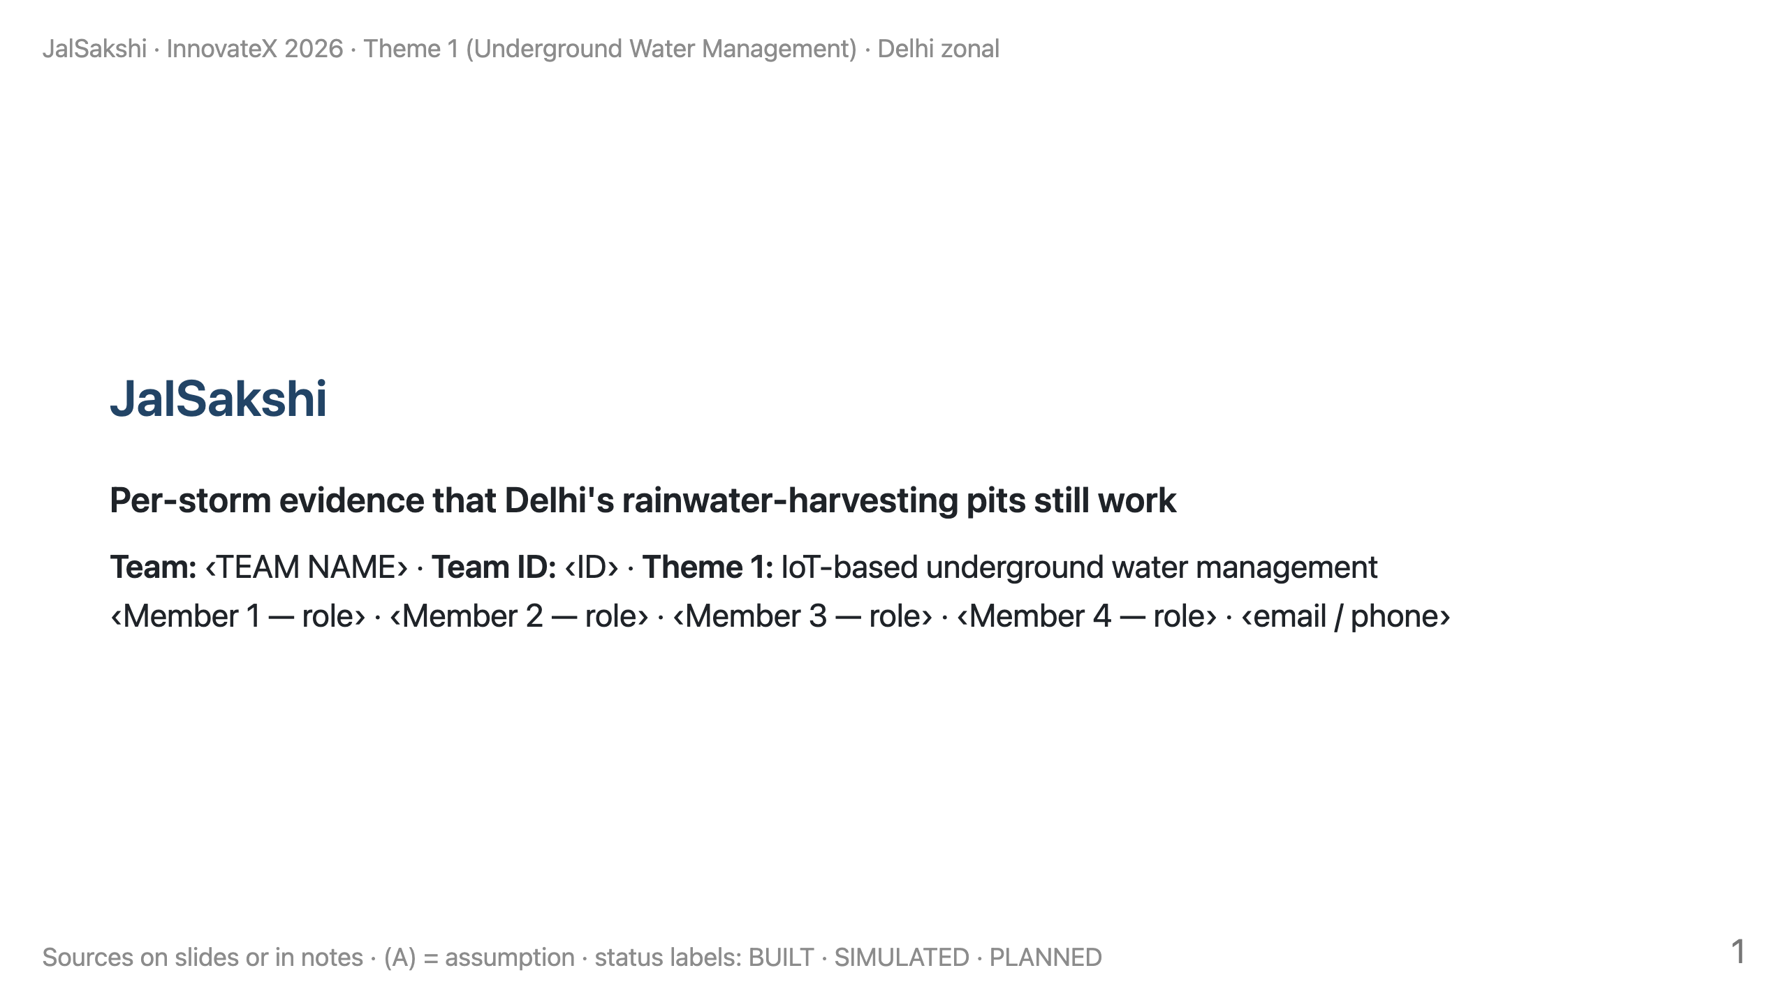
Notes:
TIME 0:00–0:20 (20 s). LOGISTICS: present from your own laptop, zonal-deck.pdf first, with the demo HTML pre-opened in a second tab (offline). Cue card: presenter-card.pdf.
SAY: "We're ‹team›. Delhi has made rainwater harvesting compulsory for 25 years and pays rebates for it. Today, checking a pit means an inspector's visit. We propose continuous, storm-by-storm evidence. We've built the software and a simulation; the field instrument is our Round-2 build."

Slide 2
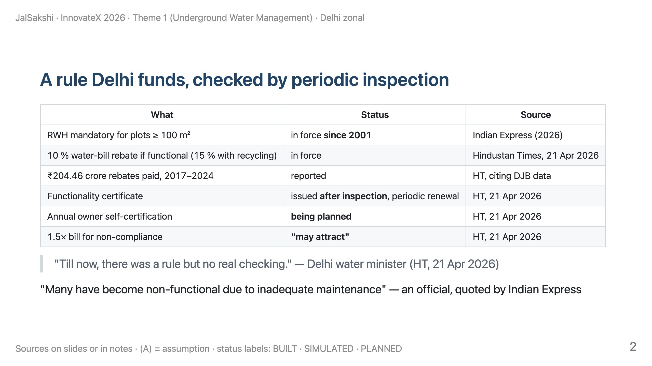
Notes:
TIME 0:20–1:40 (80 s).
SAY: "The rule is 25 years old and the rebate is real money. Verification today is an inspection visit plus a renewal, and the plan adds owner self-declaration."
LINE TO LAND: "Nothing measures a pit storm by storm. That's the layer we propose, alongside inspection, not instead of it."
DON'T SAY "never checked" or "self-certification is the rule". It's planned.

Slide 3
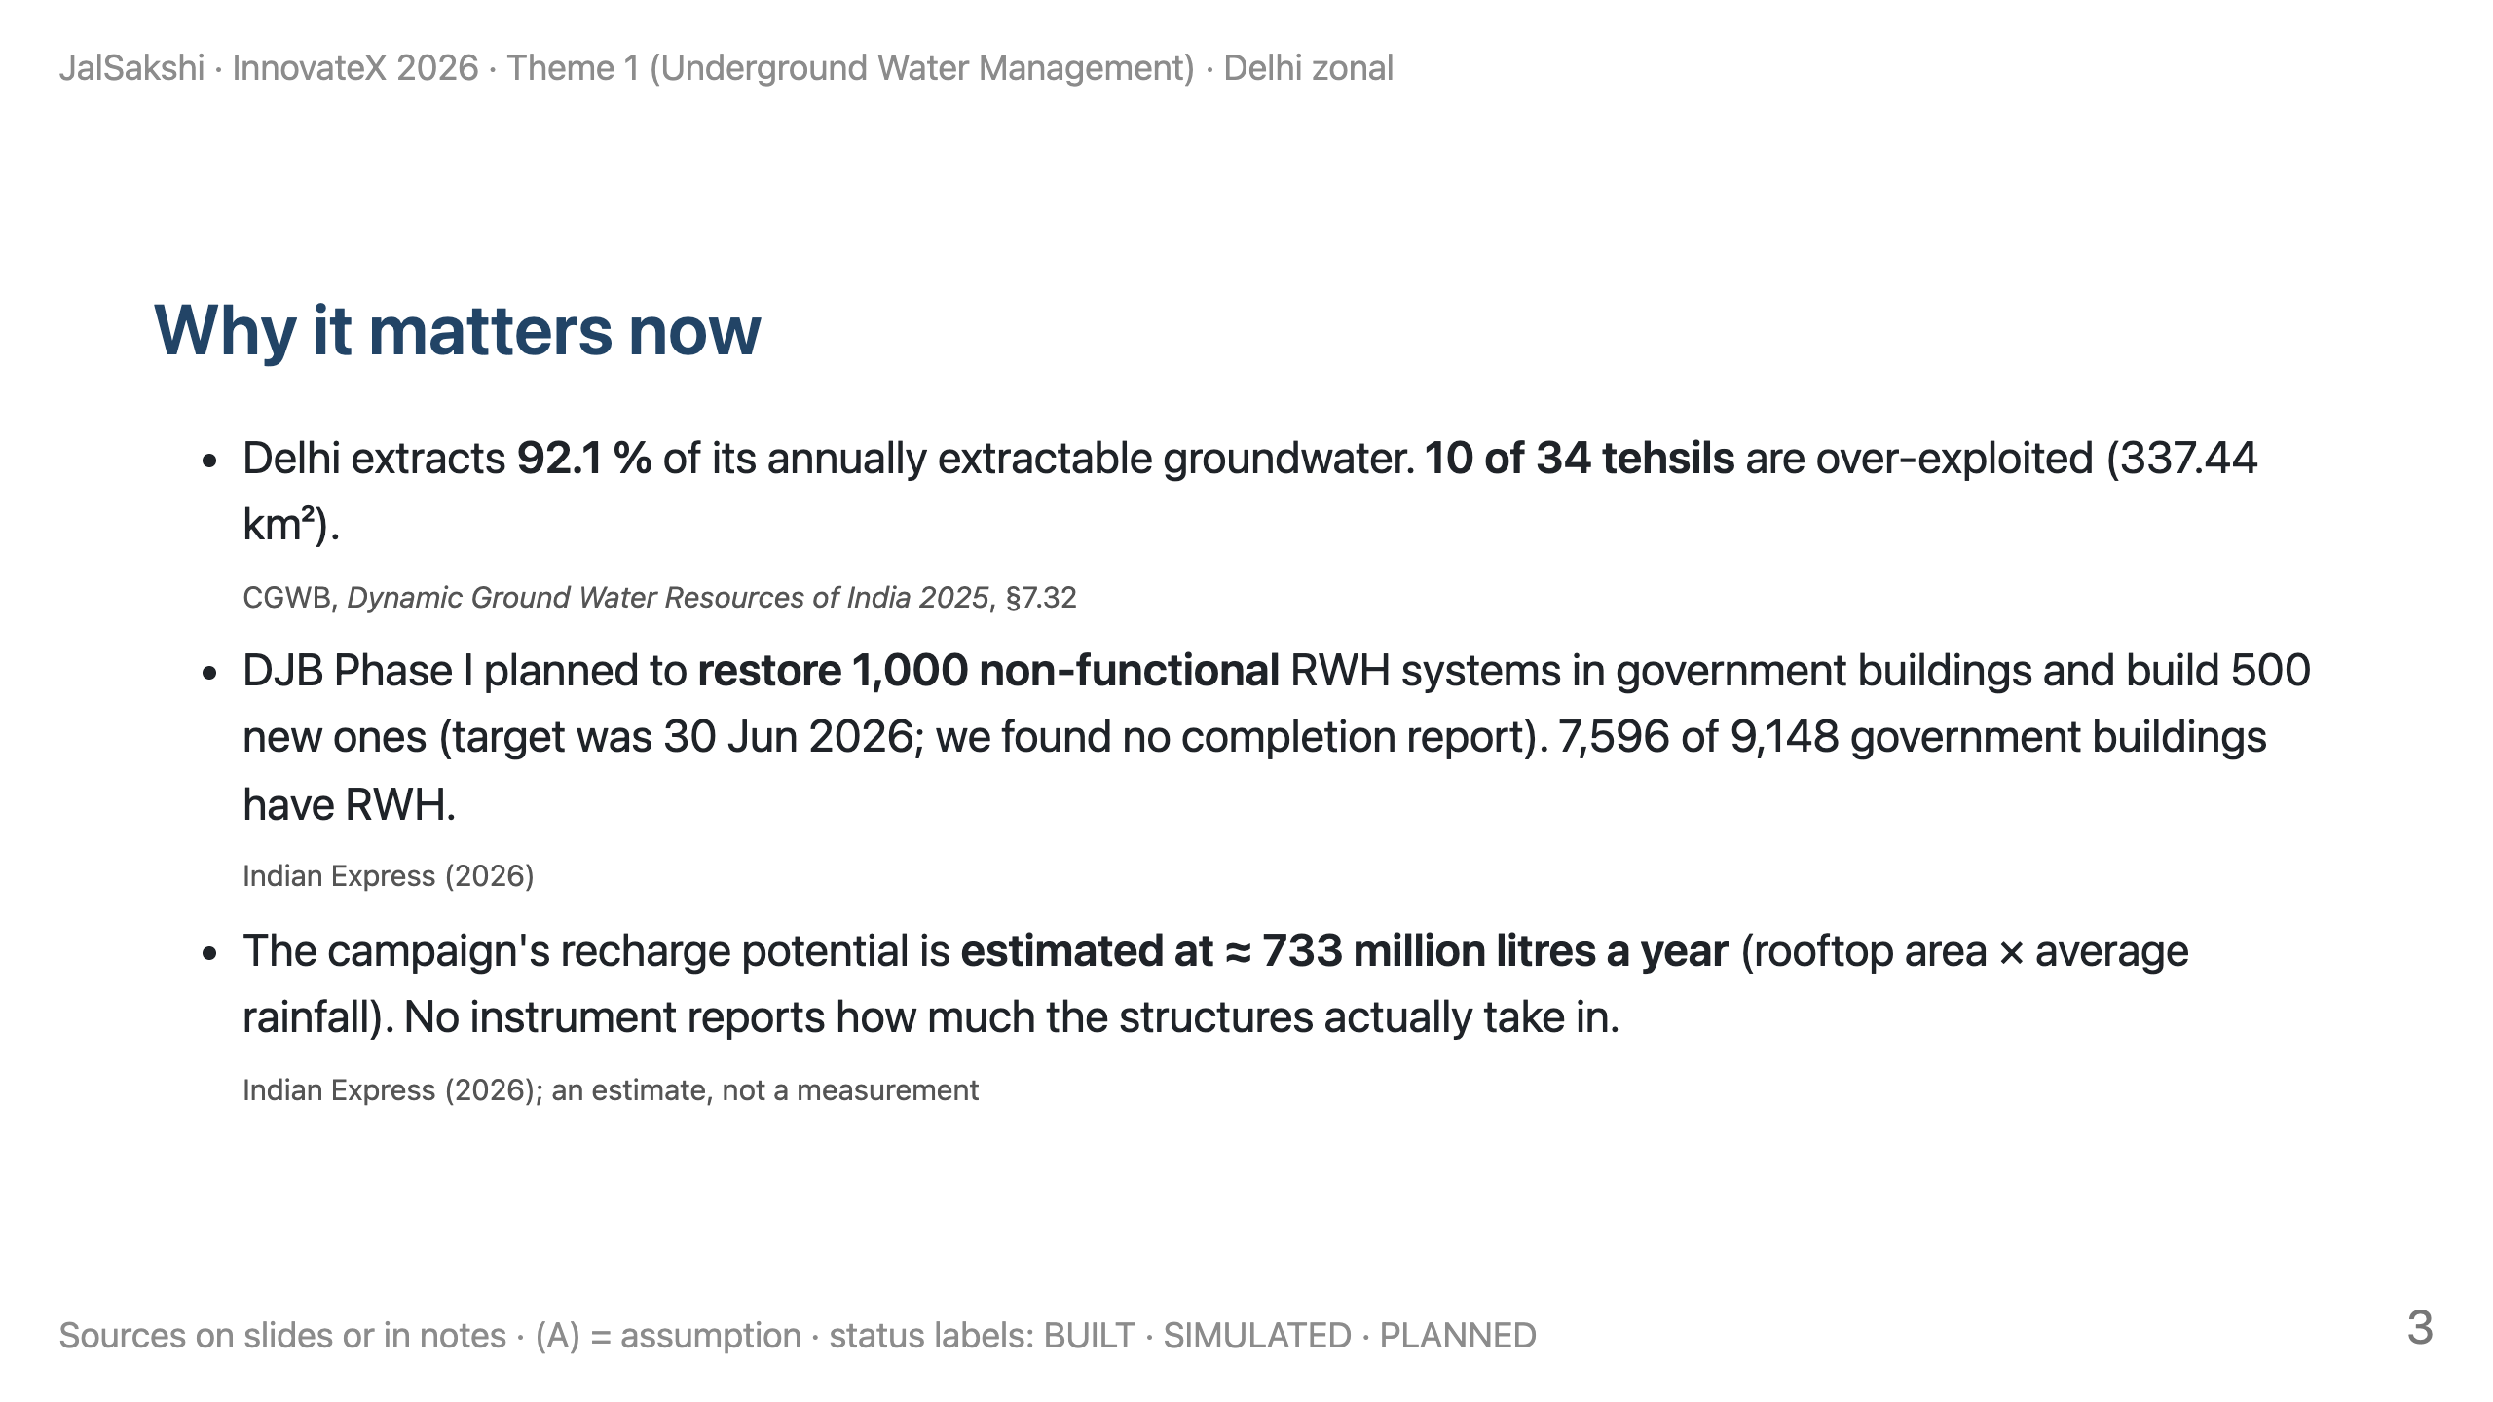
Notes:
TIME 1:40–2:30 (50 s).
SAY: "Not 'Delhi is running dry'. CGWB 2025 says 92 %, with 10 tehsils still over-exploited. The city is spending on recharge structures; we want each one to report how it performs after every storm."

Slide 4
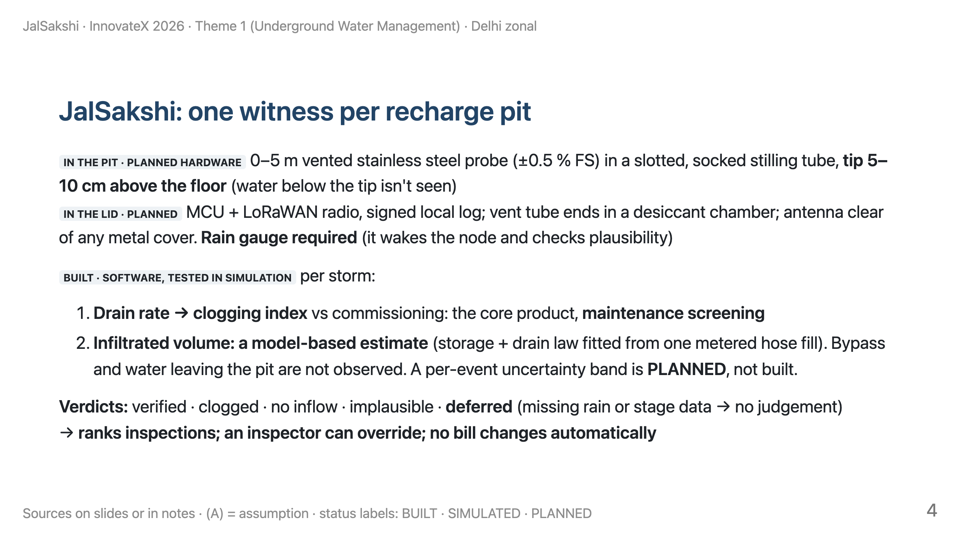
Notes:
TIME 2:30–4:00 (90 s).
SAY: "We don't claim aquifer recharge. We measure how fast a pit drains after each storm, and estimate how much it took in, using a model we calibrate once with a metered fill."
"If data are missing, it says 'deferred'. It never guesses." (Implemented and unit-tested: components/recharge_verifier/test_verifier.py.)

Slide 5
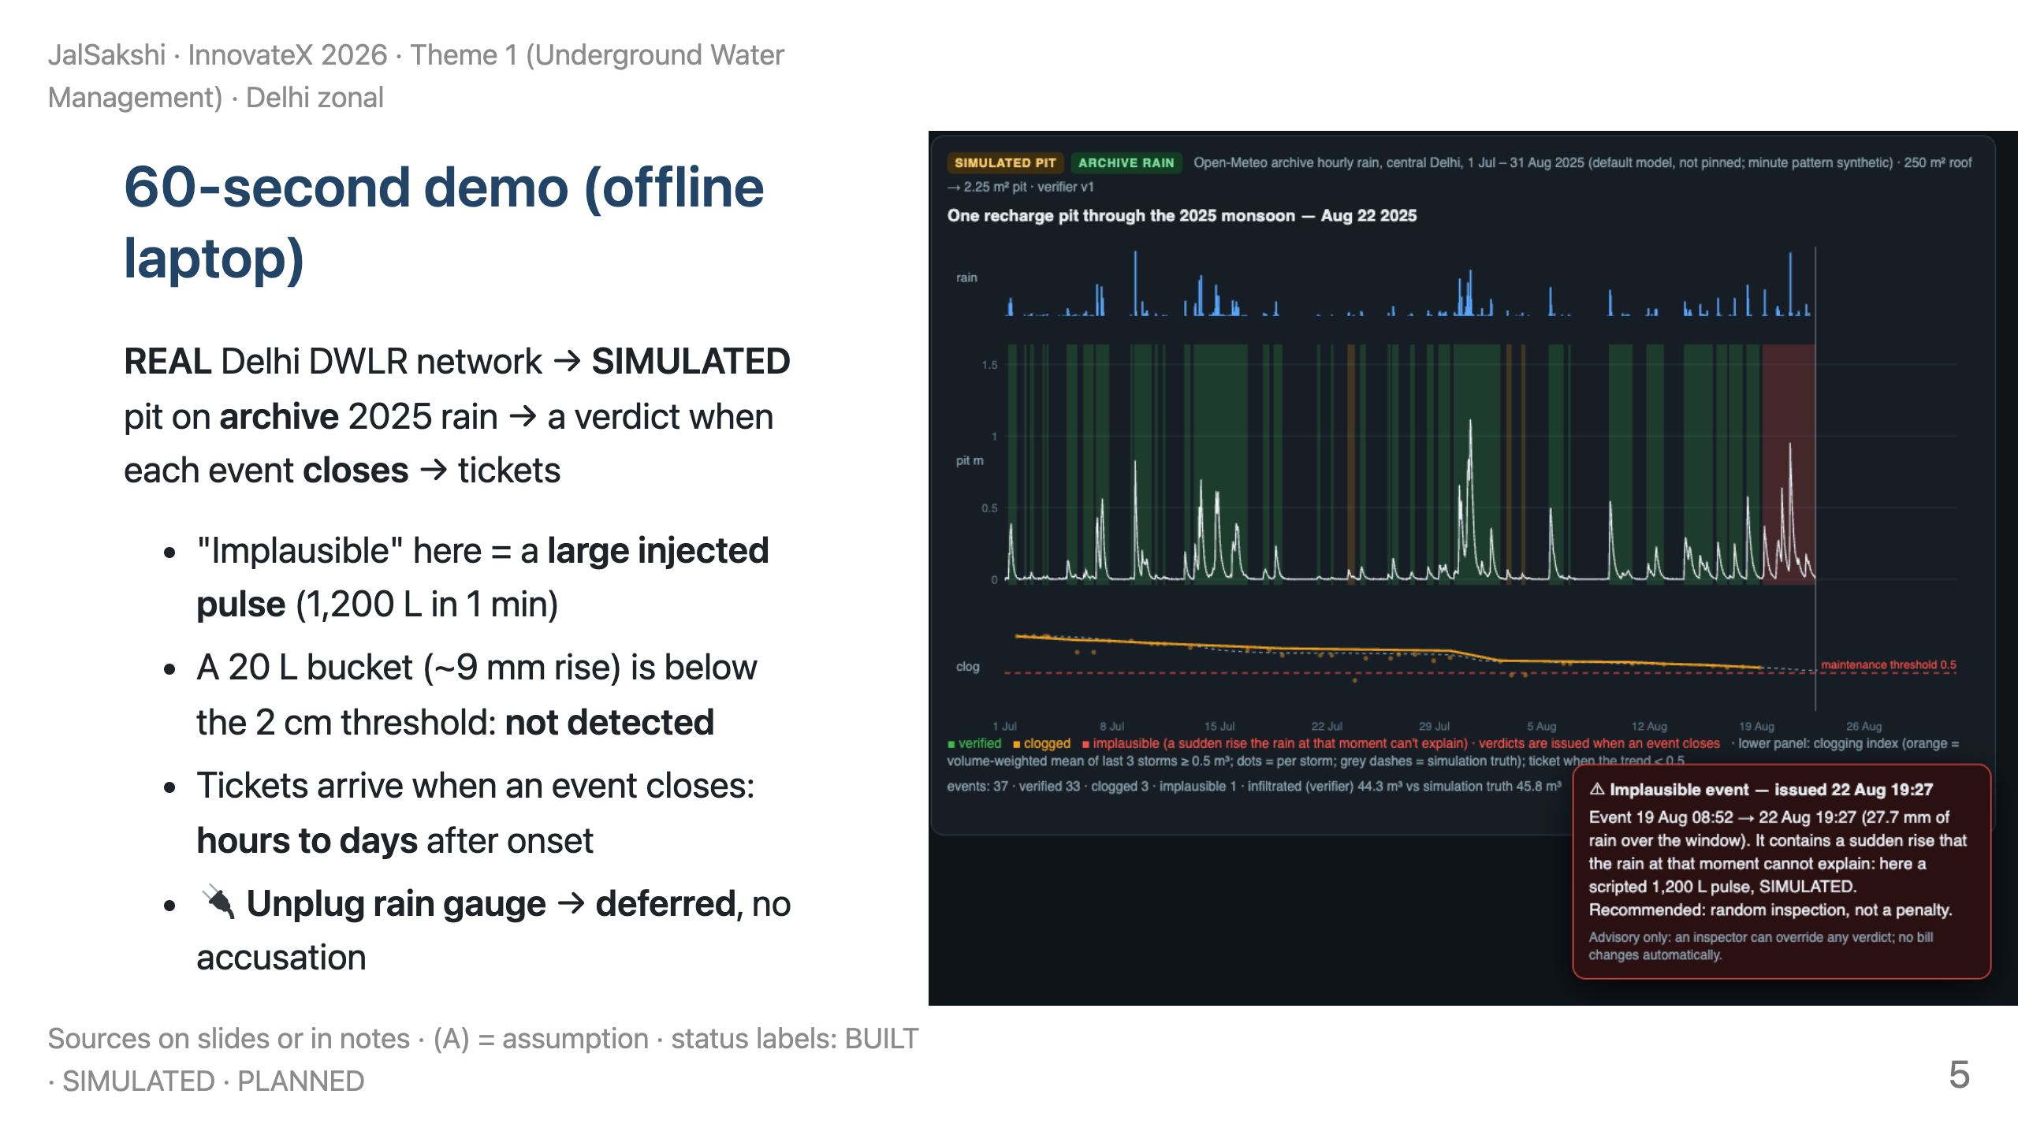
Notes:
TIME 4:00–5:15 (75 s). The demo tab is PRE-OPENED; press space. ~45 s at 1×.
SAY (left panel): "Real data: Delhi's own groundwater monitors. 185 telemetric stations; only 46 reported this year (the latest public reading is 4 June); a quarter of all readings are exactly zero."
SAY (right): "A simulated pit on Delhi's 2025 monsoon rain. Each event gets a verdict when it closes. Here's a large pulse the rain can't explain: random inspection, not a penalty. At the end, drain rate below half: a maintenance ticket."
FALLBACK: this slide's image.

Slide 6
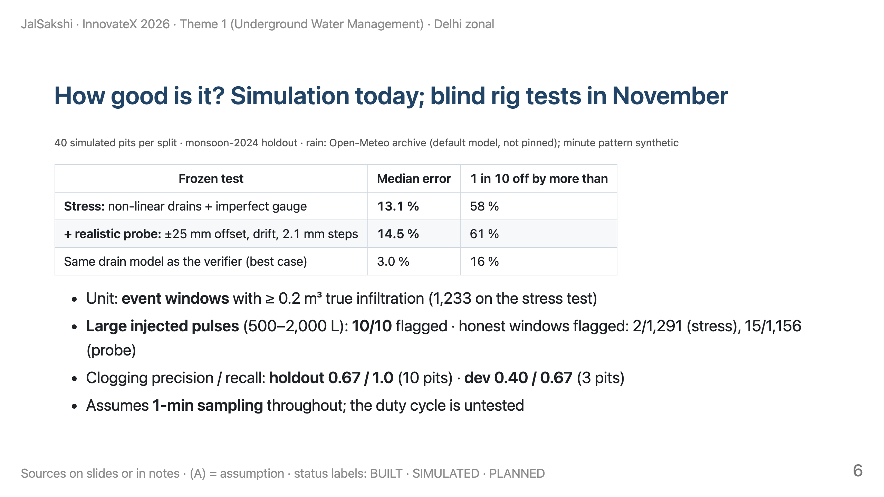
Notes:
TIME 5:15–6:15 (60 s).
SAY: "Lead with the hard number: 13 percent on the stress test, 14.5 with a realistic probe. Three percent only happens when our simulator and verifier share the physics, so we don't sell that. Clogging calls are still noisy, with dev precision 0.4. That's why the blind drum tests come first."
IF ASKED: five candidate fixes were rejected by a written keep rule (four helped one test but hurt another; one didn't help enough).
Ledger and denominators: components/recharge_verifier/autoresearch/results.tsv, eval/results/manifest.json

Slide 7
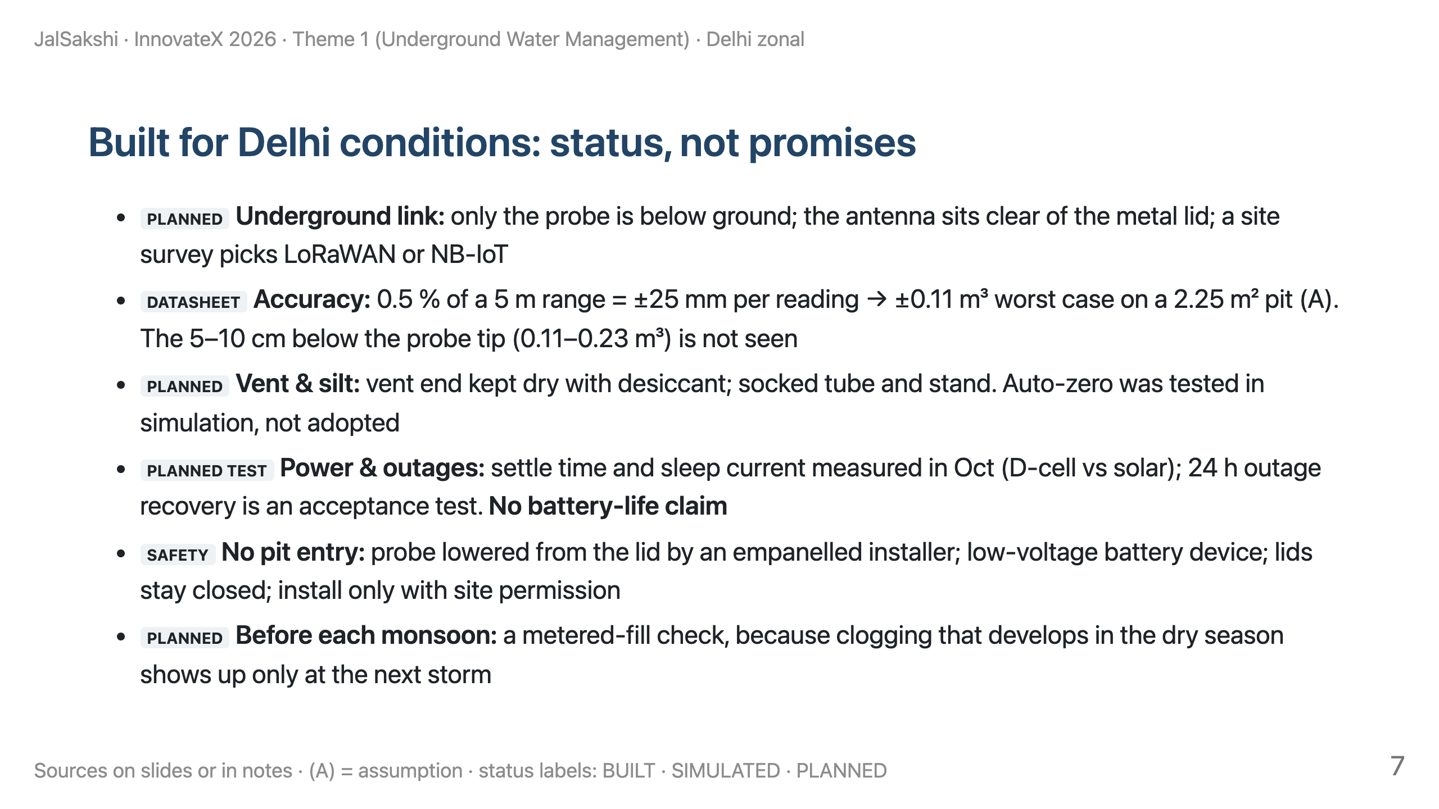
Notes:
TIME 6:15–7:00 (45 s). Probe datasheet: farnell.com/datasheets/3708809.pdf. (A) pit geometry 1.5 × 1.5 m is an assumption.

Slide 8
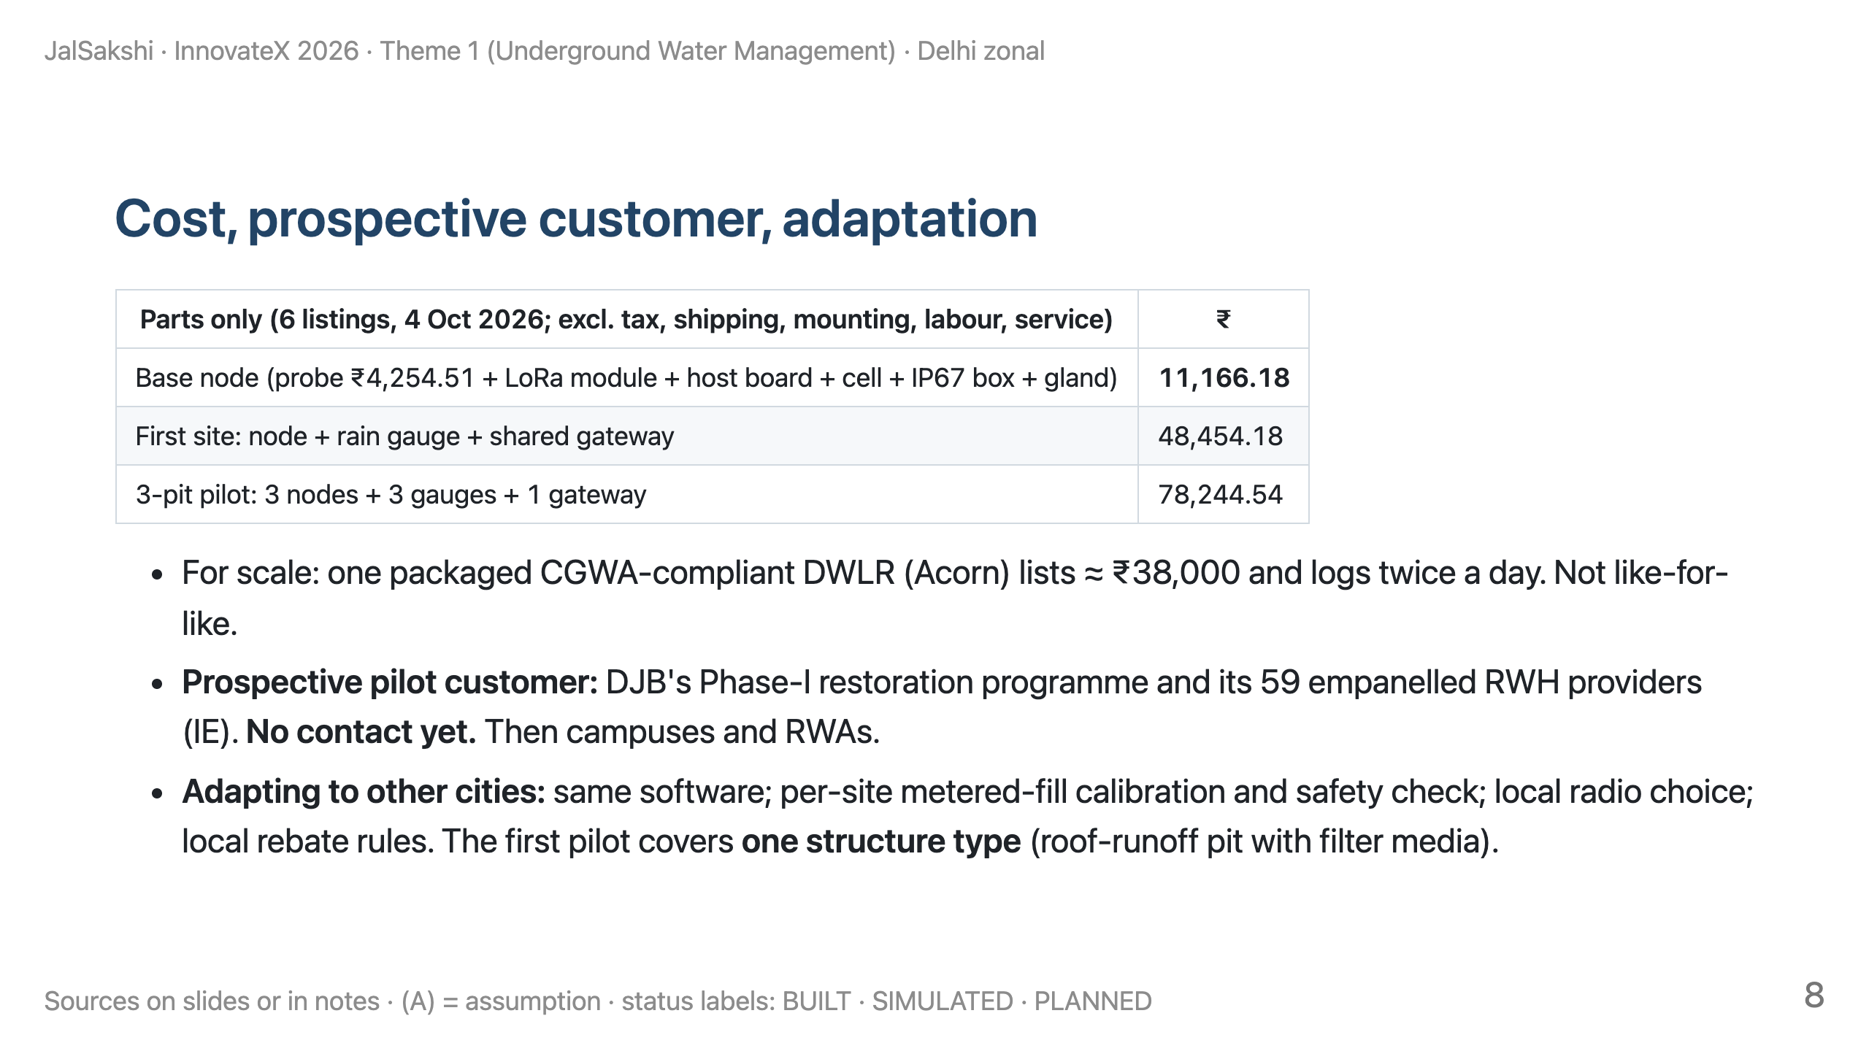
Notes:
TIME 7:00–8:00 (60 s). DON'T call ₹204 cr our market. DON'T say "first buyer".

Slide 9
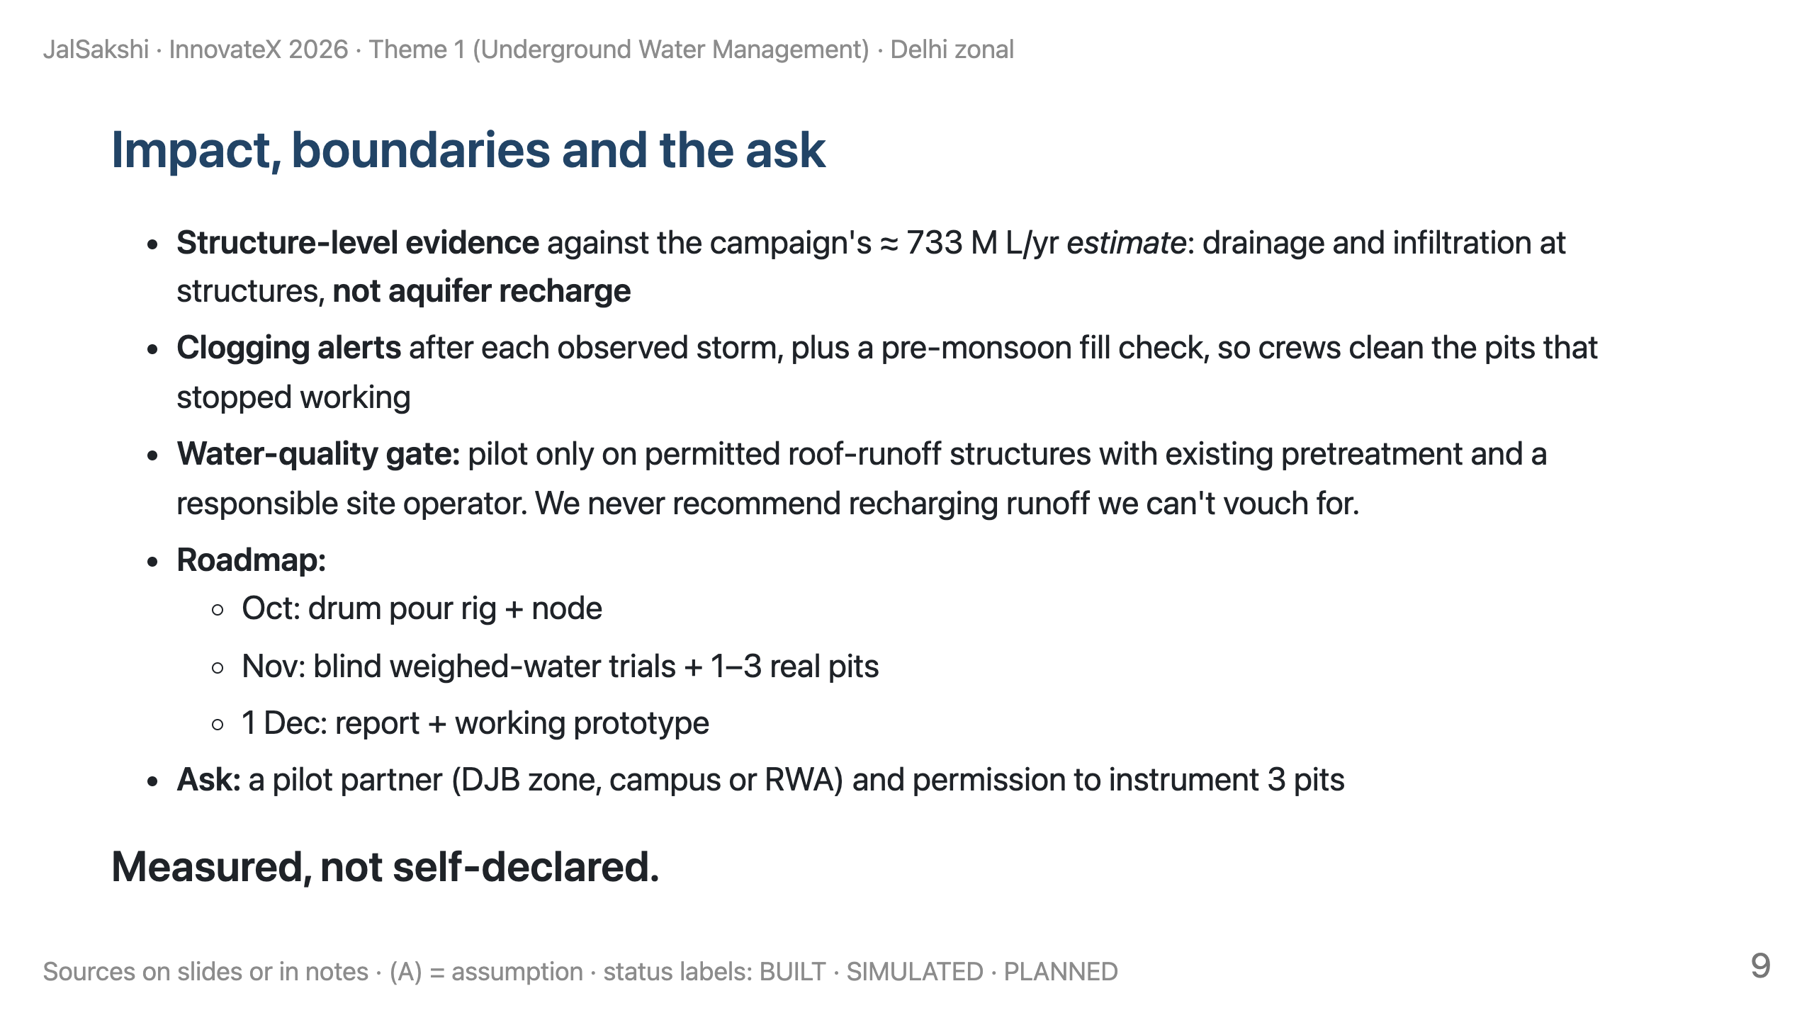
Notes:
TIME 8:00–9:15 (75 s). RESERVE 9:15–10:00 for handoff and questions.

Slide 10
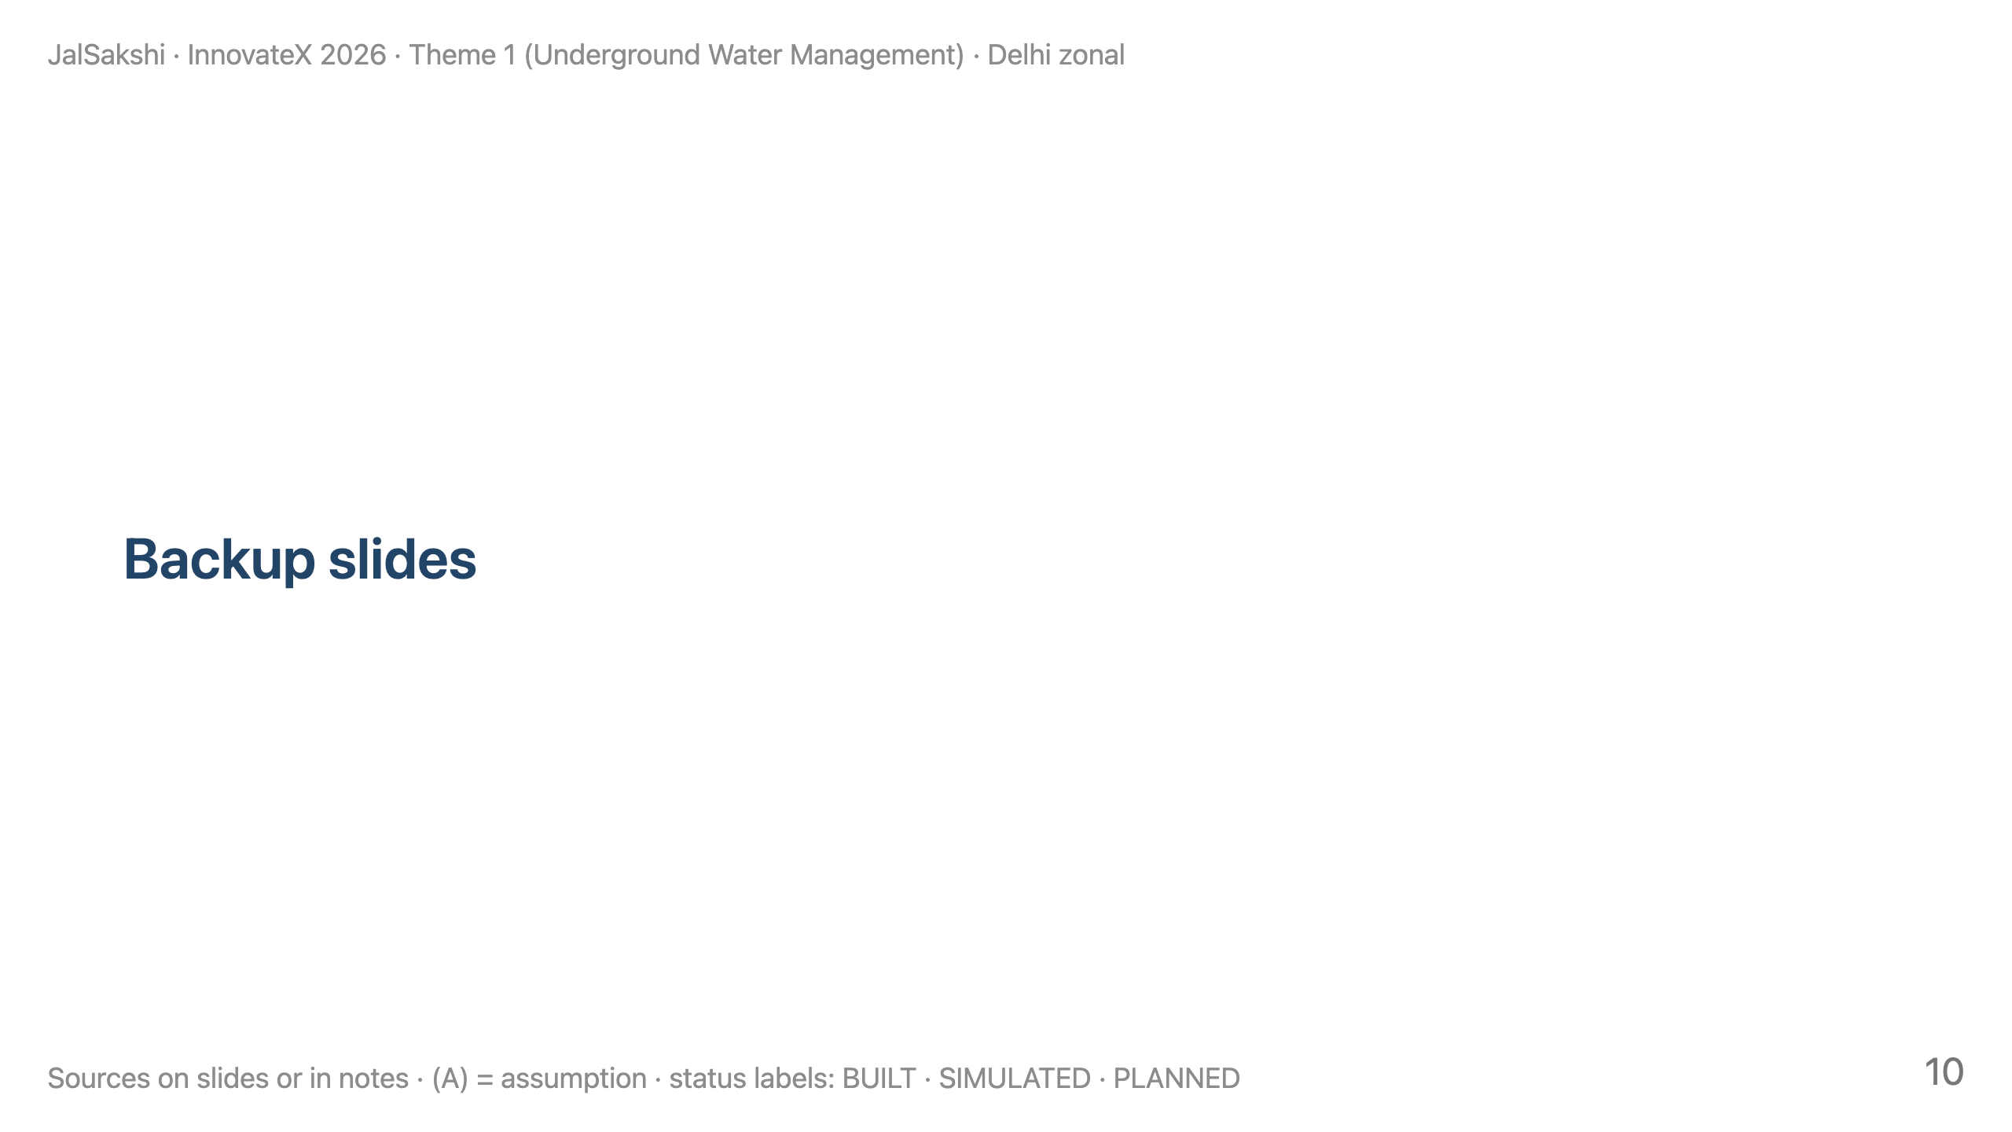

Slide 11
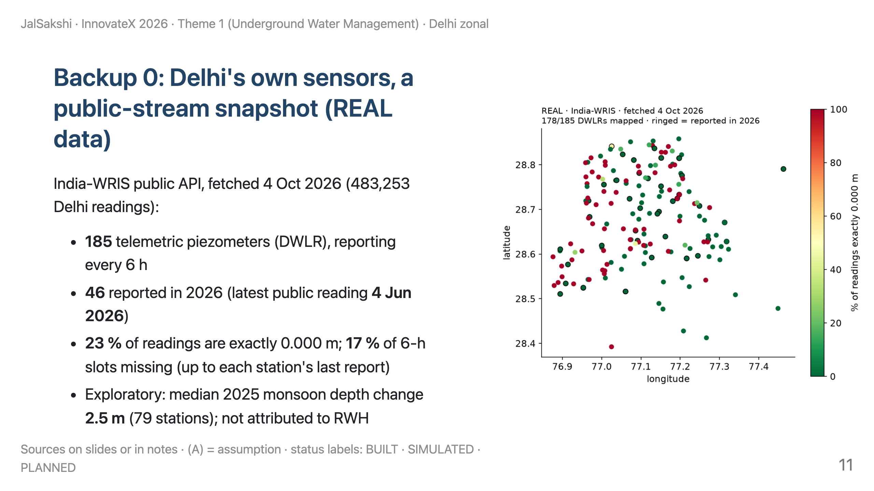
Notes:
Reproduce: eval/realdata_profile.py. Sign convention resolved heuristically per station.

Slide 12
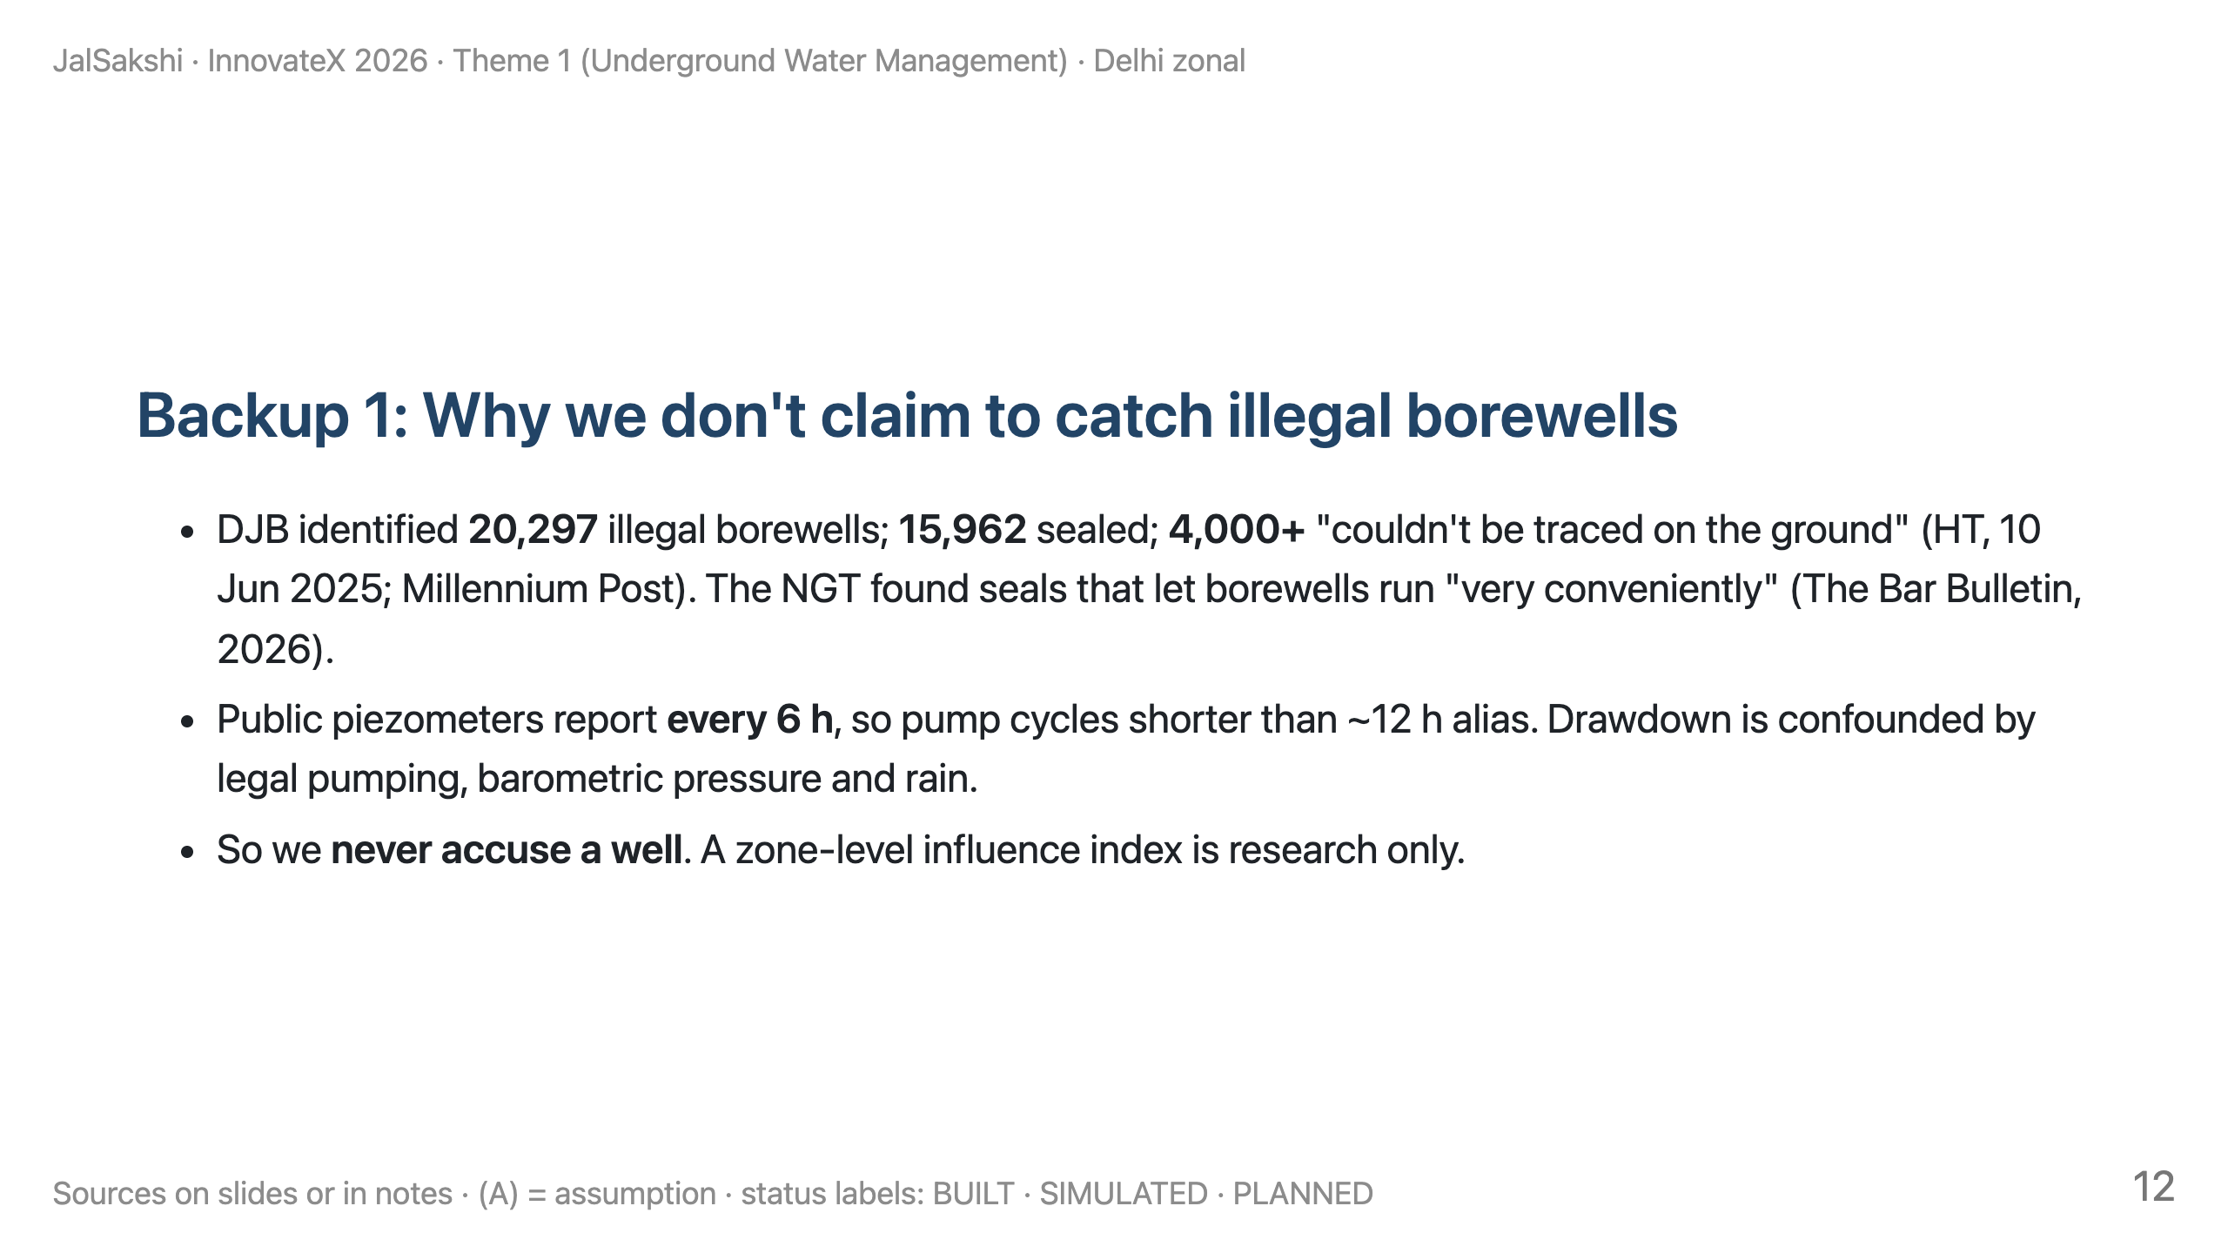

Slide 13
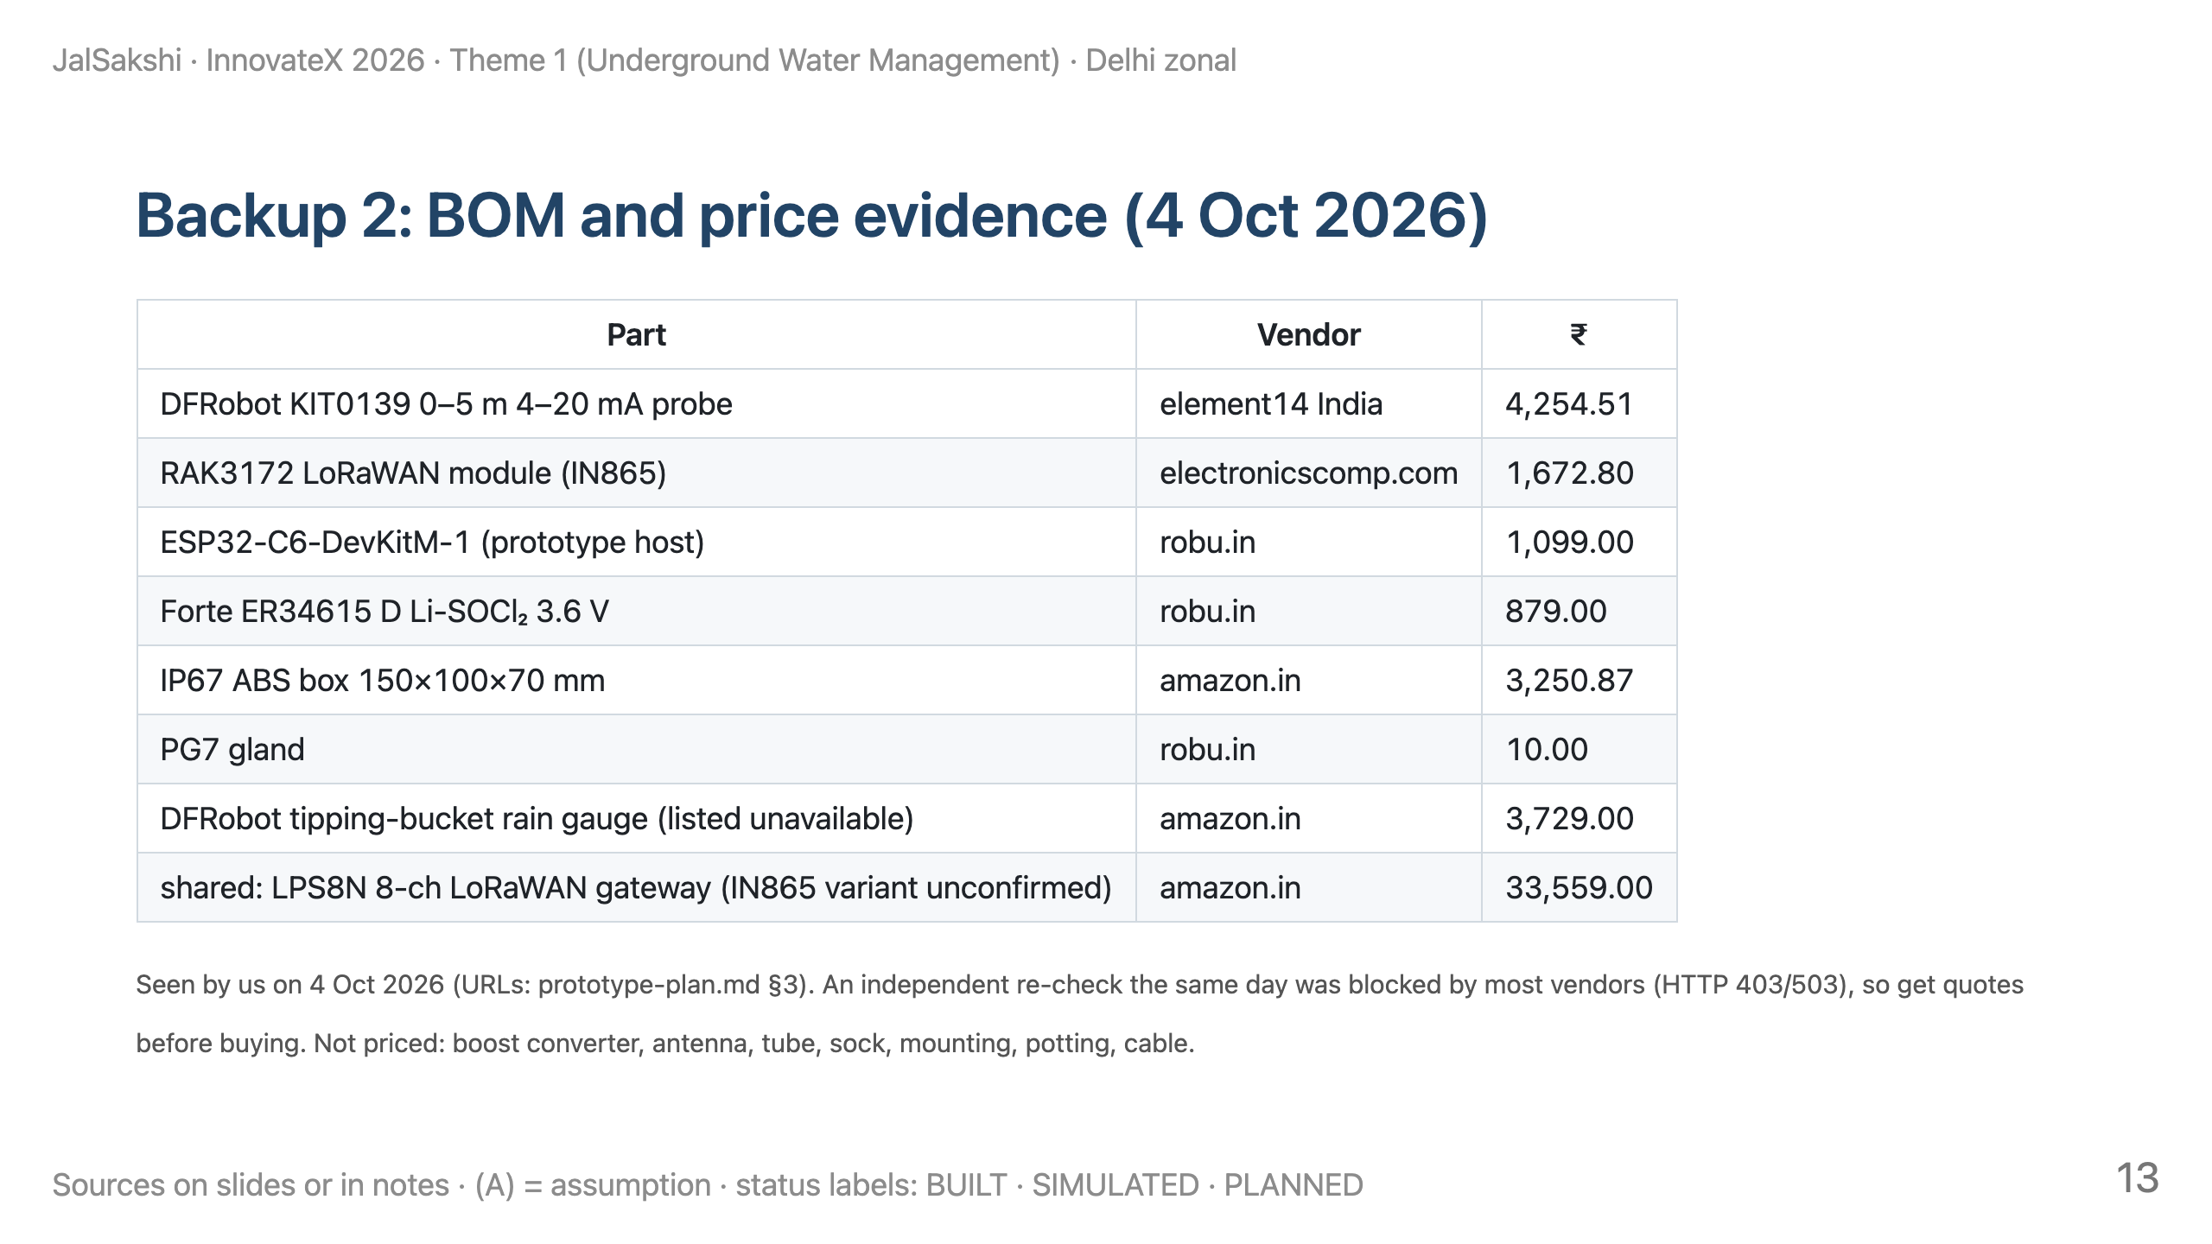

Slide 14
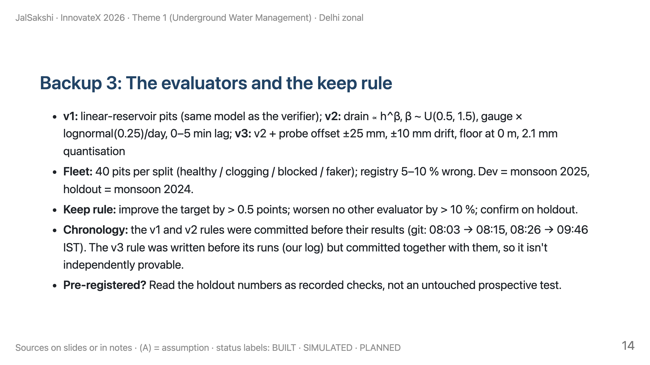

Slide 15
