Slide 1
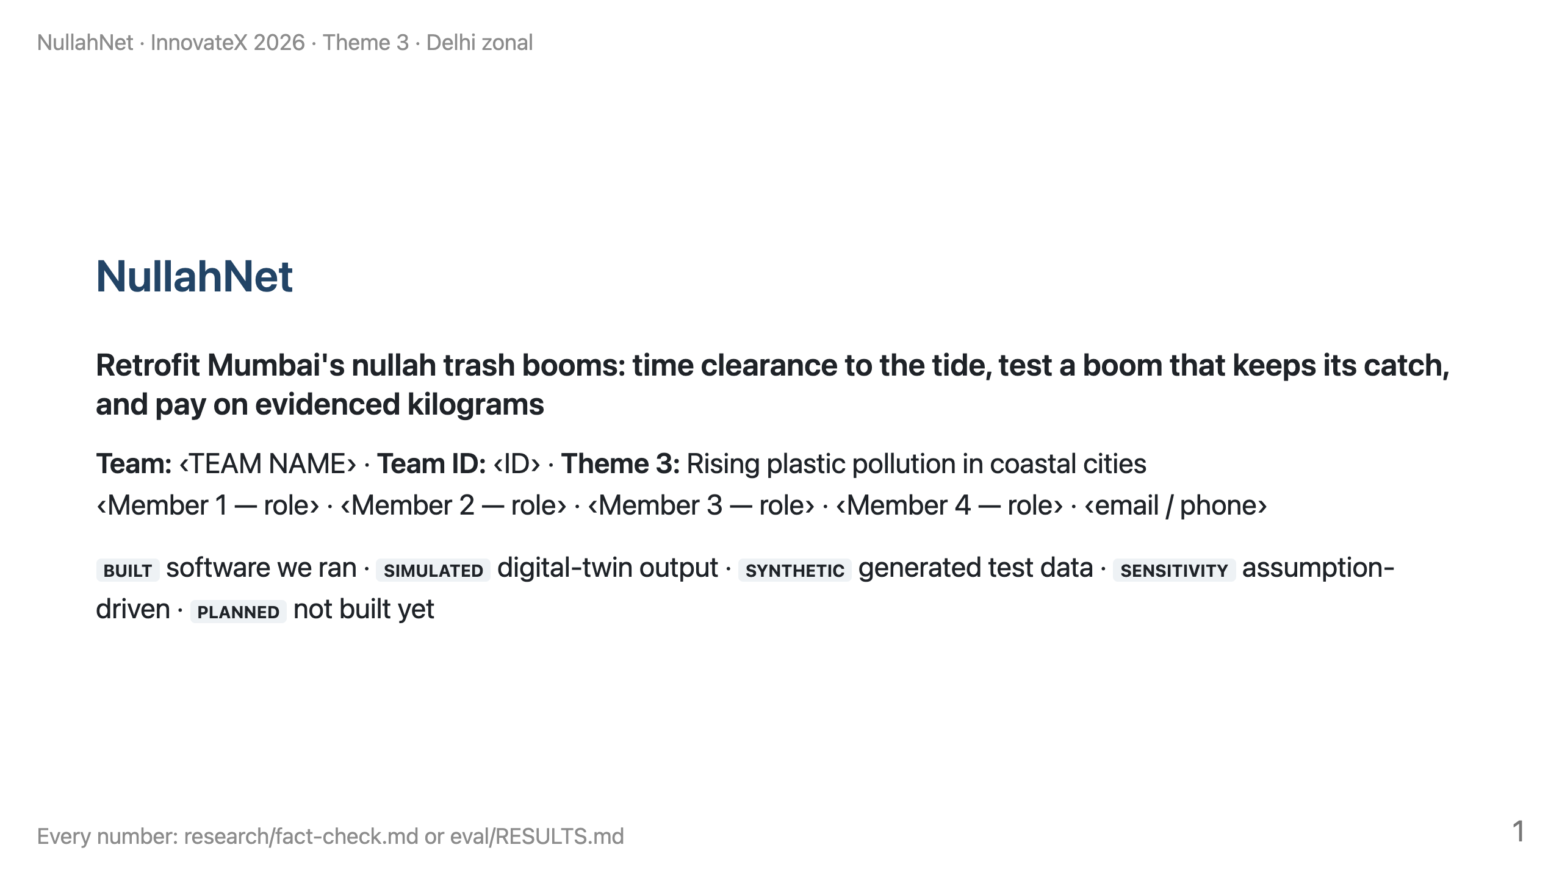
Notes:
TIME 0:00–0:25 (25 s). LOGISTICS: present zonal-deck.pdf from your own laptop; the dashboard open in a second tab (bash deliverables/serve_dashboard.sh, then http://localhost:8765); it runs offline except the map tiles.
SAY: "We're ‹team›. We picked one leak: floating single-use packaging escaping through Mumbai's storm-water outfalls. Mumbai already runs trash booms. We propose to make them measurable and better timed, and to test a retrofit that keeps more of what they catch."
LINE TO LAND: "Not another barrier: a way to make the city's existing barriers accountable."
DON'T SAY "we built a prototype". The software is built; the hardware is PLANNED.

Slide 2
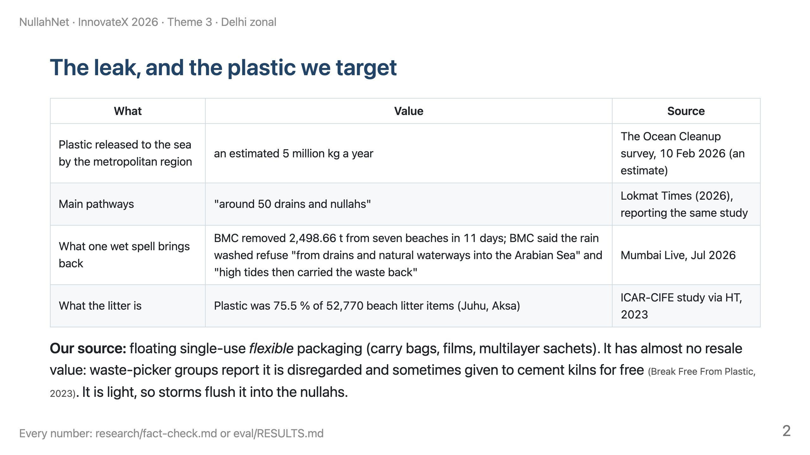
Notes:
TIME 0:25–1:25 (60 s).
SAY: "The 5-million-kilogram figure in the problem statement is The Ocean Cleanup's 2026 estimate for the region. BMC itself describes the cycle: July rain washed refuse from drains into the sea, and high tides carried it back onto the beaches. Most beach litter is plastic. We target the film and sachets that nobody is paid to collect."
LINE TO LAND: "We target the plastic nobody is paid to collect."
DON'T SAY the tonnage was measured. It is a survey estimate. DON'T SAY "pickers never collect film"; the source says it is disregarded and low-value.

Slide 3
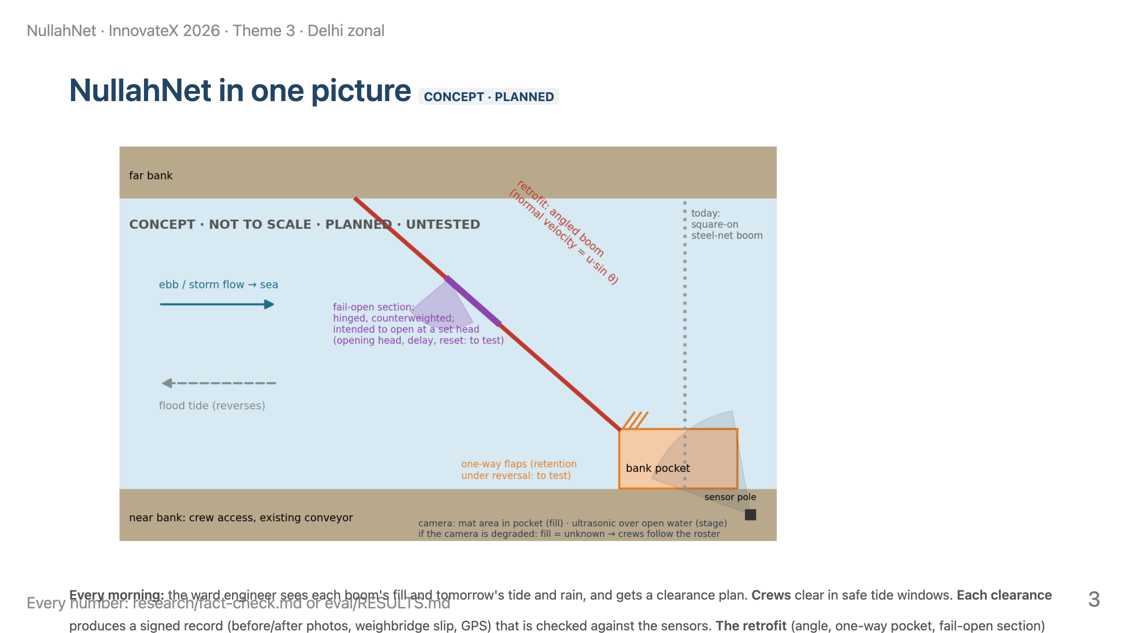
Notes:
TIME 1:25–2:30 (65 s).
SAY: "Here is the whole idea on one drawing. Today's boom sits square across the nullah. We would angle it, lead the catch into a bank-side pocket with one-way flaps, and put a hinged section in the middle that is meant to swing open before the boom backs water up. A camera watches the pocket; an ultrasonic sensor watches the water level. In the morning, the engineer gets a plan; after each clearance, a signed record."
LINE TO LAND: "One operator decision changes: when the crew goes, and what proves what they removed."
DON'T SAY the release "can't fail" or that the pocket "keeps everything". The opening head, delay, fouling and retention during release are exactly what we test.

Slide 4
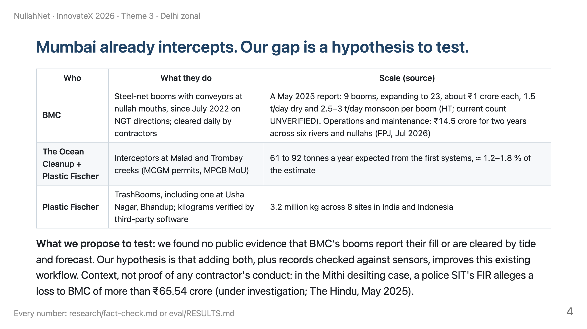
Notes:
TIME 2:30–3:25 (55 s).
SAY: "This is not an empty field. BMC has booms and a maintenance contract; The Ocean Cleanup is coming to Malad and Trombay; Plastic Fischer already runs booms and verifies kilograms. What we couldn't find in public is fill sensing or tide-timed clearance at BMC's booms. That's our hypothesis to test with BMC, not a claim that nobody does it."
LINE TO LAND: "We build on the city's booms and their verification norms; we don't compete with them."
DON'T SAY "the booms have no sensors" or "nobody does this". Say "we found no public evidence". DON'T SAY anything about guilt in the Mithi case.

Slide 5
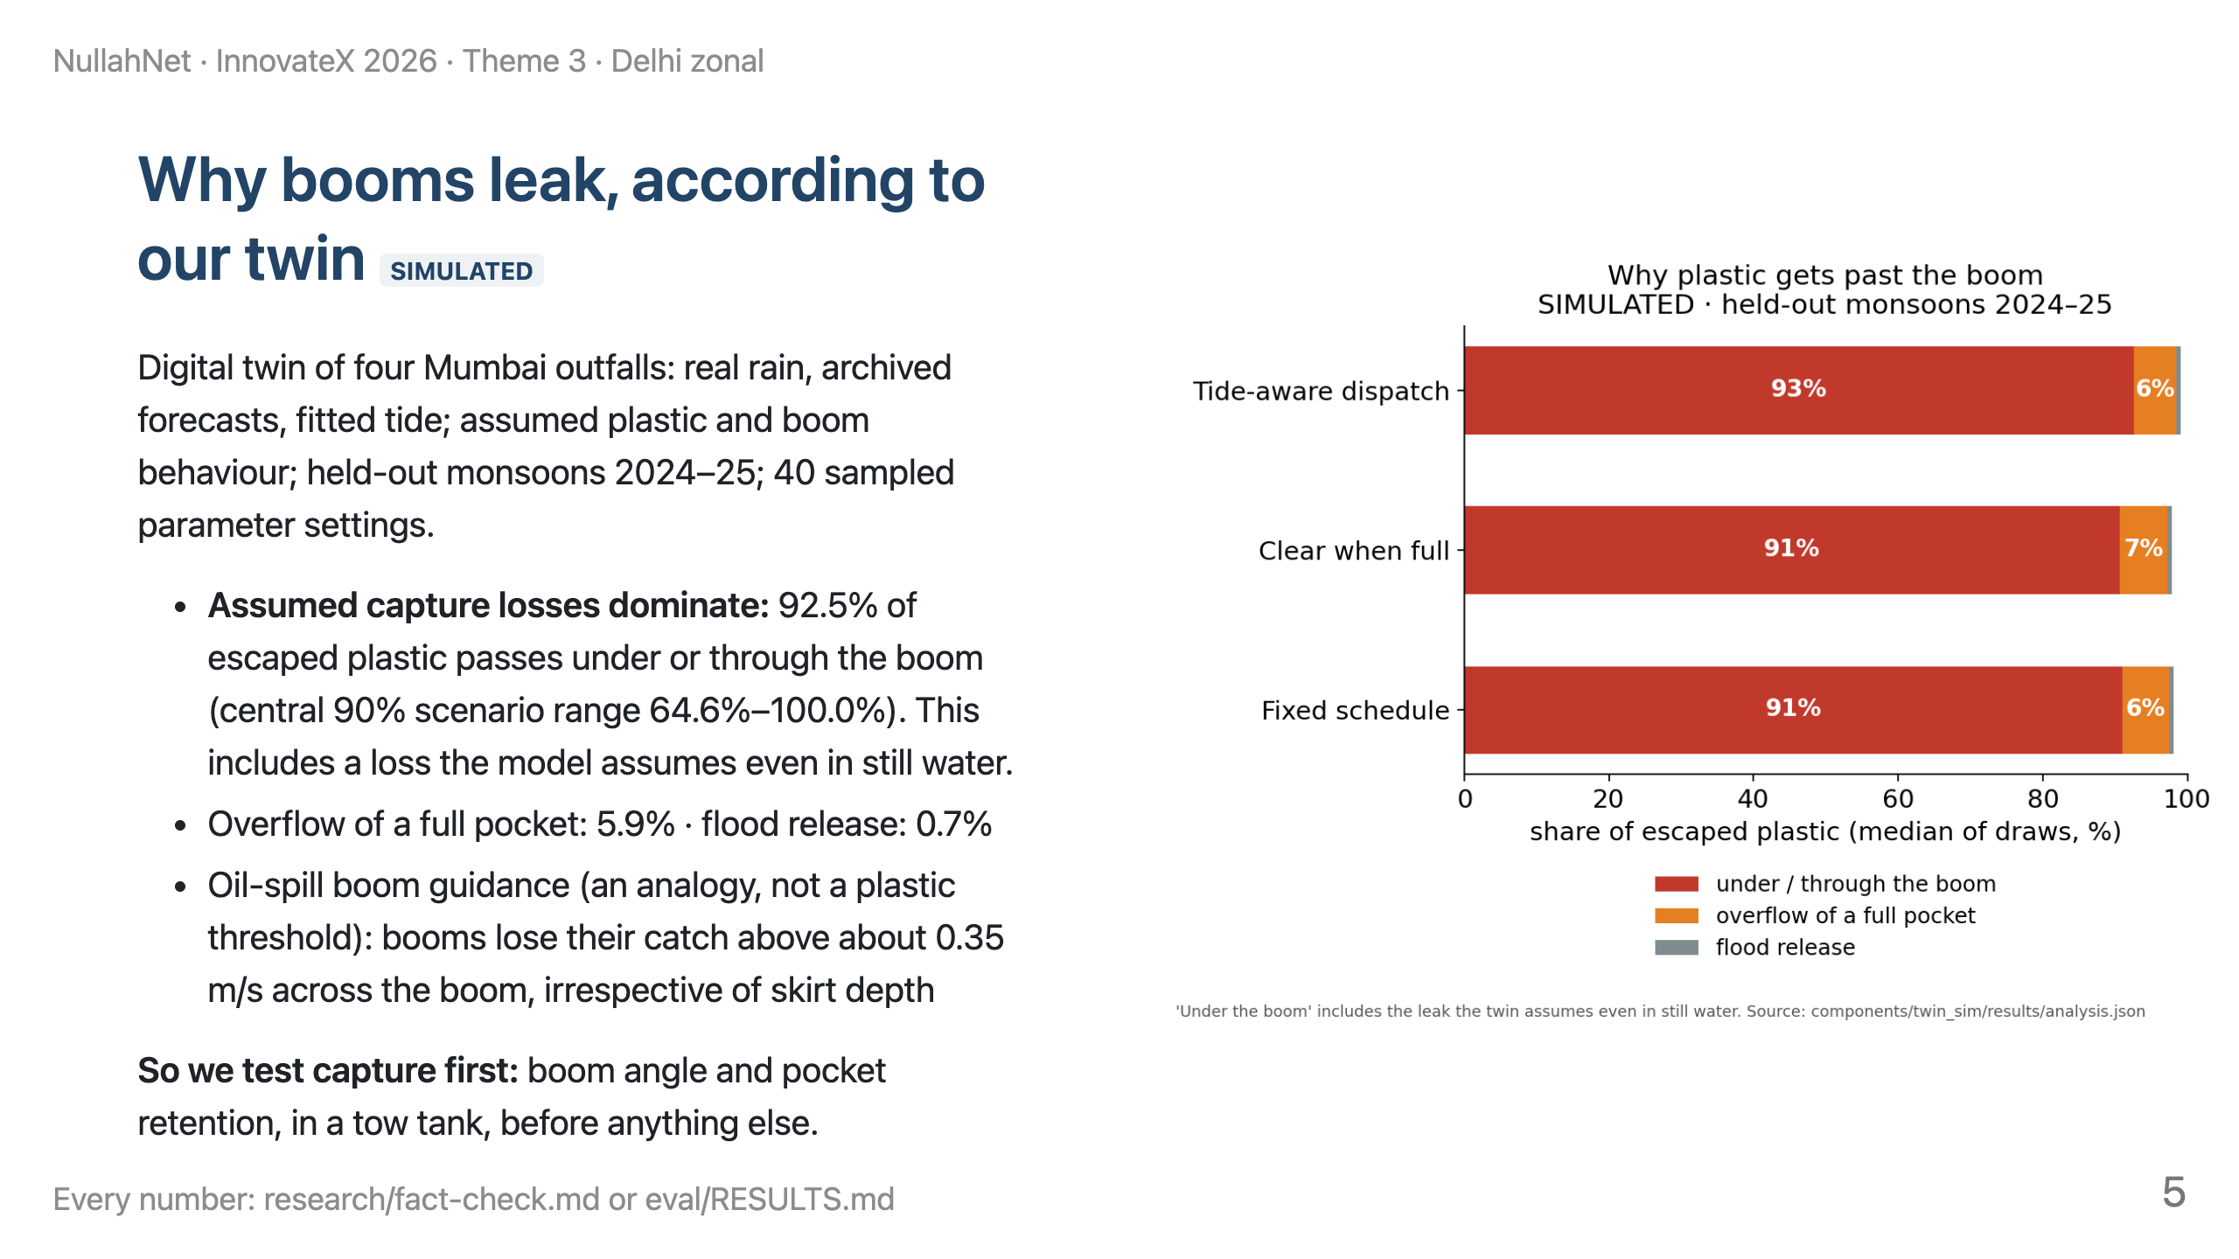
Notes:
TIME 3:25–4:20 (55 s).
SAY: "In our model, most plastic escapes by slipping under or through the boom, not by overflowing a full pocket. But that pattern comes from the capture curve we assumed, informed by oil-boom practice. It tells us what to test first: angle and retention."
LINE TO LAND: "The twin tells us where to look; the tow tank must tell us whether it's true."
DON'T SAY "booms fail because they're square to the flow" as a finding. It is a hypothesis built into the model.

Slide 6
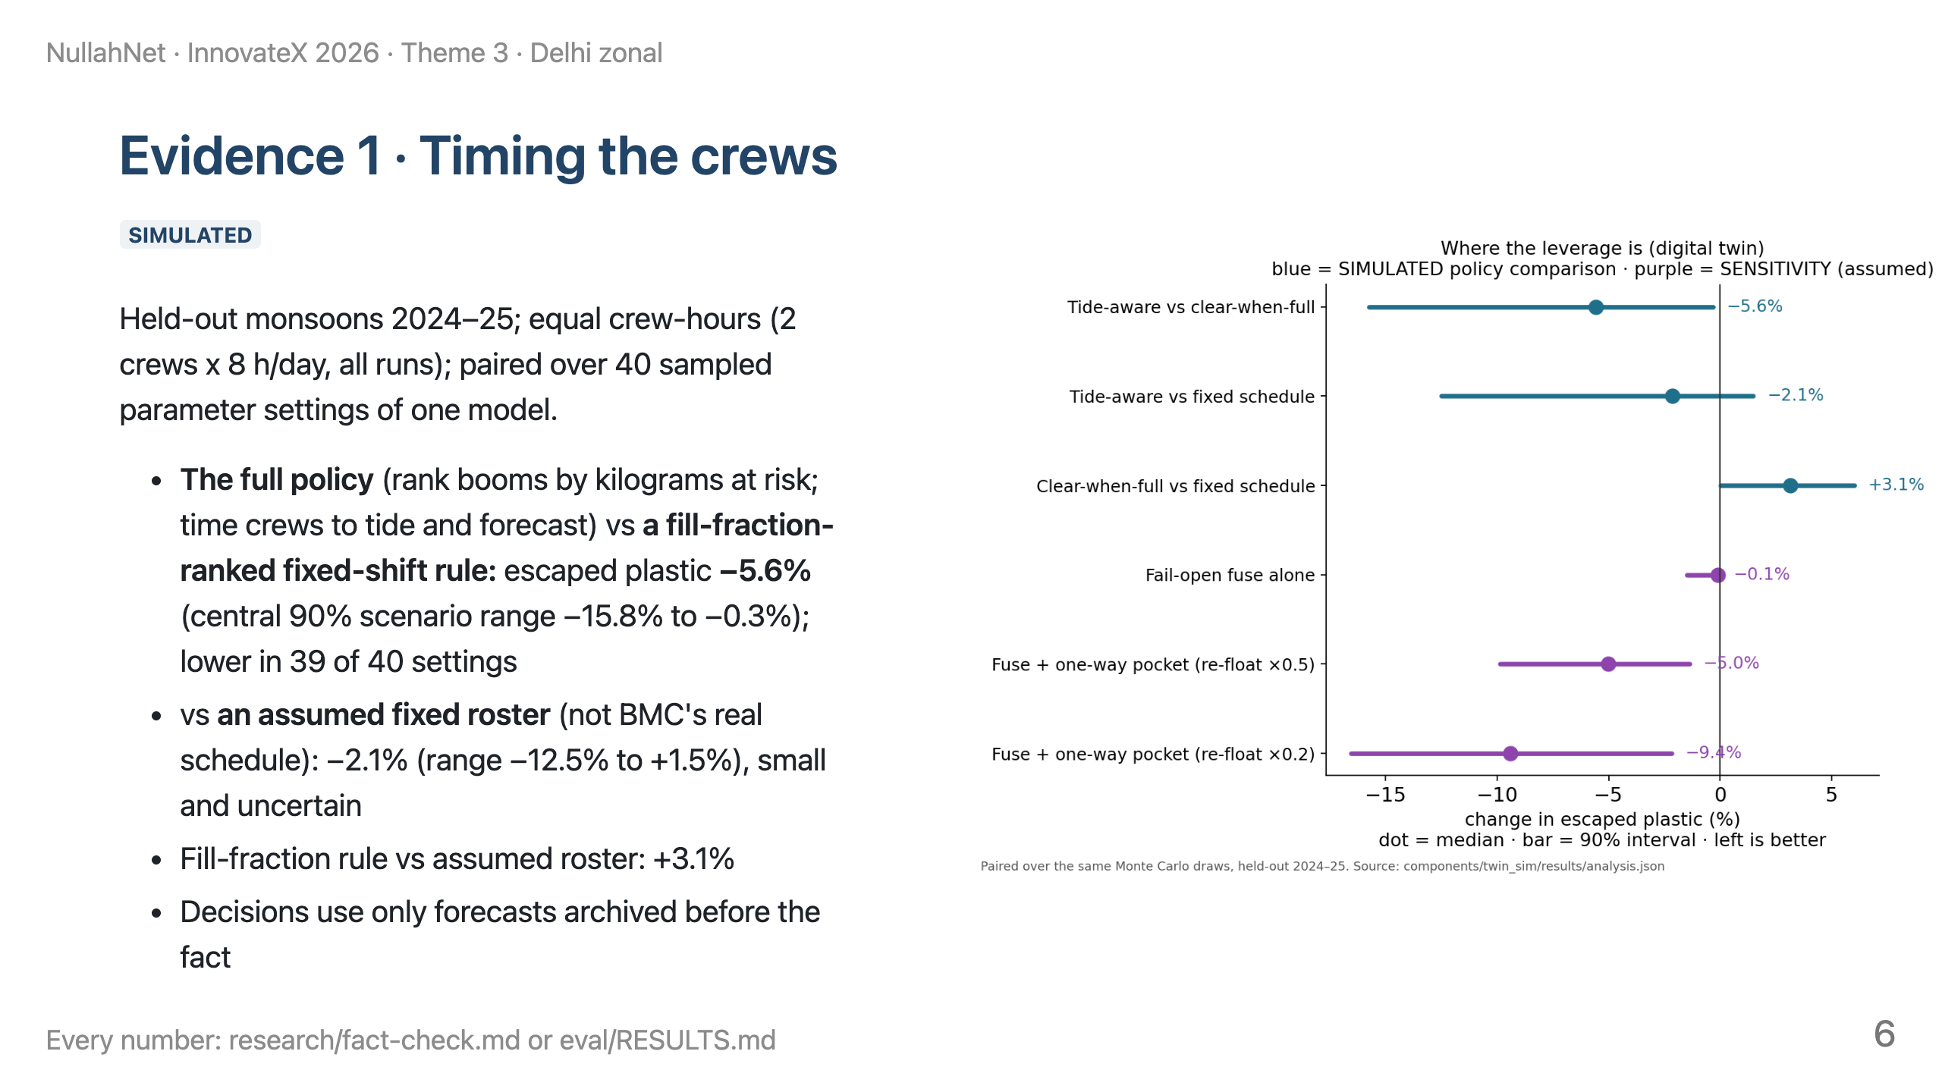
Notes:
TIME 4:20–5:30 (70 s).
SAY: "Same two crews, same hours, one model with many parameter settings. Our full policy lets less plastic escape than a simple 'clear the fullest boom' rule in 39 of 40 settings. Against a fixed roster, which we assumed rather than observed, the gain is small and could be zero. The comparison bundles three changes (ranking by kilograms, tide timing, forecasts), so we don't credit any one of them alone."
LINE TO LAND: "In our model, a sensor without good timing can make things worse; the combination is what helps."
DON'T SAY "tide timing saves this much" or "39 of 40 seasons". It's 39 of 40 parameter settings of one model, and the gain belongs to the whole policy.

Slide 7
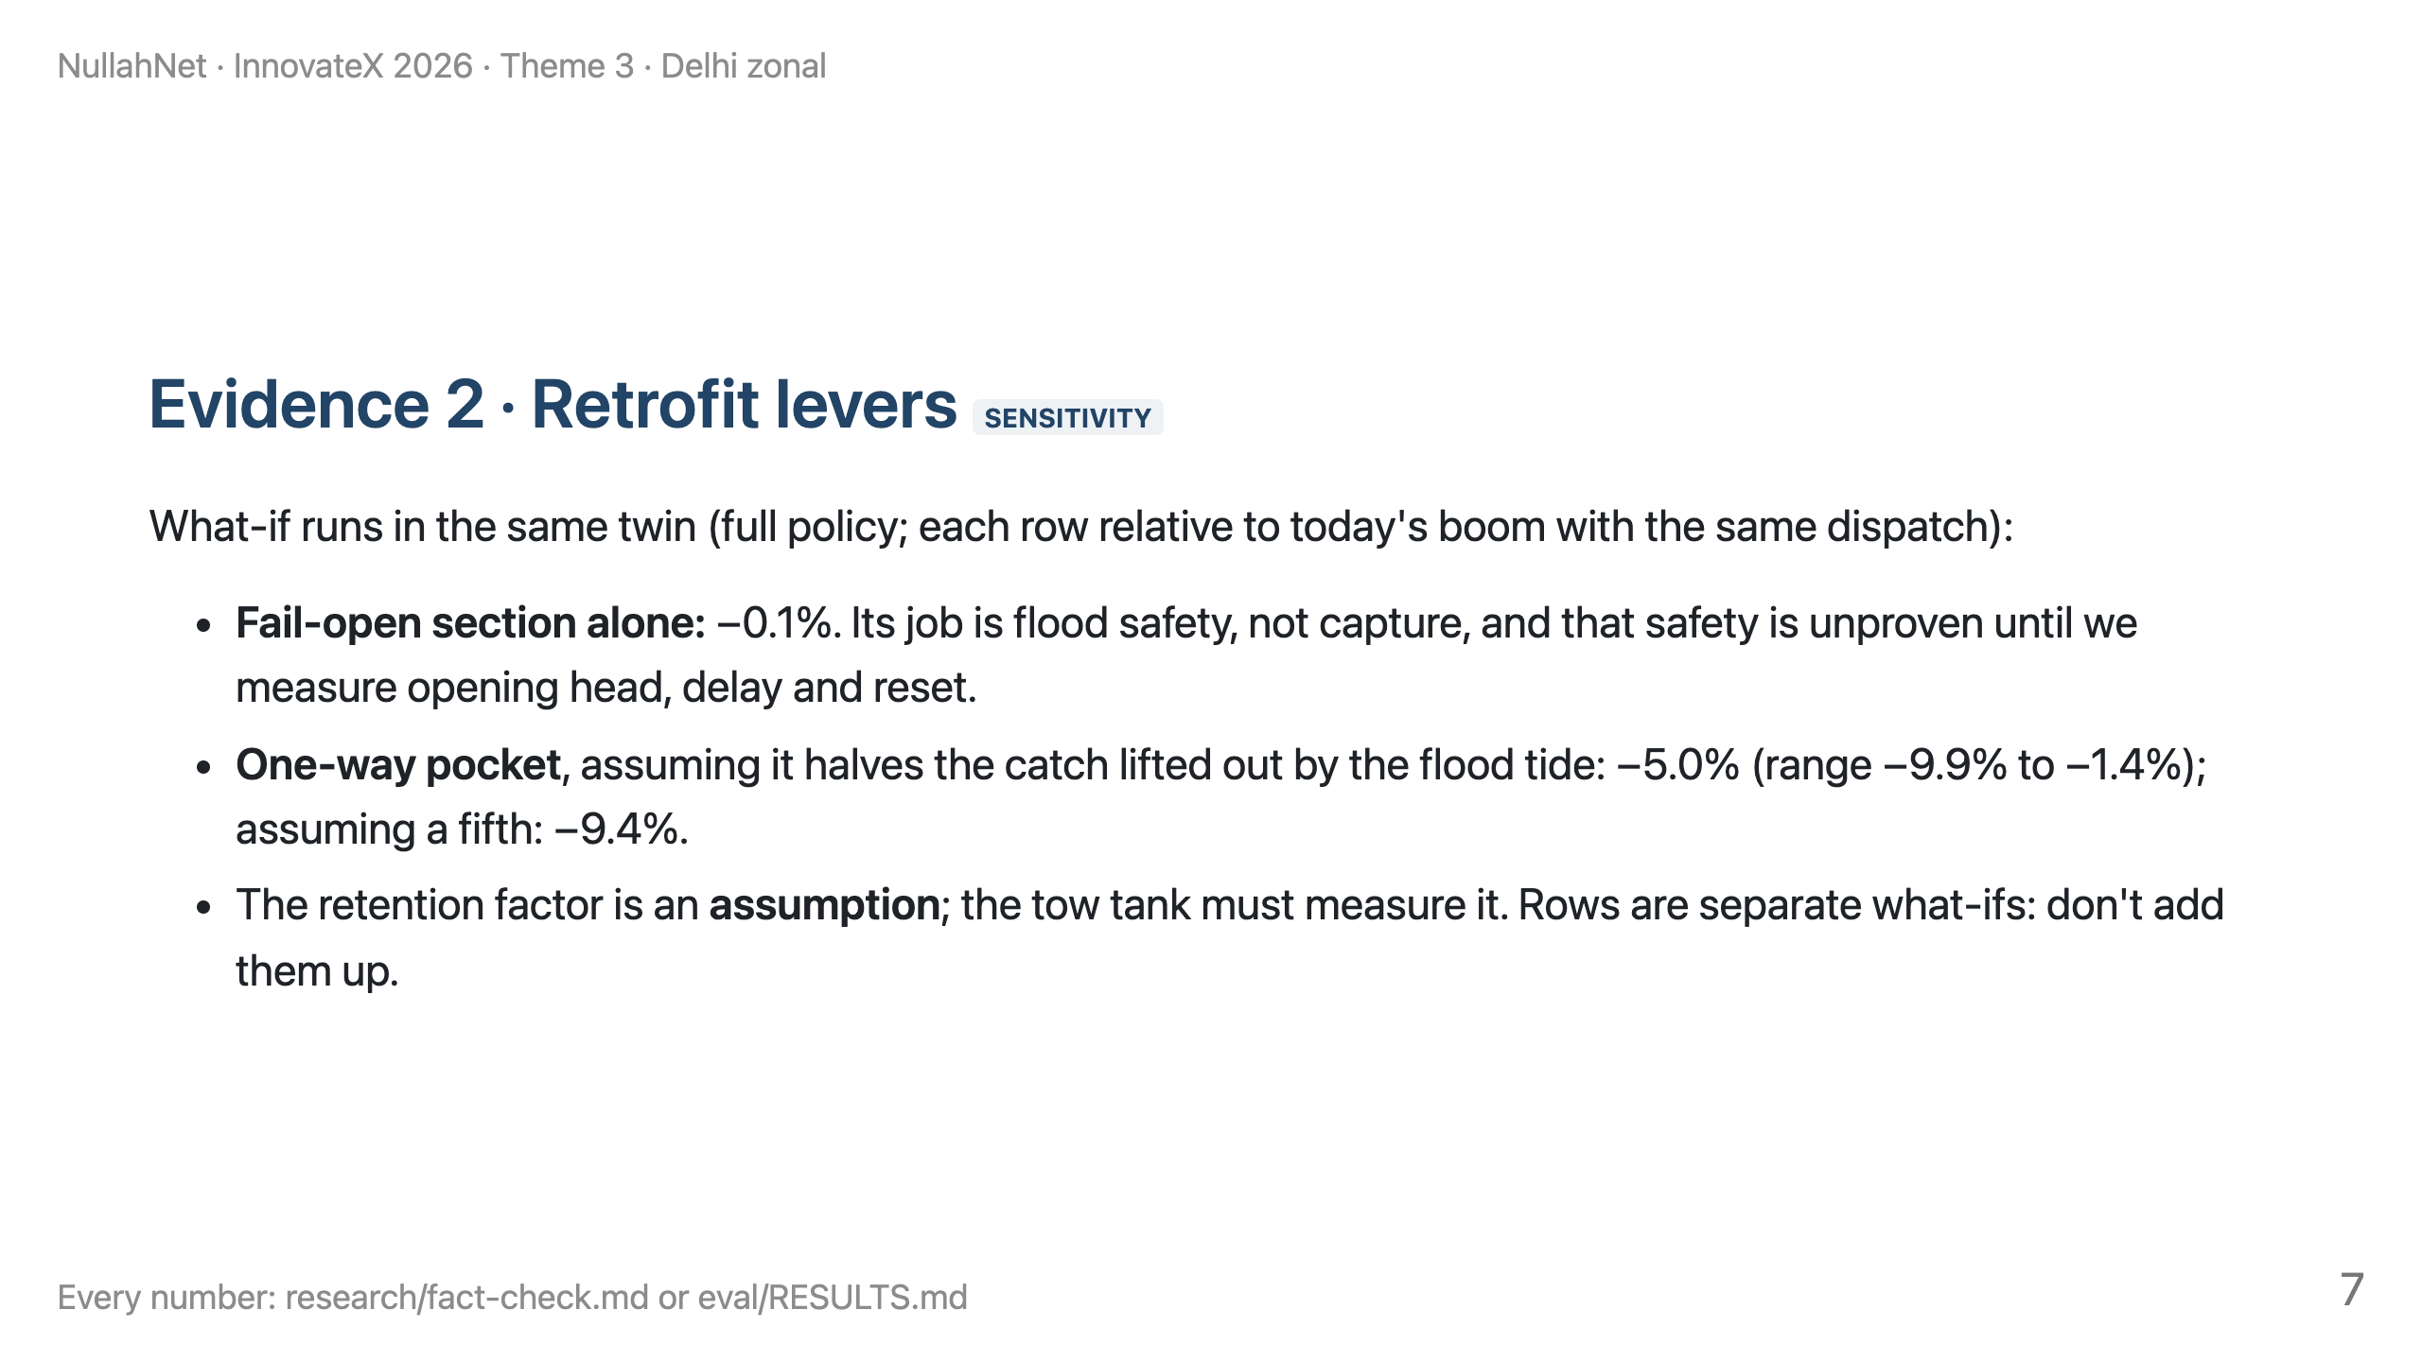
Notes:
TIME 5:30–6:25 (55 s).
SAY: "These are what-ifs, not evidence. The fail-open section barely changes capture in the model; it's there for flood safety, which we still have to measure. A one-way pocket matters only if it really holds its catch when the tide reverses, and that is the first thing our tow tank measures."
LINE TO LAND: "We only claim what the tow tank shows."
DON'T SAY the pocket "cuts escape" as a fact. Say "if it retains half, the model says −5.0%".

Slide 8
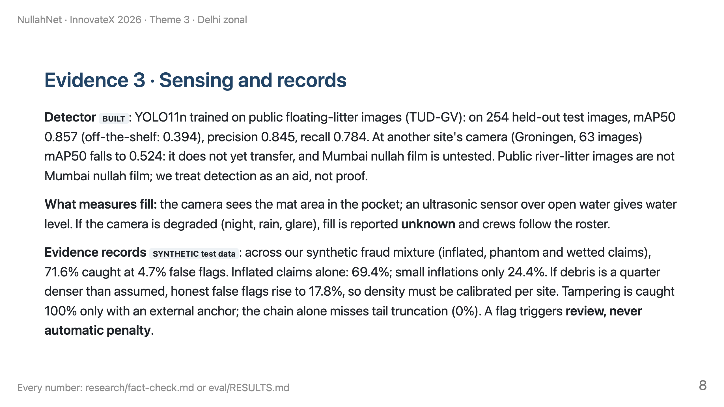
Notes:
TIME 6:25–7:25 (60 s).
SAY: "The camera is an aid; when it can't see, we say so and fall back to the roster. The records system catches most inflated claims in synthetic tests, misses small ones, and its false flags depend on knowing the debris density, so a flag means a second look, never a penalty."
LINE TO LAND: "We report our weak numbers as plainly as our strong ones."
DON'T SAY "AI detects all plastic" or "tamper-proof". Hashes make edits detectable; they cannot make inputs true.

Slide 9
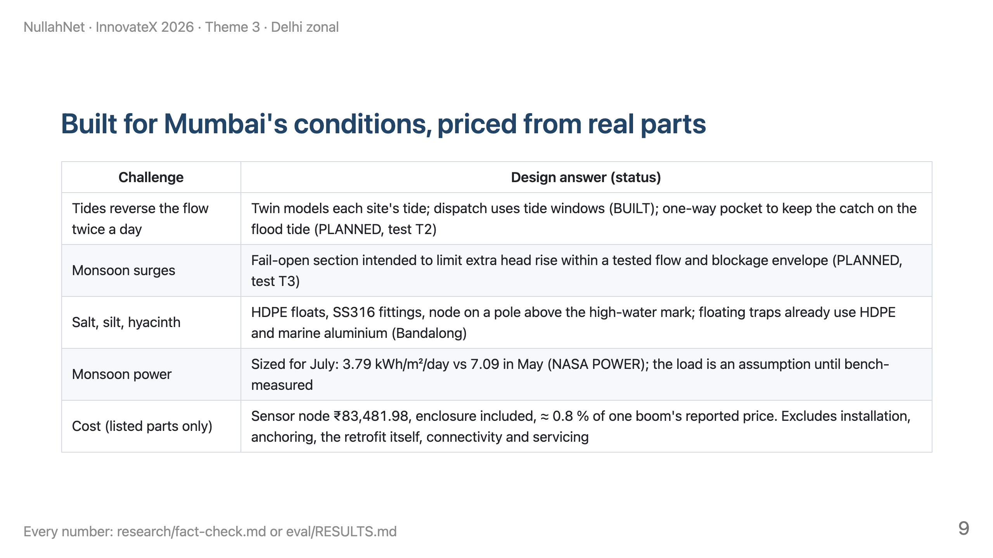
Notes:
TIME 7:25–8:20 (55 s).
SAY: "Every hardware line is priced from a real Indian retailer page, with link and date in the prototype plan. That's listed parts, not an installed cost; installation, anchoring and servicing come on top. Even so, a sensor node is under one percent of a boom's reported price."
LINE TO LAND: "Small add-on, large existing asset."
DON'T SAY it "pays for itself"; the effect size is unmeasured. DON'T divide the maintenance contract per boom; we don't have its asset list.

Slide 10
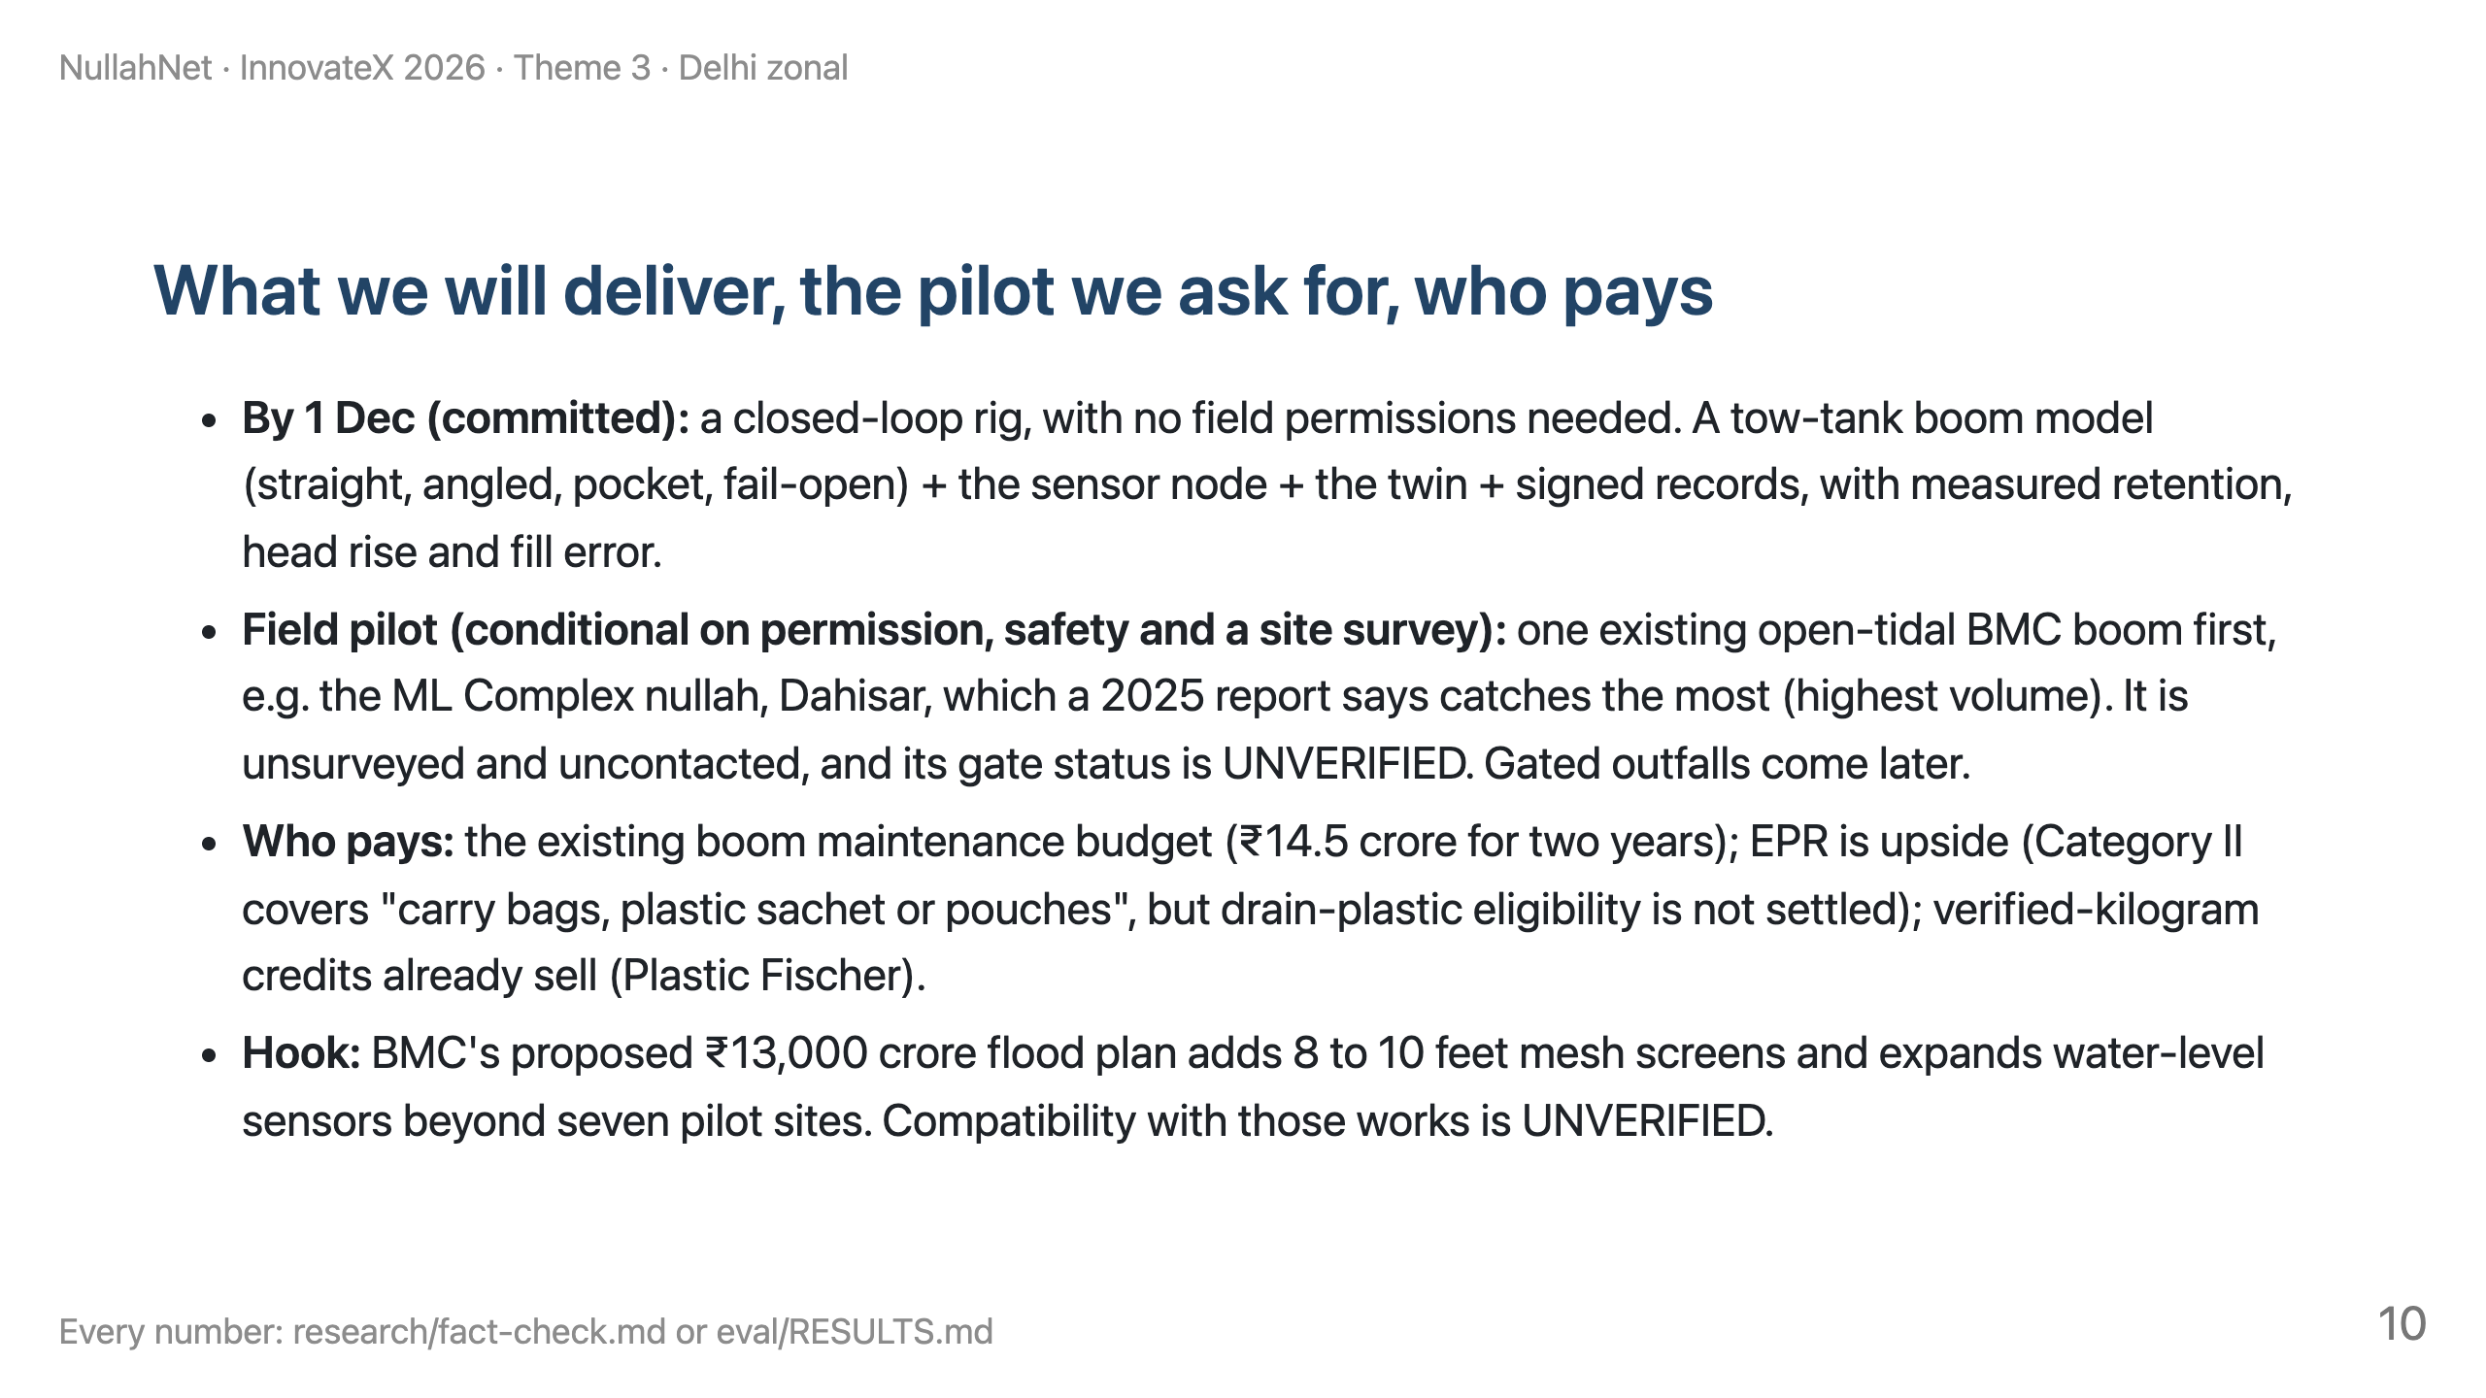
Notes:
TIME 8:20–9:15 (55 s).
SAY: "By December we commit to a working closed loop on the bench: tow tank, sensor node, twin and records. With permission, our first field site would be one existing BMC boom. We ask for one site survey and one conversation with the storm-water drain department."
LINE TO LAND: "Give us one existing boom to measure, and we'll show whether timing, a better pocket and honest records move the numbers."
RESERVE 45 s for overrun.

Slide 11
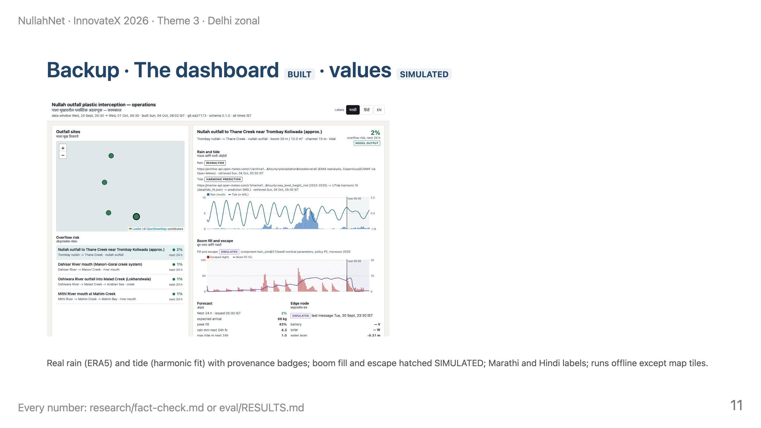
Notes:
Use if asked "show us the software". Walk: map → a site → rain + tide → fill and escape (SIMULATED) → tomorrow's plan → ledger tab with signature check → tamper demo.

Slide 12
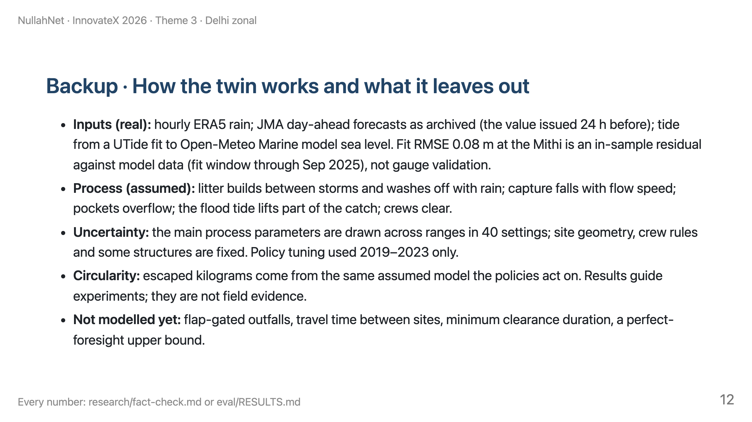
Notes:
Use for "your results are simulated". Parameter table with sources: research/components/twin.md.

Slide 13
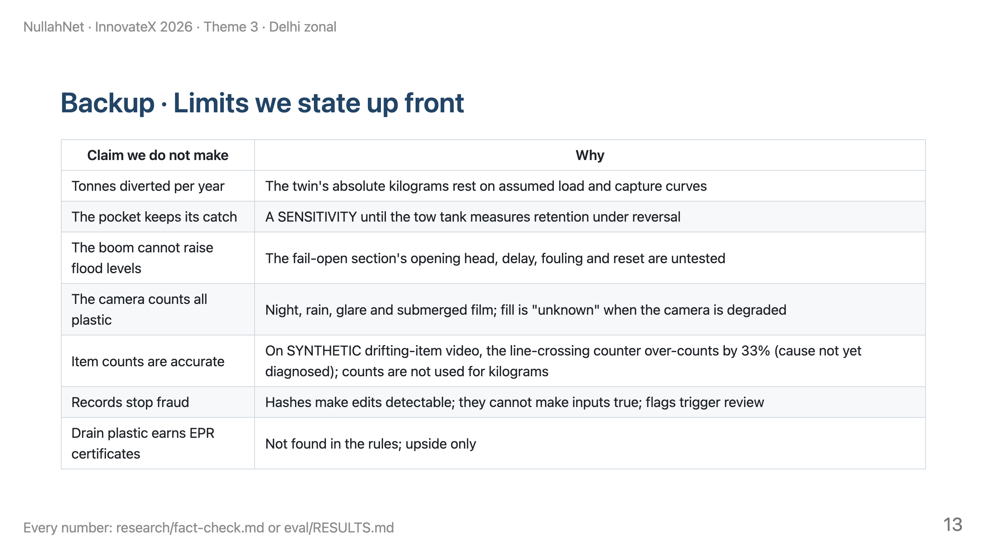
Notes:
Use for any "too good to be true" question.

Slide 14
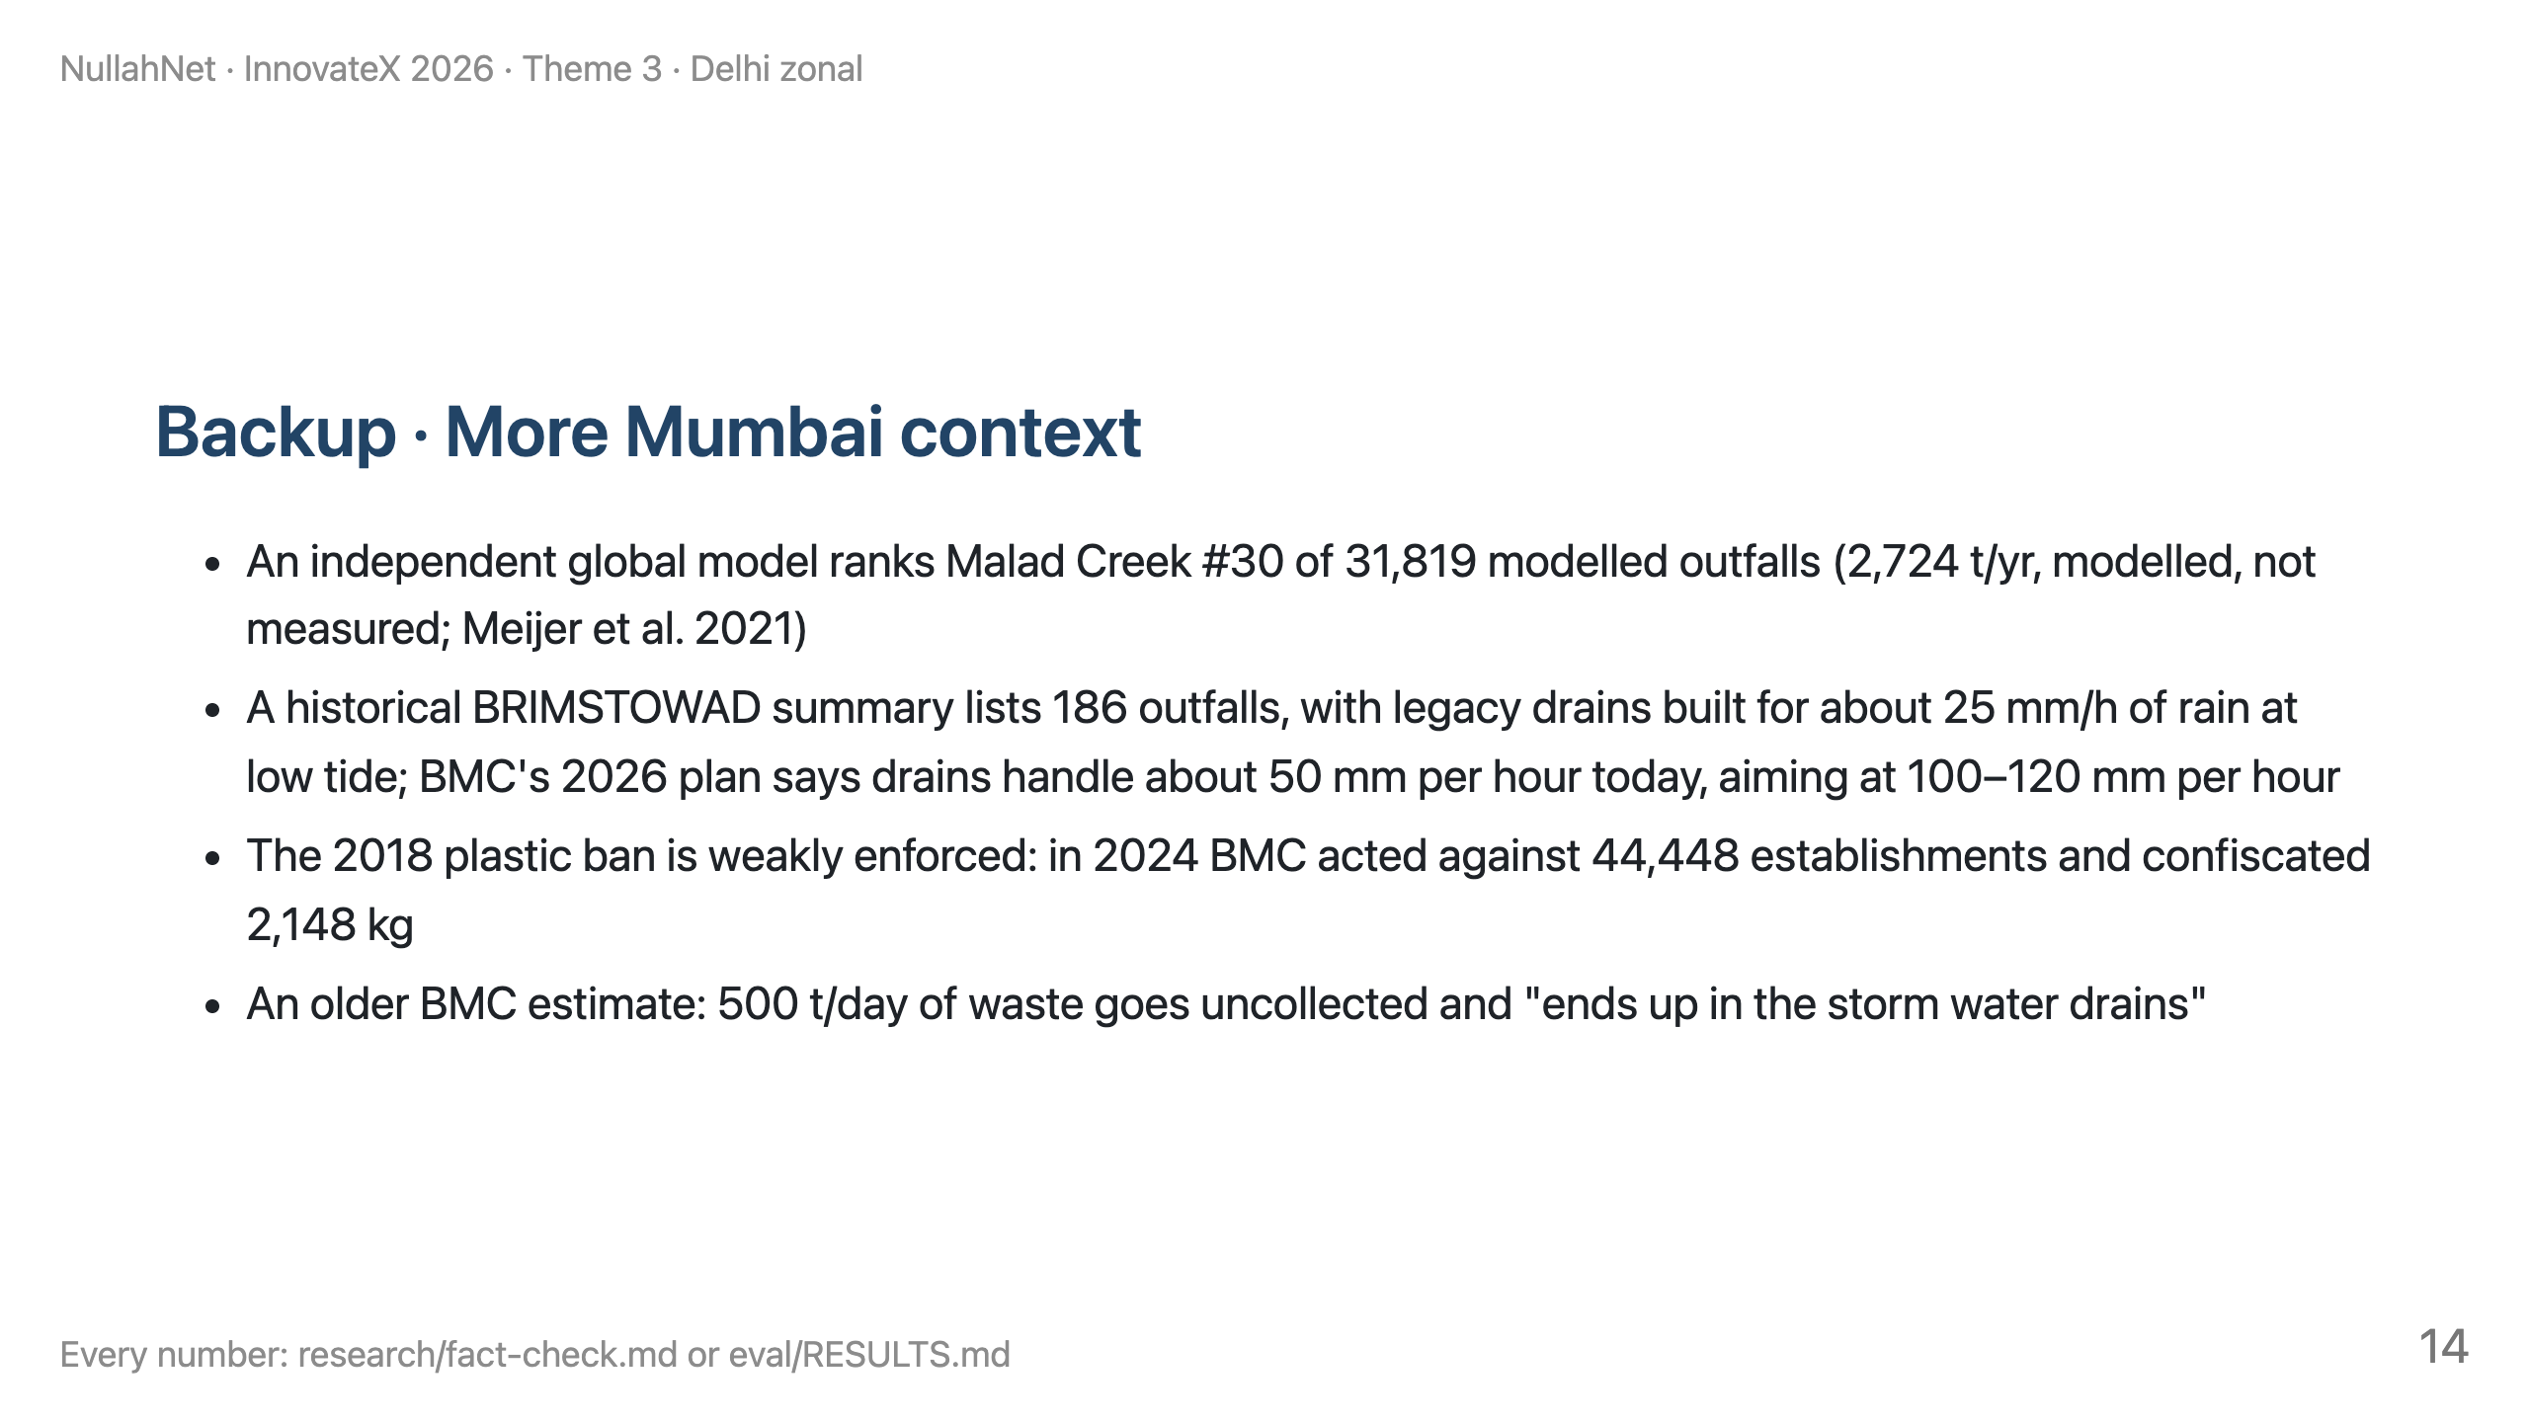
Notes:
Use for "how well do you know Mumbai?"

Slide 15
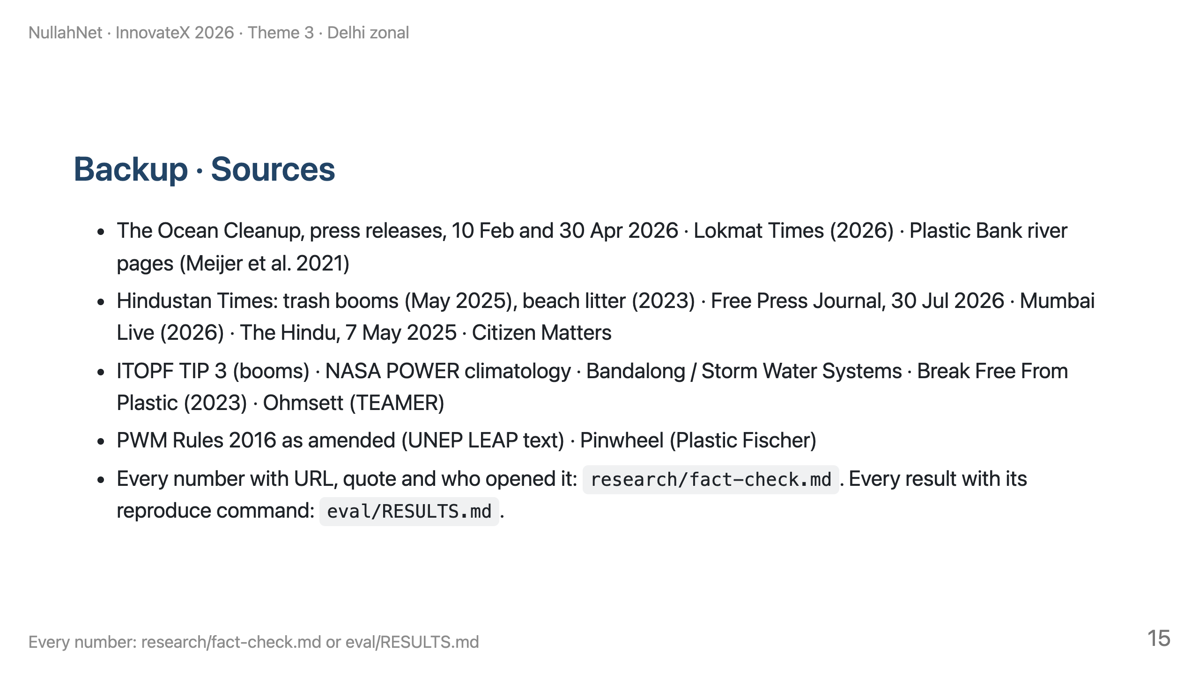
Notes:
Point judges to the repo files if they ask for evidence.

