Slide 1


About adptotalsource.com
  Log onto www.adptotalsource.com
  Secure Access 24/7
  View your paycheck
  View your benefits
  View & change direct deposit, tax withholdings & update your personal profile
  Link to the personal discount programs

Slide 2
Web Enrollment Navigation
Open Enrollment from:
Now – Friday, December 23rd
Log on 24/7 and enroll in 8 easy steps!
You are able to access and make changes to your elections during this period.
You will not be able to make changes to your
elections again until our Annual Open Enrollment Period, unless you have a qualifying event.
Notes:
ADP Associate: The links in the presentation are only “live” in Slide Show View. They are not “live” in normal or Slide Sorter View!
Today, we’ll highlight your competitive benefits options with ADP Totalsource. We’ve worked closely with your employer to design a benefits package that is comprehensive and world class. We’ll also help you think about your benefits strategy as a whole: moving beyond health care, managing your costs and incorporating health care cost factors. We’ll review current health care trends and how you can build an awareness about the importance of wellness, we’ll review using the MyTotalSource.com site to enroll in benefits and we’ll take a look at benefits offered by our health plan carriers.

Slide 3
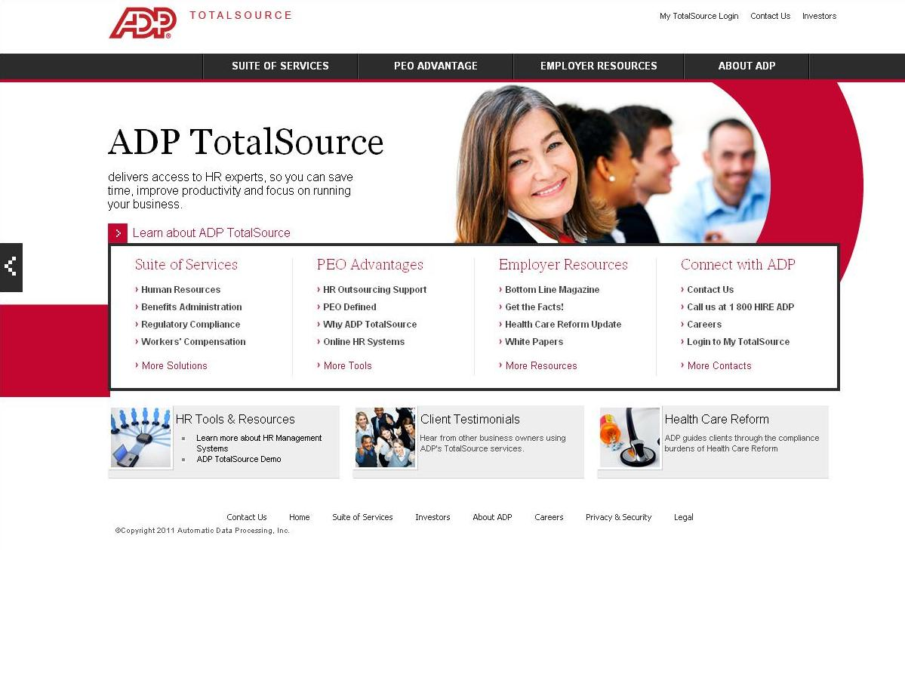
Registration & Login Instructions
  www.adptotalsource.com
  To begin, go to our website – also commonly referred to as MyTotalSource or “MyTS”
  Click on the link “My TotalSource Login” at the top-right of the page

Slide 4
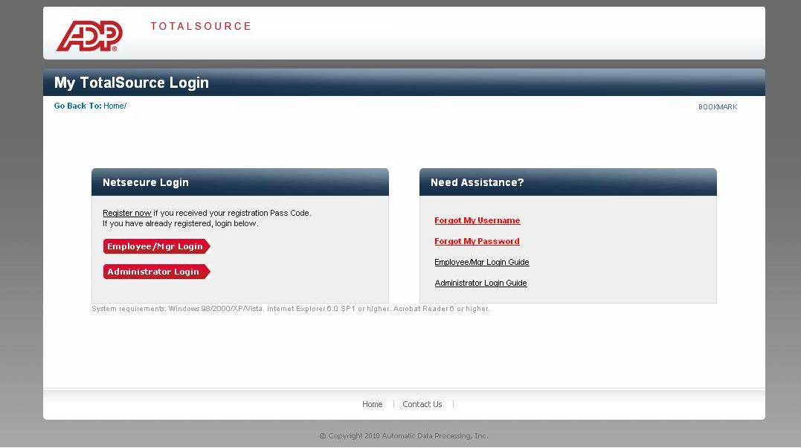
First-Time MyTS Users Must Register
  Next, go to the “Register now” link on the My TotalSource Login page
  When prompted, enter your registration pass code: famentgrp-85839
  This is the only step requiring this code
  This code is the same for all employee’s

Slide 5
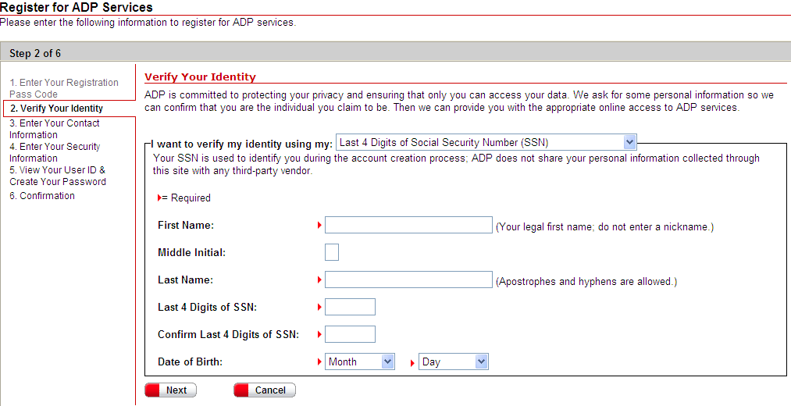
Verify your Identity

Slide 6
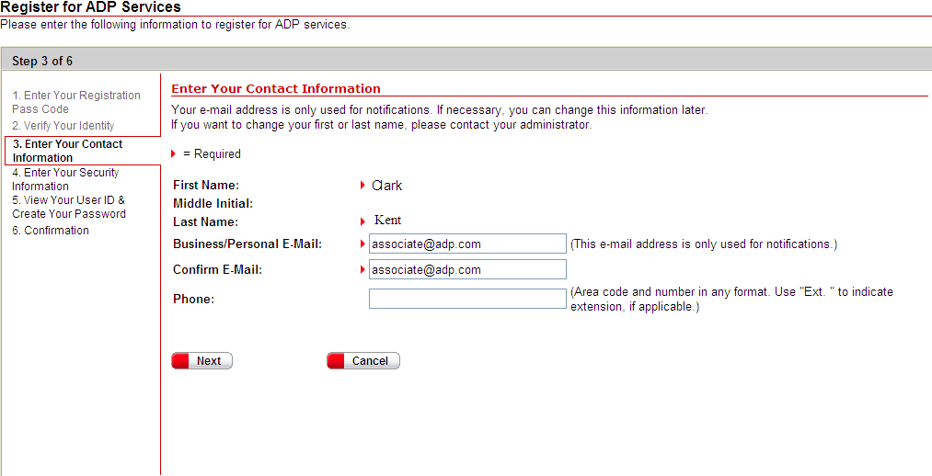
Email Confirmations
Notes:
E-mail confirmation page for Netsecure. This data is stored on Netsecure side

Slide 7
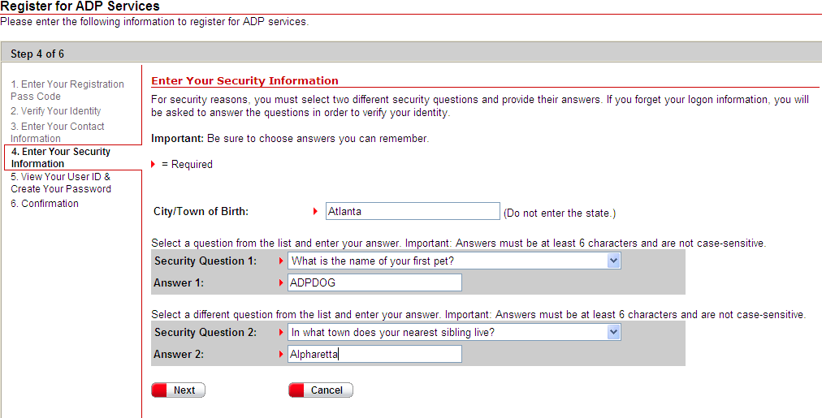
Security Questions
These case-sensitive security question will allow you to reset your password should you forget it
Notes:
These security questions are CASE SENSITIVE. WSE’s are the only ones who can use the password reset feature. Admin will need to call ESC or PSR to have pw reset. WSE’s who have forgotten their security answers can also call the ESC for pw resets.

Slide 8
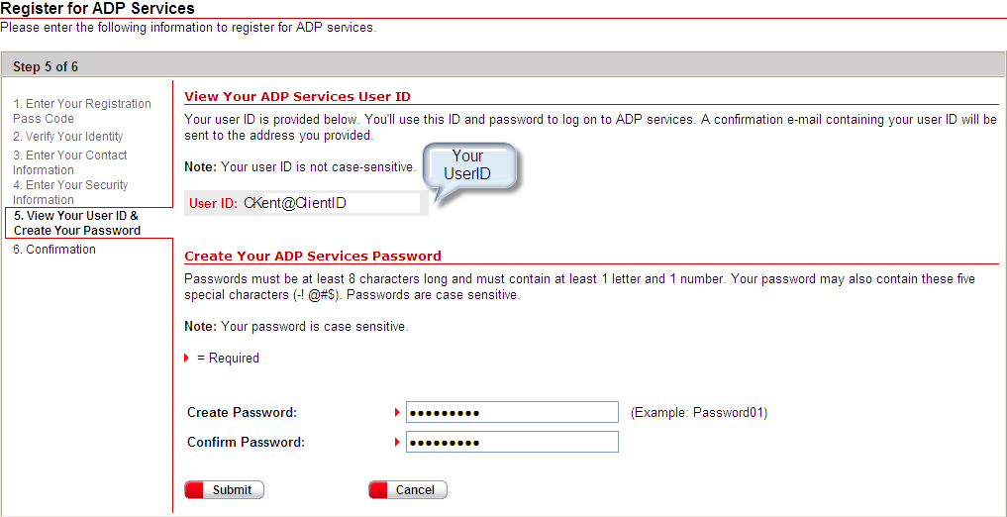
Password creation and User ID
Notes:
Password is also CASE SENSITIVE. The Client ID is also displayed on this screen and will also be displayed in the confirmation e-mail after registration is complete. Password will not be included in the e-mail.

Slide 9
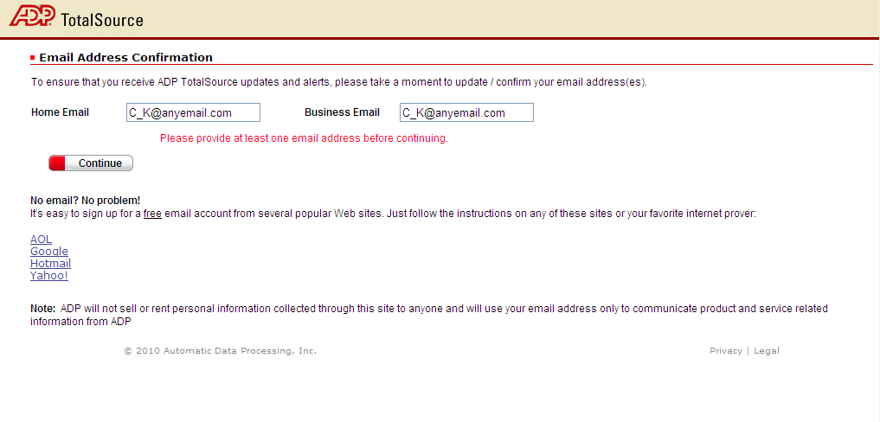
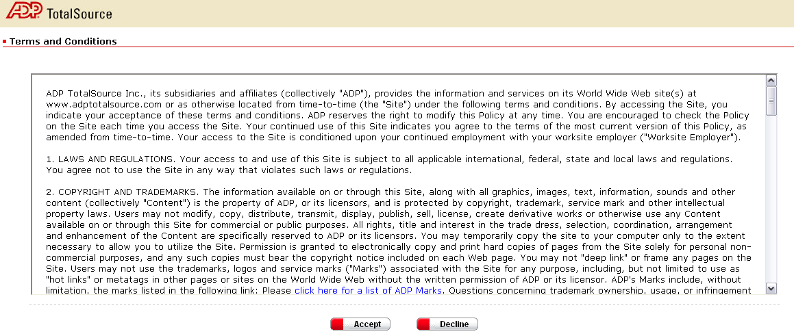
Initial login and Terms and Conditions
Notes:
In order to complete first login, terms and conditions MUST be accepted. E-mail confirmation on this page is for My TotalSource and stored on the TotalSource side.

Slide 10
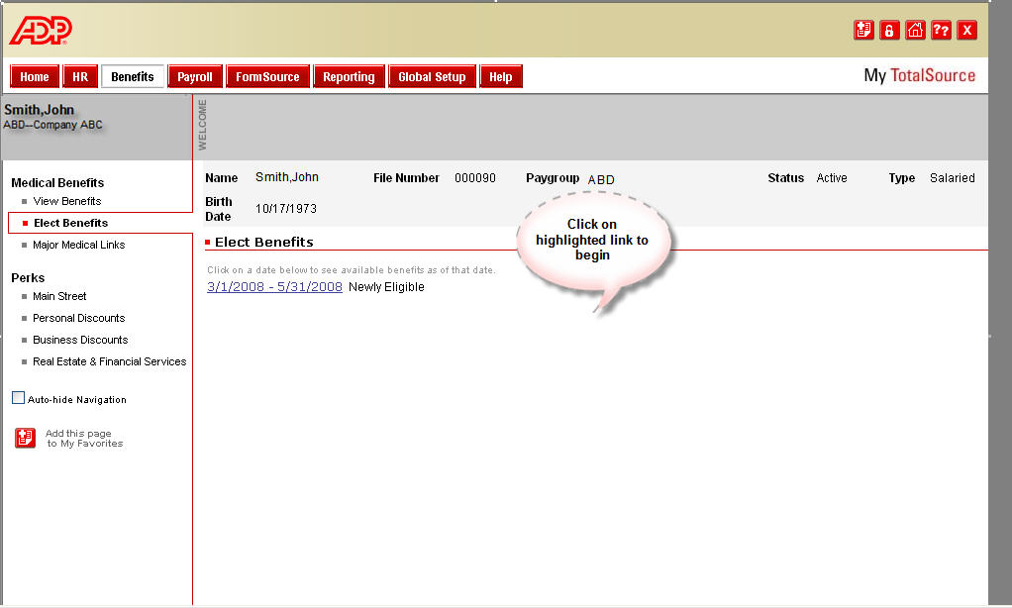
Enrolling in Benefits via MyTotalSource.com
Step 1. Click benefits link

Slide 11
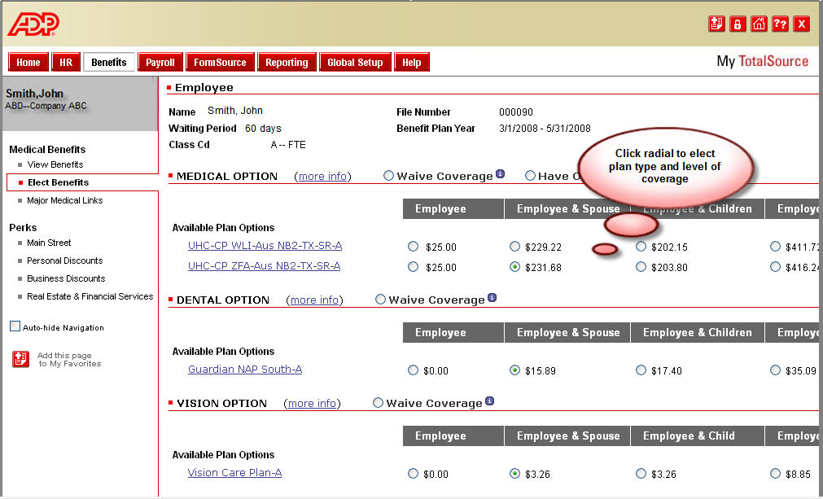
Step 2. Review & Elect Your Benefits

Slide 12
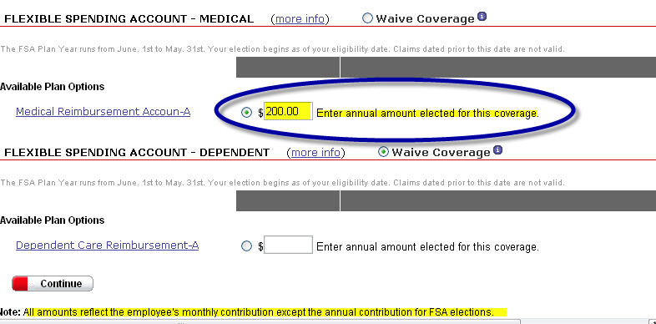
Step 3. Elect FSA Plan Year Amount

Slide 13
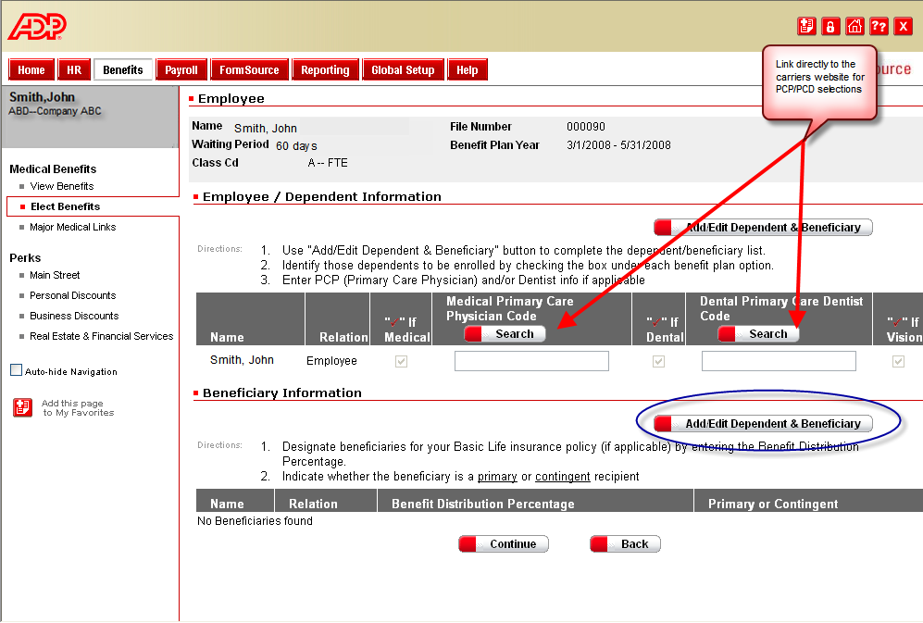
Step 4. Select your PCP or Dentist

Slide 14
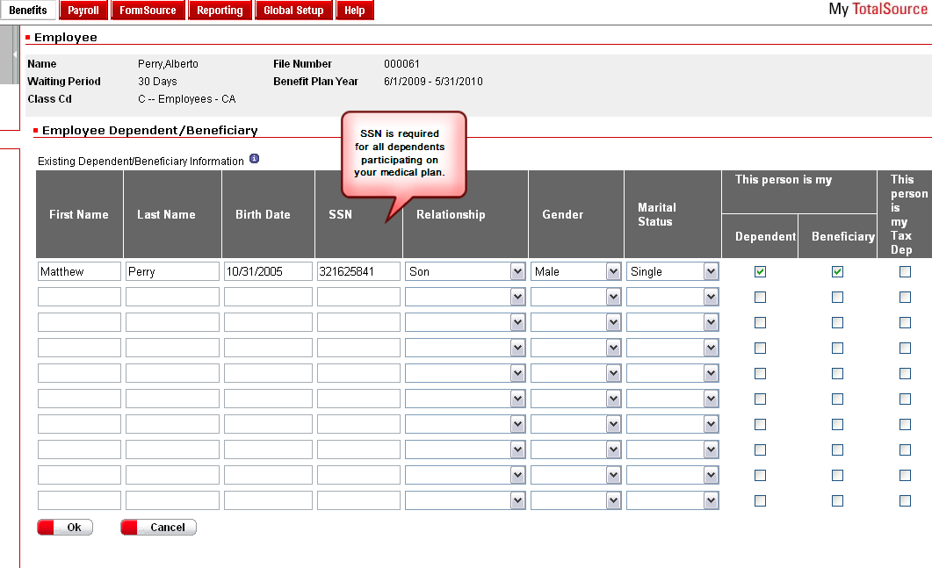
Step 5. Enter Dependent & Beneficiary Info

Slide 15
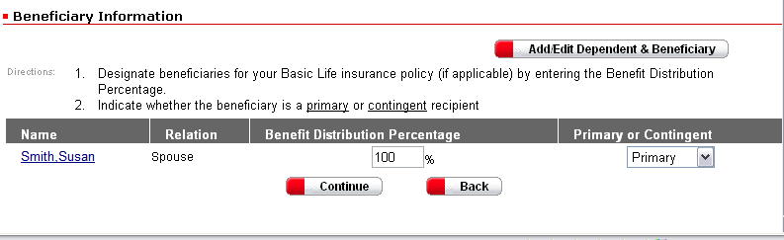
Step 6. Determine Life Insurance Distribution amounts

Slide 16
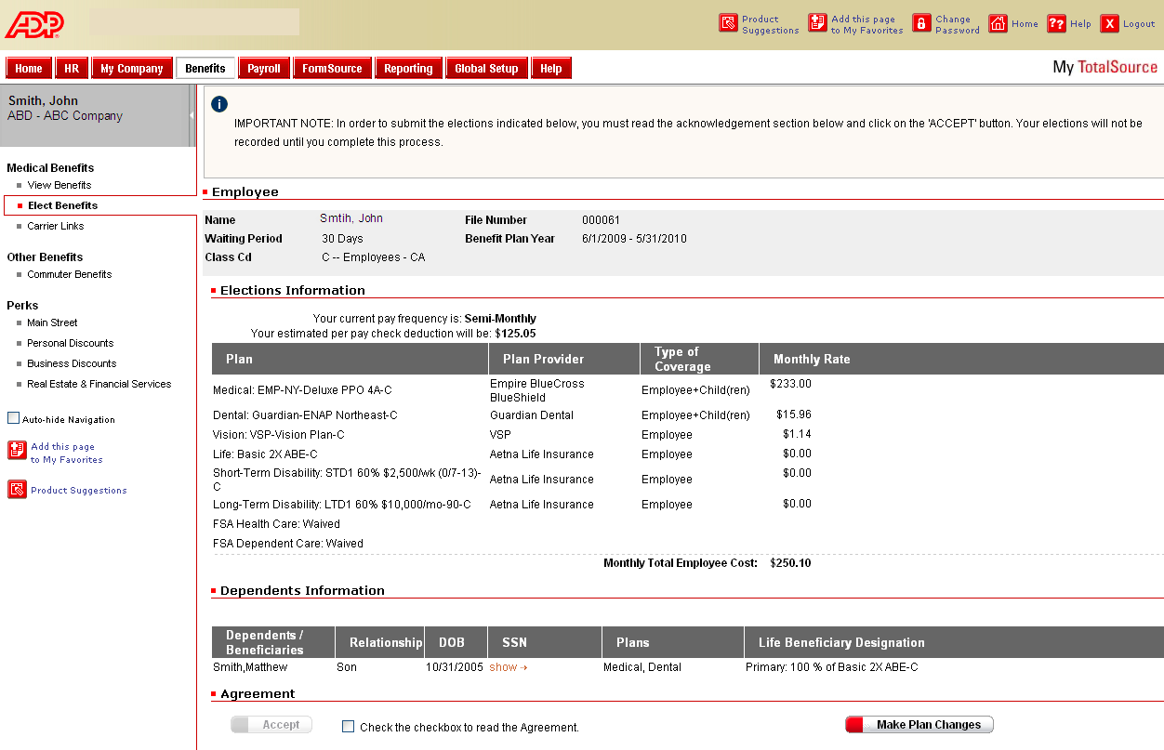
Step 7. View your elections and Accept!

Slide 17
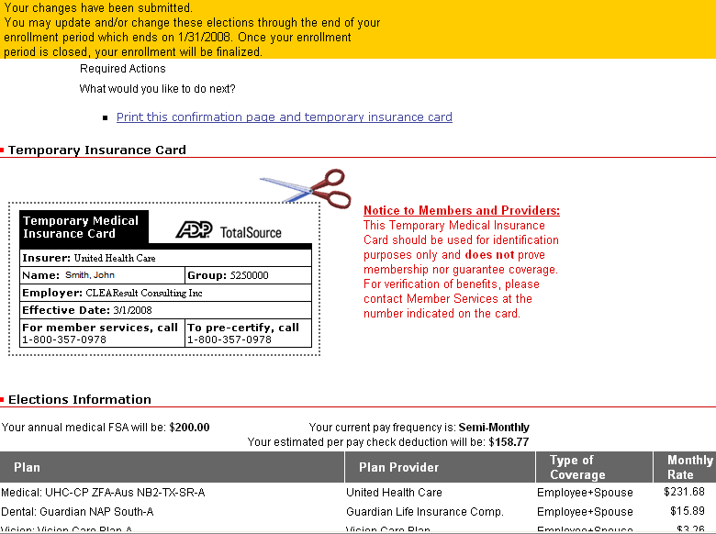
Step 8. Print Confirmation Page & Temporary Insurance Card

