Slide 1
Computational Systems Biology
Databases, formats and sources
2013, Valencia
Ignacio Medina
http://bioinfo.cipf.es/imedina
imedina@cipf.es
Head of the Computational Biology Unit
Computational Genomics Institute
Centro de Investigación Príncipe Felipe (CIPF)
Valencia, Spain

Slide 2
Index
Introduction
Data formats
Biological databases

Slide 3
Introduction
Overview of data sources and formats
Many new data repositories and data formats exist, many small projects and custom formats, some data sources do not provide standard formats!
Biological networks data is split into different repositories, many times you need to parse and join different sources
Different computation skills needed: RESTful/SOAP web services, XML and XSD, tabular format, RDF, SPARQL, …

Slide 4
Introduction
Computing needs
XML and schema
  PyXB, a python schema binding
Web Services
  SOAP
  RESTful
OBO ontologies
  SBO ontology
  MI ontology

Slide 5
Data formats
Overview
There too many, main data formats include:
  Simple interaction file (SIF)
  NNF
  GML and XGMML
  SBML
  BioPAX
  PSI-MI and PSI-MI tab
  DOT
One Graphical language format proposed:
  SBGN

Slide 6
Data formats
SIF format
SIF: Simple Interaction format
Very simple format tabulated file with 3 columns:
  nodeA <relationship type> nodeB
  nodeC <relationship type> nodeA nodeC
  Example:
    node1 typeA node2
    node2 typeB node3 node4 node5
    node0
The tag relationship type can be any string. Commonly:
  pp .................. protein – protein interaction
  pd .................. protein -> DNA
  pr .................. protein -> reaction
  rc .................. reaction -> compound
  cr .................. compound -> reaction
  gl .................. genetic lethal relationship
  pm .................. protein-metabolite interaction
  mp .................. metabolite-protein interaction
More info at: http://www.cytoscape.org/manual/Cytoscape2_7Manual.html#SIF Format

Slide 7
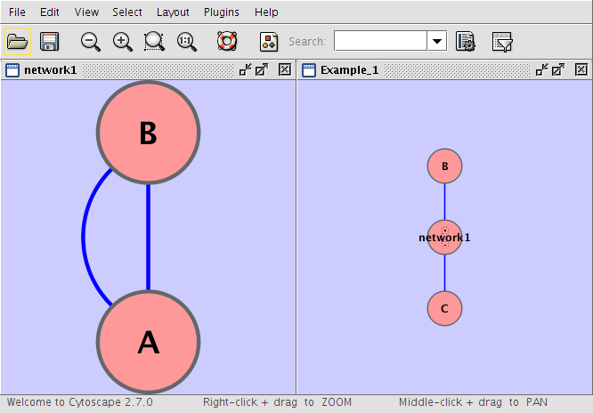
Data formats
NNF format
NNF: Nested Network format
Simple and similar to SIF but allows nested network in a node
  Example:
  Example_1 C
  Example_1 network1
  network1 A pp B
  network1 B pp A
  Example_1 C pp B
More info and examples at: http://www.cytoscape.org/manual/Cytoscape2_7Manual.html#NNF

Slide 8
Data formats
GML and XGMML format
GML: Rich graph format. Used by many other network visualization packages
  GML: http://www.fim.uni-passau.de/en/fim/faculty/chairs/theoretische-informatik/projects.html
XGMML: the XML evolution of GML
  Contains information about interactions, attributes, graphical representation, …
  XML schema provided
  http://wiki.cytoscape.org/XGMML

Slide 9
Data formats
SBML format
SBML: Systems Biology Markup Language
It's a XML format to describe biochemical networks
Web site: http://sbml.org/Documents
Three different releases are available named 'Levels'. Levels are intended to coexist .
Most stable release is Level 2 Version 4: http://sbml.org/Documents/Specifications#SBML_Level_2_Version_4
XML schema and libraries for many languages provided

Slide 10
Data formats
BioPAX format
BioPAX: Biological Pathway Exchange format
Very advance semantic technologies applied
It's a RDF/OWL-based format to represent biological pathways
  RDF: Resource Description Framework (http://en.wikipedia.org/wiki/Resource_Description_Framework)
  OWL: Web Ontology Language (http://en.wikipedia.org/wiki/Web_Ontology_Language)
Serialized in RDF/XML
Web site: http://www.biopax.org/

Slide 11
Data formats
PSI-MI and PSI-MI TAB format
PSI-MI: Proteomic Standard Initiative – Molecular Interaction. Initiative founded at the HUPO meeting in 2002
Web site at http://www.psidev.info/
Two main standards:
  PSI-MI XML: http://www.psidev.info/mif
  PSI-MI TAB: ftp://ftp.ebi.ac.uk/pub/databases/intact/current/psimitab/README
MI onotology: http://www.obofoundry.org/cgi-bin/detail.cgi?id=psi-mi

Slide 12
Data formats
DOT format
DOT format is used in the generic Graphviz package
Specification:
  http://www.graphviz.org/content/dot-language
  Demos: http://api.graphviz.org/webdot/demo.html
Need to install graphviz?
  sudo apt-get install graphviz

Slide 13
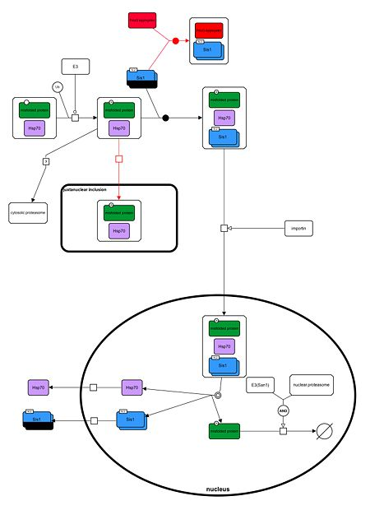
Data formats
SBGN format
SBGN: Systems Biology Graphical Notation
It's an effort to standardize the graphical notation use in biological networks
Web site: http://www.sbgn.org/Main_Page

Slide 14
Biological Databases
Overview
Many different sources with different type of information
Many times the database you need does not exist... so? Just create it yourself
Very few initiatives to join and standardize databases. Many times you will need to merge a few of them
Types
  Protein-protein interaction (PPI) databases
  Pathways
  Regulatory
  Co-expression
  Functional databases

Slide 15
Biological Databases
Protein-protein interaction databases
Main PPI databases
  IntAct: http://www.ebi.ac.uk/intact/
  Mint: http://mint.bio.uniroma2.it/mint/Welcome.do
  HPRD: http://www.hprd.org/
  ...

Slide 16
Biological Databases
Pathway databases
Some main databases:
  KEGG: http://www.genome.jp/kegg/
  Reactome: http://www.reactome.org/
  BioCyc: http://biocyc.org/
Important! Different type of data
  In silico vs in vivo
Others:
  MetaCyc: http://metacyc.org/

Slide 17
Biological Databases
Regulatory databases
Some data respositories
  MiRTarBase: http://mirtarbase.mbc.nctu.edu.tw/
  Ensembl and Encode data... not a real database

Slide 18
Biological Databases
Co-expression databases
Main database
  Expression Atlas at EBI: http://www.ebi.ac.uk/gxa/ and data at ftp://ftp.ebi.ac.uk/pub/databases/microarray/data/gxa/

Slide 19
Biological Databases
Functional databases
Two main data sources:
  STRING: http://string-db.org/
  Genemania: http://www.genemania.org/

