Slide 1



Visualization of mapped reads
Integrative Genomics Viewer (IGV)
University of Cambridge
Cambridge, UK
4th March 2014

Slide 2

The pipeline
Fastq
Sequence preprocessing
Fastq
Mapping
BAM
Visualization
BAM
Variant calling
RNA-Seq processing
VCF
???
Exome analysis
RNA-Seq analysis
Variant annotation
RNA-Seq data analysis
Association studies
Functional analysis

Slide 3

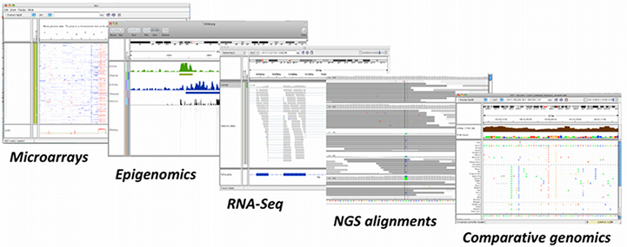



Introduction
Large quantities of genomic data (NGS, array based methods, etc)
Human interpretation and judgment using visualization can help complex biological relationships
Integrative Genomics Viewer (IGV)
  Integrate different data types simultaneously
  View large datasets easily
  Faster navigation or browsing
  Runs locally on your desktop
  Used by large-scale projects
  Open source and freely available
Helga Thorvaldsdóttir, James T. Robinson, and Jill P. Mesirov
Integrative Genomics Viewer (IGV): high-performance genomics data visualization and exploration
Brief Bioinform (2013) 14 (2): 178-192

Slide 4
Data types
Any data related to genome coordinates
Sample annotations or attributes
Genome annotations
Recommended file formats
Source data | Recommended File Formats
Sequence alignment data | SAM (must be sorted/indexed) BAM (must be indexed)
Genome annotations | GFF or GFF3 format BED format
ChIP-Seq, RNA-Seq | TDF format (can be generated using igvtools)
Any numeric data | IGV format, TAB format WIG format
Gene expression data | GCT format RES format

Slide 5
Indexing a BAM file
BAM format: Binary SAM file → Reduces disk space and time
  For each read, provides the position(s) where it maps and information about the alignment
  BAM files need to be indexed (using samtools) → SAM files will be sorted by start position and indexed
Index an example BAM file
Take a look at the file size
samtools index NA12878_child.bam
samtools index NA12891_dad.bam
samtools index NA12892_mom.bam
ls -lh

Slide 6
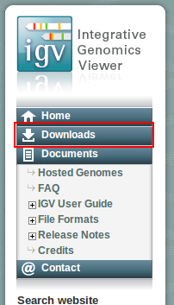
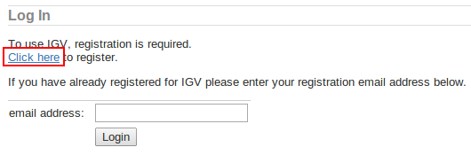
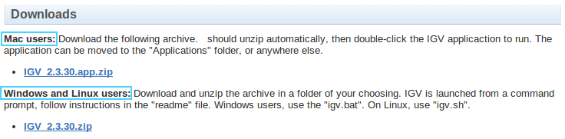
Registration and download
Be sure that Java 6 or later is installed on your machine
Go to the IGV website:
Click Downloads at the left panel
Click to register and fill the form
Download the most suitable file for your system
Run IGV
http://www.broadinstitute.org/igv/home
igv

Slide 7
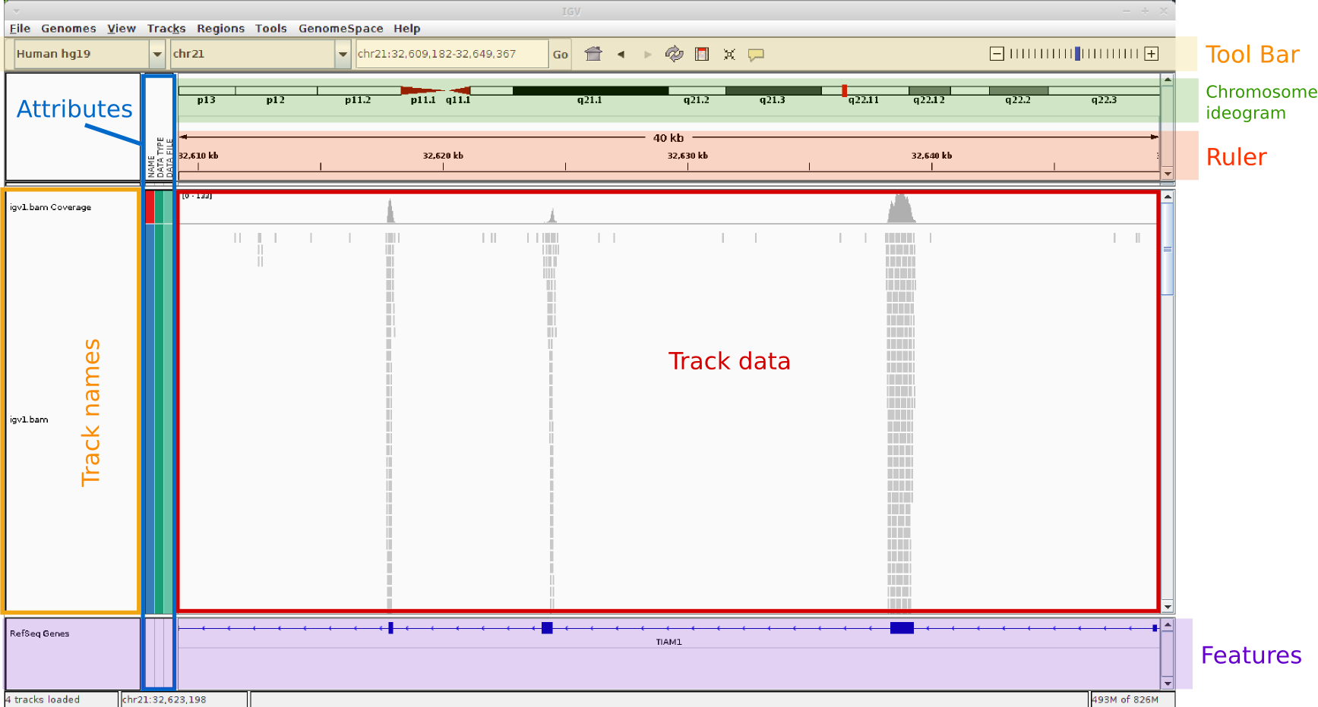
IGV interface

Slide 8





IGV Tool Bar
 | Genome drop-down box
 | Chromosome drop-down box
 | Search box
 | Whole genome view
 | Moves backward and forward through views of the genome
 | Refreshes the display
 | Defines a region of interest on the chromosome
 | Reduces the row height on all tracks to fit all data
 | Toggles the pop-up information windows in IGV on or off
 | Zooms in and out on a chromosome

Slide 9
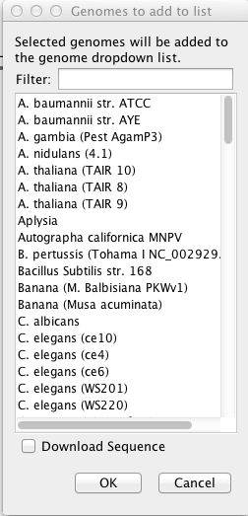
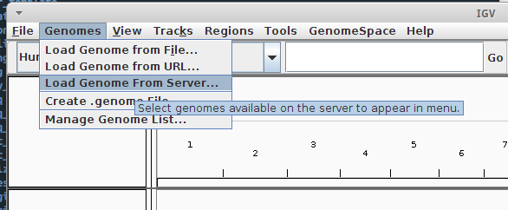
Download genome
Initially, the genome drop-down list contains a single item, "Human hg18"
IGV provides a number of genomes that are hosted on a server at the Broad Institute
List of genomes hosted: http://www.broadinstitute.org/software/igv/Genomes
Genomes → Load genome from server...
Select Human hg19

Slide 10
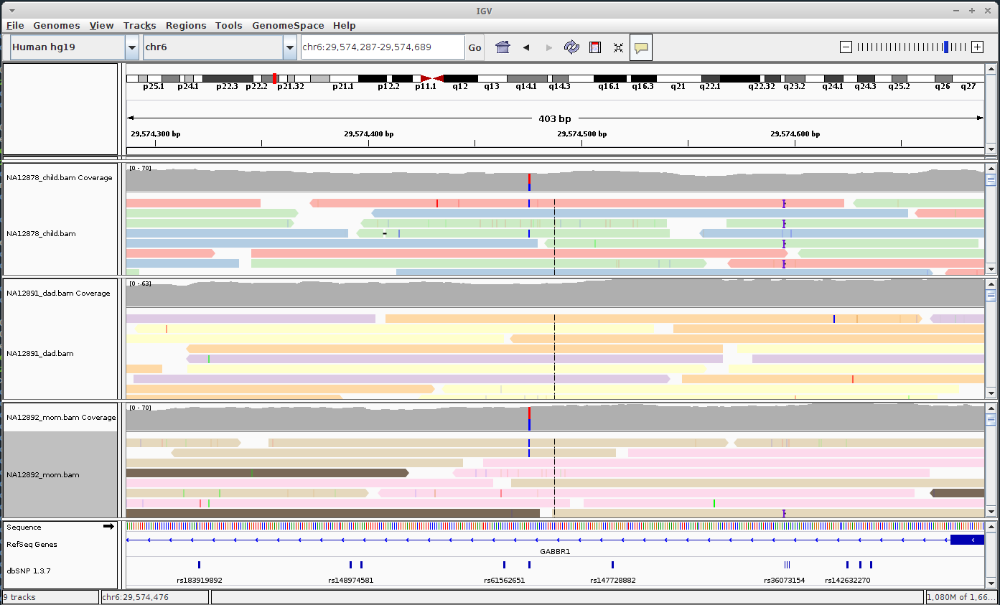
Loading and browsing files
File → Load from file...
Select NA12878_child.bam, NA12891_dad.bam and NA12892_mom.bam

Slide 11
THANK YOU.

