Slide 1



NGS data analysis:
Variant Calling
David Montaner
dmontaner@cipf.es
Variant calling

Slide 2
Where are we?
Sequence preprocessing
NGS
pipeline
Mapping
Variant Calling
Transcriptomics
Variant prioritization
Isoform detection
Functional annot.
GWAS Analysis
Differ. expression
Functional Analysis
David Montaner
dmontaner@cipf.es
Variant calling

Slide 3
Genomic Variation
SNPs / single nucleotide variants
Insertions / Deletions
Translocations
Inversions
Copy number alterations
...
David Montaner
dmontaner@cipf.es
Variant calling

Slide 4
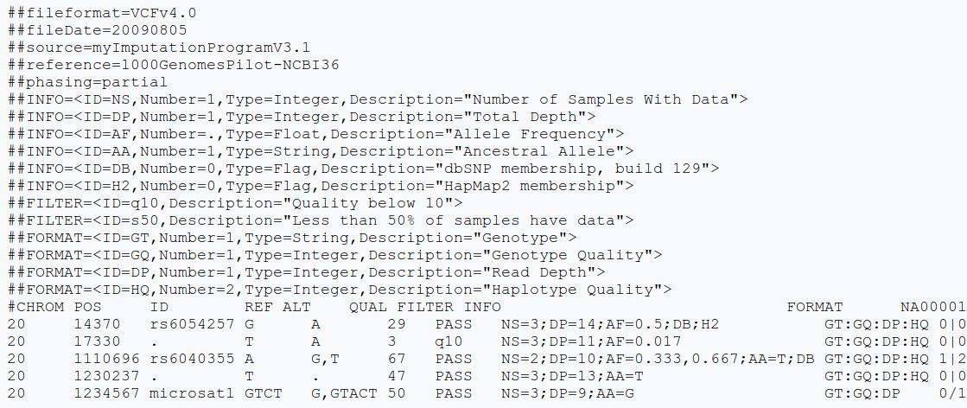
File Format
David Montaner
dmontaner@cipf.es
Variant calling

Slide 5
VCF file format
##fileformat=VCFv4.0
##fileDate=20090805
##source=myImputationProgramV3.1
##reference=1000GenomesPilot-NCBI36
##phasing=partial
##INFO=<ID=NS,Number=1,Type=Integer,Description="Number of Samples With Data">
...
##FILTER=<ID=q10,Description="Quality below 10">
...
##FORMAT=<ID=HQ,Number=2,Type=Integer,Description="Haplotype Quality">
#CHROM POS ID REF ALT QUAL FILTER INFO FORMAT NA00001 NA00002 NA00003
20 14370 rs6054257 G A 29 PASS NS=3;DP=14;AF=0.5;DB;H2 GT:GQ:DP:HQ 0|0:48:1:51,51 1|0:48:8:51,51 1/1:43:5:.,.
20 17330 . T A 3 q10 NS=3;DP=11;AF=0.017 GT:GQ:DP:HQ 0|0:49:3:58,50 0|1:3:5:65,3 0/0:41:3
20 1110696 rs6040355 A G,T 67 PASS NS=2;DP=10;AF=0.333,0.667;AA=T;DB GT:GQ:DP:HQ 1|2:21:6:23,27 2|1:2:0:18,2 2/2:35:4
20 1230237 . T . 47 PASS NS=3;DP=13;AA=T GT:GQ:DP:HQ 0|0:54:7:56,60 0|0:48:4:51,51 0/0:61:2
20 1234567 microsat1 GTCT G,GTACT 50 PASS NS=3;DP=9;AA=G GT:GQ:DP 0/1:35:4 0/2:17:2 1/1:40:3
QUAL: quality score of the calls (phred scale)
FILTER: PASS / filtering_tag
INFO: additional information
FORMAT: describes further extra columns
CHROM: chromosome
POS: position
ID: name
REF: reference base(s)
ALT: non-reference alleles
David Montaner
dmontaner@cipf.es
Variant calling

Slide 6
VCF file format: INFO
INFO column: semicolon-separated fields. <key>=<data>[,data]
Some reserved (but optional) keys:
AA ancestral allele
AC allele count in genotypes, for each ALT allele, in the same order as listed
AF allele frequency
CIGAR cigar string describing how to align an alternate allele to the reference allele
DB dbSNP membership
MQ RMS mapping quality, e.g. MQ=52
MQ0 Number of MAPQ == 0 reads covering this record
NS Number of samples with data
SB strand bias at this position
SOMATIC indicates that the record is a somatic mutation, for cancer genomics
VALIDATED validated by follow-up experiment
David Montaner
dmontaner@cipf.es
Variant calling

Slide 7
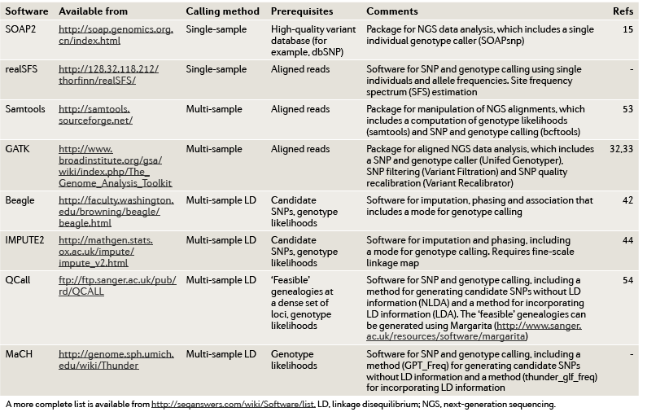
Software
David Montaner
dmontaner@cipf.es
Variant calling

Slide 8
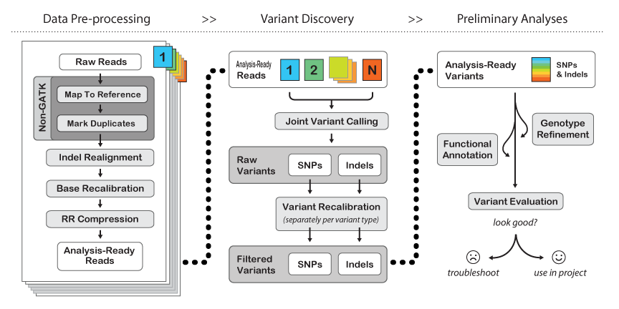
GATK Best Practices workflow
David Montaner
dmontaner@cipf.es
Variant calling

Slide 9
Mark Duplicates
All NGS sequencing platforms are NOT single molecule sequencing
PCR → duplicate DNA fragments in the final library.
If there is a base variation it will have high depth support
Can result in false SNP calls
Tools
Samtools: samtools rmdup or samtools rmdupse
Picard/GATK: MarkDuplicates
David Montaner
dmontaner@cipf.es
Variant calling

Slide 10
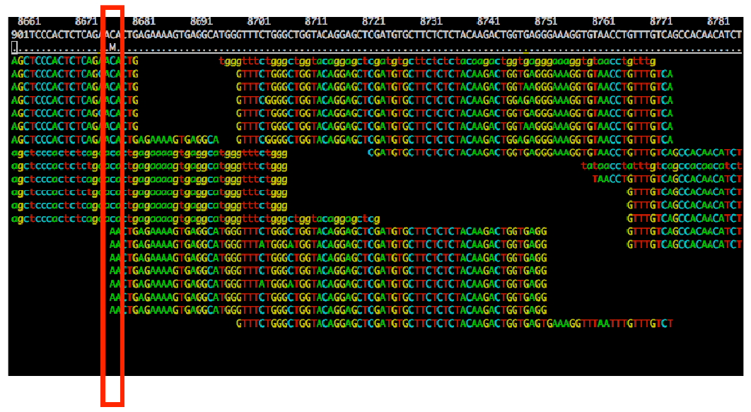
Duplicated induce biased SNP calls
David Montaner
dmontaner@cipf.es
Variant calling

Slide 11
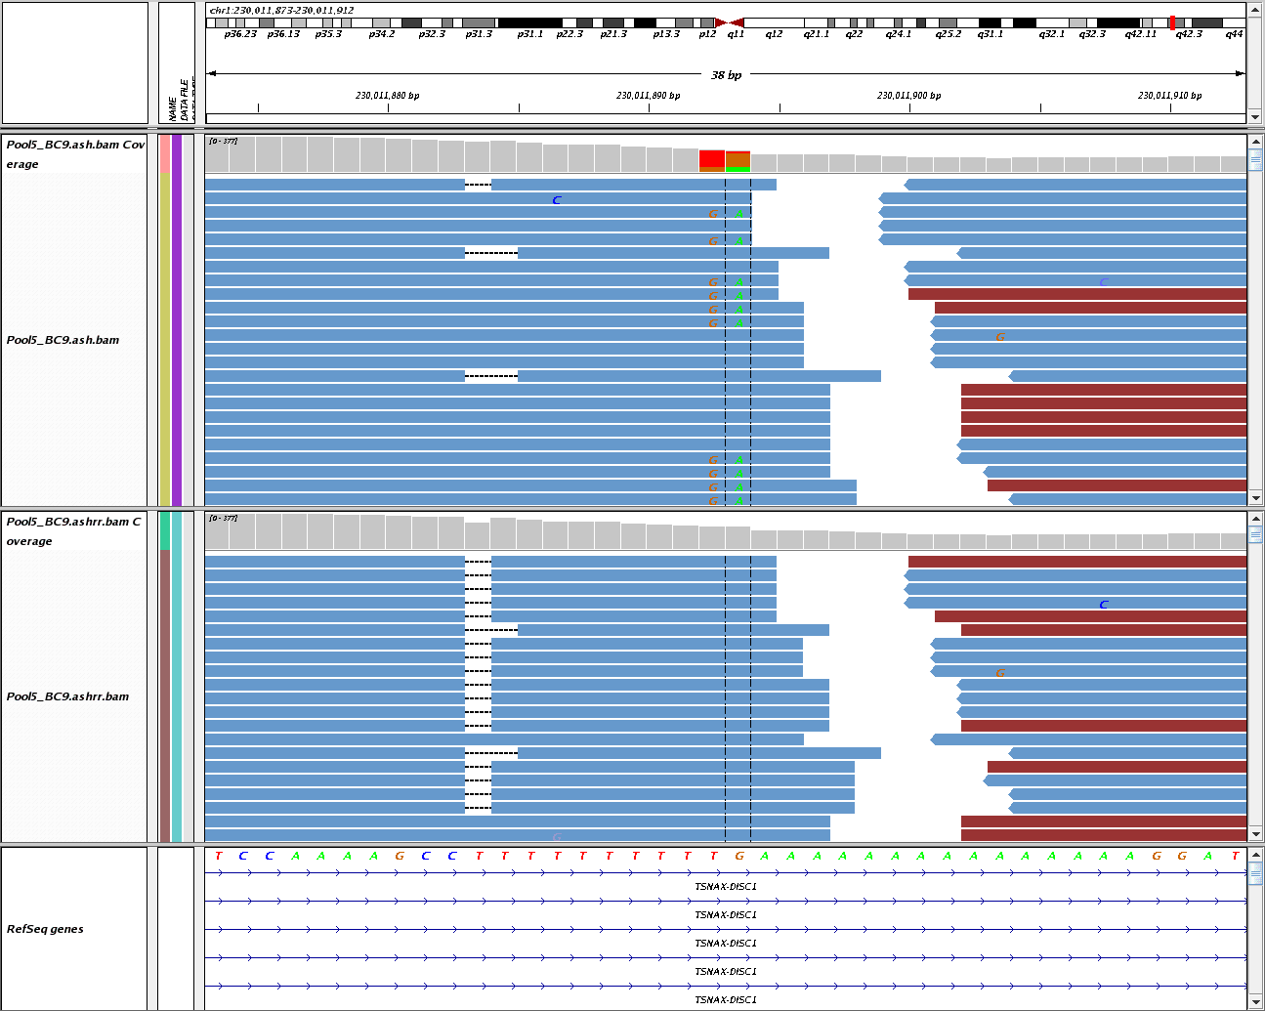
INDEL Realignment
Local realignment of all reads at a specific location simultaneously to minimize mismatches to the reference genome.
Reduces erroneous SNPs refines location of INDELS.
David Montaner
dmontaner@cipf.es
Variant calling

Slide 12
Base quality recalibration
Recalibrate base quality scores in order to correct sequencing errors and other experimental artifacts:
Analyze patterns of covariation in the sequence data:
creates a report that will be used later.
Generate before/after plots:
check the effect before you apply it to your sequence data.
Apply the recalibration to your sequence data:
transform your bam files.
Requires a reference genome and a catalog of known variable sites.
The known sites are used to build the covariation model and estimate empirical base qualities.
David Montaner
dmontaner@cipf.es
Variant calling

Slide 13
Calling: GATK
Probabilistic method: Bayesian estimation of the most likely genotype.
Calculates many parameters for each position of the genome.
SNP and indel calling.
Used in many NGS projects, including the 1000 Genomes Project, The Cancer
Genome Atlas, etc.
Base quality recalibration.
Indel realignment
Uses standard input and output files.
Many tools for manage VCF files.
Multi-sample calling
http://www.broadinstitute.org/gatk/
David Montaner
dmontaner@cipf.es
Variant calling

Slide 14
T
David Montaner
dmontaner@cipf.es
Variant calling

