Slide 1
A note on DLW
KG 11/2023

Slide 2
Markups estimation
In the industrial organization literature, estimating markups has long been a tradition.
That is, there are information in the price-cost margin that’s not necessarily markups.
In the recent literature, estimating markups uses the notion that under the perfect competition condition, the growth of output must be in-proportion with the growth of inputs.
That is, perfectly competitive firms will have to share the same revenue with its factor of productions, most notably labour.
De Loecker and Warzynski (2012) (DLW hereafter) is the frontier markups estimators at the moment.

Slide 3
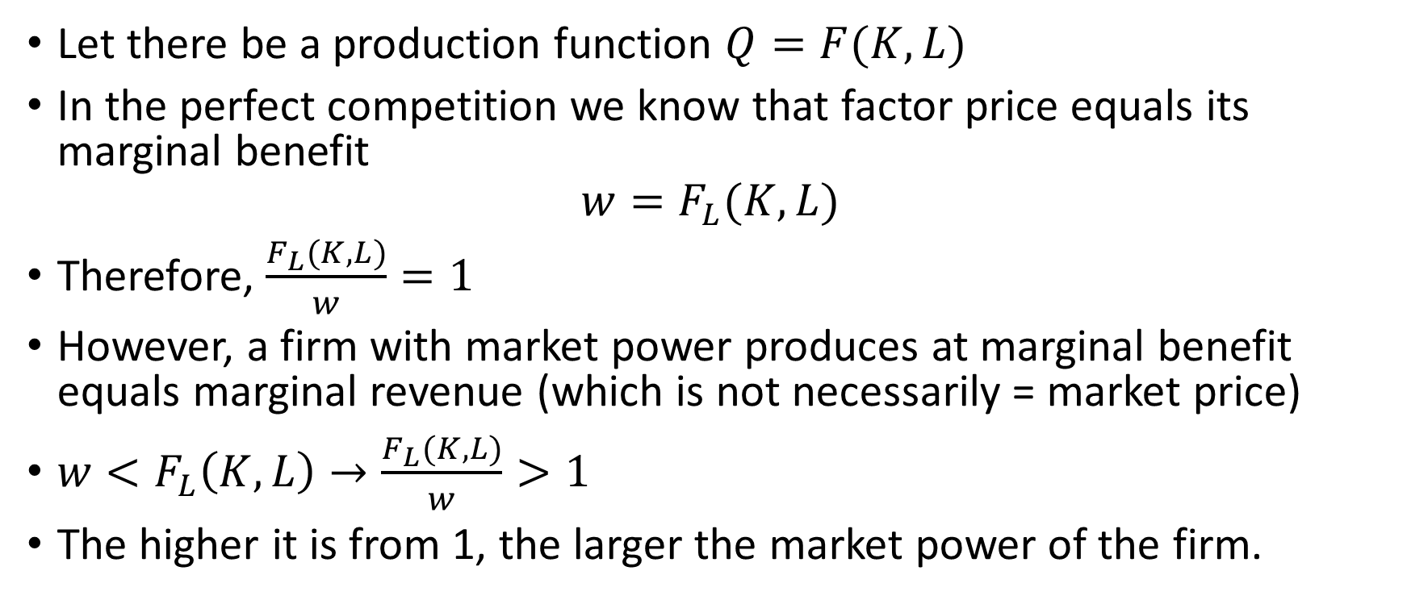
DLW framework
Let there be a production function $Q=F(K,L)$
In the perfect competition we know that factor price equals its marginal benefit
$$w=F_{L}(K,L)$$
Therefore, $\frac{F_{L}(K,L)}{w}=1$
However, a firm with market power produces at marginal benefit equals marginal revenue (which is not necessarily = market price)
$w<F_{L}\left(K,L\right)→\frac{F_{L}(K,L)}{w}>1$
The higher it is from 1, the larger the market power of the firm.

Slide 4
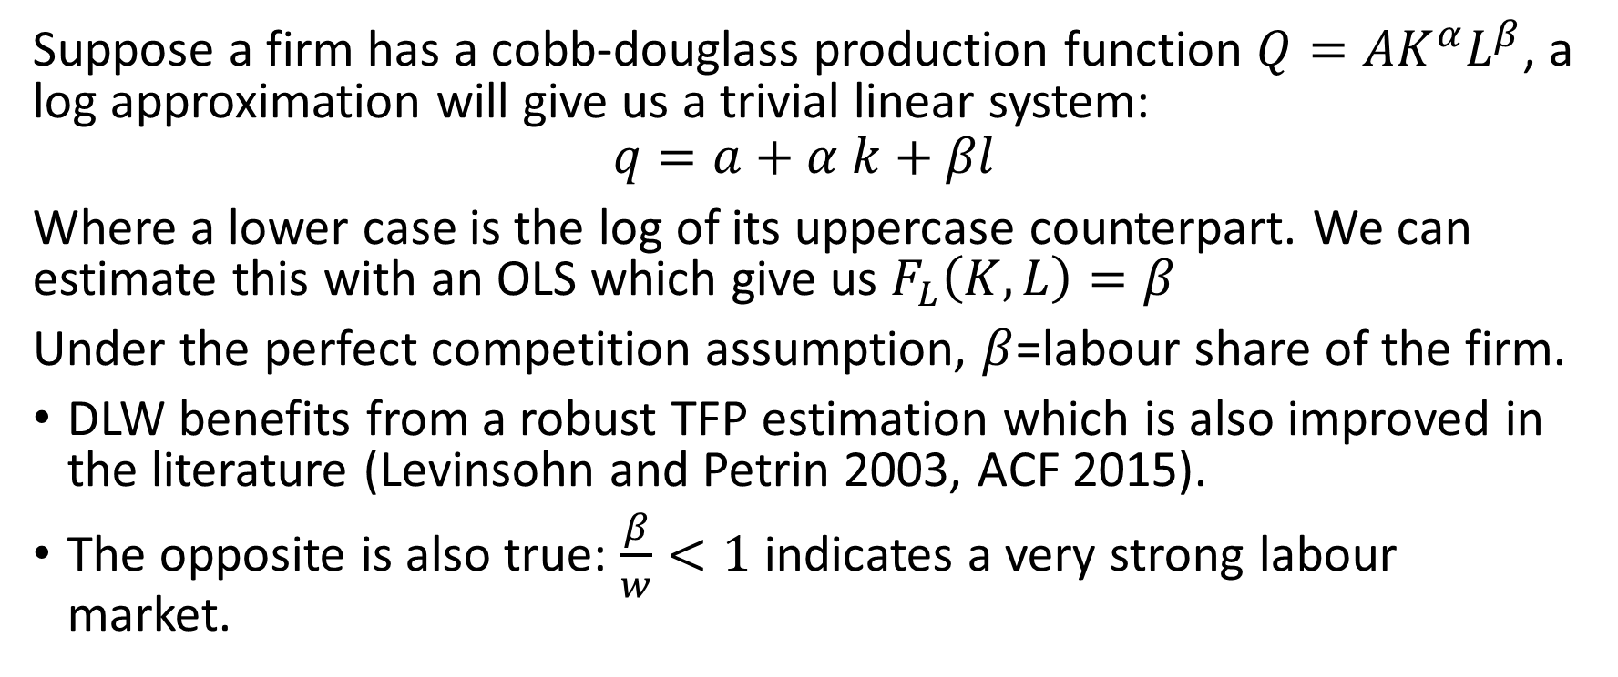
DLW framework (2)
Suppose a firm has a cobb-douglass production function $Q={AK}^{α}L^{β}$, a log approximation will give us a trivial linear system:
$$q=a+α k+βl$$
Where a lower case is the log of its uppercase counterpart. We can estimate this with an OLS which give us $F_{L}\left(K,L\right)=β$
Under the perfect competition assumption, $β$=labour share of the firm.
DLW benefits from a robust TFP estimation which is also improved in the literature (Levinsohn and Petrin 2003, ACF 2015).
The opposite is also true: $\frac{β}{w}<1$ indicates a very strong labour market.

