Slide 1
Ilmu Ekonomi
Pertemuan 5 Prodi PIWAR Politeknik APP Jakarta

Slide 2
Recap on last week
Elasticities matter, as they dictate how surpluses are distributed in a market.
It is important also for the government.
Demand elasticity varies depending on preference and the state of the good
substitute vs complement, luxury vs normal, etc
usually hard to change market preferences.
preference can be estimated but it is beyond the cover of this course.

Slide 3
Today’s cover
Supply curve is a bit different:
Cost can be easier to guess.
Easier to make framework.
Has an important implication to the market.
What we will learn today is:
The production function.
Types of cost.
Implication to the supply curve and the market.

Slide 4
The Production Function

Slide 5
The production function
A firm is an organization that produces goods and services.
To produce, it uses inputs and transform them into a final product and then sell it to the market.
This relationship:
$$input\overset{magic!}{→}output$$
is called production function

Slide 6
Reminder: What is a function?
Function is a mathematical expression to show a relationship between two or more variables.
Let $X$ be input and $Y$ be output, a production function is:
$$Y=f\left(X\right)$$
How labor makes rice is sometimes not the main emphasize for economist.
We care more on how much $X$ is needed to make $Y$.

Slide 7
The production function
Let there be a hypothetical rice farmer named Us.
Us own a hectare of land. In the short run, Us can’t increase his number of land.
However, Us can hire a labour to work at his farm.
In this case, the inputs are land and labour, while the output is rice.

Slide 8
Fixed and variable input
We call land a fixed input, an input which can’t be changed.
We call labour a variable input because Us can hire or fire labour anytime.
It is important to distinguish the two, because a producer can adjust variable input to adjust demand.
In good times, hire more labour. In bad times, fires.

Slide 9
Short and long run
Fixed input won’t probably be fixed for long.
buying and selling new land may take time, but it is doable.
However, when there’s a quick shock to demand, it is not easy to adjust it.
For example, the price for surgical mask at one point rose to 150k IDR a box, but it is now settled back to around 30k IDR a box.
In the short run, fixed input can’t keep up.
TSMC and Samsung need time to build new factories.

Slide 10
Short and long run
How long is ‘long run’? depends on how quickly the fixed input can adjust.
In the case of masks, it catched up to the demand shock in less than a year. Hand sanitizer is even faster.
In the case of chip, the new capacity for TSMC will operate somewhere in 2022, while Samsung needs even longer time.
Knowing how long is the demand shock is also important.
forecasting demand is a useful skill to have.

Slide 11
The hypothetical farmer
Us can’t change his arable land, but can change how much labour he employs.

Slide 12
Quantity of labour L (workers) | Quantity of rice Q (ton) | MPL
0 | 0 | -
1 | 19 | 19
2 | 36 | 17
3 | 51 | 15
4 | 64 | 13
5 | 75 | 11
6 | 84 | 9
7 | 91 | 7
8 | 96 | 5
MPL is short for Marginal Product of Labour
$$MPL=\frac{ΔQ}{ΔL}$$
MPL shows how much Q increase if we increase L by 1.

Slide 13
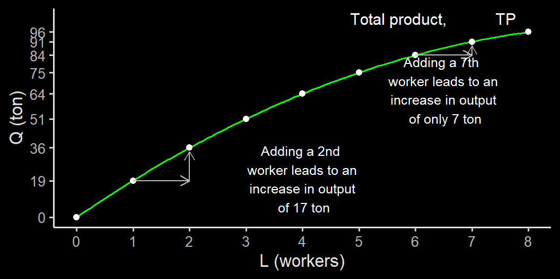
Total product curve

Slide 14
Marginal product
In general, marginal product of an input is the additional quantity of output produced by using one more additional unit of that input.
In our case, we have MPL of every one more additional worker. But if that data is not possible, we can just use the formula in general
for example, if Us have only two data points: one where he work alone and one when he hire 7 workers.

Slide 15
Marginal product
worker | production
1 | 19
8 | 96

Slide 16
$$MPL=\frac{ΔQ}{ΔL}=\frac{96−19}{8−1}=11$$
In our case, MPL decreases as the number of worker increases:
it is better to have a smooth data point.
We call this a diminishing return to labour

Slide 17
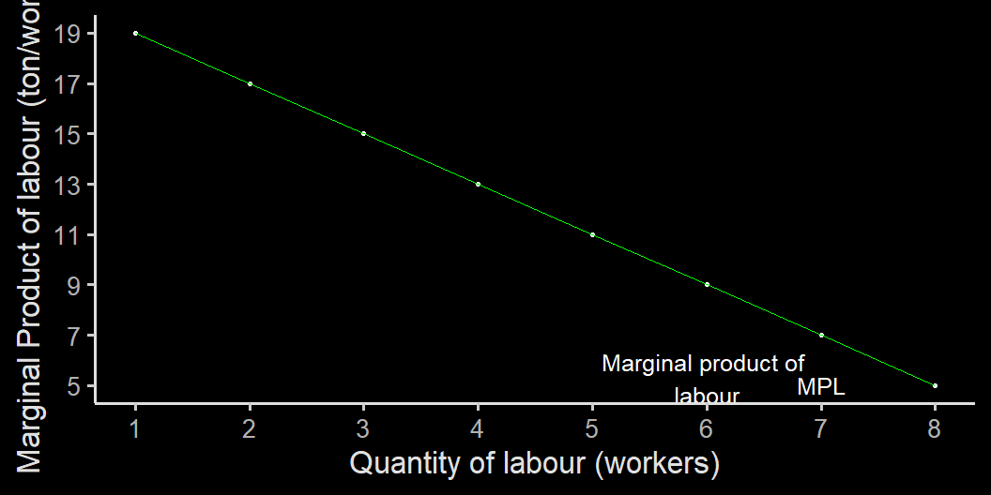
Marginal product curve

Slide 18
Diminishing return to an input
When you have 1 hectare of land, 1 worker can only work so much before he gets tired.
It is sensible to hire one more person to work on a larger area. This will lead to a huge gain in harvest.
If the land area is fixed, as we introduce more people, each person will have to work in a smaller area.
Too much people become inefficient.
In an office setting: imagine if you add workers without adding the number of computers.

Slide 19
Marginal product and the fixed input
If Us would like to scale up production, increasing only labour will be inefficient.
Us can start planning to increase its land to 2 hectare by buying or renting his neighbour’s land, for example.
Suppose it takes one year for Us to buy one more hectare of land, what’s his TP and MPL would look like one year later?

Slide 20
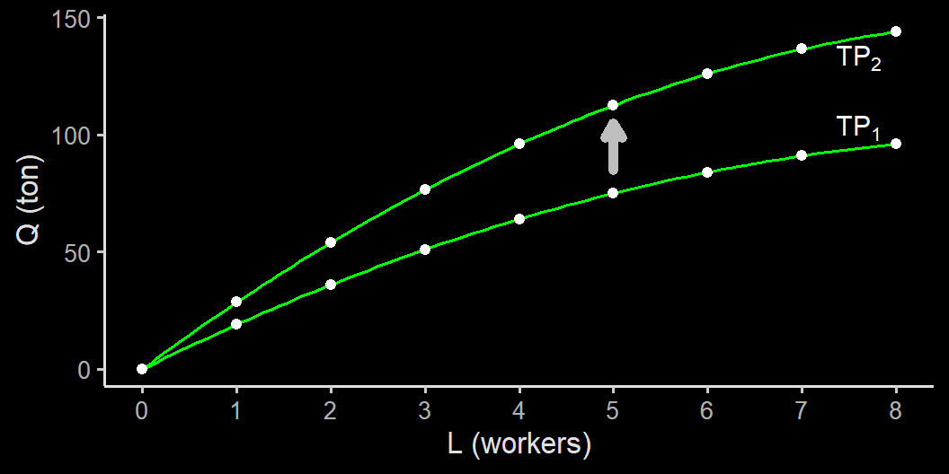
TP shifts up with land

Slide 21
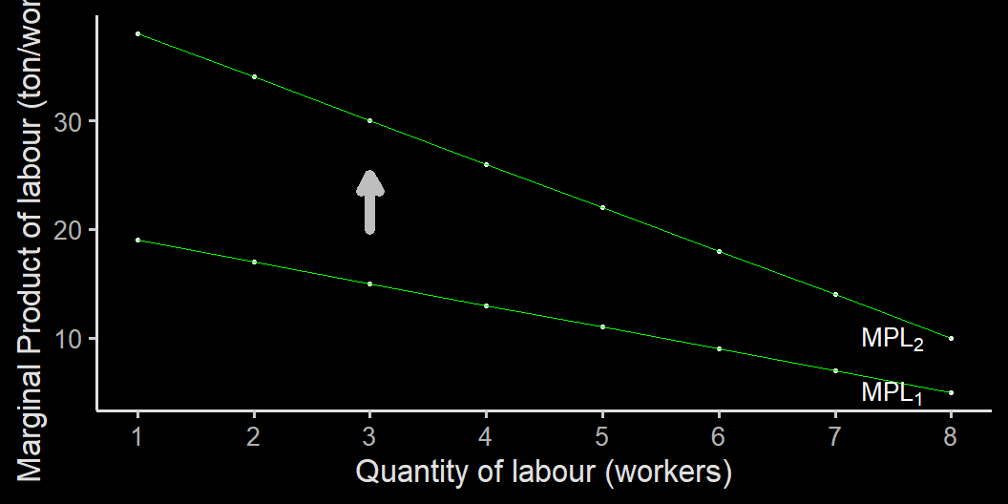
MPL is still diminishing, but higher

Slide 22
Marginal product
The crucial point of the diminishing marginal product concept is ceteris paribus.
if you increase labour AND land, then MPL will look like it goes up.
Hence, when we measure MP of an input, it must be the case that everything else is held fixed.
Production function can be a bit more complex.
1 programmer in 12 months $↛$ 12 programmers in 1 month.

Slide 23
Cost
via GIPHY

Slide 24
From production function to profit
Us understand how his farm work. He would like to profit from his farm.
If Us can’t control the selling price (rice is competitive), he needs to know how to control his own cost.
He has to know at least two things:
fixed cost (FC), the cost of his land, and
variable cost (VC), the cost of labour.

Slide 25
Us’s hypothetical cost
point | L (workers) | Q (ton) | FC | VC | TC=FC+VC
A | 0 | 0 | 200 | 0 | 200
B | 1 | 19 | 200 | 100 | 300
C | 2 | 36 | 200 | 200 | 400
D | 3 | 51 | 200 | 300 | 500
E | 4 | 64 | 200 | 400 | 600
F | 5 | 75 | 200 | 500 | 700
G | 6 | 84 | 200 | 600 | 800
H | 7 | 91 | 200 | 700 | 900
I | 8 | 96 | 200 | 800 | 1000
Suppose Us’s land’s rent price is 200 k IDR, while the wage rate in his neighbourhood is 100k IDR.

Slide 27
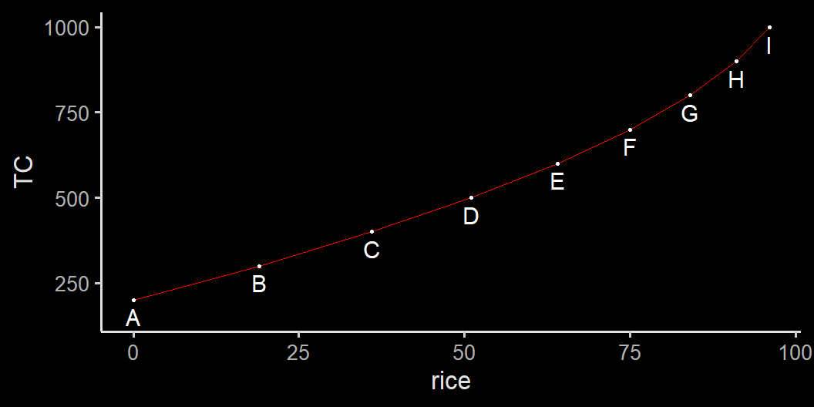
Total cost curve for Us’s farm

Slide 28
Total product curve vs total cost curve
Both are upward sloping
however, as production increase, TP is getting flatter, while TC is increasingly steeper.
Using more labour increases additional TC but decreases additional TP.

Slide 29
Two key concepts:
Marginal cost & average cost

Slide 30
Nea’s fancy footwear
Q | FC | VC | TC
0 | 108 | 0 | 108
1 | 108 | 12 | 120
2 | 108 | 48 | 156
3 | 108 | 108 | 216
4 | 108 | 192 | 300
5 | 108 | 300 | 408
6 | 108 | 432 | 540
7 | 108 | 588 | 696
8 | 108 | 768 | 876
9 | 108 | 972 | 1080
10 | 108 | 1200 | 1308
Nea is a learning entrepreneur. She start her fancy footwear business in New York with this cost structure:

Slide 32
Marginal cost
Marginal cost (MC) is the change in total cost generated by producing one additional unit of output.
$$MC=\frac{\text{Change in }TC}{\text{change in }Q}=\frac{ΔTC}{ΔQ}$$
Let’s add MC on Nea’s fancy footwear cost structure

Slide 33
Nea’ fancy footwear cost structure
Q | FC | VC | TC | MC
0 | 108 | 0 | 108 | 0
1 | 108 | 12 | 120 | 12
2 | 108 | 48 | 156 | 36
3 | 108 | 108 | 216 | 60
4 | 108 | 192 | 300 | 84
5 | 108 | 300 | 408 | 108
6 | 108 | 432 | 540 | 132
7 | 108 | 588 | 696 | 156
8 | 108 | 768 | 876 | 180
9 | 108 | 972 | 1080 | 204
10 | 108 | 1200 | 1308 | 228
For the first fancy footwear produced, Nea’s $Δ$Q is 1, while her $Δ$TC is 120-108=12
The second fancy footwear, her $ΔTC=156−120=36$ and so on.
In our case, we have complete one fancy footwear incremental. In the real world, you might not have this kind of data.
But the principle is the same.

Slide 34
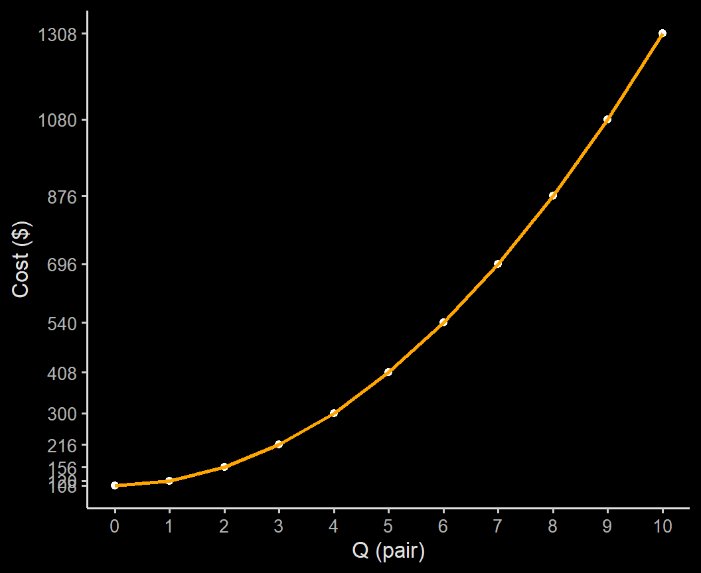
Nea’s fancy footwear
The cost is upward sloping, and the incremental is faster.
An additional pair of fancy footwear from 1 to 2 costs an additional $36
The additional cost is $180 from 7 pairs to 8 pairs

Slide 35
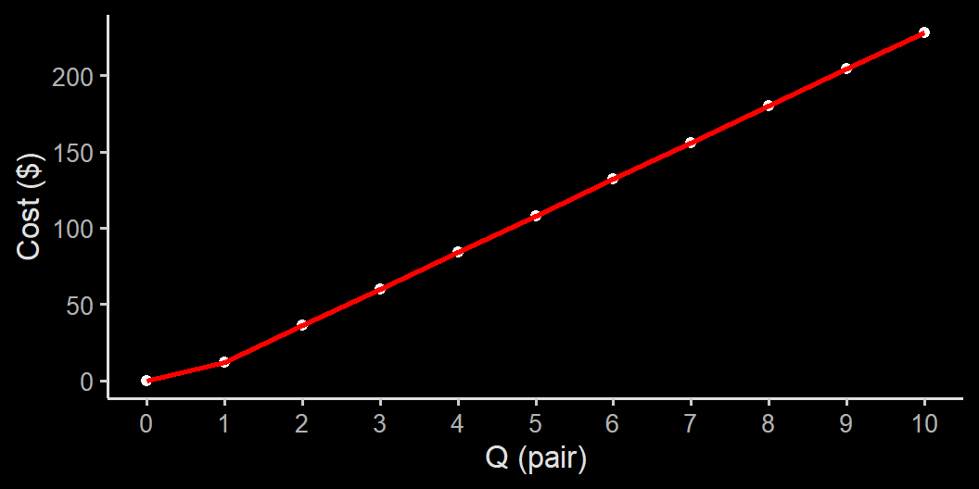
Nea’s fancy footwear
The marginal cost is also upward sloping.
in this case, the cost structure is designed to be diminishing in return
It means, the additional bobba needs more input as the fancy footwear increases.
recall that the TP curve in Us’s case is flattening because of this.

Slide 36
Average Total Cost (ATC)
There is also average total cost, or simply Average Cost
$$ATC=\frac{TC}{Q}$$
ATC is important because it tells the cost of each fancy footwear given the current state of production.
Be careful, $ATC≠MC$
Which one would Nea use to set the price?

Slide 37
Nea’s fancy footwear cost structure
Q | FC | VC | TC | MC | AFC | AVC | ATC
0 | 108 | 0 | 108 | 0 | Inf | NaN | Inf
1 | 108 | 12 | 120 | 12 | 108.00 | 12 | 120.00
2 | 108 | 48 | 156 | 36 | 54.00 | 24 | 78.00
3 | 108 | 108 | 216 | 60 | 36.00 | 36 | 72.00
4 | 108 | 192 | 300 | 84 | 27.00 | 48 | 75.00
5 | 108 | 300 | 408 | 108 | 21.60 | 60 | 81.60
6 | 108 | 432 | 540 | 132 | 18.00 | 72 | 90.00
7 | 108 | 588 | 696 | 156 | 15.43 | 84 | 99.43
8 | 108 | 768 | 876 | 180 | 13.50 | 96 | 109.50
9 | 108 | 972 | 1080 | 204 | 12.00 | 108 | 120.00
10 | 108 | 1200 | 1308 | 228 | 10.80 | 120 | 130.80

Slide 39
Nea’s cost structure
Q | TC | AFC | AVC | ATC
0 | 108 | Inf | NaN | Inf
1 | 120 | 108.00 | 12 | 120.00
2 | 156 | 54.00 | 24 | 78.00
3 | 216 | 36.00 | 36 | 72.00
4 | 300 | 27.00 | 48 | 75.00
5 | 408 | 21.60 | 60 | 81.60
6 | 540 | 18.00 | 72 | 90.00
7 | 696 | 15.43 | 84 | 99.43
8 | 876 | 13.50 | 96 | 109.50
9 | 1080 | 12.00 | 108 | 120.00
10 | 1308 | 10.80 | 120 | 130.80
Note that ATC decreases before it increases.
AFC drives ATC down: Fixed cost doesn’t change no matter how much fancy footwear is produced (spreading effect).
AVC increases as Q increases due to diminishing returns effect.
at what Q does ATC at its lowest point?

Slide 40
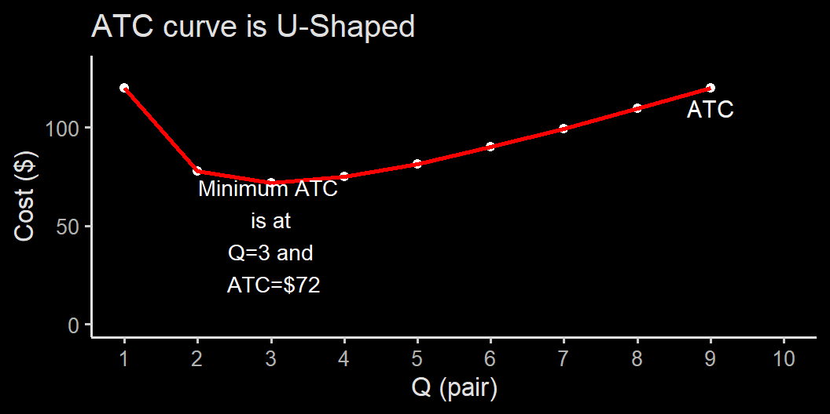
Nea’s fancy footwear Average Total Cost Curve

Slide 41
MC and ATC
It is probably best to produce at the lowest ATC. Q=3 is the minimum-cost output.
Note that:
at $Q=3$, $ATC=MC$;
at $Q<3$, $ATC<MC$;
at $Q>3$, $ATC>MC$.
Works like your GPA: At GPA=3.0, an additional A will increase your GPA, a C will decrease your GPA, while a B doesn’t change your GPA.

Slide 42
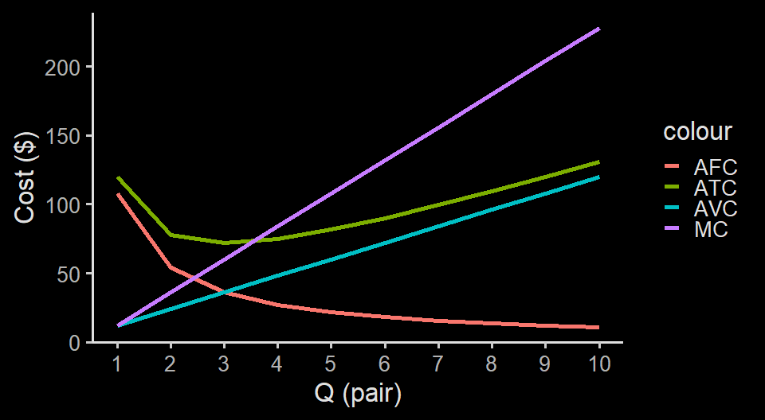
Cost Curves

Slide 43
Cost curves
Note that in our graph, ATC is not exactly equals to MC.
This is because MC is an incremental cost from Q:
for example, a marginal cost from Q=1 to Q=2 should be plotted somewhere between Q=1 and Q=2, not exactly at Q=2.
It easier to understand the logic when we use function.
The logic remains: a Q where cost is lowest is when MC=ATC

Slide 44
Short run and long run
In the long run, Nea can upgrade (or downgrade) her capacity by changing her fixed cost.
Higher fixed cost leads to higher overall cost, but typically can reduces variable cost at a higher Q.
If Nea’s client is just 3 people, buying a automated sewing machine might be an overkill.
If Nea’s business is forecasted to grow in the future, she can prepare for an upgrade.

Slide 45
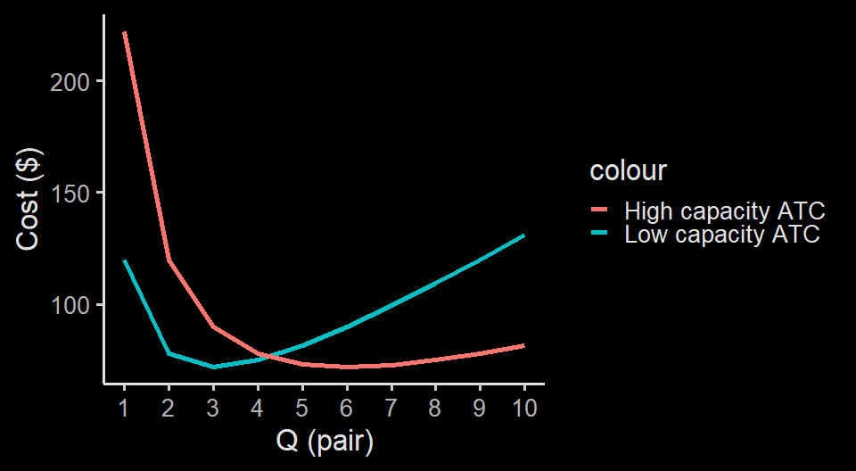
High capacity vs low capacity

Slide 46
High capacity vs low capacity
Upgrading is only worth it if Nea sell at least 5 pairs of shoes.
If upgraded, the minimum-cost output is $Q=6$
In the long run, fixed cost can be changed (hence become variable to some extent)
The most important is to know:
How the different capacity ATC looks like;
How easy each input can be changed;
whether changes in the market is long lasting or not.

Slide 47
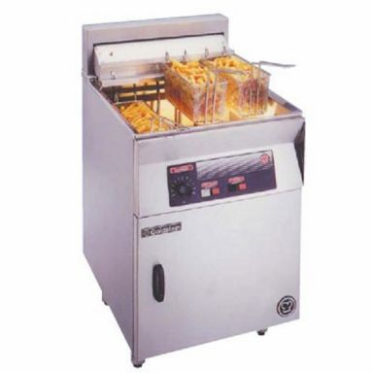

High capacity vs low capacity
fryer
gorengan

Slide 48
Long run cost curves
Long run average cost (LRAC) is an average total cost which treat the fixed cost as a variable cost.
Calculating LRAC requires many curves corresponding with different level of fixed cost.
In fact, with so many other costs, using graph may no longer be practical.
We won’t cover it in this course, but it is useful to know that LRAC exists and can be useful for you in the future.

Slide 49
Returns to scale
Upgrading makes sense if the industry is having an increasing returns to scale.
Increasing returns to scale happens when scaing up leads to lower LRAC.
in Nea’s case, she scaling up leads to lower cost overall, which may lower the price.
this is also the case for many industries, where big firms are able to offer their products at a lower price.
When increasing scale leads to higher cost, we say decreasing returns to scale. Happens when a firm is too big, coordination gets costly.

Slide 50
Calculating profit

Slide 51
Perfect competition
We learned in the perfect competition, producer takes price as given.
This is called price-taking producers (and price-taking consumers)
essentially means nobody can affect prices.
How much should Nea produce? Depends on the revenue.
For now, let’s assume that the fancy footwear a highly competitive industry, where P=$100

Slide 52
Nea’s cost, revenue and profit (Total)
Quantity sold | Total Cost | Total Revenue | Total Profit
Q | TC | TR | TR-TC
1 | 120 | 100 | -20
2 | 156 | 200 | 44
3 | 216 | 300 | 84
4 | 300 | 400 | 100
5 | 408 | 500 | 92
6 | 540 | 600 | 60
7 | 696 | 700 | 4
8 | 876 | 800 | -76
9 | 1080 | 900 | -180
10 | 1308 | 1000 | -308

Slide 54
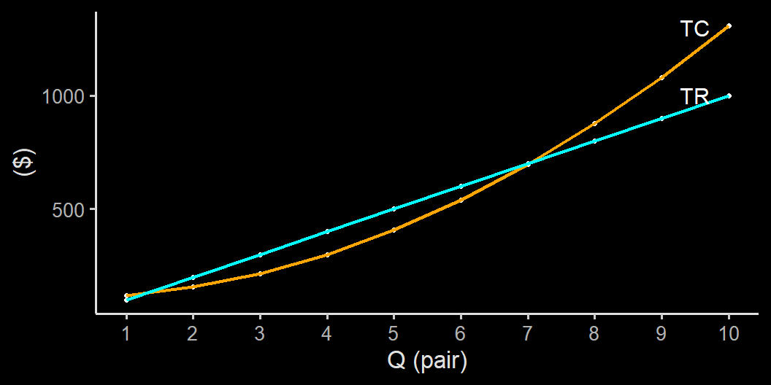
Nea’s cost, revenue and profit (total)

Slide 55
Nea’s cost, revenue and profit (per unit)
Quantity sold | Average Total Cost | Price per pair | margin
Q | ATC | P | P-ATC
1 | 120.00 | 100 | -20.00
2 | 78.00 | 100 | 22.00
3 | 72.00 | 100 | 28.00
4 | 75.00 | 100 | 25.00
5 | 81.60 | 100 | 18.40
6 | 90.00 | 100 | 10.00
7 | 99.43 | 100 | 0.57
8 | 109.50 | 100 | -9.50
9 | 120.00 | 100 | -20.00
10 | 130.80 | 100 | -30.80

Slide 57
Profit under perfect market
The necessary condition for profit maximisation is as close as possible with:
$$MR=MC$$
MR is short for Marginal Revenue, how much additional revenue you get from selling one more good.
$$MR=\frac{ΔTR}{ΔQ}$$
It is like marginal cost, but revenue.
This is why marginal cost is important.

Slide 58
Marginal Revenue & Marginal Cost
Quantity sold | Total cost | Total revenue | Total Profit | Marginal revenue | Marginal cost | condition
Q | TC | TR | TR-TC | MR | MC | MR-MC
1 | 120 | 100 | -20 | 100 | 12 | 88
2 | 156 | 200 | 44 | 100 | 36 | 64
3 | 216 | 300 | 84 | 100 | 60 | 40
4 | 300 | 400 | 100 | 100 | 84 | 16
5 | 408 | 500 | 92 | 100 | 108 | -8
6 | 540 | 600 | 60 | 100 | 132 | -32
7 | 696 | 700 | 4 | 100 | 156 | -56
8 | 876 | 800 | -76 | 100 | 180 | -80
9 | 1080 | 900 | -180 | 100 | 204 | -104
10 | 1308 | 1000 | -308 | 100 | 228 | -128

Slide 60
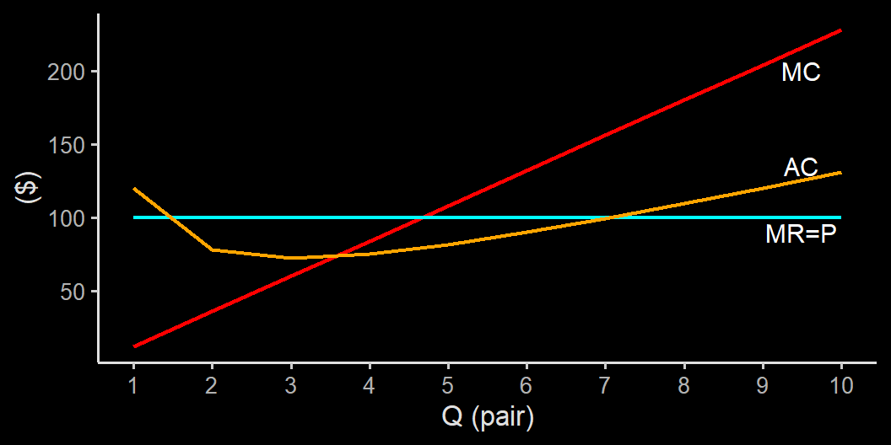
MR, MC and AC in action

Slide 61
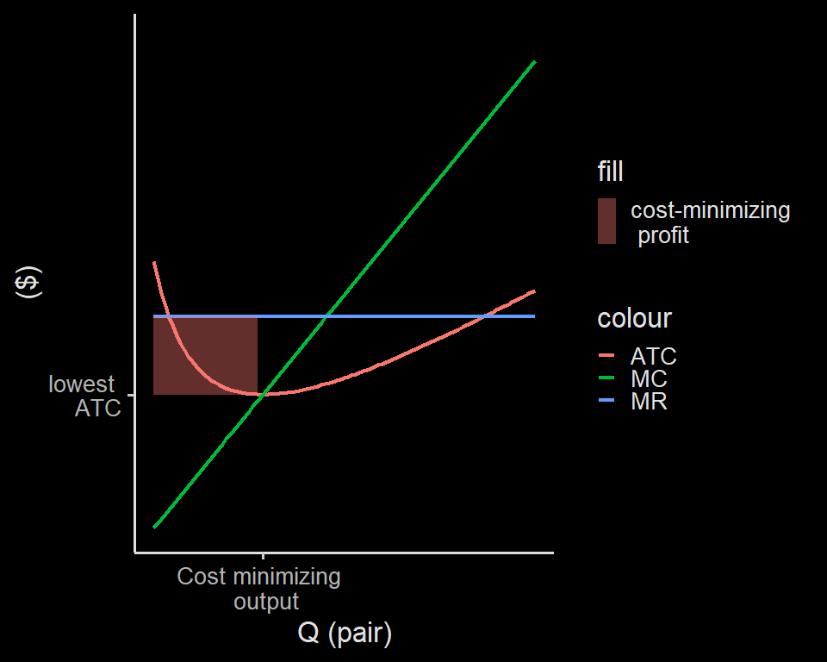

Slide 62
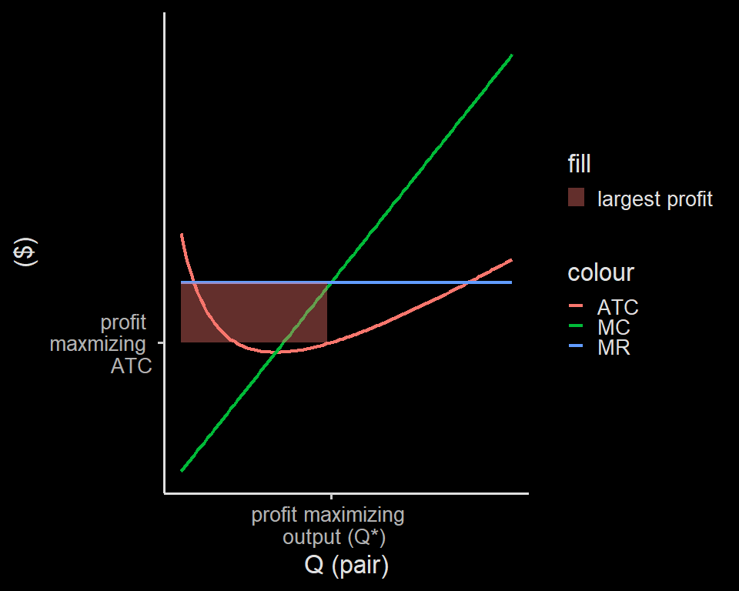

Slide 63
MR & MC
Profit is equals to margin times quantity sold
$$π=\left(P−ATC\right)×Q$$
hence the red area on the previous 2 graphs.
When $MR<MC$, the additional Q that we produce reduces profit.
When $MR>MC$, the additional Q that we produce increases profit.
That is why at $MR=MC$, we have profit-maximizing output.

Slide 64
MR & MC
In Nea’s case, she doesn’t have any point where $MR=MC$
In this case, she produce as close as possible with $MR=MC$, but still $MR>MC$
profit is starting to go down when $MR<MC$
In a bigger firm with more Q and more continuous data point, $MR=MC$ is very useful and approachable.

Slide 65
Perfect market
In the perfect market, producers are price-taking (pasrah).
That is why $MR=P$
no matter how much (or less) a producer produce, the price will always be the same
We will see next week how the market will look like when producer’s action can change prices.

